Slide 1
Commercial Subjects Group Level 3
Subject | Financial Mathematics 2 – (Fin 316/806)
Chapter | Unit 5
Title | Financial Ratio Analysis – part 2
Second Semester
المرحلة الثانوية - المستوى الثالث (توحيد ) – الثالث (فني ومهني)
وزارة التربية والتعليم –العام الدراسي 2023-2024م

Slide 2
Learning Objectives
At this unit, our students will learn:
The benefits of liquidity ratio.
The calculation of and analyze liquidity ratio.
The benefits of liquidity ratio.
INITIATION ACTIVITY
OBJECTIVE 1
OBJECTIVE 2
50%
OBJECTIVE 3
Like it!
FINAL EVALUATION
FIN 316/806 UNIT 5 Financial Ratio Analysis
وزارة التربية والتعليم –العام الدراسي 2023-2024م

Slide 3
INATIATION ACTIVITY
What is Liquidity measuring ?
The liquidity of a business is measured by how quickly and easily it can raise cash to pay off its debts. A liquid asset is either cash or an asset that can quickly be converted into cash . debtors and stock will be sold quickly its examples for liquid assets.
A business will be in a good liquidiv position if it holds enough cash and other current assets can be easily convert to cash in order to meet current liabilities. A business is unable to pay debts on time is called illiquid. A business that is illiquid:-
may have to obtain an expensive bank loan or sell off important assets, such as machinery, to raise cash. The loss of assets could reduce the amount of output the business could make and sell in future.
may be forced to close down if it cannot raise cash. The business would be bankrupt.
INITIATION ACTIVITY
OBJECTIVE 1
OBJECTIVE 2
OBJECTIVE 3
FINAL EVALUATION
FIN 316/806 UNIT 5 Financial Ratio Analysis
وزارة التربية والتعليم –العام الدراسي 2023-2024م

Slide 4
The calculation and analyze profitability ratios.
5-2-1: Gross Profit Margin %
5-2 : Profitability Ratios
INITIATION ACTIVITY
Fahad Ltd Statement of financial position BD million
End year 1 |  | End year 2
Non-current assets Cash Inventories Accounts Receivable Current assets less current liabilities Working capital Total assets – current liabilities Financed by Non-current liabilities Shareholders’ funds Capital employed | 221 10 20 14 44 40 4 225 150 75 225 | 295 30 15 5 50 25 25 320 120 200 320
Fahad Ltd Income statements BD million
Year 1 |  | Years 2
Revenue less cost of sales Gross profit less Expenses Profit before tax less tax Profit after tax Of which distributed profit retained profit | 150 90 | 200 100
 | 60 15 | 100 20
 | 45 9 | 80 16
 | 36 | 64
 | 30 6 | 50 14
OBJECTIVE 1
OBJECTIVE 2
OBJECTIVE 3
FINAL EVALUATION
FIN 316/806 UNIT 5 Financial Ratio Analysis
وزارة التربية والتعليم –العام الدراسي 2023-2024م

Slide 5
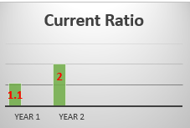
The calculation and analyze profitability ratios.
5-3-1: Current Ratio
The Current Ratio is calculated as follows:
Current ratio = $\frac{Current assets}{Current liabilities}$
5-3: Liquidity Ratios
INITIATION ACTIVITY
OBJECTIVE 1
OBJECTIVE 2
 | Year 1 | Year 2
Current assets (million BD) ÷ Current liabilities (million BD) | $\frac{44}{40}$ = 1.1 Times | $\frac{50}{25}$ = 2 Times
OBJECTIVE 3
2
FINAL EVALUATION
CR
Ratios
%
FIN 316/806 UNIT 5 Financial Ratio Analysis
وزارة التربية والتعليم –العام الدراسي 2023-2024م

Slide 6
The calculation and analyze profitability ratios.
5-3-1: Current Ratio
The following is shown by these results1.
The current ratio at the end of year 1 was rather low. The company held BD1 in cash and other current assets for every BD1 it owed in current liabilities.
Although the company could pay off its short-term debts from its current assets it had very little working capital (current assets – current liabilities) left over to meet any unexpected bills, for example a higher than anticipated electricity charge or equipment repair bill.
By the end of year 2 the managers of Fahad Ltd had reduced the current liabilities to BD25 million and increased current assets to BD50 million. It did this by increasing cash sales and holding more cash in reserve. This means it will held now BD2 in current assets for every BD1 also owed in current liabilities.
5-3: Liquidity Ratios
INITIATION ACTIVITY
OBJECTIVE 1
OBJECTIVE 2
OBJECTIVE 3
FINAL EVALUATION
FIN 316/806 UNIT 5 Financial Ratio Analysis
وزارة التربية والتعليم –العام الدراسي 2023-2024م

Slide 7
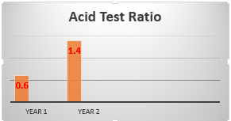
The calculation and analyze profitability ratios.
5-3-2: Quick Ratio
The quick ratio is calculated as follows:
Acid test ratio (Quick Ratio) = $\frac{( Current assets − Inventories)}{Current liabilities}$
5-3: Liquidity Ratios
INITIATION ACTIVITY
OBJECTIVE 1
OBJECTIVE 2
 | Year 1 | Year 2
Current assets – Inventories (million BD) ÷Current liabilities (million BD) | $\frac{44−20}{40}$ = 0.6 Times | $\frac{50−15}{25}$ = 1.4 Times
OBJECTIVE 3
1.4
FINAL EVALUATION
QR
Ratios
%
FIN 316/806 UNIT 5 Financial Ratio Analysis
وزارة التربية والتعليم –العام الدراسي 2023-2024م

Slide 8
The calculation and analyze profitability ratios.
5-3-2: Quick Ratio
Liquidity in the company at the end of year 1 was low. The company held only BD0.6 current assets other than inventories for every BD1 it owed in current liabilities. This mean it would be unable to pay off short-term debts in full without selling off inventories of food, drink, bed linen, towels and other items. The company would have become insolvent if it was unable to raise enough cash quickly from their sale.
Recognizing this danger, the managers of Fahad Ltd increased the cash holdings and reduced current liabilities. By the end of year 2 these actions had improved the acid test ratio of the company to BD1.4 for current assets other than inventories for every BD1 it owed in current liabilities
5-3: Liquidity Ratios
INITIATION ACTIVITY
OBJECTIVE 1
OBJECTIVE 2
OBJECTIVE 3
FINAL EVALUATION
FIN 316/806 UNIT 5 Financial Ratio Analysis
وزارة التربية والتعليم –العام الدراسي 2023-2024م

Slide 9
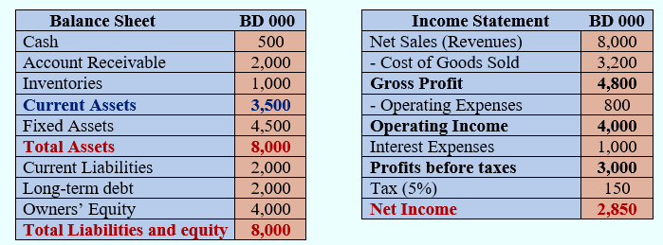
EVALUATION
Exercise (5-3):
Required:
Calculate the following ratios:
1- Gross Profit Margin %. 2- Profit Margin %.
3- Return on Capital Employed (%). 4- Working Capital.
5- Capital Employed. 6- Current Ratio.
7- Acid Test Ratio (Quick Ratio
INITIATION ACTIVITY
OBJECTIVE 1
OBJECTIVE 2
OBJECTIVE 3
FINAL EVALUATION
FIN 316/806 UNIT 5 Financial Ratio Analysis
وزارة التربية والتعليم –العام الدراسي 2023-2024م

Slide 10
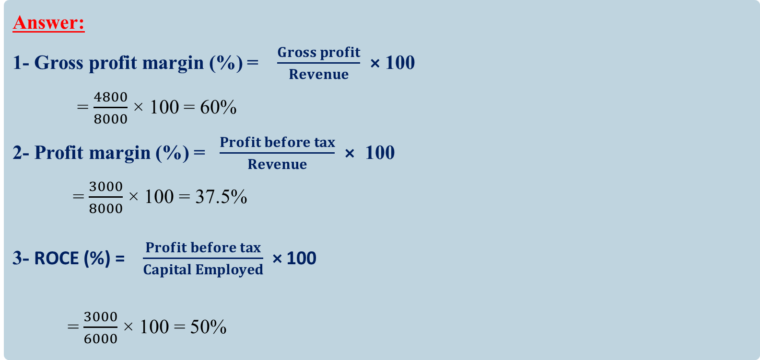
EVALUATION
Answer:
1- Gross profit margin (%) = $\frac{Gross profit}{Revenue}$ × 100
= $\frac{4800}{8000}$ × 100 = 60%
2- Profit margin (%) = $\frac{Profit before tax}{Revenue}$ × 100
= $\frac{3000}{8000}$ × 100 = 37.5%
3- ROCE (%) = $\frac{Profit before tax}{Capital Employed}$ × 100
= $\frac{3000}{6000}$ × 100 = 50%
INITIATION ACTIVITY
OBJECTIVE 1
OBJECTIVE 2
OBJECTIVE 3
FINAL EVALUATION
FIN 316/806 UNIT 5 Financial Ratio Analysis
وزارة التربية والتعليم –العام الدراسي 2023-2024م

Slide 11
EVALUATION
Answer:
4- Working Capital = Current Assets – Current Liabilities
= 3500 -2000 = BD1500
5- Capital Employed = Total assets – Current liabilities
= 8000 -2000 = BD6000
6- Current ratio = $\frac{Current assets}{Current liabilities}$
= $\frac{3500}{2000}$ =1.75 times
7- Acid test ratio (Quick Ratio) = $\frac{( Current assets − Inventories)}{Current liabilities}$
= $\frac{3500 −1000}{2000}$ =1.25 times
INITIATION ACTIVITY
OBJECTIVE 1
OBJECTIVE 2
OBJECTIVE 3
FINAL EVALUATION
FIN 316/806 UNIT 5 Financial Ratio Analysis
وزارة التربية والتعليم –العام الدراسي 2023-2024م

Slide 12
END OF LESSON
Thanks
FIN 316/806 UNIT 5 Financial Ratio Analysis
وزارة التربية والتعليم –العام الدراسي 2023-2024م

