Slide 1
Commercial Subjects Group Level 3
Subject | Financial Mathematics 2 – (Fin 316/806)
Chapter | Unit 4
Title | Break-even Analysis – part 2
Second Semester
المرحلة الثانوية - المستوى الثالث (توحيد ) – الثالث (فني ومهني)
وزارة التربية والتعليم –العام الدراسي 2023-2024م

Slide 2
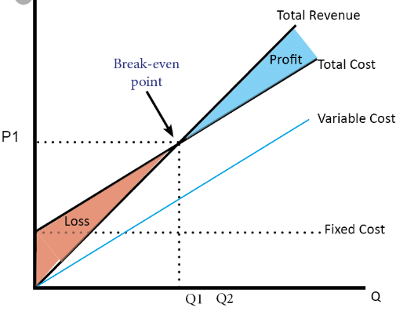
Learning Objectives
At this unit, our students will learn:
The calculation of margin of safety in units.
The calculation of sales in units to get target profit.
The calculation of sales in Bahraini Dinar to get target profit.
INITIATION ACTIVITY
BD
OBJECTIVE 1
OBJECTIVE 2
OBJECTIVE 3
FINAL EVALUATION
FIN 316/806 UNIT 4 Break-even Analysis
وزارة التربية والتعليم –العام الدراسي 2023-2024م

Slide 3
INATIATION ACTIVITY
What is the meaning of margin of safety? ( From the previous commercial subject)
A business should plan to have margin of safety by producing and selling more than its needs to break-even.
All businesses aim to make a profit by producing and selling
products Above the break-even output. ABC company has
annual sales 30,000 units (actual sales)and break-even sales
was 20,000 units. The margin of safety is the difference
between the actual level of output and the break-even level of
output which equals to 10,000 units.
INITIATION ACTIVITY
OBJECTIVE 1
400,0000
OBJECTIVE 2
Margin of Safety
OBJECTIVE 3
20,000
30,000
FINAL EVALUATION
FIN 316/806 UNIT 4 Break-even Analysis
وزارة التربية والتعليم –العام الدراسي 2023-2024م

Slide 4
The calculating margin of safety
ABC company sold 30000 units a computer at BD20 per unit and it had variable cost of BD12 per unit. The total annual fixed cost is BD160,000.
Required:
Calculate break-even point sales in units.
Calculate break-even point sales in BD.
3) Calculate Margin of safety sales in units.
Answer :
Break-even point sales in units = $\frac{Fixed Cost}{Selling price per unit − Variable cost per unit}$
${Unit Sales }/{BEP}$ = $\frac{FC}{USP−UVC}$
= = $\frac{160,000}{20−12}$ = 20,000 Units
INITIATION ACTIVITY
OBJECTIVE 1
OBJECTIVE 2
OBJECTIVE 3
FINAL EVALUATION
FIN 316/806 UNIT 4 Break-even Analysis
وزارة التربية والتعليم –العام الدراسي 2023-2024م

Slide 5
The calculating margin of safety
2- Break-even point in sales BD = Break-even point in sales units × Unit Selling Price
= 20,000 × 20 = BD400,000
3- Margin of Safety = Actual Unit Sales - Break-even point sales in units
= 30,000 - 20,000 = 10,000 Units
INITIATION ACTIVITY
OBJECTIVE 1
OBJECTIVE 2
OBJECTIVE 3
FINAL EVALUATION
FIN 316/806 UNIT 4 Break-even Analysis
وزارة التربية والتعليم –العام الدراسي 2023-2024م

Slide 6
The calculating target operating Income
Example 4-3-1:
ABC Company sold a computer at BD20 per unit and it had variable cost BD12 per unit. The total annual fixed cost is BD160,000.
Required:
How many units must be sold to earn an operating income of BD40,000.
Compute sale revenue needed to earn an operating income of BD40,000.
If the company sold 30,000 units, what would be the company’s profit or loss?
INITIATION ACTIVITY
OBJECTIVE 1
OBJECTIVE 2
OBJECTIVE 3
FINAL EVALUATION
FIN 316/806 UNIT 4 Break-even Analysis
وزارة التربية والتعليم –العام الدراسي 2023-2024م

Slide 7
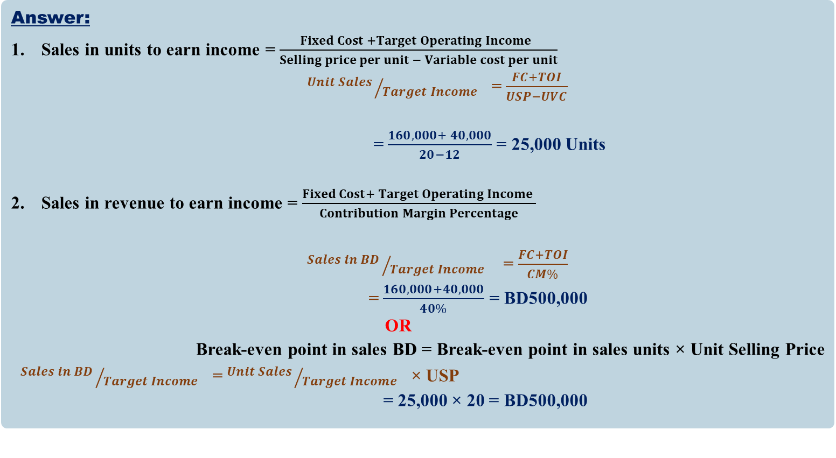
The calculating target operating Income
Answer:
Sales in units to earn income = $\frac{Fixed Cost +Target Operating Income }{Selling price per unit − Variable cost per unit}$
${Unit Sales }/{Target Income}$ = $\frac{FC+TOI}{USP−UVC}$
= $\frac{160,000+ 40,000}{20−12}$ = 25,000 Units
Sales in revenue to earn income = $\frac{Fixed Cost+ Target Operating Income }{Contribution Margin Percentage}$
${Sales in BD }/{Target Income}$ = $\frac{FC+TOI}{CM\%}$
= $\frac{160,000+40,000}{40\%}$ = BD500,000
OR
Break-even point in sales BD = Break-even point in sales units × Unit Selling Price
${Sales in BD }/{Target Income}$ = ${Unit Sales }/{Target Income}$ × USP
= 25,000 × 20 = BD500,000
INITIATION ACTIVITY
OBJECTIVE 1
OBJECTIVE 2
OBJECTIVE 3
FINAL EVALUATION
FIN 316/806 UNIT 4 Break-even Analysis
وزارة التربية والتعليم –العام الدراسي 2023-2024م

Slide 8
The calculating target operating Income
Answer:
3- Profit/Loss = Units Sales × ($Selling price per unit − Variable cost per unit$ ) –
Fixed Costs
Profit/Loss = [ $Q$× (USP – UVC)] - FC =
= [30,000 × (20 – 12)] – (160,000)
= [30,000 × (8)] – (160,000)
= [240,000] – (160,000)
= BD80,000
INITIATION ACTIVITY
OBJECTIVE 1
OBJECTIVE 2
OBJECTIVE 3
FINAL EVALUATION
FIN 316/806 UNIT 4 Break-even Analysis
وزارة التربية والتعليم –العام الدراسي 2023-2024م

Slide 9
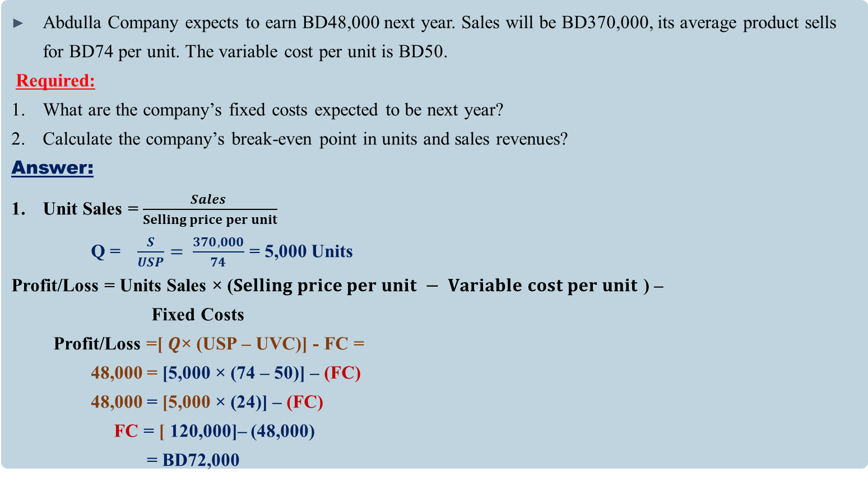
The calculating target operating Income
Abdulla Company expects to earn BD48,000 next year. Sales will be BD370,000, its average product sells for BD74 per unit. The variable cost per unit is BD50.
Required:
What are the company’s fixed costs expected to be next year?
Calculate the company’s break-even point in units and sales revenues?
Answer:
Unit Sales =$\frac{Sales }{Selling price per unit}$
Q = $\frac{S}{USP}= \frac{370,000}{74}$ = 5,000 Units
Profit/Loss = Units Sales × ($Selling price per unit − Variable cost per unit$ ) –
Fixed Costs
Profit/Loss =[ $Q$× (USP – UVC)] - FC =
48,000 = [5,000 × (74 – 50)] – (FC)
48,000 = [5,000 × (24)] – (FC)
FC = [ 120,000]– (48,000)
= BD72,000
INITIATION ACTIVITY
OBJECTIVE 1
OBJECTIVE 2
OBJECTIVE 3
FINAL EVALUATION
FIN 316/806 UNIT 4 Break-even Analysis
وزارة التربية والتعليم –العام الدراسي 2023-2024م

Slide 10
The calculating target operating Income
Abdulla Company expects to earn BD48,000 next year. Sales will be BD370,000, its average product sells for BD74 per unit. The variable cost per unit is BD50.
Required:
What are the company’s fixed costs expected to be next year?
Calculate the company’s break-even point in units and sales revenues?
Answer:
Unit Sales =$\frac{Sales }{Selling price per unit}$
Q = $\frac{S}{USP}= \frac{370,000}{74}$ = 5,000 Units
Profit/Loss = Units Sales × ($Selling price per unit − Variable cost per unit$ ) –
Fixed Costs
Profit/Loss =[ $Q$× (USP – UVC)] - FC =
48,000 = [5,000 × (74 – 50)] – (FC)
48,000 = [5,000 × (24)] – (FC)
FC = [ 120,000]– (48,000)
= BD72,000
INITIATION ACTIVITY
OBJECTIVE 1
OBJECTIVE 2
OBJECTIVE 3
FINAL EVALUATION
FIN 316/806 UNIT 4 Break-even Analysis
وزارة التربية والتعليم –العام الدراسي 2023-2024م

Slide 11
The calculating target operating Income
Answer:
2- Break-even point sales in units = $\frac{Fixed Cost}{Selling price per unit − Variable cost per unit}$
${Unit Sales }/{BEP}$ = $\frac{FC}{USP−UVC}$
= $\frac{72,000}{74−50}$ = 3,000 Units
2- Break-even point in sales revenue = Break-even point in sales units × Unit Selling Price
${Sales in BD }/{BEP}$ = ${Unit Sales }/{BEP}$ × USP =
= 3,000 × 74 = BD222,000
INITIATION ACTIVITY
OBJECTIVE 1
OBJECTIVE 2
OBJECTIVE 3
FINAL EVALUATION
FIN 316/806 UNIT 4 Break-even Analysis
وزارة التربية والتعليم –العام الدراسي 2023-2024م

Slide 12
EVALUATION
Exercise (4-2):
Some financial data for each of three firms are as follow:
Required:
What is the break-even point in units and sales revenue for each company?
What is the units and sales revenue to get target profit?
What is the margin of safety in units?
INITIATION ACTIVITY
Title | Ahmed’s Company | Osama’s Company | Abdulla’s Company
Selling price per unit | BD100 | BD90 | BD150
Variable cost per unit | BD80 | BD60 | BD120
Fixed Cost | BD140,000 | BD120,000 | BD180,000
Target Operating Income | BD60,000 | BD30,000 | BD90,000
Unit Sold | 5,000 units | 4,000 units | 6,000 units
OBJECTIVE 1
OBJECTIVE 2
OBJECTIVE 3
FINAL EVALUATION
FIN 316/806 UNIT 4 Break-even Analysis
وزارة التربية والتعليم –العام الدراسي 2023-2024م

Slide 13
EVALUATION
Answer: Ahmed’s Company
1- Break-even point sales in units = $\frac{Fixed Cost}{Selling price per unit − Variable cost per unit}$
${Unit Sales }/{BEP}$ = $\frac{FC}{USP−UVC}$
= $\frac{140000}{100−80}$ = 7,000 Units
Break-even point in sales revenue = Break-even point in sales units × Unit Selling Price
${Sales in BD }/{BEP}$ = ${Unit Sales }/{BEP}$ × USP =
= 7,000 × 100 = BD700,000
INITIATION ACTIVITY
OBJECTIVE 1
OBJECTIVE 2
OBJECTIVE 3
FINAL EVALUATION
FIN 316/806 UNIT 4 Break-even Analysis
وزارة التربية والتعليم –العام الدراسي 2023-2024م

Slide 14
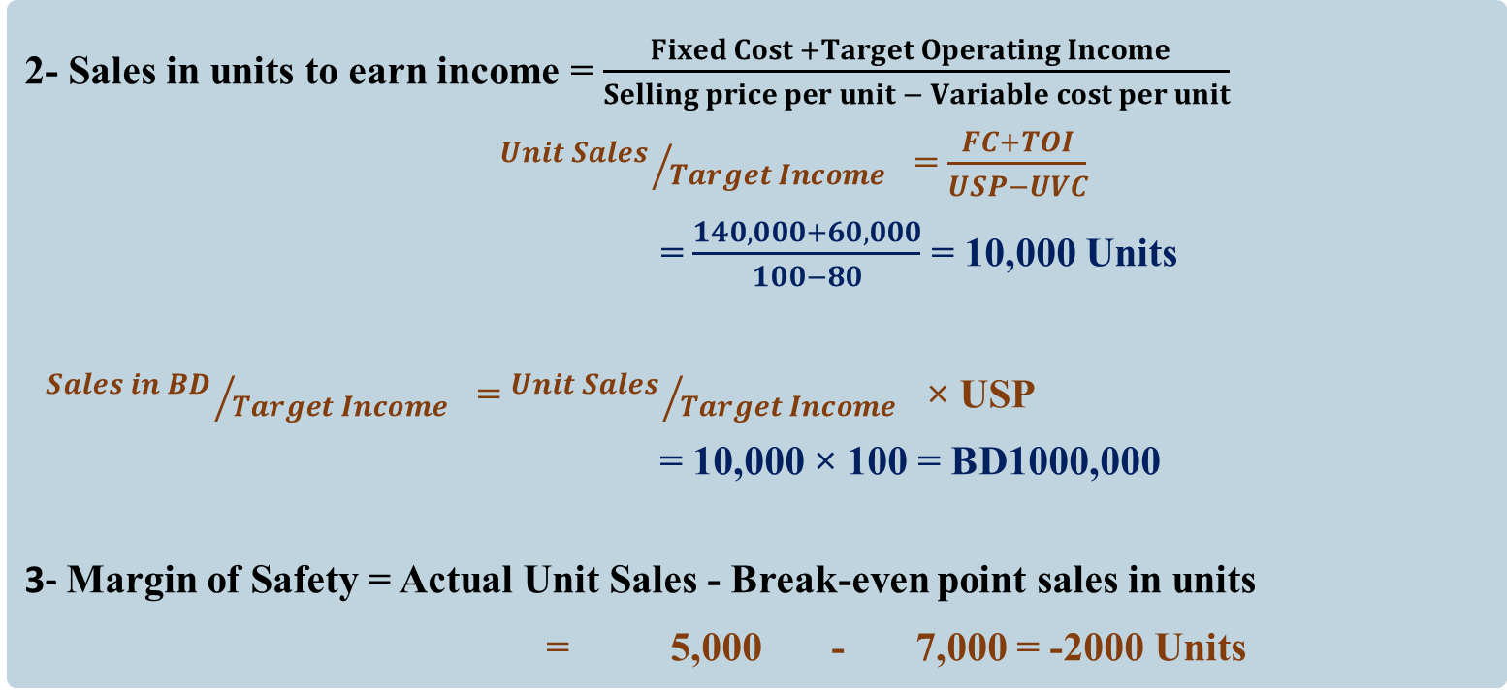
EVALUATION
2- Sales in units to earn income = $\frac{Fixed Cost +Target Operating Income }{Selling price per unit − Variable cost per unit}$
${Unit Sales }/{Target Income}$ = $\frac{FC+TOI}{USP−UVC}$
= $\frac{140,000+60,000}{100−80}$ = 10,000 Units
${Sales in BD }/{Target Income}$ = ${Unit Sales }/{Target Income}$ × USP
= 10,000 × 100 = BD1000,000
3- Margin of Safety = Actual Unit Sales - Break-even point sales in units
= 5,000 - 7,000 = -2000 Units
INITIATION ACTIVITY
OBJECTIVE 1
OBJECTIVE 2
OBJECTIVE 3
FINAL EVALUATION
FIN 316/806 UNIT 4 Break-even Analysis
وزارة التربية والتعليم –العام الدراسي 2023-2024م

Slide 15
END OF LESSON
Thanks
FIN 316/806 UNIT 4 Break-even Analysis
وزارة التربية والتعليم –العام الدراسي 2023-2024م

