Slide 1
Commercial Subjects Group Level 3
Subject | Financial Mathematics 2 – (Fin 316/806)
Chapter | Unit 4
Title | Break-even Analysis – part 1
Second Semester
المرحلة الثانوية - المستوى الثالث (توحيد ) – الثالث (فني ومهني)
وزارة التربية والتعليم –العام الدراسي 2023-2024م

Slide 2
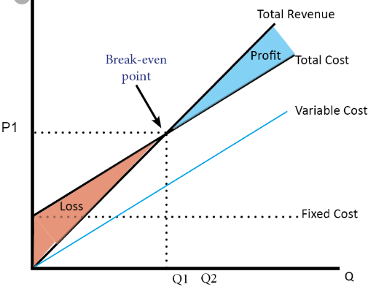
Learning Objectives
At this unit, our students will learn:
The meaning of break-even point.
The calculation of break-even point sales in units.
The calculation of break-even point sales in Bahraini Dinar.
INITIATION ACTIVITY
BD
OBJECTIVE 1
OBJECTIVE 2
OBJECTIVE 3
FINAL EVALUATION
FIN 316/806 UNIT 4 Break-even Analysis
وزارة التربية والتعليم –العام الدراسي 2023-2024م

Slide 3
INATIATION ACTIVITY
What is mean of break-even point ?
In business, it is helpful to know how much output needs to be sold to cover costs. If costs are not covered by revenue, the business will make a loss. If revenue is greater than costs, the business will make a profit. If costs are exactly the same as revenue, the business will break even.
It is the quantity of output, denominated in units, those results in an EBIT (earnings before interest and taxes) level equal to zero. Use of the break-even model, therefore, enables the financial officer (1) to determine the quantity of output that must be sold to cover all operating costs, as distinct from financial costs, and (2) to calculate the EBIT that will be achieved at various output levels.
INITIATION ACTIVITY
OBJECTIVE 1
OBJECTIVE 2
OBJECTIVE 3
FINAL EVALUATION
FIN 316/806 UNIT 4 Break-even Analysis
وزارة التربية والتعليم –العام الدراسي 2023-2024م

Slide 4
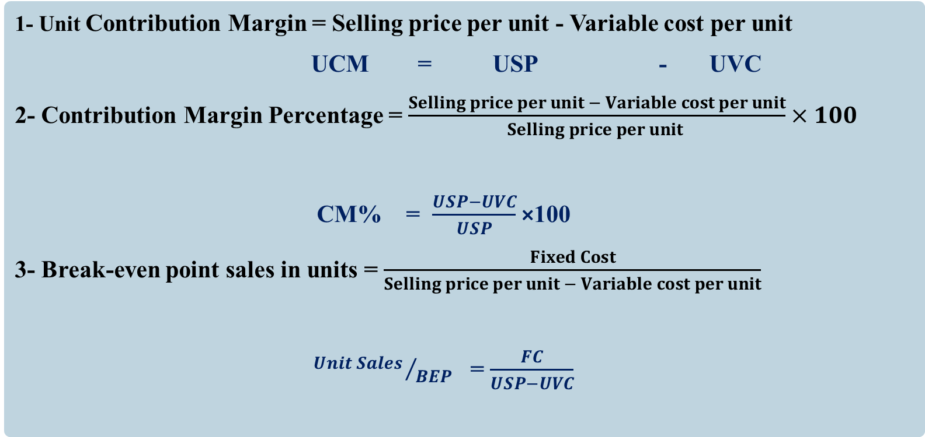
The calculation and analyze profitability ratios.
1- Unit Contribution Margin = Selling price per unit - Variable cost per unit
UCM = USP - UVC
2- Contribution Margin Percentage = $\frac{Selling price per unit − Variable cost per unit}{Selling price per unit }×100$
CM% = $\frac{USP−UVC}{USP}$ ×100
3- Break-even point sales in units = $\frac{Fixed Cost}{Selling price per unit − Variable cost per unit}$
${Unit Sales }/{BEP}$ = $\frac{FC}{USP−UVC}$
INITIATION ACTIVITY
OBJECTIVE 1
OBJECTIVE 2
OBJECTIVE 3
FINAL EVALUATION
FIN 316/806 UNIT 4 Break-even Analysis
وزارة التربية والتعليم –العام الدراسي 2023-2024م

Slide 5
The calculating the Break-even point.
4- Break-even point sales in BD = $\frac{Fixed Cost}{Contribution Margin Percentage}$
${Sales in BD }/{BEP}$ = $\frac{FC}{CM\%}$
OR
Break-even point in sales BD = Break-even point in sales units × Unit Selling Price
$${Sales in BD }/{BEP}$$
INITIATION ACTIVITY
OBJECTIVE 1
OBJECTIVE 2
OBJECTIVE 3
FINAL EVALUATION
FIN 316/806 UNIT 4 Break-even Analysis
وزارة التربية والتعليم –العام الدراسي 2023-2024م

Slide 6
The calculating the Break-even point.
Example 4-2-1
ABC Company sold a computer at BD20 per unit and it had variable cost of
BD12 per unit. The total annual fixed cost is BD160,000.
Required:
Calculate contribution margin per unit.
Calculate contribution margin percentage.
Calculate break-even point sales in units.
Calculate break-even point sales revenue in BD.
Answer:
1- Unit Contribution Margin = Selling price per unit - Variable cost per unit
UCM = USP - UVC
= 20 – 12 = BD8
INITIATION ACTIVITY
OBJECTIVE 1
OBJECTIVE 2
OBJECTIVE 3
FINAL EVALUATION
FIN 316/806 UNIT 4 Break-even Analysis
وزارة التربية والتعليم –العام الدراسي 2022-2023م

Slide 7
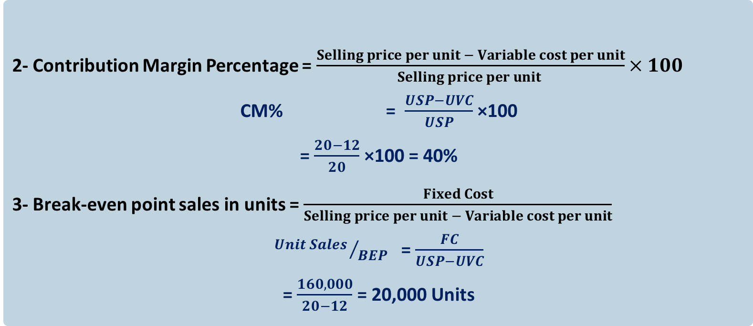
The calculating the Break-even point.
2- Contribution Margin Percentage = $\frac{Selling price per unit − Variable cost per unit}{Selling price per unit }×100$
CM% = $\frac{USP−UVC}{USP}$ ×100
= $\frac{20−12}{20}$ ×100 = 40%
3- Break-even point sales in units = $\frac{Fixed Cost}{Selling price per unit − Variable cost per unit}$
${Unit Sales }/{BEP}$ = $\frac{FC}{USP−UVC}$
= $\frac{160,000}{20−12}$ = 20,000 Units
INITIATION ACTIVITY
OBJECTIVE 1
OBJECTIVE 2
OBJECTIVE 3
FINAL EVALUATION
FIN 316/806 UNIT 4 Break-even Analysis
وزارة التربية والتعليم –العام الدراسي 2023-2024م

Slide 8
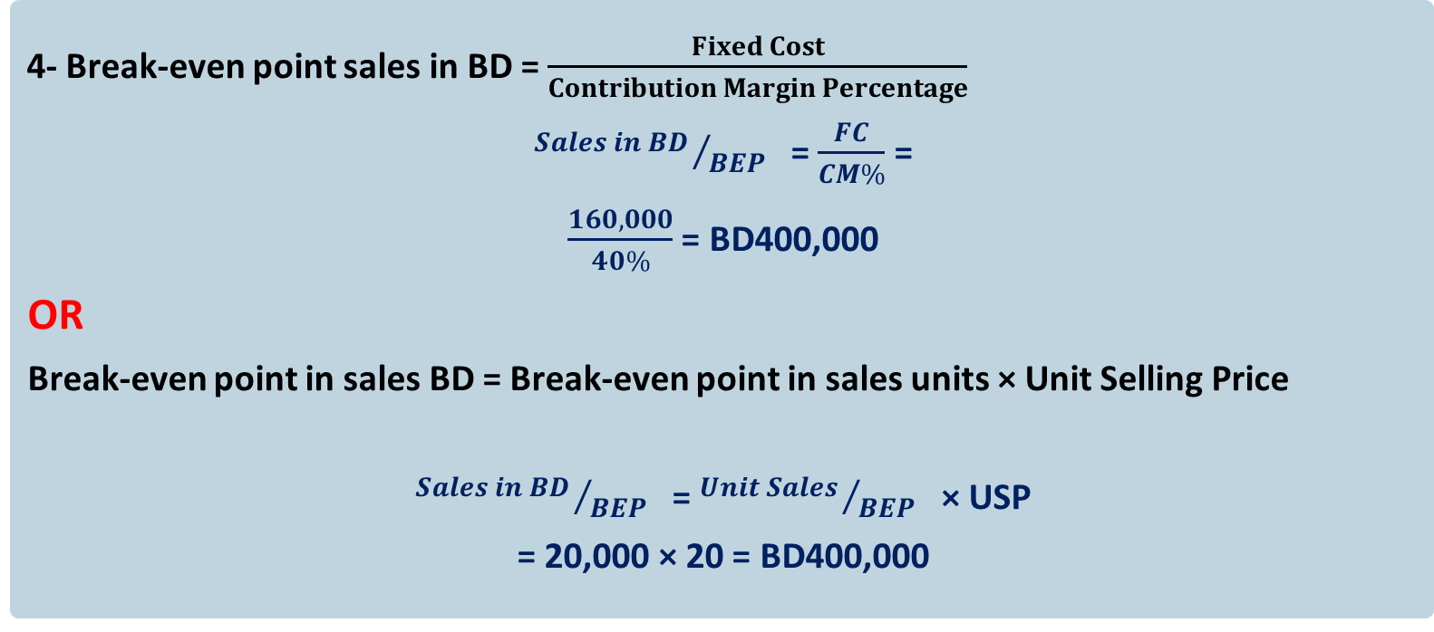
The calculating the Break-even point.
4- Break-even point sales in BD = $\frac{Fixed Cost}{Contribution Margin Percentage}$
${Sales in BD }/{BEP}$ = $\frac{FC}{CM\%}$ =
$\frac{160,000}{40\%}$ = BD400,000
OR
Break-even point in sales BD = Break-even point in sales units × Unit Selling Price
${Sales in BD }/{BEP}$ = ${Unit Sales }/{BEP}$ × USP
= 20,000 × 20 = BD400,000
INITIATION ACTIVITY
OBJECTIVE 1
OBJECTIVE 2
OBJECTIVE 3
FINAL EVALUATION
FIN 316/806 UNIT 4 Break-even Analysis
وزارة التربية والتعليم –العام الدراسي 2023-2024م

Slide 9
The calculating the Break-even point.
Example 4-2-2
Refer to example 4-2-1: ABC company sold a computer at BD20 per unit and it had variable cost of BD12 per unit. The total annual fixed cost is BD160,000. If the variable cost per unit increased to BD16.
Required: New break-even after changing variable cost per unit
1- Calculate break-even point sales in units.
2- Calculate break-even point sales in BD.
INITIATION ACTIVITY
OBJECTIVE 1
OBJECTIVE 2
BD
TC, 2
TR, 2
OBJECTIVE 3
800,0000
TC, 1
TR, 1
400,0000
FINAL EVALUATION
Q
20,0000
40,0000
FIN 316/806 UNIT 4 Break-even Analysis
وزارة التربية والتعليم –العام الدراسي 2023-2024م

Slide 10
The calculating the Break-even point.
1- Break-even point sales in units = $\frac{Fixed Cost}{Selling price per unit − Variable cost per unit}$
${Unit Sales }/{BEP}$ = $\frac{FC}{USP−UVC}$
= $\frac{160,000}{20−16}$ = 40,000 Units
2-Break-even point in sales BD = Break-even point in sales units × Unit Selling Price
${Sales in BD }/{BEP}$ = ${Unit Sales }/{BEP}$ × USP
= 40,000 × 20 = BD800,000
If the company has an increase in variable cost per unit from BD12 to BD16, it must increase the output from 20,000 units to 40,000 units to get the break-even point.
INITIATION ACTIVITY
OBJECTIVE 1
OBJECTIVE 2
OBJECTIVE 3
FINAL EVALUATION
FIN 316/806 UNIT 4 Break-even Analysis
وزارة التربية والتعليم –العام الدراسي 2023-2024م

Slide 11
The calculating the Break-even point.
Example 4-2-3
ABC Company sold a computer, it had variable cost BD12 per unit and the total annual fixed cost is BD160,000. If the break-even sales was 20,000 units.
Required: Find the selling price per unit.
Answer:
${Unit Sales }/{BEP}$ = $\frac{FC}{USP−UVC}$
20,000 = $\frac{160,000}{P−12}$
P – 12 = $\frac{160,000}{20,000}$
P – 12 = 8
P = 8 + 12 = BD20
INITIATION ACTIVITY
OBJECTIVE 1
OBJECTIVE 2
OBJECTIVE 3
FINAL EVALUATION
FIN 316/806 UNIT 4 Break-even Analysis
وزارة التربية والتعليم –العام الدراسي 2023-2024م

Slide 12
The calculating the Break-even point.
Exercise (4-1):
AL Huda Company sell’s office disk for BD30 each and estimated variable costs are expected to be 70% of sales. If the company’s fixed costs are BD360,000.
Required:
How many office disk must the company sell to break-even?
Compute sales revenue for break-even.
INITIATION ACTIVITY
OBJECTIVE 1
OBJECTIVE 2
OBJECTIVE 3
FINAL EVALUATION
FIN 316/806 UNIT 4 Break-even Analysis
وزارة التربية والتعليم –العام الدراسي 2023-2024م

Slide 13
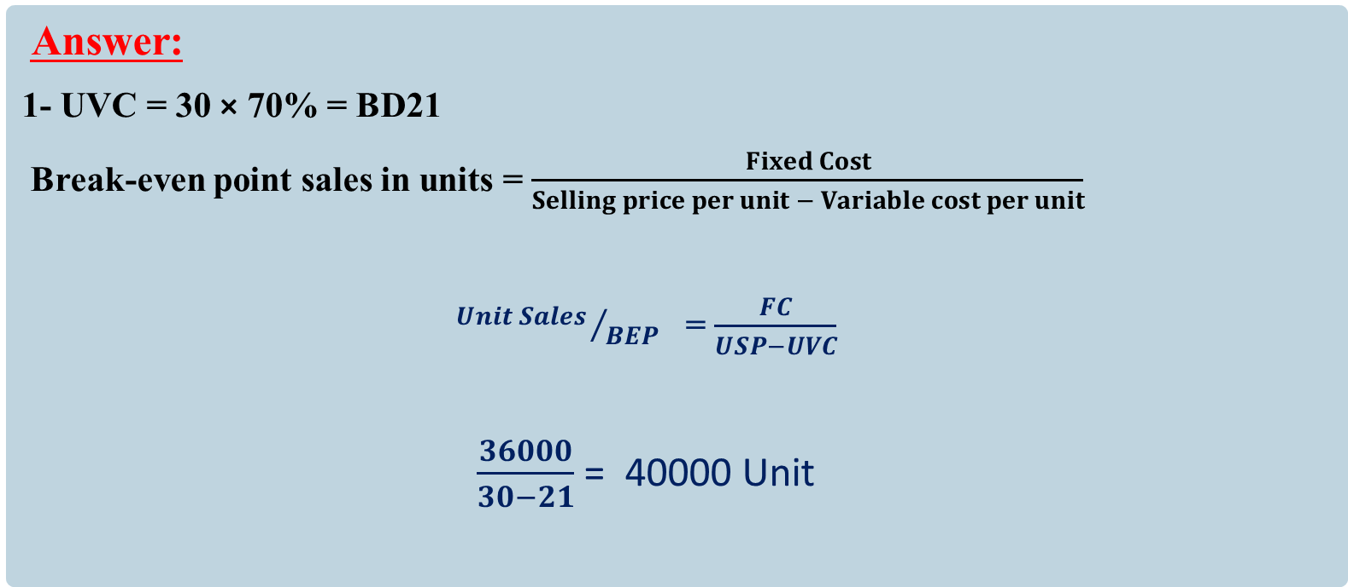
The calculating the Break-even point.
Answer:
1- UVC = 30 × 70% = BD21
Break-even point sales in units = $\frac{Fixed Cost}{Selling price per unit − Variable cost per unit}$
${Unit Sales }/{BEP}$ = $\frac{FC}{USP−UVC}$
$\frac{36000}{30−21}$ = 40000 Unit
INITIATION ACTIVITY
OBJECTIVE 1
OBJECTIVE 2
OBJECTIVE 3
FINAL EVALUATION
FIN 316/806 UNIT 4 Break-even Analysis
وزارة التربية والتعليم –العام الدراسي 2023-2024م

Slide 14
The calculating the Break-even point.
Answer:
Break-even point in sales BD = Break-even point in sales units × Unit Selling Price
${Sales in BD }/{BEP}$= 40000× 30 = BD1200,000
INITIATION ACTIVITY
OBJECTIVE 1
OBJECTIVE 2
OBJECTIVE 3
FINAL EVALUATION
FIN 316/806 UNIT 4 Break-even Analysis
وزارة التربية والتعليم –العام الدراسي 2023-2024م

Slide 15
END OF LESSON
Thanks
FIN 316/806 UNIT 4 Break-even Analysis
وزارة التربية والتعليم –العام الدراسي 2023-2024م

