Slide 1
Commercial Subjects Group Level 3
Subject | Financial Mathematics 2 – (Fin 316/806)
Chapter | Unit 3
Title | Capital Budget Decision Model – Payback period
Second Semester
المرحلة الثانوية - المستوى الثالث (توحيد ) – الثالث (فني ومهني)
وزارة التربية والتعليم –العام الدراسي 2023-2024م

Slide 2
Learning Objectives
At this unit, our students will learn:
The difference between a short-term and long-term decision.
The calculation of the payback period.
INITIATION ACTIVITY
OBJECTIVE 1
OBJECTIVE 2
FINAL EVALUATION
FIN 316/806 UNIT 3 CAPITAL BUDGET DECISION MODEL
وزارة التربية والتعليم –العام الدراسي 2023-2024م

Slide 3
INATIATION ACTIVITY
Compare between a short-term decision and long-term decision.
What is the difference between a short-term decision and long-term decision?
We can separate short-term decision a long-term decision into three dimensions:
Length of effect
Cost
Degree of information gathering prior to the decision
The longer the effect and the higher the cost associated with a decision, the greater the time and degree allotted to gathering information on choices and the more sophisticated or complex the decision model.
INITIATION ACTIVITY
OBJECTIVE 1
OBJECTIVE 2
FINAL EVALUATION
FIN 316/806 UNIT 3 CAPITAL BUDGET DECISION MODEL
وزارة التربية والتعليم –العام الدراسي 2023-2024م

Slide 4
The difference between a short-term and long-term decision.
What is the difference between a short-term decision and long-term decision?
A short-term decision, you will decide today what to eat for your next meal. This decision may involve a set of choice with varying costs. The choice affects you for only a short period, and the difference in cost of the different menu options is relatively small. In addition, you will face the next meal selection.
Then there are long-term decisions, recall for a moment your decision concerning which college to attend. This decision affects you for a number of years and carries with it significant financial costs. Moreover, this choice may well have been a once-in-a-lifetime decision. Although you can change schools after your initial choice, you cannot pick a different school to attend every few hours as you can with your menu choice at mealtime.
INITIATION ACTIVITY
OBJECTIVE 1
OBJECTIVE 2
FINAL EVALUATION
FIN 316/806 UNIT 3 CAPITAL BUDGET DECISION MODEL
وزارة التربية والتعليم –العام الدراسي 2023-2024م

Slide 5
The calculation of the payback period.
Example 3-2-1:
Given the cash flow of three projects A, B and C, and using the payback period decision model, which projects do you accept and which project you will choose ?
INITIATION ACTIVITY
Cash Flow | Project A | Project B | Project C
Cost (Cash Outflow) | BD10,000 | BD10,000 | BD10,000
Cash inflow year 1 | BD3,500 | BD2,000 | BD5,500
Cash inflow year 2 | BD3,500 | BD3,400 | BD4,500
Cash inflow year 3 | BD3,500 | BD4,000 | BD4,000
Cash inflow year 4 | BD3,500 | BD5,000 | BD3,000
Cash inflow year 5 | BD3,500 | BD6,000 | BD2,000
OBJECTIVE 1
OBJECTIVE 2
FINAL EVALUATION
FIN 316/806 UNIT 3 CAPITAL BUDGET DECISION MODEL
وزارة التربية والتعليم –العام الدراسي 2023-2024م

Slide 6
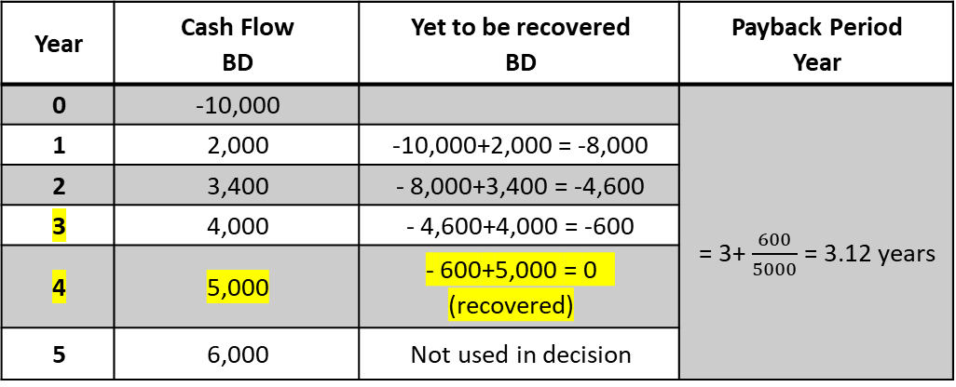
The difference between a short-term and long-term decision.
Answer:
1. Project A: ( Fixed Cash Inflow):
Payback Period = $\frac{Cost ( Initial Investment)}{Annual Cash inflow}$
Payback Period = $\frac{10000}{3500}$ = 2.86 years
2. Project B: ( Changeable Cash Inflow):
INITIATION ACTIVITY
OBJECTIVE 1
Year | Cash Flow BD | Yet to be recovered BD | Payback Period Year
0 | -10,000 |  | = 3+ $\frac{600}{5000}$ = 3.12 years
1 | 2,000 | -10,000+2,000 = -8,000
2 | 3,400 | - 8,000+3,400 = -4,600
3 | 4,000 | - 4,600+4,000 = -600
4 | 5,000 | - 600+5,000 = 0 (recovered)
5 | 6,000 | Not used in decision
OBJECTIVE 2
FINAL EVALUATION
FIN 316/806 UNIT 3 CAPITAL BUDGET DECISION MODEL
وزارة التربية والتعليم –العام الدراسي 2023-2024م

Slide 7
The difference between a short-term and long-term decision.
3. Project C: ( Changeable Cash Inflow):
We can choose the project C because it has the lowest payback period. The company has required 2 years recover period is less than projects A and B.
Although the payback period method is used widely, it has two significant weaknesses:
It ignored all cash flow after the initial cash outflow has been recovered.
It ignored the time value of money.
Year | Cash Flow BD | Yet to be recovered BD | Payback Period Year
0 | -10,000 |  | 2 years
1 | 5,500 | -10,000 + 5,500 = - 4,500
2 | 4,500 | - 4,500 + 4,500 = 0 (recovered)
3 | 4,000 | Not used in decision
4 | 3,000 | Not used in decision
5 | 2,000 | Not used in decision
PAYBACK
INITIATION ACTIVITY
OBJECTIVE 1
OBJECTIVE 2
FINAL EVALUATION
FIN 316/806 UNIT 3 CAPITAL BUDGET DECISION MODEL
وزارة التربية والتعليم –العام الدراسي 2023-2024م

Slide 8
The difference between a short-term and long-term decision.
Advantages and Disadvantages of Payback Method:
Advantages of the Payback Method
The most significant advantage of the payback method is its simplicity. It's an easy way to compare several projects and then to take the project that has the shortest payback time. However, the payback has several practical and theoretical drawbacks.
Disadvantages of the Payback Method
Ignores the time value of money: The most serious disadvantage of the payback method is that it does not consider the time value of money. Cash flows received during the early years of a project get a higher weight than cash flows received in later years. Two projects could have the same payback period, but one project generates more cash flow in the early years, whereas the other project has higher cash flows in the later years. In this instance, the payback method does not provide a clear determination as to which project to select.
INITIATION ACTIVITY
OBJECTIVE 1
OBJECTIVE 2
FINAL EVALUATION
FIN 316/806 UNIT 3 CAPITAL BUDGET DECISION MODEL
وزارة التربية والتعليم –العام الدراسي 2023-2024م

Slide 9
The difference between a short-term and long-term decision.
Disadvantages of the Payback Method
2. Neglects cash flows received after payback period: For some projects, the largest cash flows may not occur until after the payback period has ended. These projects could have higher returns on investment and may be preferable to projects that have shorter payback times.
3. Ignores a project's profitability: Just because a project has a short payback period does not mean that it is profitable. If the cash flows end at the payback period or are drastically reduced, a project might never return a profit and therefore, it would be an unwise investment.
4. Does not consider a project's return on investment: Some companies require capital investments to exceed a certain hurdle of rate of return; otherwise, the project is declined. The payback method does not consider a project's rate of return.
INITIATION ACTIVITY
OBJECTIVE 1
OBJECTIVE 2
FINAL EVALUATION
FIN 316/806 UNIT 3 CAPITAL BUDGET DECISION MODEL
وزارة التربية والتعليم –العام الدراسي 2023-2024م

Slide 10
EVALUATION
Exercises (3-1):
The following three projects” their cash flow and using 8% discount rate.
REQUIRED:
Which projects do you accept and which projects do you reject by using:
Payback Period Method.
Cash Flow | Project A BD | Project B BD | Project C BD
Cost (Initial Investment) | 20,000 | 20,000 | 20,000
Cash flow year 1 | 6,000 | 8,000 | 3,000
Cash flow year 2 | 6,000 | 7,500 | 4,000
Cash flow year 3 | 6,000 | 6,000 | 5,000
Cash flow year 4 | 6,000 | 5,000 | 6,000
INITIATION ACTIVITY
OBJECTIVE 1
OBJECTIVE 2
FINAL EVALUATION
FIN 316/806 UNIT 3 CAPITAL BUDGET DECISION MODEL
وزارة التربية والتعليم –العام الدراسي 2023-2024م

Slide 11
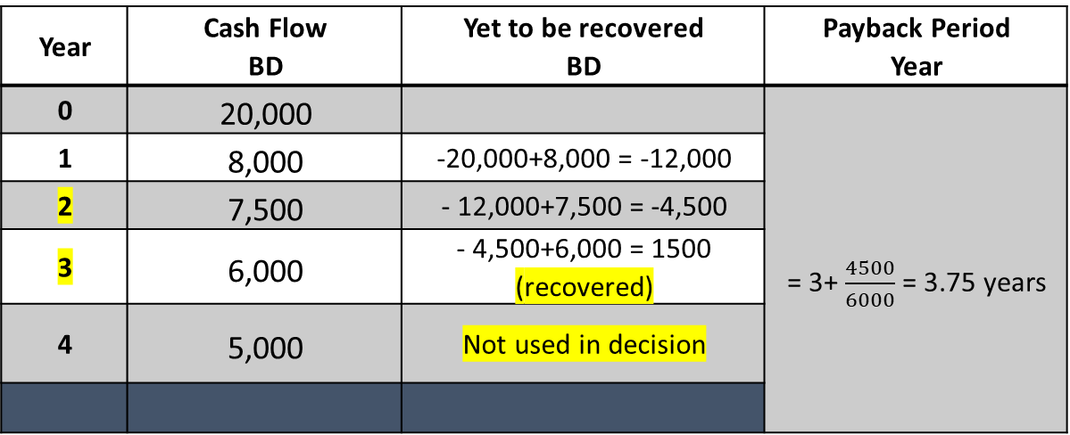
The difference between a short-term and long-term decision.
Answer:
1. Project A: ( Fixed Cash Inflow):
Payback Period = $\frac{Cost ( Initial Investment)}{Annual Cash inflow}$
Payback Period = $\frac{20000}{6000}$ = 3.33 years
2. Project B: ( Changeable Cash Inflow):
INITIATION ACTIVITY
Year | Cash Flow BD | Yet to be recovered BD | Payback Period Year
0 | 20,000 |  | = 3+ $\frac{4500}{6000}$ = 3.75 years
1 | 8,000 | -20,000+8,000 = -12,000
2 | 7,500 | - 12,000+7,500 = -4,500
3 | 6,000 | - 4,500+6,000 = 1500 (recovered)
4 | 5,000 | Not used in decision
OBJECTIVE 1
OBJECTIVE 2
FINAL EVALUATION
FIN 316/806 UNIT 3 CAPITAL BUDGET DECISION MODEL
وزارة التربية والتعليم –العام الدراسي 2023-2024م

Slide 12
The difference between a short-term and long-term decision.
3. Project C: ( Changeable Cash Inflow):
We can choose the project A because it has the lowest payback period. The company has required 3.33 years recover period is less than projects B and C.
Although the payback period method is used widely, it has two significant weaknesses:
It ignored all cash flow after the initial cash outflow has been recovered.
It ignored the time value of money.
Year | Cash Flow BD | Yet to be recovered BD | Payback Period Year
0 | 20,000 |  | Reject the project Not recovered During 4 years
1 | 3,000 | -20,000 + 3,000 = - 17,000
2 | 4,000 | - 17,000 + 4,000 = -13,000
3 | 5,000 | - 13,000 +5,000= -8,000
4 | 6,000 | - 8,000 + 6,000 = -2,000
PAYBACK
INITIATION ACTIVITY
OBJECTIVE 1
OBJECTIVE 2
FINAL EVALUATION
FIN 316/806 UNIT 3 CAPITAL BUDGET DECISION MODEL
وزارة التربية والتعليم –العام الدراسي 2023-2024م

Slide 13
EVALUATION
Exercises (3-2):
What are the payback periods projects R, S and T? Assume all the cash flow is evenly spread throughout the year. If the cutoff period is three years, which projects do you accept?
INITIATION ACTIVITY
Cash Flow | Project R BD | Project S BD | Project T BD
Cost (Initial Investment) | 12,000 | 15,000 | 10,000
Cash flow year 1 | 5,000 | 4,000 | 7,000
Cash flow year 2 | 8,000 | 6,500 | 3,500
Cash flow year 3 | 9,000 | 7,000 | 3,000
OBJECTIVE 1
OBJECTIVE 2
FINAL EVALUATION
FIN 316/806 UNIT 3 CAPITAL BUDGET DECISION MODEL
وزارة التربية والتعليم –العام الدراسي 2023-2024م

Slide 14
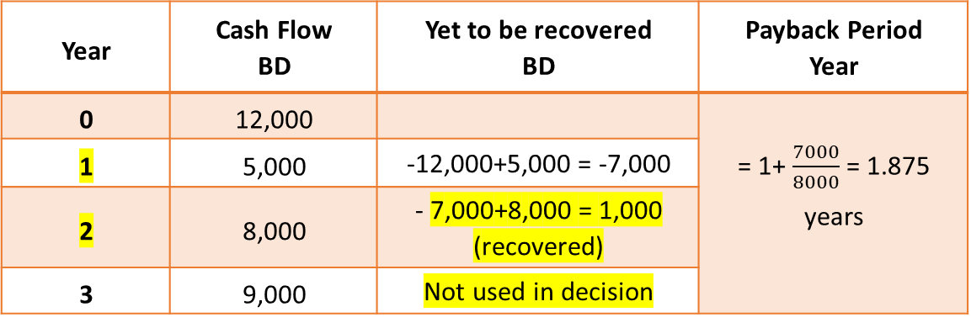
The difference between a short-term and long-term decision.
Answer:
1. Project R:( Changeable Cash Inflow):
Year | Cash Flow BD | Yet to be recovered BD | Payback Period Year
0 | 12,000 |  | = 1+ $\frac{7000}{8000}$ = 1.875 years
1 | 5,000 | -12,000+5,000 = -7,000
2 | 8,000 | - 7,000+8,000 = 1,000 (recovered)
3 | 9,000 | Not used in decision
INITIATION ACTIVITY
OBJECTIVE 1
OBJECTIVE 2
FINAL EVALUATION
FIN 316/806 UNIT 3 CAPITAL BUDGET DECISION MODEL
وزارة التربية والتعليم –العام الدراسي 2023-2024م

Slide 15
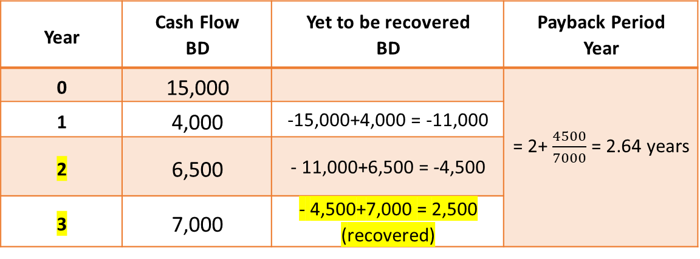
The difference between a short-term and long-term decision.
Answer:
2. Project S:( Changeable Cash Inflow):
PAYBACK
INITIATION ACTIVITY
Year | Cash Flow BD | Yet to be recovered BD | Payback Period Year
0 | 15,000 |  | = 2+ $\frac{4500}{7000}$ = 2.64 years
1 | 4,000 | -15,000+4,000 = -11,000
2 | 6,500 | - 11,000+6,500 = -4,500
3 | 7,000 | - 4,500+7,000 = 2,500 (recovered)
OBJECTIVE 1
OBJECTIVE 2
FINAL EVALUATION
FIN 316/806 UNIT 3 CAPITAL BUDGET DECISION MODEL
وزارة التربية والتعليم –العام الدراسي 2023-2024م

Slide 16
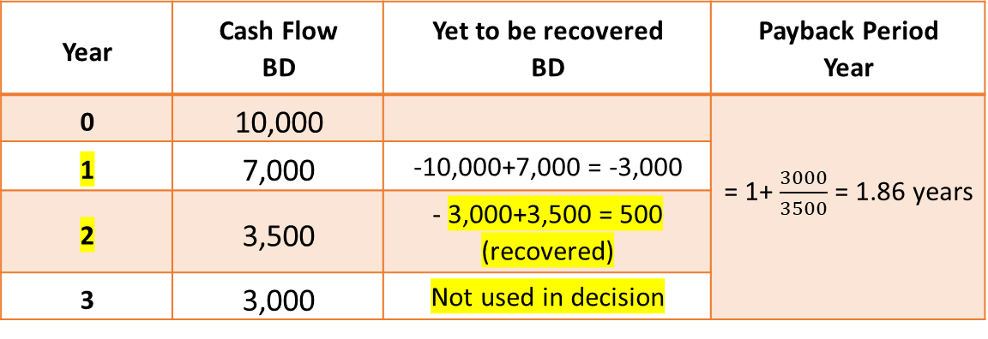
The difference between a short-term and long-term decision.
Answer:
3. Project T:( Changeable Cash Inflow):
We can choose the project T because it has the lowest payback period. The company has required 3.33 years recover period is less than projects R and S.
Year | Cash Flow BD | Yet to be recovered BD | Payback Period Year
0 | 10,000 |  | = 1+ $\frac{3000}{3500}$ = 1.86 years
1 | 7,000 | -10,000+7,000 = -3,000
2 | 3,500 | - 3,000+3,500 = 500 (recovered)
3 | 3,000 | Not used in decision
INITIATION ACTIVITY
OBJECTIVE 1
OBJECTIVE 2
FINAL EVALUATION
FIN 316/806 UNIT 3 CAPITAL BUDGET DECISION MODEL
وزارة التربية والتعليم –العام الدراسي 2023-2024م

Slide 17
END OF LESSON
Thanks
FIN 316/806 UNIT 3 CAPITAL BUDGET DECISION MODEL
وزارة التربية والتعليم –العام الدراسي 2023-2024م

