Slide 1
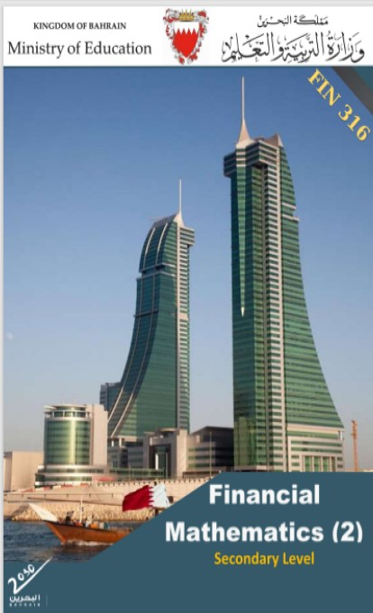
Commercial Subjects Group Level 3
Subject | Financial Mathematics 2 – (Fin 316/806)
Chapter | Unit 2
Title | Annuities and Amortization Loan – part 3
Second Semester
المرحلة الثانوية - المستوى الثالث (توحيد ) – الثالث (فني ومهني)
وزارة التربية والتعليم –العام الدراسي 2023-2024م

Slide 2
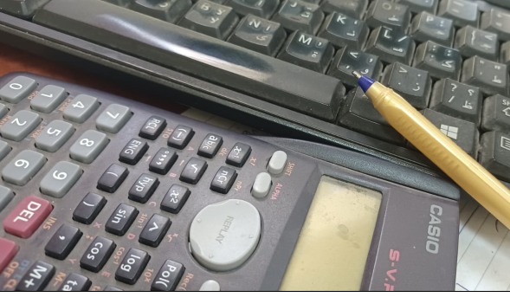
Learning Objectives
At this unit, our students will learn:
Method of amortized loan.
The preparation of amortized loan schedule
INITIATION ACTIVITY
OBJECTIVE 1
OBJECTIVE 2
FINAL EVALUATION
FIN 316/806 UNIT 2 Annuities and Amortization Loan
وزارة التربية والتعليم –العام الدراسي 2023-2024م

Slide 3
INATIATION ACTIVITY
What is the methods of loan payment?
When you borrow money, there are three different ways to repay the loan:
1. You can pay off the principal (the original loan amount that you borrowed) and all the interest (the amount the lender charges you for borrowing money) at one time at the maturity date of the loan. This kind of loan is called a discount loan.
2. You can make interest payments as you go and then pay the principal and final interest payment at the maturity date. This kind of loan is called interest-only loan.
3. You can pay both principal and interest as you go by making equal payments each period. This kind of loan is called amortized loan.
INITIATION ACTIVITY
OBJECTIVE 1
OBJECTIVE 2
OBJECTIVE 3
FINAL EVALUATION
FIN 316/806 UNIT 2 Annuities and Amortization Loan
وزارة التربية والتعليم –العام الدراسي 2023-2024م

Slide 4
The preparation of amortized loan schedule
Example 2-5-1
Amortized Loan
A trader borrowed BD50,548.320 from a bank at compound interest rate 6% annually with 5 equal annual payments.
REQUIRED:
Compute annual payments.
Prepare amortization loan schedule
Answer:
PMT = 50,548.320$÷[\frac{{1−\left(1+.06\right)}^{−5}}{0.06}$]
= 50,548.320$÷[\frac{1−0.7473}{0.06}$]
= 50,548.320÷ 4.21236
= BD12000
OR: PMT = $\left[\frac{{PV}_{n}}{(PVIF n ,i ) }\right]$
= $\left[\frac{50548.320}{(PVIF 5 ,6\% ) }\right]$
= $\left[\frac{50548.320}{4.21236 }\right]$
= BD12,000
INITIATION ACTIVITY
OBJECTIVE 1
TABLE (PV of Ordinary Annuity) (annuity in arrears … end of period)
n i | 5.00% | 6.00% | 7.00% | 8.00% | 9.00% | 10.00% | 11.00% | 12.00%
1 | 0.95238 | 0.94340 | 0.93458 | 0.92593 | 0.91743 | 0.90909 | 0.90090 | 0.89286
2 | 1.85941 | 1.83339 | 1.80802 | 1.78326 | 1.75911 | 1.73554 | 1.71252 | 1.69005
3 | 2.72325 | 2.67301 | 2.62432 | 2.57710 | 2.53129 | 2.48685 | 2.44371 | 2.40183
4 | 3.54595 | 3.46511 | 3.38721 | 3.31213 | 3.23972 | 3.16987 | 3.10245 | 3.03735
5 | 4.32948 | 4.21236 | 4.10020 | 3.99271 | 3.88965 | 3.79079 | 3.69590 | 3.60478
OBJECTIVE 2
OBJECTIVE 3
FINAL EVALUATION
FIN 316/806 UNIT 2 Annuities and Amortization Loan
وزارة التربية والتعليم –العام الدراسي 2023-2024م

Slide 5
The preparation of amortized loan schedule
Example 2-5-1
Amortized Loan
Year 1:
1- Simple Interest (SI) = 50,548.320 ×6%×1 =BD3032.899
2- Principal Reduction = PMT – SI
= 12000 – 3032.899 =BD8967.101
3- Remaining Principal = Beginning Year Principal - Principal Reduction
= 50,548.320 - 8967.101 =BD41581.219
Year 2:
1- Remaining Principal year1 = Beginning Principal Year2 = BD41581.219
2-Simple Interest (SI) = 41581.219×6%×1 =BD2494.873
3- Principal Reduction = PMT – SI
= 12000 – 2494.873=BD9505.127
4- Remaining Principal = Beginning Year Principal - Principal Reduction
= 41581.219- 9505.127=BD32076.092
INITIATION ACTIVITY
OBJECTIVE 1
OBJECTIVE 2
OBJECTIVE 3
FINAL EVALUATION
FIN 316/806 UNIT 2 Annuities and Amortization Loan
وزارة التربية والتعليم –العام الدراسي 2023-2024م

Slide 6
The preparation of amortized loan schedule
Example 2-5-1
Amortized Loan
Year 3:
Remaining Principal year1 = Beginning Principal Year2 = BD32076.092
Simple Interest (SI) = 32076.092×6%×1 =BD1924.566
Principal Reduction = PMT – SI
= 12000 – 1924.566=BD10075.434
Remaining Principal = Beginning Year Principal - Principal Reduction
= 32076.092- 10075.434=BD22000.658
Year 4:
Remaining Principal year1 = Beginning Principal Year2 = BD22000.658
Simple Interest (SI) = 22000.658×6%×1 =BD1320.039
Principal Reduction = PMT – SI
= 12000 – 1320.039=BD10679.961
Remaining Principal = Beginning Year Principal - Principal Reduction
= 22000.658- 10679.961=BD11320.697
INITIATION ACTIVITY
OBJECTIVE 1
OBJECTIVE 2
OBJECTIVE 3
FINAL EVALUATION
FIN 316/806 UNIT 2 Annuities and Amortization Loan
وزارة التربية والتعليم –العام الدراسي 2023-2024م

Slide 7
The preparation of amortized loan schedule
Example 2-5-1
Amortized Loan
INITIATION ACTIVITY
Year 5:
Remaining Principal year1 = Beginning Principal Year2 = BD11320.697
Simple Interest (SI) = 11320.697×6%×1 =BD679.242*
Principal Reduction = PMT – SI
= 12000 – 679.242=BD11320.697*
Remaining Principal = Beginning Year Principal - Principal Reduction
= 11320.697- 11320.697=BD0
OBJECTIVE 1
OBJECTIVE 2
OBJECTIVE 3
FINAL EVALUATION
FIN 316/806 UNIT 2 Annuities and Amortization Loan
وزارة التربية والتعليم –العام الدراسي 2023-2024م

Slide 8
The preparation of amortized loan schedule
Example 2-5-1
Loan Amortization Schedule
INITIATION ACTIVITY
year | Beginning Principal 1 | Annual Payment 2 | Interest Expense 3 = 1×6% | Principal Reduction 4 = 2 - 3 | Remaining Principal 5 = 1 - 4
1 | 50,548.320 | 12,000 | 3,032.899 | 8967.101 | 41,581.219
2 | 41,581.219 | 12,000 | 2,494.873 | 9505.127 | 32,076.092
3 | 32,076.092 | 12,000 | 1,924.566 | 10075.434 | 22,000.658
4 | 22,000.658 | 12,000 | 1,320.039 | 10679.961 | 11,320.697
5 | 11,320.697 | 12,000 | 679.303* | 11,320.697 | 0
Total | - | 60,000 | 9451.680 | 50,548.320 | -
OBJECTIVE 1
OBJECTIVE 2
OBJECTIVE 3
FINAL EVALUATION
FIN 316/806 UNIT 2 Annuities and Amortization Loan
وزارة التربية والتعليم –العام الدراسي 2023-2024م

Slide 9
The preparation of amortized loan schedule
Example 2-5-2
Amortized Loan
Ahmed borrowed BD97,368 from a bank at compound interest rate 10% annually for 7 years.
REQUIRED:
Compute annual payments.
Prepare amortization loan schedule
Answer:
PMT = 97368$÷[\frac{{1−\left(1+.10\right)}^{−7}}{0.10}$]
= 97368$÷[\frac{1−0.5132}{0.10}$]
= 97368÷ 4.8684
= BD20,000
OR: PMT = $\left[\frac{{PV}_{n}}{(PVIF n ,i ) }\right]$
= $\left[\frac{97,368}{(PVIF 7 ,10\% ) }\right]$
= $\left[\frac{97,368}{4.8684 }\right]$
= BD20,000
INITIATION ACTIVITY
OBJECTIVE 1
TABLE (PV of Ordinary Annuity) n i (annuity in arrears … end of period)
 | 5.00% | 6.00% | 7.00% | 8.00% | 9.00% | 10.00% | 11.00% | 12.00%
1 | 0.95238 | 0.94340 | 0.93458 | 0.92593 | 0.91743 | 0.90909 | 0.90090 | 0.89286
2 | 1.85941 | 1.83339 | 1.80802 | 1.78326 | 1.75911 | 1.73554 | 1.71252 | 1.69005
3 | 2.72325 | 2.67301 | 2.62432 | 2.57710 | 2.53129 | 2.48685 | 2.44371 | 2.40183
4 | 3.54595 | 3.46511 | 3.38721 | 3.31213 | 3.23972 | 3.16987 | 3.10245 | 3.03735
5 | 4.32948 | 4.21236 | 4.10020 | 3.99271 | 3.88965 | 3.79079 | 3.69590 | 3.60478
6 | 5.07569 | 4.91732 | 4.76654 | 4.62288 | 4.48592 | 3.35526 | 4.23054 | 4.11141
7 | 5.78637 | 5.58238 | 5.38929 | 5.20637 | 5.03295 | 4.86842 | 4.71220 | 4.56376
OBJECTIVE 2
OBJECTIVE 3
FINAL EVALUATION
FIN 316/806 UNIT 2 Annuities and Amortization Loan
وزارة التربية والتعليم –العام الدراسي 2023-2024م

Slide 10
The preparation of amortized loan schedule
Example 2-5-2
Loan Amortization Schedule
Year | Beginning Principal 1 | Annual Payment 2 | Interest Expense 3 = 1 ×10% | Principal Reduction 4 = 2 - 3 | Remaining Principal 5 = 1 - 4
1 | 97,368 | 20,000 | 9,736.8 | 10,263.2 | 87,104.8
2 | 87,104.8 | 20,000 | 8,710.48 | 11,289.52 | 75,815.28
3 | 75,815.28 | 20,000 | 7,581.53 | 12,418.47 | 63,396.81
4 | 63,396.81 | 20,000 | 6,339.68 | 13660.32 | 49,736.49
5 | 49,736.49 | 20,000 | 4,973.65 | 15,026.35 | 34,710.14
6 | 34,710.14 | 20,000 | 3,471.01 | 16,528.99 | 1,8181.15
7 | 18,181.15 | 20,000 | 1,818.85* | 18,181.15 | 0
Total |  | 140,000 | 42,632 | 97368
INITIATION ACTIVITY
OBJECTIVE 1
OBJECTIVE 2
OBJECTIVE 3
FINAL EVALUATION
FIN 316/806 UNIT 2 Annuities and Amortization Loan
وزارة التربية والتعليم –العام الدراسي 2023-2024م

Slide 11
EVALUATION
Activity
Amortized Loan
1- Set up amortization loan schedule for a BD25,000 loan to be repaid in equal instalments at the end of each of the next five years. The interest rate is 10% annually.
Answer:
PMT = 2$5000÷[\frac{{1−\left(1+.10\right)}^{−5}}{0.10}$]
= 2$5000 ÷[\frac{1−0.6209}{0.10}$]
= 25000 ÷ 3.79079
= BD20,000
OR: PMT = $\left[\frac{{PV}_{n}}{(PVIF n ,i ) }\right]$
= $\left[\frac{97,368}{(PVIF 7 ,10\% ) }\right]$
= $\left[\frac{25000}{3.79079 }\right]$
= BD6594.931 ≌
= BD6595
INITIATION ACTIVITY
OBJECTIVE 1
TABLE (PV of Ordinary Annuity) n i (annuity in arrears … end of period)
 | 5.00% | 6.00% | 7.00% | 8.00% | 9.00% | 10.00% | 11.00% | 12.00%
1 | 0.95238 | 0.94340 | 0.93458 | 0.92593 | 0.91743 | 0.90909 | 0.90090 | 0.89286
2 | 1.85941 | 1.83339 | 1.80802 | 1.78326 | 1.75911 | 1.73554 | 1.71252 | 1.69005
3 | 2.72325 | 2.67301 | 2.62432 | 2.57710 | 2.53129 | 2.48685 | 2.44371 | 2.40183
4 | 3.54595 | 3.46511 | 3.38721 | 3.31213 | 3.23972 | 3.16987 | 3.10245 | 3.03735
5 | 4.32948 | 4.21236 | 4.10020 | 3.99271 | 3.88965 | 3.79079 | 3.69590 | 3.60478
6 | 5.07569 | 4.91732 | 4.76654 | 4.62288 | 4.48592 | 3.35526 | 4.23054 | 4.11141
7 | 5.78637 | 5.58238 | 5.38929 | 5.20637 | 5.03295 | 4.86842 | 4.71220 | 4.56376
OBJECTIVE 2
OBJECTIVE 3
FINAL EVALUATION
FIN 316/806 UNIT 2 Annuities and Amortization Loan
وزارة التربية والتعليم –العام الدراسي 2023-2024م

Slide 12
The preparation of amortized loan schedule
Example 2-5-1
Loan Amortization Schedule
INITIATION ACTIVITY
year | Beginning Principal 1 | Annual Payment 2 | Interest Expense 3 = 1×10% | Principal Reduction 4 = 2 - 3 | Remaining Principal 5 = 1 - 4
1 | 25000 | 6595 | 2500 | 4095 | 20905
2 | 20905 | 6595 | 2090.5 | 4504.5 | 16400.5
3 | 16400.5 | 6595 | 1640 | 4955 | 11445.5
4 | 11455.5 | 6595 | 1144.55 | 5450.45 | 6005
5 | 6005 | 6595 | 590* | 6005 | 0
Total | - | 32975 | 7975* | 25000 | -
OBJECTIVE 1
OBJECTIVE 2
OBJECTIVE 3
FINAL EVALUATION
FIN 316/806 UNIT 2 Annuities and Amortization Loan
وزارة التربية والتعليم –العام الدراسي 2023-2024م

Slide 13
END OF LESSON
Thanks
FIN 316/806 UNIT 2 Annuities and Amortization Loan
وزارة التربية والتعليم –العام الدراسي 2023-2024م

