Slide 1
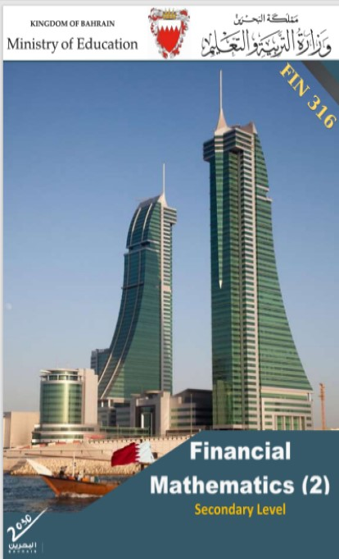
Commercial Subjects Group Level 3
Subject | Financial Mathematics 2 – (Fin 316/806)
Chapter | Unit 2
Title | Annuities and Amortization Loan – part1
Second Semester
المرحلة الثانوية - المستوى الثالث (توحيد ) – الثالث (فني ومهني)
وزارة التربية والتعليم –العام الدراسي 2023-2024م

Slide 2
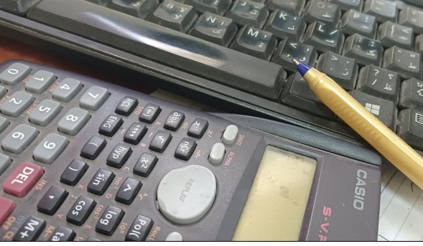
Learning Objectives
At this unit, our students will learn:
The concept of annuity/ payments
The different types of annuities
The definition of future and present value of annuities.
The calculation of the future and present value of annuities.
INITIATION ACTIVITY
OBJECTIVE 1
OBJECTIVE 2
FINAL EVALUATION
FIN 316/806 UNIT 2 Annuities and Amortization Loan
وزارة التربية والتعليم –العام الدراسي 2023-2024م

Slide 3
INATIATION ACTIVITY
What is mean of Annuities?
An annuity is a stream consisting of a fixed number of equal cash flows paid at regular intervals. An annuity a stream of equal cash flows arriving at a regular interval and ending after a specified period. Therefore, the difference between an annuity and a perpetuity is that an annuity ends after some fixed number of payments whereas a perpetuity continues forever. Most car loans, mortgages, and some bonds are annuities. We represent the cash flows of an annuity on a time line as follows:
INITIATION ACTIVITY
OBJECTIVE 1
OBJECTIVE 2
First period | Second period | Third period | Fourth period | Period etc..
BD 100 | BD 100 | BD 100 | BD 100 | BD 100
OBJECTIVE 3
FINAL EVALUATION
FIN 316/806 UNIT 2 Annuities and Amortization Loan
وزارة التربية والتعليم –العام الدراسي 2023-2024م

Slide 4
The different types of annuities
There are two types of annuities:.
Is a payment paid at the end of each period (end of each month– end of each six months – end of each year).
Is paid at the beginning of each period (begins every month – begins every six months – begins every year).
INITIATION ACTIVITY
A- Payment / Ordinary Annuities:
OBJECTIVE 1
OBJECTIVE 2
B- Investment / Due Annuities:
OBJECTIVE 3
FINAL EVALUATION
FIN 316/806 UNIT 2 Annuities and Amortization Loan
وزارة التربية والتعليم –العام الدراسي 2023-2024م

Slide 5
The definition of future and present value of annuities.
To compute the future value (compound amount) for one annuity monetary unit by using an electronic calculator or you can use the facilities, which are provided in the Microsoft office excel to compute the compound amount for one annuity monetary unit with a certain formula.
present value of a lump sum, which in simple terms in the current value of a future payment. What we will be doing is, in fact, nothing other than inverse compounding. The differences in these techniques come about merely from the investor’s point of view. In compounding, we explained earlier about the growth rate and investment in determining the present value, and we will explain the present value of money and equal payments that will be obtained or paid in the future.
Future Value of Annuities
INITIATION ACTIVITY
OBJECTIVE 1
Present Value of Annuities
OBJECTIVE 2
OBJECTIVE 3
FINAL EVALUATION
FIN 316/806 UNIT 2 Annuities and Amortization Loan
وزارة التربية والتعليم –العام الدراسي 2023-2024م

Slide 6
The calculation of the future and present value of annuities.
Ordinary Annuities
Title | Method | Ordinary
Future Value | Table | ${FV}_{n}$ = PMT × FVIF n ,i
 | Calculator | ${FV}_{n}$ =$PMT×[\frac{{(1+i)}^{n}−1}{i}$]
Present Value | Table | ${PV}_{n}$ = PMT × PVIF n ,i
 | Calculator | ${PV}_{n}$= $PMT×[\frac{{1−(1+i)}^{−n}}{i}$]
INITIATION ACTIVITY
OBJECTIVE 1
OBJECTIVE 2
${FV}_{n}$ : Future value of ordinary annuity.
${PV}_{n}$ : Present value of ordinary annuity.
PMT : Equal Payments.
n : Number of Annuities.
i : Interest Rate.
FVIF n ,i: Searching from future value of ordinary annuity table.
PVIF n ,i: Searching from present value of ordinary annuity table.
OBJECTIVE 3
FINAL EVALUATION
FIN 316/806 UNIT 2 Annuities and Amortization Loan
وزارة التربية والتعليم –العام الدراسي 2023-2024م

Slide 7
The calculation of the future and present value of annuities.
Example 2-3-1
Ordinary Annuities
A trader paid an annuity of BD150 at the end of each year for 3 years at an interest rate of 5% annually. Find the following:
Future value (amount) and interest at the end of the period.
Present value (amount) at the end of the period.
Answer:
${FV}_{n}$ =$PMT×[\frac{{(1+i)}^{n}−1}{i}$]
= $150×[\frac{{(1+5\%)}^{3}−1}{5\%}$]
= $150×[\frac{0.157625}{0.05}$ ]
= $150×[3.1525$ ] = BD 472 . 875
OR by using interest table = 150 x 3.1525 = BD 472 . 875
INITIATION ACTIVITY
OBJECTIVE 1
TABLE (FV of Ordinary Annuity) (annuity in arrears … end of period)
n i | 4.00% | 5.00% | 6.00% | 7.00% | 8.00% | 9.00% | 10.00% | 11.00% | %12.00
1 | 1.00000 | 1.00000 | 1.00000 | 1.00000 | 1.00000 | 1.00000 | 1.00000 | 1.00000 | 1.00000
2 | 2.04000 | 2.05000 | 2.06000 | 2.07000 | 2.08000 | 2.09000 | 2.10000 | 2.11000 | 2.12000
3 | 3.12160 | 3.15250 | 3.18360 | 3.21490 | 3.24640 | 3.27810 | 3.31000 | 3.34210 | 3.37440
OBJECTIVE 2
OBJECTIVE 3
FINAL EVALUATION
FIN 316/806 UNIT 2 Annuities and Amortization Loan
وزارة التربية والتعليم –العام الدراسي 2023-2024م

Slide 8
The calculation of the future and present value of annuities.
Example 2-3-1
Ordinary Annuities
A trader paid an annuity of BD150 at the end of each year for 3 years at an interest rate of 5% annually. Find the following:
1- Future value (amount) and interest at the end of the period.
2- Present value (amount) at the end of the period.
Answer:
CI = ${FV}_{n}$ - ( PMT x n)
= 472.875 - (150 x 3)
= 472.875 - 450
= BD 22.875
INITIATION ACTIVITY
OBJECTIVE 1
OBJECTIVE 2
OBJECTIVE 3
FINAL EVALUATION
FIN 316/806 UNIT 2 Annuities and Amortization Loan
وزارة التربية والتعليم –العام الدراسي 2023-2024م

Slide 9
The calculation of the future and present value of annuities.
Example 2-3-1
Ordinary Annuities
A trader paid an annuity of BD150 at the end of each year for 3 years at an interest rate of 5% annually. Find the following:
1- Future value (amount) and interest at the end of the period.
2- Present value (amount) at the end of the period.
Answer:
2- ${PV}_{n}$=$PMT×[\frac{{1−(1+i)}^{−n}}{i}$]
= $150×[\frac{{1−(1+5\%)}^{−3}}{5\%}$]
= $150×[\frac{0.1362}{0.05}$]
= 150 x 2.72325 = BD 408.488
OR by using interest table =150 x 2.72325 = BD 408.488
INITIATION ACTIVITY
OBJECTIVE 1
TABLE (PV of Ordinary Annuity) (annuity in arrears … end of period)
n i | 5.00% | 6.00% | 7.00% | 8.00% | 9.00% | 10.00% | 11.00% | 12.00%
1 | 0.95238 | 0.94340 | 0.93458 | 0.92593 | 0.91743 | 0.90909 | 0.90090 | 0.89286
2 | 1.85941 | 1.83339 | 1.80802 | 1.78326 | 1.75911 | 1.73554 | 1.71252 | 1.69005
3 | 2.72325 | 2.67301 | 2.62432 | 2.57710 | 2.53129 | 2.48685 | 2.44371 | 2.40183
4 | 3.54595 | 3.46511 | 3.38721 | 3.31213 | 3.23972 | 3.16987 | 3.10245 | 3.03735
OBJECTIVE 2
OBJECTIVE 3
FINAL EVALUATION
FIN 316/806 UNIT 2 Annuities and Amortization Loan
وزارة التربية والتعليم –العام الدراسي 2023-2024م

Slide 10
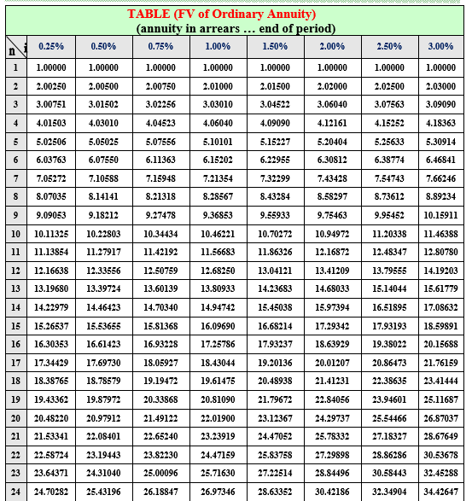
The calculation of the future and present value of annuities.
Example 2-3-1
Calculate the future value and interest of an ordinary annuity of BD200 paid 4 times a year for 6 years if the nominal rate is 4% annually.
Answer:
No. of annuities ( n ) = 6 × 4 = 24
Partial rate (i) = 4% ÷ 4 = 1%
${1− FV}_{n}$ =$PMT×[\frac{{(1+i)}^{n}−1}{i}$]
= $200×[\frac{{(1+1\%)}^{24}−1}{1\%}$]
= 200 x 26.9734 = BD 5394.680
OR by using interest table = 200 x 26.9734 = BD 5394.680
2- CI = ${FV}_{n}$ - ( PMT x n)
= 5394.680 - (200 x 24) = BD 594.680
Ordinary Annuities
INITIATION ACTIVITY
OBJECTIVE 1
OBJECTIVE 2
OBJECTIVE 3
FINAL EVALUATION
FIN 316/806 UNIT 2 Annuities and Amortization Loan
وزارة التربية والتعليم –العام الدراسي 2023-2024م

Slide 11
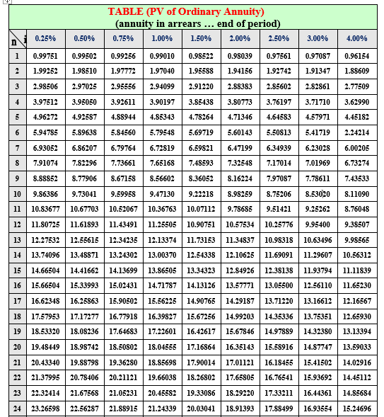
The calculation of the future and present value of annuities.
Example 2-3-2
Calculate the present value of an ordinary annuity of BD200 paid 4 times a year for 6 years if the nominal rate is 4% annually.
Answer:
${PV}_{n}$= $PMT×[\frac{{1−(1+i)}^{−n}}{i}$]
= 200 x$[\frac{{1−(1+1\%)}^{−24}}{1\%}$]
= 200 x$[\frac{1−0.787566}{0.01}$]
= 200 x 21.24339 = BD 4248.678
OR by using interest table = 200 x 21.24339 = BD 4248.678
Ordinary Annuities
INITIATION ACTIVITY
OBJECTIVE 1
OBJECTIVE 2
OBJECTIVE 3
FINAL EVALUATION
FIN 316/806 UNIT 2 Annuities and Amortization Loan
وزارة التربية والتعليم –العام الدراسي 2023-2024م

Slide 12
The calculation of the future and present value of annuities.
Example 2-3-1
Calculate the future value and interest of an ordinary annuity of BD500 paid 2 times a year for 5 years if the nominal rate is 6% annually, Compounded interest semiannual.
Answer:
No. of annuities ( n ) = 5 × 2 = 10
Partial rate (i) = 6% ÷ 2 = 3%
${1− FV}_{n}$ =$PMT×[\frac{{(1+i)}^{n}−1}{i}$]
= $500×[\frac{{(1+3\%)}^{10}−1}{3\%}$]
= 500 x 11.46388 = BD 5731.940
OR by using interest table = 500 x 11.46388 = BD 5731.940
2- CI = ${FV}_{n}$ - ( PMT x n)
= 5394.680 - (500 x 10) = BD 594.680
Ordinary Annuities
INITIATION ACTIVITY
OBJECTIVE 1
OBJECTIVE 2
OBJECTIVE 3
FINAL EVALUATION
FIN 316/806 UNIT 2 Annuities and Amortization Loan
وزارة التربية والتعليم –العام الدراسي 2023-2024م

Slide 13
The calculation of the future and present value of annuities.
Activity 2-3-2
Calculate the present value of an ordinary annuity of BD500 paid 2 times a year for 5 years if the nominal rate is 6% annually, Compounded interest semiannual.
Answer:
${PV}_{n}$= $PMT×[\frac{{1−(1+i)}^{−n}}{i}$]
= 500 x$[\frac{{1−(1+3\%)}^{−10}}{3\%}$]
= 500 x$[\frac{1−0.74409}{0.03}$]
= 500 x 8.53020 = BD 4265.100
OR by using interest table = 500 x 8.53020 = BD 4265.100
Ordinary Annuities
INITIATION ACTIVITY
OBJECTIVE 1
OBJECTIVE 2
OBJECTIVE 3
FINAL EVALUATION
FIN 316/806 UNIT 2 Annuities and Amortization Loan
وزارة التربية والتعليم –العام الدراسي 2023-2024م

Slide 14
END OF LESSON
Thanks
FIN 316/806 UNIT 2 Annuities and Amortization Loan
وزارة التربية والتعليم –العام الدراسي 2023-2024م

