Slide 1
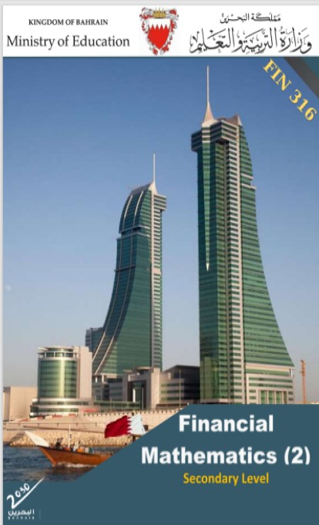
Commercial Subjects Group Level 3
Subject | Financial Mathematics 2 – (Fin 316/806)
Chapter | Unit 1
Title | Compound Interest – part 3
Second Semester
المرحلة الثانوية - المستوى الثالث (توحيد ) – الثالث (فني ومهني)
وزارة التربية والتعليم –العام الدراسي 2023-2024م

Slide 2
Learning Objectives
At this unit, our students will learn:
The calculation of compound interest for changeable investment/loan.
The calculation of the factors of compound interest.
INITIATION ACTIVITY
OBJECTIVE 1
OBJECTIVE 2
OBJECTIVE 3
FINAL EVALUATION
FIN 316/806 UNIT 1 Compound interest
وزارة التربية والتعليم –العام الدراسي 2023-2024م

Slide 3

INATIATION ACTIVITY
What is the factors of compound interest?
INITIATION ACTIVITY
n
FV
OBJECTIVE 1
PV
CI
here
i%
OBJECTIVE 2
$${(1+i)}^{n}$$
FV
OBJECTIVE 3
CI
PV
FINAL EVALUATION
FIN 316/806 UNIT 1 Compound interest
وزارة التربية والتعليم –العام الدراسي 2023-2024م

Slide 4
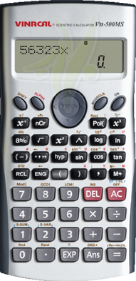

Finding the present value (principal) .
Example 1-5-1:
Hasan deposited an amount of money in a bank at 5% annually. If the compound amount at the end of 12 years is BD8,081.550. Calculate the present value (principal)?
Answer:
PV = FV ÷ (1+ i )^{n}
PV = 8,081.550 ÷ (1+ 5%)¹²
= 8,081.550 ÷ 1.7959
= BD 4500
A) Finding the present value (principal) by knowing future value:
INITIATION ACTIVITY
OBJECTIVE 1
OBJECTIVE 2
$${(1+i)}^{n}$$
FV
OBJECTIVE 3
CI
PV
FINAL EVALUATION
FIN 316/806 UNIT 1 Compound interest
وزارة التربية والتعليم –العام الدراسي 2023-2024م

Slide 5

Finding the present value (principal) .
Example 1-5-2:
A person deposited an amount of money in a bank at 3% annually. If the compound interest at the end of 10 years was BD171.950 – Find:
a) The deposited amount.
b) The compound amount at the end of the period.
Answer:
a) PV = CI ÷ [ (1+ i) ^{n} - 1]
PV = 171.950 ÷ [(1+ 3%)¹⁰ – 1]
= 171.950 ÷ [1.3439 – 1]
= 171.950 ÷ 0.3439 = BD 500
b) FV = PV + CI
= 500 + 171.950 = BD 671.950
= BD 4500
B) Finding the present value (principal) by knowing Compound interest:
INITIATION ACTIVITY
OBJECTIVE 1
OBJECTIVE 2
$${(1+i)}^{n}$$
FV
OBJECTIVE 3
CI
PV
FINAL EVALUATION
FIN 316/806 UNIT 1 Compound interest
وزارة التربية والتعليم –العام الدراسي 2023-2024م

Slide 6
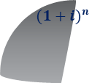
EVALUATION
Activity 1-5-1:
1- Find the present value (principal), if the amount after 5 years is BD1469.330 and the compound interest rate is 8% annually, then find the interest.
Answer
PV = FV ÷ (1+ i )^{n}
PV = 1469.330 ÷ (1+ 8%)⁵
= 1469.330 ÷ 1.4693
= BD 1000
INITIATION ACTIVITY
OBJECTIVE 1
OBJECTIVE 2
$${(1+i)}^{n}$$
FV
OBJECTIVE 3
PV
FINAL EVALUATION
FIN 316/806 UNIT 1 Compound interest
وزارة التربية والتعليم –العام الدراسي 2023-2024م

Slide 7
EVALUATION
Activity 1-5-1:
5- Find the present value (principal) that generates an interest of BD700 at 2% annually for 5 years.
Answer
PV = CI ÷ [ (1+ i) ^{n} - 1]
PV = 700 ÷ [(1+ 2%)⁵ – 1]
= 700 ÷ [1.1041 – 1]
= 700 ÷ 0.1041 = BD 6724.304
INITIATION ACTIVITY
OBJECTIVE 1
OBJECTIVE 2
$${(1+i)}^{n}$$
FV
OBJECTIVE 3
PV
FINAL EVALUATION
FIN 316/806 UNIT 1 Compound interest
وزارة التربية والتعليم –العام الدراسي 2023-2024م

Slide 8
Finding the time / periods.
Example 1-5-3:
HA principal of BD3175.309 is invested at 8% annually, how long would it take to make the future value to BD18643.829.
Answer:
(1+ i )^{n} = FV ÷ PV
(1+8%)^{n} = 18643.829 ÷ 3175.309
= 5.8715 we are choosing to find n = 23 years by two ways.
C) Finding the Time/Periods
INITIATION ACTIVITY
a) By using calculator
Press Log 5.8715 ÷ log 1.08
n = 0.768749065 ÷ 0.033423755
= 23 Years
OBJECTIVE 1
OBJECTIVE 2
8.75% | 8.5% | 8.25% | 8% | N
5.3529 | 5.1120 | 4.8816 | 4.6610 | 20
5.8212 | 5.5466 | 5.2843 | 5.0338 | 21
6.3306 | 6.0180 | 5.7202 | 5.4365 | 22
6.8845 | 6.5296 | 6.1922 | 5.8715 | 23
7.4869 | 7.0846 | 6.7030 | 6.3412 | 24
OBJECTIVE 3
FINAL EVALUATION
FIN 316/806 UNIT 1 Compound interest
وزارة التربية والتعليم –العام الدراسي 2023-2024م

Slide 9
EVALUATION
Activity 1-4-1:
A loan of BD2,000 amounted to BD3591.713. Find the borrowing. period if the interest rate was 5% annually.
Answer:
(1+ i )^{n} = FV ÷ PV
(1+5%)^{n} = 3591.713 ÷ 2000
= 1.7959
Log 1.7959 ÷ Log 1.05 = 12 years
C) Finding the Time/Periods
INITIATION ACTIVITY
OBJECTIVE 1
OBJECTIVE 3
OBJECTIVE 3
$${(1+i)}^{n}$$
FV
FINAL EVALUATION
PV
FIN 316/806 UNIT 1 Compound interest
وزارة التربية والتعليم –العام الدراسي 2023-2024م

Slide 10
Finding the interest rate.
Example 1-5-5:
Mahmood deposited BD3000 in the bank, if the amount at the end of 6 years was BD5031.300 – Find the interest rate.
Answer:
(1+ i )^{n} = FV ÷ PV
(1+i%)⁶ = 5031.300 ÷ 3000
= 1.6771 we finding the time by two ways.
I = 9% Annually.
D) Finding the interest rate
INITIATION ACTIVITY
OBJECTIVE 1
a) By using calculator
Press ^{6 x} √ 1.6771 = 1.08999
i =1.80999 –1= 0.8999 x 100 = 9%
OBJECTIVE 2
OBJECTIVE 3
9.25% | 9% | 8.5% | 8.75% | N
1.3040 | 1.2950 | 1.2861 | 1.2773 | 3
1.4246 | 1.4116 | 1.3987 | 1.3859 | 4
1.5563 | 1.5386 | 1.5211 | 1.5037 | 5
1.7003 | 1.6771 | 1.6542 | 1.6315 | 6
1.8576 | 1.8280 | 1.7989 | 1.7701 | 7
FINAL EVALUATION
FIN 316/806 UNIT 1 Compound interest
وزارة التربية والتعليم –العام الدراسي 2023-2024م

Slide 11
EVALUATION
Activity 1-4-1:
A loan of BD2,000 amounted to BD3591.713. Find the borrowing. period if the interest rate was 5% annually.
Answer:
(1+ i )^{n} = FV ÷ PV
(1+5%)^{n} = 3591.713 ÷ 2000
= 1.7959
Log 1.7959 ÷ Log 1.05 = 12 years
C) Finding the Time/Periods
INITIATION ACTIVITY
OBJECTIVE 1
OBJECTIVE 2
OBJECTIVE 3
$${(1+i)}^{n}$$
FV
FINAL EVALUATION
PV
FIN 316/806 UNIT 1 Compound interest
وزارة التربية والتعليم –العام الدراسي 2023-2024م

Slide 12
EVALUATION
Activity 1-4-1:
4- Jawad borrowed BD8,000 for 4 years. If the compound interest was BD 2,948.800 find the semi-annually interest rate, and the annually interest rate.
Answer:
FV = PV + CI
= 8000 + 2948.800 = BD10948.800
(1+ i )^{n} = FV ÷ PV
(1+i%)⁴ = 10948.800 ÷ 8000
= 1.3686
I = 1.08 – 1 = 8%
D) Finding the interest rate
INITIATION ACTIVITY
OBJECTIVE 1
OBJECTIVE 2
OBJECTIVE 3
$${(1+i)}^{n}$$
FV
FINAL EVALUATION
PV
FIN 316/806 UNIT 1 Compound interest
وزارة التربية والتعليم –العام الدراسي 2023-2024م

Slide 13
END OF LESSON
Thanks
FIN 316/806 UNIT 1 Compound interest
وزارة التربية والتعليم –العام الدراسي 2023-2024م

