Slide 1
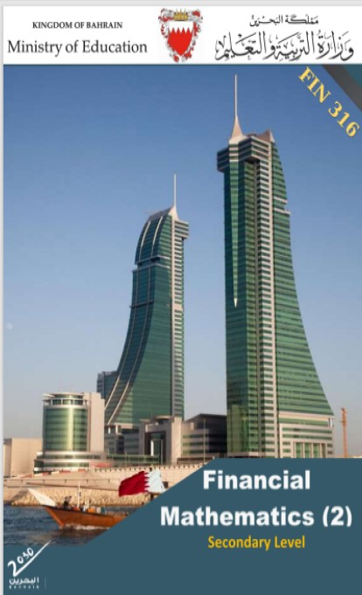
Commercial Subjects Group Level 3
Subject | Financial Mathematics 2 – (Fin 316/806)
Chapter | Unit 1
Title | Compound Interest – part 2
Second Semester
المرحلة الثانوية - المستوى الثالث (توحيد ) – الثالث (فني ومهني)
وزارة التربية والتعليم –العام الدراسي 2023-2024م

Slide 2
Learning Objectives
At this unit, our students will learn:
The difference between nominal and partial interest rates.
The calculation of CI in more than once a year situation.
The calculation of compound interest for changeable interest rate.
INITIATION ACTIVITY
OBJECTIVE 1
OBJECTIVE 2
OBJECTIVE 3
FINAL EVALUATION
FIN 316/806 UNIT 1 Compound interest
وزارة التربية والتعليم –العام الدراسي 2023-2024م

Slide 3
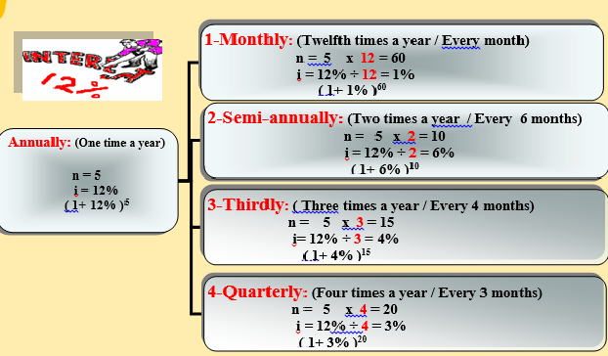
INATIATION ACTIVITY
Explain the benefit of the following table.
INITIATION ACTIVITY
OBJECTIVE 1
OBJECTIVE 2
OBJECTIVE 3
FINAL EVALUATION
FIN 316/806 UNIT 1 Compound interest
وزارة التربية والتعليم –العام الدراسي 2023-2024م

Slide 4
The difference between nominal and partial interest rates.
Example 1-3-6:
A woman deposited BD 5,000 in a bank that pays 3.8% quarterly on saving accounts for 4 years and 6 months. Find the future value.
FV = PV× (1+ i )^{n}
= 5000 × (1+3.8%)¹⁸
= 5000 × 1.95682 = BD9784.100
B) Partial interest rate
INITIATION ACTIVITY
OBJECTIVE 1
The number of times | Four times (4) a year or every three months n= 4 x 4 years and 6 months = 18 periods
months | Jan 1 | Feb 2 | Mar 3 | Apr 4 | May 5 | Jun 6 | Jul 7 | Aug 8 | Sep 9 | Oct 10 | Nov 11 | Dec 12
Rate | 3.8% |  |  | 3.8% |  |  | 3.8% |  |  | 3.8%
OBJECTIVE 2
OBJECTIVE 3
FINAL EVALUATION
FIN 316/806 UNIT 1 Compound interest
وزارة التربية والتعليم –العام الدراسي 2023-2024م

Slide 5
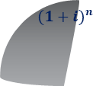
The difference between nominal and partial interest rates.
Example 1-3-7:
Ali deposited BD3000 at 2¾% every 4 months – find the future value at the end of 4 years and 8 months?
FV = PV× (1+ i )^{n}
= 3000 × (1+2.75%)¹⁴
= 3000 × 1.461994 = BD4385.982
B) Partial interest rate
INITIATION ACTIVITY
OBJECTIVE 1
The number of times | Three times (3) a year or every four months n= 3 x 4 years and 8 months = 14 periods
months | Jan 1 | Feb 2 | Mar 3 | Apr 4 | May 5 | Jun 6 | Jul 7 | Aug 8 | Sep 9 | Oct 10 | Nov 11 | Dec 12
Rate | 2¾% |  |  |  | 2¾% |  |  |  | 2¾%
OBJECTIVE 2
OBJECTIVE 3
$${(1+i)}^{n}$$
FV
FINAL EVALUATION
PV
FIN 316/806 UNIT 1 Compound interest
وزارة التربية والتعليم –العام الدراسي 2023-2024م

Slide 6
EVALUATION
Activity 1-3-7:
4- A person deposited BD8750 at 3% each quarter – find the future value and the interest at the end of 6 years.
Answer:
INITIATION ACTIVITY
B) Partial interest rate
OBJECTIVE 1
OBJECTIVE 2
$${(1+i)}^{n}$$
FV
OBJECTIVE 3
PV
FINAL EVALUATION
FIN 316/806 UNIT 1 Compound interest
وزارة التربية والتعليم –العام الدراسي 2023-2024م

Slide 7
EVALUATION
Activity 1-3-7:
4- A person deposited BD8750 at 3% each quarter – find the future value and the interest at the end of 6 years.
Answer
i = 3% each quarter
n = 6 × 4 = 24 times
FV = PV× (1+ i )^{n}
= 8750 × (1+3%)²⁴
= 8750 × 2.0328 = BD17787
CI = FV – PV
= 17787 – 8750 = BD9037
B) Partial interest rate
INITIATION ACTIVITY
OBJECTIVE 1
OBJECTIVE 2
OBJECTIVE 3
$${(1+i)}^{n}$$
FV
FINAL EVALUATION
PV
FIN 316/806 UNIT 1 Compound interest
وزارة التربية والتعليم –العام الدراسي 2023-2024م

Slide 8
The calculation of compound interest for changeable interest rate.
A) Changeable interest rate
Example 1-4-1
Hashim invested BD 5,000 for 6 years at 4% annually for the first two years, 6% annually for the following 3 years and 7% annually for the last year; Find the compound interest at the end of the period?
Answer:
FV = PV× (1+ i) ^{n}
FV = 5000 × (1+4%)² × (1+6%)³× (1+7%)¹
= 5000 × 1.0816× 1.1910 × 1.07 = BD 6,891.793
CI = FV - PV
CI = 6,891.793 – 5000 = BD 1,891.793
INITIATION ACTIVITY
OBJECTIVE 1
OBJECTIVE 2
OBJECTIVE 3
FINAL EVALUATION
FIN 316/806 UNIT 1 Compound interest
وزارة التربية والتعليم –العام الدراسي 2023-2024م

Slide 9
EVALUATION
Activity 1-4-1:
3- Find the future value that Saad will get if he saves BD2,000 in a bank for 10 years at changing rate, as following: at 5% annually for the first 5 years, 4.6% annually for the sixth year and 6% annually compounded semi-annually for the rest years.
Answer:
A) Changeable interest rate
INITIATION ACTIVITY
OBJECTIVE 1
OBJECTIVE 2
OBJECTIVE 3
$${(1+i)}^{n}$$
FV
FINAL EVALUATION
PV
FIN 316/806 UNIT 1 Compound interest
وزارة التربية والتعليم –العام الدراسي 2023-2024م

Slide 10
EVALUATION
Activity 1-4-1:
3- Find the future value that Saad will get if he saves BD2,000 in a bank for 10 years at changing rate, as following: at 5% annually for the first 5 years, 4.6% annually for the sixth year and 6% annually compounded semi-annually for the rest years.
Answer:
1. I = 5 % n = 5
I = 4.6% n = 1
I = 6 ÷ 2 = 3% n = 4 × 2 = 8
FV= PV× (1+ i) ^{n}
FV = 2000 × (1+5%)⁵ × (1+4.6%)¹× (1+3%)⁸
= 2000 × 1.2763× 1.046 × 1.2668 = BD 3382.380
A) Changeable interest rate
INITIATION ACTIVITY
OBJECTIVE 1
OBJECTIVE 2
OBJECTIVE 3
$${(1+i)}^{n}$$
FV
FINAL EVALUATION
PV
FIN 316/806 UNIT 1 Compound interest
وزارة التربية والتعليم –العام الدراسي 2023-2024م

Slide 11
The calculation of compound interest for changeable interest rate.
Example 1-4-2:
Fayez invested BD3500 at 7% annually and after 3 years he withdrew from his account BD1000 and invested the rest at 8% annually - find the future value and the interest at the end of 10 years. Answer:
CI = 787.500 + 2346.618 = BD3134.118
B) Changeable principal
INITIATION ACTIVITY
OBJECTIVE 1
CA for the rest 7 years
FV2 = PV2× (1+ i )^{n}
= 3,287.500 × (1+ 8%)⁷
= 3,287.500 × 1.7138
= BD 5,634.118
CI2 = 5634.118 – 3287.500
= BD2346.618
CA for the first 3 years
FV1 = PV1× (1+ i )^{n}
= 3500 × (1+ 7%)³
= 3500 × 1.2250
= BD 4,287.500
CI1 = 4287.500 – 3500
= BD787.500
OBJECTIVE 2
The balance after withdrawal
4,287.500
–
1,000
= 3,287.500
OBJECTIVE 3
FINAL EVALUATION
FIN 316/806 UNIT 1 Compound interest
وزارة التربية والتعليم –العام الدراسي 2023-2024م

Slide 12
EVALUATION
Activity 1-4-2:
Noora invested BD4000 at Al- Ahli bank at interest rate of 9% annually and after 3 years she deposited BD3000 to her account at 4% every 4 months. Find the future value and the compound interest at the end of 8 years from the first deposit.
INITIATION ACTIVITY
A) Changeable interest rate
OBJECTIVE 1
OBJECTIVE 2
OBJECTIVE 3
$${(1+i)}^{n}$$
FV
FINAL EVALUATION
PV
FIN 316/806 UNIT 1 Compound interest
وزارة التربية والتعليم –العام الدراسي 2023-2024م

Slide 13
EVALUATION
Activity 1-4-2:
Noora invested BD4000 at Al- Ahli bank at interest rate of 9% annually and after 3 years she deposited BD3000 to her account at 4% every 4 months. Find the future value and the compound interest at the end of 8 years from the first deposit.
CI = 1180 + 6551.362 = BD7731.362
A) Changeable interest rate
INITIATION ACTIVITY
CA for the rest 7 years
I = 4% n= 5 × 3 = 15
FV2 = PV2× (1+ i )^{n}
= 8180 × (1+ 4%)¹⁵
= 8180 × 1.8009
= BD 14731.362
CI2 = 14731.362 – 8180
= BD6551.362
OBJECTIVE 1
CA for the first 3 years
FV1 = PV1× (1+ i )^{n}
= 4000 × (1+ 9%)³
= 4000 × 1.2950
= BD 5180
CI1 = 5180 - 4000
= BD1180
The balance after withdrawal
5180
+
3,000
= BD8180
OBJECTIVE 2
OBJECTIVE 3
FINAL EVALUATION
FIN 316/806 UNIT 1 Compound interest
وزارة التربية والتعليم –العام الدراسي 2023-2024م

Slide 14
END OF LESSON
Thanks
FIN 316/806 UNIT 1 Compound interest
وزارة التربية والتعليم –العام الدراسي 2023-2024م

