Slide 1
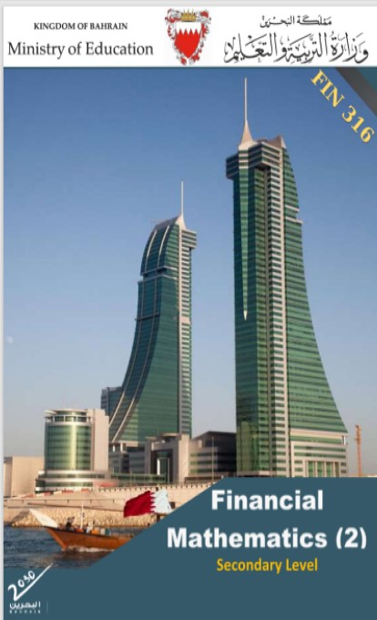
Commercial Subjects Group Level 3
Subject | Financial Mathematics 2 – (Fin 316/806)
Chapter | Unit 1
Title | Compound Interest – part 1
Second Semester
المرحلة الثانوية - المستوى الثالث (توحيد ) – الثالث (فني ومهني)
وزارة التربية والتعليم –العام الدراسي 2023-2024م

Slide 2
Learning Objectives
At this unit, our students will learn:
The difference between SI & CI (using simple interest equation).
The calculation of compound interest.
The calculation of future and present value.
The difference between nominal and partial interest rates.
INITIATION ACTIVITY
OBJECTIVE 1
OBJECTIVE 2
FINAL EVALUATION
FIN 316/806 UNIT 1 Compound interest
وزارة التربية والتعليم –العام الدراسي 2023-2024م

Slide 3
INATIATION ACTIVITY
Compare between long term and short-term loan.
The tenure of short-term loans, generally, is up to 24 months or less. Term loans that have a loan tenure of more than 24 months are classified as long-term loans. When it comes to personal loan, the tenure of long-term loans can extend for up to 60 months. Due to the short tenure, the interest rate tends to be higher.
INITIATION ACTIVITY
OBJECTIVE 1
OBJECTIVE 2
OBJECTIVE 3
FINAL EVALUATION
FIN 316/806 UNIT 1 Compound interest
وزارة التربية والتعليم –العام الدراسي 2023-2024م

Slide 4
The difference between SI & CI (using simple interest equation).
Interest is the cost of borrowing money, where the borrower pays a fee to the lender for the loan. The interest, typically expressed as a percentage, can be either simple or compounded. Simple interest is based on the principal amount of a loan or deposit. In contrast, compound interest is based on the principal amount and the interest that accumulates on it in every period. Simple interest is calculated only on the principal amount of a loan or deposit, so it is easier to determine than compound interest.
Simple Interest is the cost of borrowing. It is the interest only on the principal amount as a percentage of the principal amount. Borrowers will benefit simple interest by paying interest only when loans approved. In other words, it is the paid interest only loans approved. Simple Interest is the amount that one pays to the borrower for using the borrowed money for a fixed period.
INITIATION ACTIVITY
OBJECTIVE 1
OBJECTIVE 2
OBJECTIVE 3
FINAL EVALUATION
FIN 316/806 UNIT 1 Compound interest
وزارة التربية والتعليم –العام الدراسي 2023-2024م

Slide 5
The calculation of future and present value.
Future Value = Present Vale x (1 + interest rate) ^{Number of periods}
FV = PV × (1+ i) ^{n}
Where, FV = the future value of the investment at the end of n years.
PV = the present value, or original amount invested at the beginning of the first year.
i = the annual interest (or discount) rate.
n = the number of years during which the compounding occurs.
Compound Interest = Future Value - Present Vale
CI = FV – PV
OR
Compound Interest = Present Vale x [(1 + interest rate) ^{Number of periods} - 1 ]
CI = PV × [(1+ i) ^{n} -1]
Calculate Future Value & Interest
INITIATION ACTIVITY
OBJECTIVE 1
OBJECTIVE 2
OBJECTIVE 3
FINAL EVALUATION
FIN 316/806 UNIT 1 Compound interest
وزارة التربية والتعليم –العام الدراسي 2023-2024م

Slide 6
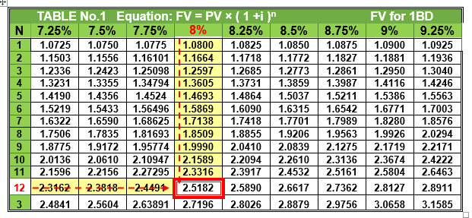
The calculation of future and present value.
Example 1-2-1 : A trader borrowed BD3000 from a bank for 12 years at 8% annually.
Find the future value and compound interest at the end of the period
Answer:
Future Value:
FV = PV × (1+ i) ^{n}
= 3000 × (1+ 8%)¹²
= 3000 × 2.5182= BD 7554.600
Using FV table for 1BD to find value of (1+8%)¹²
(by searching under I = 8% and n = 12 periods)
INITIATION ACTIVITY
OBJECTIVE 1
OBJECTIVE 2
OBJECTIVE 3
FINAL EVALUATION
FIN 316/806 UNIT 1 Compound interest
وزارة التربية والتعليم –العام الدراسي 2023-2024م

Slide 7
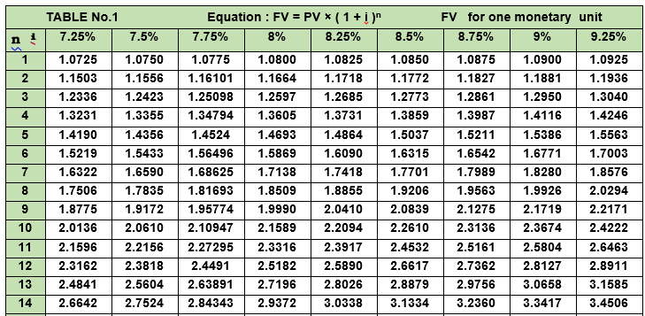
The calculation of future and present value.
Answer:
Compound Interest:
CI = FV - PV
= 7554.600 - 3000
= BD 4554.600
CI = PV × [(1+i )^{n} – 1]
= 3000 x [(1+ 8%)¹² _ 1]
= 3000 x ( 2.5182 –1)
= 3000 x 1.5182
= BD 4554.600
INITIATION ACTIVITY
OBJECTIVE 1
OBJECTIVE 2
OBJECTIVE 3
FINAL EVALUATION
FIN 316/806 UNIT 1 Compound interest
وزارة التربية والتعليم –العام الدراسي 2022-2023م

Slide 8
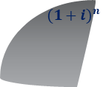
The difference between nominal and partial interest rates.
Shahd invested BD1000 in a bank at 6% annually for 4 years – find the future value if the interest is compounded annually.
Answer:
Example 1-3-1 :
INITIATION ACTIVITY
OBJECTIVE 1
The number of times | Once(1) a year n= 1 x 4 years = 4 periods
months | Jan 1 | Feb 2 | Mar 3 | Apr 4 | May 5 | Jun 6 | Jul 7 | Aug 8 | Sep 9 | Oct 10 | Nov 11 | Dec 12
Rate | i = 6%÷ 1 = 6%
OBJECTIVE 2
OBJECTIVE 3
$${(1+i)}^{n}$$
FV
FV = PV× (1+ i )^{n}
= 1000 × (1+6%)⁴
= 1000 × 1.2625 = BD1262.500
FINAL EVALUATION
PV
FIN 316/806 UNIT 1 Compound interest
وزارة التربية والتعليم –العام الدراسي 2023-2024م

Slide 9
The difference between nominal and partial interest rates.
Shahd invested BD1000 in a bank at 6% annually for 4 years . find the future value if the interest is compounded semi-annually.
Answer:
Example 1-3-2 :
INITIATION ACTIVITY
OBJECTIVE 1
The number of times | Twice (2) a year n= 2 x 4 years = 8 periods i = 6%÷ 2= 3%
months | Jan 1 | Feb 2 | Mar 3 | Apr 4 | May 5 | Jun 6 | Jul 7 | Aug 8 | Sep 9 | Oct 10 | Nov 11 | Dec 12
Rate | 3% |  |  |  |  |  | 3%
OBJECTIVE 2
OBJECTIVE 3
$${(1+i)}^{n}$$
FV
FV = PV× (1+ i )^{n}
= 1000 × (1+3%)⁸
= 1000 × 1.2668 = BD1266.800
FINAL EVALUATION
PV
FIN 316/806 UNIT 1 Compound interest
وزارة التربية والتعليم –العام الدراسي 2022-2023م

Slide 10
The difference between nominal and partial interest rates.
Shahd invested BD1000 in a bank at 6% annually for 4 years . find the future value if the interest is compounded semi-annually.
Answer:
Example 1-3-2 :
INITIATION ACTIVITY
OBJECTIVE 1
The number of times | Twice (2) a year n= 2 x 4 years = 8 periods i = 6%÷ 2= 3%
months | Jan 1 | Feb 2 | Mar 3 | Apr 4 | May 5 | Jun 6 | Jul 7 | Aug 8 | Sep 9 | Oct 10 | Nov 11 | Dec 12
Rate | 3% |  |  |  |  |  | 3%
OBJECTIVE 2
OBJECTIVE 3
$${(1+i)}^{n}$$
FV
FV = PV× (1+ i )^{n}
= 1000 × (1+3%)⁸
= 1000 × 1.2668 = BD1266.800
FINAL EVALUATION
PV
FIN 316/806 UNIT 1 Compound interest
وزارة التربية والتعليم –العام الدراسي 2023-2024م

Slide 11
The difference between nominal and partial interest rates.
Shahd invested BD1000 in a bank at 6% annually for 4 years . find the future value if the interest is compounded quarterly.
Answer:
Example 1-3-2 :
INITIATION ACTIVITY
OBJECTIVE 1
The number of times | Four times (4) a year or every three months n= 4 x 4 years = 16 periods i = 6%÷ 4= 1.5%
months | Jan 1 | Feb 2 | Mar 3 | Apr 4 | May 5 | Jun 6 | Jul 7 | Aug 8 | Sep 9 | Oct 10 | Nov 11 | Dec 12
Rate | 1.5% |  |  | 1.5% |  |  | 1.5% |  |  | 1.5%
OBJECTIVE 2
OBJECTIVE 3
$${(1+i)}^{n}$$
FV
FV = PV× (1+ i )^{n}
= 1000 × (1+1.5%)¹⁶
= 1000 × 1.2690 = BD1269
FINAL EVALUATION
PV
FIN 316/806 UNIT 1 Compound interest
وزارة التربية والتعليم –العام الدراسي 2023-2024م

Slide 12
The difference between nominal and partial interest rates.
Shahd invested BD1000 in a bank at 6% annually for 4 years . find the future value if the interest is compounded monthly.
Answer:
Example 1-3-2 :
INITIATION ACTIVITY
OBJECTIVE 1
The number of times | Twelve times (12) a year or every month n= 12 x 4 years = 48 periods i = 6%÷ 12= 0.5%
months | Jan 1 | Feb 2 | Mar 3 | Apr 4 | May 5 | Jun 6 | Jul 7 | Aug 8 |  | Sep 9 | Oct 10 | Nov 11 | Dec 12
Rate | ½% | ½% | ½% | ½% | ½% | ½% | ½% |  | ½% | ½% | ½% | ½% | ½%
OBJECTIVE 2
OBJECTIVE 3
$${(1+i)}^{n}$$
FV
FV = PV× (1+ i )^{n}
= 1000 × (1+0.5%)⁴⁸
= 1000 × 1.2705 = BD1270.500
FINAL EVALUATION
PV
FIN 316/806 UNIT 1 Compound interest
وزارة التربية والتعليم –العام الدراسي 2023-2024م

Slide 13
Evaluation
Mariam deposited BD2550 in a bank at an effective rate of 6% annually. If the interest is compounded semi-annually. Calculate her fund at the end of 8 years, and then find the compound interest.
Answer:
i = 6% ÷ 2 = 3% semi-annually
n = 8 × 2 = 16 times
Activity 1-3-1 :
INITIATION ACTIVITY
OBJECTIVE 1
OBJECTIVE 2
FV = PV× (1+ i )^{n}
= 2550 × (1+3%)¹⁶
= 2550× 1.6047 = BD4091.985
CI = FV – PV
= 4091.985 -2550 = BD1541.985
OBJECTIVE 3
$${(1+i)}^{n}$$
FV
FINAL EVALUATION
PV
FIN 316/806 UNIT 1 Compound interest
وزارة التربية والتعليم –العام الدراسي 2023-2024م

Slide 14
Evaluation
3- Sakeena Ahmed deposited BD2600 in a bank at 12% annually compounded quarterly. Find her fund at the end of 5 years and 9 months and find the compound interest.
Answer:
i = 12% ÷ 4 = 3% quarterly
n = (5.75) × 4 = 23 times
Activity 1-3-1 :
INITIATION ACTIVITY
OBJECTIVE 1
OBJECTIVE 2
FV = PV× (1+ i )^{n}
= 2600 × (1+3%)²³
= 2600× 1.9736 = BD5131.360
CI = FV – PV
= 5131.360 – 2600 = BD2531.360
OBJECTIVE 3
$${(1+i)}^{n}$$
FV
FINAL EVALUATION
PV
FIN 316/806 UNIT 1 Compound interest
وزارة التربية والتعليم –العام الدراسي 2023-2024م

Slide 15
END OF LESSON
Thanks
FIN 316/806 UNIT 1 Compound interest
وزارة التربية والتعليم –العام الدراسي 2023-2024م

