Slide 1
Communication Skills ادر 213
Chapter 3
Telephone Communication
SECOND SEMESTER
Pages 69-76
للصف الثاني ثانوي / تجاري

Slide 2
Chapter 3
Oral
Communication
Communication Skills ادر 213 Chapter 3 Lesson 3.3: Telephone Communication
وزارة التربية والتعليم –الفصل الدراسي الثاني 2020-2021م

Slide 3
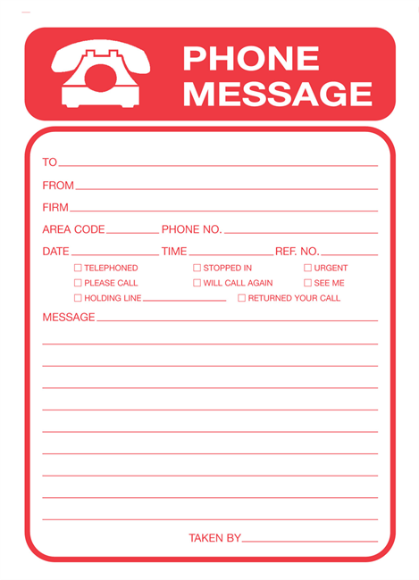
3.3
Telephone Communication
The importance of telephone
When to call
Telephone etiquette
Taking a message
Communication Skills ادر 213 Chapter 3 Lesson 3.3: Telephone Communication
وزارة التربية والتعليم –الفصل الدراسي الثاني 2020-2021م

Slide 4
Learning Objectives
By the end of this lesson, the student should be able to:
recognize the importance of the telephone in business.
clarify when to call.
describe the proper techniques for receiving and relaying messages by telephone.
describe how to take a complete telephone message.
Engaging Starters
The First Goal
The Second Goal
The Third Goal
The Fourth Goal
Questions
Communication Skills ادر 213 Chapter 3 Lesson 3.3: Telephone Communication
وزارة التربية والتعليم –الفصل الدراسي الثاني 2020-2021م

Slide 5
Engaging Starters
Amal is a telephonist. It was a very busy day. She must write a report, answer the phone while her manager is in the meeting and file the documents. She received 10 calls with different messages for her manager, some calls were urgent. One phone call conversation was the following:
Amal: “Hello, yes? We are very busy, call later. Bye”.
Her boss Mr. Rashid came to her after the meeting and asked her if there were any telephone messages. She remembers only 4 messages.
What is Amal’s job?
What are the mistakes that Amal did?
What suggestions would you give to Amal to overcome her mistakes?
Engaging Starters
The First Goal
The Second Goal
The Third Goal
The Fourth Goal
Questions
Communication Skills ادر 213 Chapter 3 Lesson 3.3: Telephone Communication
وزارة التربية والتعليم –الفصل الدراسي الثاني 2020-2021م

Slide 6
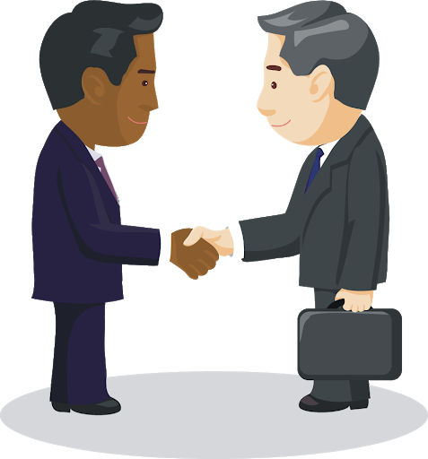
The Importance of Telephone
The fixed telephone (or landline), mobile telephone and also tablets and computers are vital pieces of equipment in modern businesses. They allow managers and employees within an organization to talk to each other, to their customers, to suppliers and to other organizations, almost anywhere in the world and at any time of the day. The cost of equipment and calls can be expensive but they save on time and money when compared to other forms of communication.
Engaging Starters
The First Goal
The Second Goal
The Third Goal
The Fourth Goal
Questions
Next
Communication Skills ادر 213 Chapter 3 Lesson 3.3: Telephone Communication
وزارة التربية والتعليم –الفصل الدراسي الثاني 2020-2021م

Slide 7
Evaluation Activity
Engaging Starters
Activity
The First Goal
Answer Activity (3.3.1) page 71 in the Textbook.
The Second Goal
Type of activity
In Groups – Oral
The Third Goal
The Fourth Goal
Time
3 minutes
Questions
Communication Skills ادر 213 Chapter 3 Lesson 3.3: Telephone Communication
وزارة التربية والتعليم –الفصل الدراسي الثاني 2020-2021م

Slide 8
When to Call
Engaging Starters
Suitable | Unsuitable
Speed is important. | The subject is highly confidential.
You need to discuss something with someone and cannot do so in person. | Full written record of an exchange is needed.
To discuss documents in details but holding a meeting is impossible. | The subject is complicated and needs to be considered carefully and at some length by the other person.
The First Goal
The Second Goal
The Third Goal
The Fourth Goal
Questions
Next
Communication Skills ادر 213 Chapter 3 Lesson 3.3: Telephone Communication
وزارة التربية والتعليم –الفصل الدراسي الثاني 2020-2021م
Visual communication is the conveyance of ideas and information in forms that can be read or looked upon.

Slide 9
When to Call
Some situations demand a combination of a telephone call and a letter. The most usual practice is to send a letter of confirmation following the call, to provide a record of what has been said or agreed on.
Engaging Starters
The First Goal
The Second Goal
The Third Goal
The Fourth Goal
Questions
Next
Communication Skills ادر 213 Chapter 3 Lesson 3.3: Telephone Communication
وزارة التربية والتعليم –الفصل الدراسي الثاني 2020-2021م
Visual communication is the conveyance of ideas and information in forms that can be read or looked upon.

Slide 10
Evaluation Activity
Engaging Starters
Activity
The First Goal
Answer Activity (3.3.2) page 71 in the Textbook
The Second Goal
Type of activity
In Group - written
The Third Goal
The Fourth Goal
Time
3 minutes
Questions
Communication Skills ادر 213 Chapter 3 Lesson 3.3: Telephone Communication
وزارة التربية والتعليم –الفصل الدراسي الثاني 2020-2021م

Slide 11
Telephone Etiquette
Telephone etiquette relates to the correct way to answer the telephone in a business environment. The main points to note are given in the table below:
Engaging Starters
Receiving a call | Making a Call
Answer promptly with your organization's standard greeting, and identify yourself or your department. | Check you know the reason for making the call.
Sound pleasant and cheerful and listen carefully. | Write down the information you must give or find out.
Have a pen and notepad to hand. | Introduce yourself and explain why you are calling.
The First Goal
The Second Goal
The Third Goal
The Fourth Goal
Questions
Next
Communication Skills ادر 213 Chapter 3 Lesson 3.3: Telephone Communication
وزارة التربية والتعليم –الفصل الدراسي الثاني 2020-2021م

Slide 12
Telephone Etiquette
Receiving a call | Making a Call
Write down the name of the caller, the person they want to speak to and the reason for their call. | Do not use slang or jargon such as 'OK' or 'Bye'.
If you cannot help, pass the call to a colleague or take a message. | Do not gabble. Ask the other person to slow down if they speak too quickly.
Ask the caller to spell their name if it is unusual. | Ask people to spell unusual words.
Check you have the caller's number before you ring off. | Say figures in pairs as they are easier to understand, for example, 12-78-97, not 127-897.
Say 'Thank you for calling' at the end of the call. | If you mishear something, never say 'What?' Say 'Sorry, could you please repeat that?'.
Pass any message on promptly. | Write down the information you receive.
Engaging Starters
The First Goal
The Second Goal
The Third Goal
The Fourth Goal
Questions
Next
Communication Skills ادر 213 Chapter 3 Lesson 3.3: Telephone Communication
وزارة التربية والتعليم –الفصل الدراسي الثاني 2020-2021م

Slide 13
Telephone Etiquette
If a wrong number is dialed, do not cut off the call. Apologize for your mistake and then end the phone call.
When making a call say:
May I speak to Mr. "Talal Khaled", please?
Do not say: "Is Mr. Talal Khaled in?“
When dialing a wrong number, apologize for the mistake by saying:
"Sorry, I must have dialled the wrong number."
Engaging Starters
The First Goal
The Second Goal
The Third Goal
The Fourth Goal
Questions
Next
Communication Skills ادر 213 Chapter 3 Lesson 3.3: Telephone Communication
وزارة التربية والتعليم –الفصل الدراسي الثاني 2020-2021م

Slide 14
Telephone Etiquette
Proper telephone etiquettes in a professional business setting begins by stating the company’s name first followed by a greeting and the name of the individual answering the call. The caller should know that he/she has dialed the correct number.
Example: "ABC Company, Good Morning, this is Sara".
A telephone etiquette dictates that the person who calls is the one who should end the conversation.
A good technique for ending the call is by saying:
"Thank you for calling ….. Company / Office"
OR "Thank you for calling or Goodbye" not "bye bye".
Engaging Starters
The First Goal
The Second Goal
The Third Goal
The Fourth Goal
Questions
Next
Communication Skills ادر 213 Chapter 3 Lesson 3.3: Telephone Communication
وزارة التربية والتعليم –الفصل الدراسي الثاني 2020-2021م

Slide 15
Evaluation Activity
Engaging Starters
Activity
The First Goal
Answer Activity (3.3.3) page 74 in the Textbook
The Second Goal
Type of activity
In Group - Oral
The Third Goal
The Fourth Goal
Time
5 minutes
Questions
Communication Skills ادر 213 Chapter 3 Lesson 3.3: Telephone Communication
وزارة التربية والتعليم –الفصل الدراسي الثاني 2020-2021م

Slide 16
Taking Messages
Name of the person who received the call.
Do not leave telephone messages to memory. It is not possible for anyone to remember all the details from all the callers.
The message sheets used in offices has the following details of the caller:
Caller’s name (get the correct spelling), company/department and number.
Name of person for whom the message was left.
Date and time.
Action to be taken (i.e., “Please Call,” “Will call back,” or “URGENT”).
Message in short.
Name of the person who received the call.
Engaging Starters
The First Goal
The Second Goal
The Third Goal
The Fourth Goal
Questions
Next
Communication Skills ادر 213 Chapter 3 Lesson 3.3: Telephone Communication
وزارة التربية والتعليم –الفصل الدراسي الثاني 2020-2021م

Slide 17
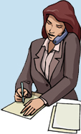
Taking Messages
A significant proportion of business calls involves the leaving and receiving of messages. Many times problems arise with this seemingly simple process. These problems include:
the message is not delivered to the appropriate person,
the message is incomplete or incorrect,
the message is delivered too late,
the message is misplaced,
the message is confusing.
Engaging Starters
The First Goal
The Second Goal
The Third Goal
The Fourth Goal
Questions
Next
Communication Skills ادر 213 Chapter 3 Lesson 3.3: Telephone Communication
وزارة التربية والتعليم –الفصل الدراسي الثاني 2020-2021م

Slide 18
Taking Messages
Engaging Starters
The First Goal
The Second Goal
The Third Goal
The Fourth Goal
Questions
Next
Communication Skills ادر 213 Chapter 3 Lesson 3.3: Telephone Communication
وزارة التربية والتعليم –الفصل الدراسي الثاني 2020-2021م

Slide 19
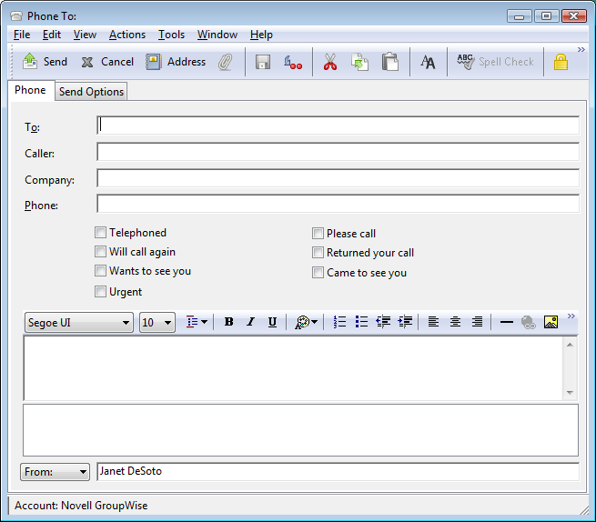
Telephone Messages Templates
Since most of the offices are connected to e-mails here is a sample of an e-mail message sheet template shown in Figure. The telephone operator or secretary can fill the sheet on the computer and send it to the person required using his/her e-mail address. It is very similar to paper sheets used by offices.
Engaging Starters
The First Goal
The Second Goal
The Third Goal
The Fourth Goal
Questions
Next
Communication Skills ادر 213 Chapter 3 Lesson 3.3: Telephone Communication
وزارة التربية والتعليم –الفصل الدراسي الثاني 2020-2021م

Slide 20
Evaluation Activity
Engaging Starters
Activity
The First Goal
Answer Activity (3.3.4) page 75 in the Textbook
The Second Goal
Type of activity
In Group - Oral
The Third Goal
The Fourth Goal
Time
5 minutes
Questions
Communication Skills ادر 213 Chapter 3 Lesson 3.3: Telephone Communication
وزارة التربية والتعليم –الفصل الدراسي الثاني 2020-2021م

Slide 21
Questions
?
1. You can use the phone when the subject is highly confidential.
Engaging Starters
The First Goal
The Second Goal
True
False
The Third Goal
The Fourth Goal
Questions
Communication Skills ادر 213 Chapter 3 Lesson 3.3: Telephone Communication
وزارة التربية والتعليم –الفصل الدراسي الثاني 2020-2021م

Slide 22
Questions
?
2. Telephone etiquette dictates that the person who calls is the one who should end the conversation.
Engaging Starters
The First Goal
The Second Goal
True
False
The Third Goal
The Fourth Goal
Questions
Communication Skills ادر 213 Chapter 3 Lesson 3.3: Telephone Communication
وزارة التربية والتعليم –الفصل الدراسي الثاني 2020-2021م

Slide 23
Questions
?
3. The telephonist job is to answer all the telephone calls and transfer them to extensions requested by the callers.
Engaging Starters
The First Goal
The Second Goal
True
False
The Third Goal
The Fourth Goal
Questions
Communication Skills ادر 213 Chapter 3 Lesson 3.3: Telephone Communication
وزارة التربية والتعليم –الفصل الدراسي الثاني 2020-2021م

Slide 24
Questions
?
4. A good technique for closing the call is to say 'bye bye'.
Engaging Starters
The First Goal
The Second Goal
True
False
The Third Goal
The Fourth Goal
Questions
Communication Skills ادر 213 Chapter 3 Lesson 3.3: Telephone Communication
وزارة التربية والتعليم –الفصل الدراسي الثاني 2020-2021م

Slide 25
Questions
?
5. As a secretary, you should keep your manager's telephone message in:
Engaging Starters
The First Goal
a. memory
b. phone message sheet.
The Second Goal
The Third Goal
c. notice board.
d. minutes.
The Fourth Goal
Questions
Communication Skills ادر 213 Chapter 3 Lesson 3.3: Telephone Communication
وزارة التربية والتعليم –الفصل الدراسي الثاني 2020-2021م

Slide 26
Questions
?
6. Fill a telephone message sheet using the following information:
Before her manager (Mr. Rashid Yousif) arrived to the office, the secretary (Ms. Fatima Omar) received today (at 8:15 a.m.) a call from Mr. Fahad Ebrahim (from Andalus Co., Tel. no. 14445888). He wanted to inform the manager that he had received (yesterday evening) the goods sent to his showroom (German Lights) in a good condition.
Engaging Starters
The First Goal
The Second Goal
The Third Goal
The Fourth Goal
Questions
Next
Communication Skills ادر 213 Chapter 3 Lesson 3.3: Telephone Communication
وزارة التربية والتعليم –الفصل الدراسي الثاني 2020-2021م

Slide 27
Questions
?
Engaging Starters
The First Goal
The Second Goal
The Third Goal
The Fourth Goal
Questions
Back
Check your answer
Communication Skills ادر 213 Chapter 3 Lesson 3.3: Telephone Communication
وزارة التربية والتعليم –الفصل الدراسي الثاني 2020-2021م

Slide 28
Questions
Engaging Starters
The First Goal
The Second Goal
Additional Activity
The Third Goal
To go over workbook pages 62-70
The Fourth Goal
Questions
Communication Skills ادر 213 Chapter 3 Lesson 3.3: Telephone Communication
وزارة التربية والتعليم –الفصل الدراسي الثاني 2020-2021م

Slide 29
End of the Lesson
Thank You!
Communication Skills ادر 213 Chapter 3 Lesson 3.3: Telephone Communication
وزارة التربية والتعليم –الفصل الدراسي الثاني 2020-2021م

Slide 30
Answer: You can not use the phone when the subject is highly confidential.
Next
Communication Skills ادر 213 Chapter 3 Lesson 3.3: Telephone Communication
وزارة التربية والتعليم –الفصل الدراسي الثاني 2020-2021م

Slide 31
Back
Communication Skills ادر 213 Chapter 3 Lesson 3.3: Telephone Communication
وزارة التربية والتعليم –الفصل الدراسي الثاني 2020-2021م

Slide 32
Next
Communication Skills ادر 213 Chapter 3 Lesson 3.3: Telephone Communication
وزارة التربية والتعليم –الفصل الدراسي الثاني 2020-2021م

Slide 33
Back
Communication Skills ادر 213 Chapter 3 Lesson 3.3: Telephone Communication
وزارة التربية والتعليم –الفصل الدراسي الثاني 2020-2021م

Slide 34
Next
Communication Skills ادر 213 Chapter 3 Lesson 3.3: Telephone Communication
وزارة التربية والتعليم –الفصل الدراسي الثاني 2020-2021م

Slide 35
Back
Communication Skills ادر 213 Chapter 3 Lesson 3.3: Telephone Communication
وزارة التربية والتعليم –الفصل الدراسي الثاني 2020-2021م

Slide 36
Answer: A good technique for closing the call is to say "Thank you for calling or Goodbye”.
Next
Communication Skills ادر 213 Chapter 3 Lesson 3.3: Telephone Communication
وزارة التربية والتعليم –الفصل الدراسي الثاني 2020-2021م

Slide 37
Back
Communication Skills ادر 213 Chapter 3 Lesson 3.3: Telephone Communication
وزارة التربية والتعليم –الفصل الدراسي الثاني 2020-2021م

Slide 38
Next
Communication Skills ادر 213 Chapter 3 Lesson 3.3: Telephone Communication
وزارة التربية والتعليم –الفصل الدراسي الثاني 2020-2021م

Slide 39
Back
Communication Skills ادر 213 Chapter 3 Lesson 3.3: Telephone Communication
وزارة التربية والتعليم –الفصل الدراسي الثاني 2020-2021م

Slide 40
Answer
6.
Mr. Rashid Yousif
today ‘s date
8:15 a.m.
Mr. Fahad Ebrahim
Andalus Co.
14445888
✓
He wanted to inform the manager
that he had received (yesterday evening) the goods sent to his showroom (German Lights) in a good condition.
Next
Fatima Omar
Communication Skills ادر 213 Chapter 3 Lesson 3.3: Telephone Communication
وزارة التربية والتعليم –الفصل الدراسي الثاني 2020-2021م

