Slide 1
Communication Skills ادر 213
Chapter 2
Other Type of Written
Communication
SECOND SEMESTER
Pages 45-55
للصف الثاني ثانوي / تجاري

Slide 2
Chapter 2
Written
Communication
Communication Skills ادر 213 Chapter 2 Lesson 2.3: Other Type of Written Communication
وزارة التربية والتعليم –الفصل الدراسي الثاني 2020-2021م

Slide 3
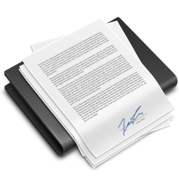
2.3
Other Type of Written
Communication
E-mail
Report
Forms
Job Description
Notice board
Communication Skills ادر 213 Chapter 2 Lesson 2.3: Other Type of Written Communication
وزارة التربية والتعليم –الفصل الدراسي الثاني 2020-2021م

Slide 4
Learning Objectives
By the end of this lesson, the student should be able to:
write an e-mail.
differentiate between formal and informal reports.
understand the use of forms in business.
use a job description.
discuses the uses of notice board.
Engaging Starters
The First Goal
The Second Goal
The Third Goal
The Fourth Goal
The Fifth Goal
Questions
Communication Skills ادر 213 Chapter 2 Lesson 2.3: Other Type of Written Communication
وزارة التربية والتعليم –الفصل الدراسي الثاني 2020-2021م

Slide 5
Engaging Starters
MBD is a successful insurance business. It has three branches with 200 employees across country A. The managing director wants to improve internal communication by introducing new technology into these branches. He says, "Customers complain about the slow service. memos never reach me; documents are everywhere and many part-time employees complain they don't know what is happening and what jobs they should do."
Define 'internal communication'.
Explain two possible reasons why MBD might want to improve communication.
Explain ways in which new technology can help improve communication at MBD.
How can MBD explain the job for part-time employees?
Engaging Starters
The First Goal
The Second Goal
The Third Goal
The Fourth Goal
The Fifth Goal
Questions
Communication Skills ادر 213 Chapter 2 Lesson 2.3: Other Type of Written Communication
وزارة التربية والتعليم –الفصل الدراسي الثاني 2020-2021م

Slide 6
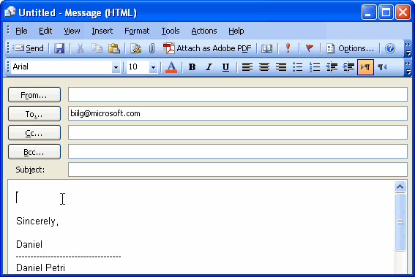
E-mail
Electronic mail (E-mail) is one of the most common methods of electronic communication. It allows businesses and individuals to communicate by sending texts or images instantly via Internet. E-mails can be used to send letters, memos, reports, photographs, videos, sounds, other images … etc., even when people are not there to receive them.
Engaging Starters
Click on "send when done"
Attachment(s)
The First Goal
The Second Goal
Senders' e-mail address.
Primary addressee(s) – all recipients can see list.
The Third Goal
Secondary addressee(s) – all recipients can see list.
Blind carbon copy – no recipients can see list.
A brief indication of the contents of the letter.
The Fourth Goal
The body of the e-mail
The Fifth Goal
Questions
Next
Communication Skills ادر 213 Chapter 2 Lesson 2.3: Other Type of Written Communication
وزارة التربية والتعليم –الفصل الدراسي الثاني 2020-2021م

Slide 7
Evaluation Activity
Engaging Starters
Activity
The First Goal
answer Activity (2.3.1) page 47 in the Textbook
The Second Goal
Type of activity
The Third Goal
Individual - written
The Fourth Goal
Time
The Fifth Goal
2 minutes
Questions
Communication Skills ادر 213 Chapter 2 Lesson 2.3: Other Type of Written Communication
وزارة التربية والتعليم –الفصل الدراسي الثاني 2020-2021م

Slide 8
Reports
Engaging Starters
The First Goal
A report is a document that is prepared to give the results of an investigation. There are two types of reports: Formal and informal.
The Second Goal
The Third Goal
The Fourth Goal
The Fifth Goal
Questions
Next
Communication Skills ادر 213 Chapter 2 Lesson 2.3: Other Type of Written Communication
وزارة التربية والتعليم –الفصل الدراسي الثاني 2020-2021م

Slide 9
Informal Report
The informal report, may be presented in a memo form under an appropriate subject heading, and with subheadings which are considered necessary as well.
Engaging Starters
The First Goal
The Second Goal
Parts of Informal Reports:
1. Introduction | Background details, a description of the current situation, and the reason for the report.
2. Findings | Information gathered on the subject.
3. Conclusion | Recommendations as to what action ought to be taken.
The Third Goal
The Fourth Goal
The Fifth Goal
Questions
Next
Communication Skills ادر 213 Chapter 2 Lesson 2.3: Other Type of Written Communication
وزارة التربية والتعليم –الفصل الدراسي الثاني 2020-2021م

Slide 10
Informal Report
Engaging Starters
The First Goal
The Second Goal
The Third Goal
The Fourth Goal
The Fifth Goal
Questions
Next
Communication Skills ادر 213 Chapter 2 Lesson 2.3: Other Type of Written Communication
وزارة التربية والتعليم –الفصل الدراسي الثاني 2020-2021م

Slide 11
Formal Report
A formal report is written in a professional and formal manner to address complex issues. Formal reports may be used to convey information, analyze an issue or a problem, and provide a recommended course of action.
Formal reports are usually written in the third person. They do not use the words 'I', 'We' and 'You'.
Engaging Starters
The First Goal
The Second Goal
The Third Goal
The Fourth Goal
The Fifth Goal
Questions
Next
Communication Skills ادر 213 Chapter 2 Lesson 2.3: Other Type of Written Communication
وزارة التربية والتعليم –الفصل الدراسي الثاني 2020-2021م

Slide 12
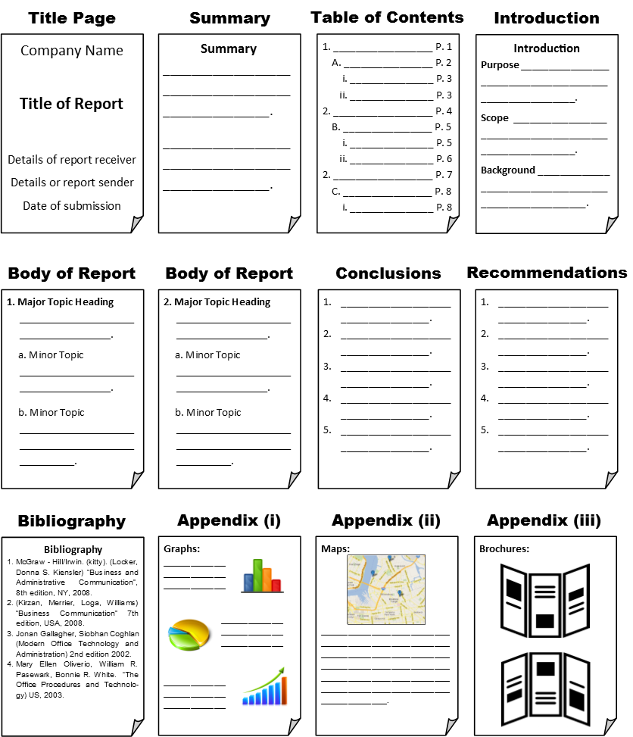
Formal Report
Engaging Starters
The First Goal
The Second Goal
The Third Goal
The Fourth Goal
The Fifth Goal
Questions
Next
Communication Skills ادر 213 Chapter 2 Lesson 2.3: Other Type of Written Communication
وزارة التربية والتعليم –الفصل الدراسي الثاني 2020-2021م

Slide 13
Evaluation Activity
Engaging Starters
Activity
The First Goal
answer Activity (2.3.2) page 50 in the Textbook
The Second Goal
Type of activity
The Third Goal
With Partner - written
The Fourth Goal
Time
The Fifth Goal
5 minutes
Questions
Communication Skills ادر 213 Chapter 2 Lesson 2.3: Other Type of Written Communication
وزارة التربية والتعليم –الفصل الدراسي الثاني 2020-2021م

Slide 14
Forms
Engaging Starters
The First Goal
Forms are used to collect specific and standard information, e.g. application form, invoice, order form, loan, license, and time sheet are all examples of different types of forms.
The Second Goal
The Third Goal
The Fourth Goal
The Fifth Goal
Questions
Next
Communication Skills ادر 213 Chapter 2 Lesson 2.3: Other Type of Written Communication
وزارة التربية والتعليم –الفصل الدراسي الثاني 2020-2021م

Slide 15
Evaluation Activity
Engaging Starters
Activity
The First Goal
answer Activity (2.3.3) page 53 in the Textbook
The Second Goal
Type of activity
The Third Goal
In Group - written
The Fourth Goal
Time
The Fifth Goal
5 minutes
Questions
Communication Skills ادر 213 Chapter 2 Lesson 2.3: Other Type of Written Communication
وزارة التربية والتعليم –الفصل الدراسي الثاني 2020-2021م

Slide 16
Job Description
A job description is a written document that provides all the details about what a job involves. A job description needs to include:
Job title - for example, Accounting Clerk.
The main duties of the job - for example, recording of financial transactions and the handling of financial information.
The department the job is in, such as the finance department or production department.
Responsibilities – what the job holder is responsible for supervising/managing.
Accountability - who the job holder reports to.
Working conditions, hours and wages or salary.
The name and location of the business organization.
Engaging Starters
The First Goal
The Second Goal
The Third Goal
The Fourth Goal
The Fifth Goal
Questions
Next
Communication Skills ادر 213 Chapter 2 Lesson 2.3: Other Type of Written Communication
وزارة التربية والتعليم –الفصل الدراسي الثاني 2020-2021م

Slide 17
Job Description
The main purpose of a job description is to show clearly what is expected of an employee.
Engaging Starters
The First Goal
The Second Goal
The Third Goal
The Fourth Goal
The Fifth Goal
Questions
Next
Communication Skills ادر 213 Chapter 2 Lesson 2.3: Other Type of Written Communication
وزارة التربية والتعليم –الفصل الدراسي الثاني 2020-2021م

Slide 18
Evaluation Activity
Engaging Starters
Activity
The First Goal
answer Activity (2.3.4) page 53 in the Textbook
The Second Goal
Type of activity
The Third Goal
With partner - written
The Fourth Goal
Time
The Fifth Goal
3 minutes
Questions
Communication Skills ادر 213 Chapter 2 Lesson 2.3: Other Type of Written Communication
وزارة التربية والتعليم –الفصل الدراسي الثاني 2020-2021م

Slide 19
Notice Board
A notice is normally used to display factual information which is open to anyone to read, such as health and safety regulations, training courses, or work celebrations and parties. Notices are normally displayed in prominent places.
Notices provide a cheap way of communicating the same information to a large number of people but they may not be read, or may be ignored.
Engaging Starters
IMPORTANT NOTICE
RECYCLING BINS FOR ALL CANS AND TINS
All staff please use the recycling bins provided for the disposal of cans and tins only.
The bins should not be used for general waste.
Should you have any queries on this or any other energy or environmental issues, please contact Talal Khaled (Extension 7448)
Facilities Management Team
The First Goal
The Second Goal
The Third Goal
The Fourth Goal
The Fifth Goal
Questions
Next
Communication Skills ادر 213 Chapter 2 Lesson 2.3: Other Type of Written Communication
وزارة التربية والتعليم –الفصل الدراسي الثاني 2020-2021م

Slide 20
Evaluation Activity
Engaging Starters
Activity
The First Goal
What is the purpose of using a notice board?
The Second Goal
Type of activity
The Third Goal
Individual - written
The Fourth Goal
Time
The Fifth Goal
2 minutes
Questions
Communication Skills ادر 213 Chapter 2 Lesson 2.3: Other Type of Written Communication
وزارة التربية والتعليم –الفصل الدراسي الثاني 2020-2021م

Slide 21
Questions
?
1. Fill the Email below from the information giving to you.
Engaging Starters
The First Goal
Sender | : | studyhere@hotmail.com <Ali Nasser>
Receiver | : | education@batelco.com.bh <Mona Jassim>
Copy to | : | education2002@batelco.com.bh <Salman Mohamed>
Subject | : | Communication Skill Book
Massage | : | I will send to you the students and teachers' opinions regarding communication skill book.
The Second Goal
The Third Goal
The Fourth Goal
The Fifth Goal
Questions
Next
Communication Skills ادر 213 Chapter 2 Lesson 2.3: Other Type of Written Communication
وزارة التربية والتعليم –الفصل الدراسي الثاني 2020-2021م

Slide 22
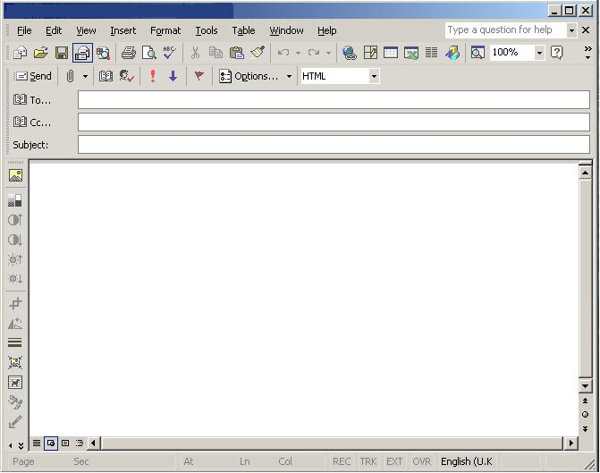
Questions
?
1. Fill the Email below from the information giving to you.
Engaging Starters
The First Goal
The Second Goal
The Third Goal
The Fourth Goal
The Fifth Goal
Questions
Back
Check your answer
Communication Skills ادر 213 Chapter 2 Lesson 2.3: Other Type of Written Communication
وزارة التربية والتعليم –الفصل الدراسي الثاني 2020-2021م

Slide 23
Questions
?
2. Fill the invoice No. BA2333 which is to be sent today to the XYZ Company, P.O. Box: 2873, Isa Town, Kingdom of Bahrain, against their order No. 2134, which was ordered two days before.
The company gives 6% trade discount in each invoice. The Sales Manager's name is Yousif Abdulla.
Engaging Starters
The First Goal
The Second Goal
Item No. | Quantity | Description Unit | Price
TOS 009 | 12 | Laptop Computer | BD 190.000
MA 234 | 22 | Computer Table | BD 40.000
CH 435 | 16 | Chair | BD 25.000
The Third Goal
The Fourth Goal
The Fifth Goal
Questions
Next
Communication Skills ادر 213 Chapter 2 Lesson 2.3: Other Type of Written Communication
وزارة التربية والتعليم –الفصل الدراسي الثاني 2020-2021م

Slide 24
Questions
?
2.
Engaging Starters
The First Goal
The Second Goal
The Third Goal
The Fourth Goal
The Fifth Goal
Questions
Back
Check your answer
Communication Skills ادر 213 Chapter 2 Lesson 2.3: Other Type of Written Communication
وزارة التربية والتعليم –الفصل الدراسي الثاني 2020-2021م

Slide 25
Questions
?
3. The format of a report is usually determined by the audience, information and purpose.
Engaging Starters
The First Goal
The Second Goal
The Third Goal
True
False
The Fourth Goal
The Fifth Goal
Questions
Communication Skills ادر 213 Chapter 2 Lesson 2.3: Other Type of Written Communication
وزارة التربية والتعليم –الفصل الدراسي الثاني 2020-2021م

Slide 26
Questions
?
4. The main purpose of a job description is to show clearly what is expected from an employer.
Engaging Starters
The First Goal
The Second Goal
The Third Goal
True
False
The Fourth Goal
The Fifth Goal
Questions
Communication Skills ادر 213 Chapter 2 Lesson 2.3: Other Type of Written Communication
وزارة التربية والتعليم –الفصل الدراسي الثاني 2020-2021م

Slide 27
Questions
?
5. Notices provide a cheap way of communicating the same information to a large number of people but they may not be read, or may be ignored.
Engaging Starters
The First Goal
The Second Goal
The Third Goal
True
False
The Fourth Goal
The Fifth Goal
Questions
Communication Skills ادر 213 Chapter 2 Lesson 2.3: Other Type of Written Communication
وزارة التربية والتعليم –الفصل الدراسي الثاني 2020-2021م

Slide 28
Questions
Engaging Starters
The First Goal
The Second Goal
Additional Activity
The Third Goal
To go over workbook pages 39-48
The Fourth Goal
The Fifth Goal
Questions
Communication Skills ادر 213 Chapter 2 Lesson 2.3: Other Type of Written Communication
وزارة التربية والتعليم –الفصل الدراسي الثاني 2020-2021م

Slide 29
End of the Lesson
Thank You!
Communication Skills ادر 213 Chapter 2 Lesson 2.3: Other Type of Written Communication
وزارة التربية والتعليم –الفصل الدراسي الثاني 2020-2021م

Slide 30
Answer
education@batelco.com.bh <Mona Jassim>
education2002@batelco.com.bh <Salman Mohamed>
Communication Skill Book
Dear Mrs. Mona:
I will send to you the students and teachers' opinions regarding communication skill book.
Your sincerely,
Ali Nasser
Next
Communication Skills ادر 213 Chapter 2 Lesson 2.3: Other Type of Written Communication
وزارة التربية والتعليم –الفصل الدراسي الثاني 2020-2021م

Slide 31
Answer
2.
XYZ Company
P.O. Box: 2873, Isa Town, Kingdom of Bahrain
Isa Town
2134
2/3/2021
No. BA2333
4/3/2021
TOS 009
Laptop Computer
12
190 000
2280 000
MA 234
Computer Table
22
40 000
880 000
CH 435
Chair
16
25 000
400 000
3560.000
Yousif Abdulla
Sales Manager
213.600
Next
3346.400
Communication Skills ادر 213 Chapter 2 Lesson 2.3: Other Type of Written Communication
وزارة التربية والتعليم –الفصل الدراسي الثاني 2020-2021م

Slide 32
Next
Communication Skills ادر 213 Chapter 2 Lesson 2.3: Other Type of Written Communication
وزارة التربية والتعليم –الفصل الدراسي الثاني 2020-2021م

Slide 33
Back
Communication Skills ادر 213 Chapter 2 Lesson 2.3: Other Type of Written Communication
وزارة التربية والتعليم –الفصل الدراسي الثاني 2020-2021م

Slide 34
Answer: The main purpose of a job description is to show clearly what is expected from an employee.
Next
Communication Skills ادر 213 Chapter 2 Lesson 2.3: Other Type of Written Communication
وزارة التربية والتعليم –الفصل الدراسي الثاني 2020-2021م

Slide 35
Back
Communication Skills ادر 213 Chapter 2 Lesson 2.3: Other Type of Written Communication
وزارة التربية والتعليم –الفصل الدراسي الثاني 2020-2021م

Slide 36
Next
Communication Skills ادر 213 Chapter 2 Lesson 2.3: Other Type of Written Communication
وزارة التربية والتعليم –الفصل الدراسي الثاني 2020-2021م

Slide 37
Back
Communication Skills ادر 213 Chapter 2 Lesson 2.3: Other Type of Written Communication
وزارة التربية والتعليم –الفصل الدراسي الثاني 2020-2021م

