Slide 1
Communication Skills ادر 213
Chapter 1
Organizational Communication
SECOND SEMESTER
Pages 26-31
للصف الثاني ثانوي / تجاري

Slide 2
Chapter 1
Communication
in Business
Communication Skills ادر 213 Chapter 1 Lesson 1.3: Organizational Communication
وزارة التربية والتعليم –الفصل الدراسي الثاني 2020-2021م

Slide 3
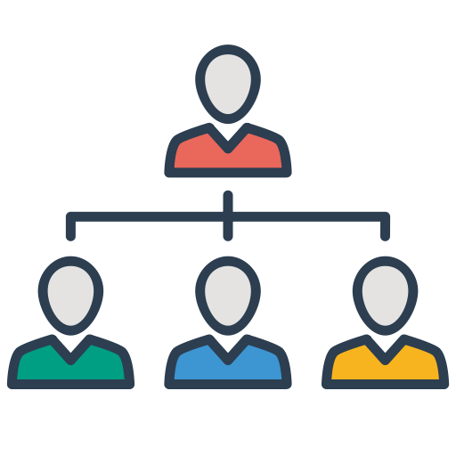
1.3
Organizational Communication
Organizational communication.
Internal and external communication.
Formal and informal communication.
The direction of formal communications.
Communication Skills ادر 213 Chapter 1 Lesson 1.3: Organizational Communication
وزارة التربية والتعليم –الفصل الدراسي الثاني 2020-2021م

Slide 4
Learning Objectives
By the end of this lesson, the student should be able to:
explain what an organizational communication means.
differentiate between internal and external communication.
categorize the formal and informal communication in an organization.
compare between the different types of formal communication.
Engaging Starters
The First Goal
The Second Goal
The Third Goal
The Fourth Goal
Questions
Communication Skills ادر 213 Chapter 1 Lesson 1.3: Organizational Communication
وزارة التربية والتعليم –الفصل الدراسي الثاني 2020-2021م

Slide 5
Engaging Starters
An organization is a composite of many individuals working together towards its growth. They are constantly interacting with each other and with people outside the organization.
In groups, draw the organization chart of your school. Use your chart to decide who are the people inside your school that communicate with each other?
Does your school communicate with people from the outside? If yes, mention them.
Engaging Starters
The First Goal
The Second Goal
The Third Goal
The Fourth Goal
Questions
Communication Skills ادر 213 Chapter 1 Lesson 1.3: Organizational Communication
وزارة التربية والتعليم –الفصل الدراسي الثاني 2020-2021م

Slide 6
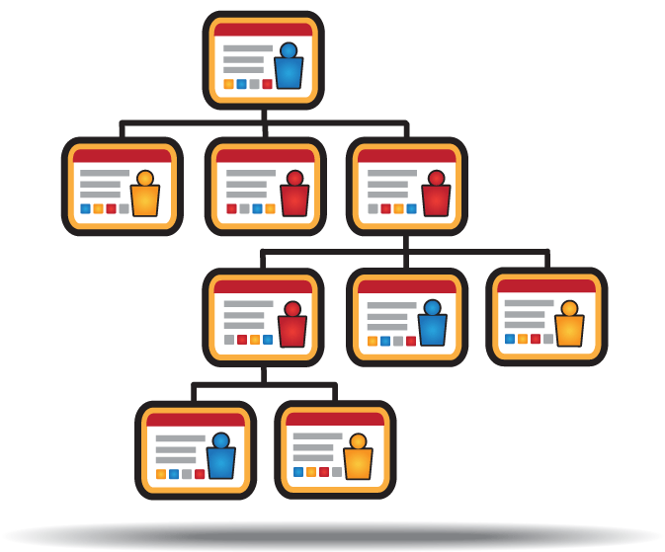
Organizational Communication
Organizational Communication: A system of pathways through which messages flow among people who comprise the organization. (who communicates with whom?).
Engaging Starters
The First Goal
Without organizational communication, it would be extremely difficult to know what an organization stands for, why it exists, who its customers are, how work is completed, who has authority over others and so on.
The Second Goal
The Third Goal
The Fourth Goal
Questions
Next
Communication Skills ادر 213 Chapter 1 Lesson 1.3: Organizational Communication
وزارة التربية والتعليم –الفصل الدراسي الثاني 2020-2021م

Slide 7
Organizational Communication
Types of organizational communication:
Engaging Starters
Upward
The First Goal
Formal
Communication
Downward
The Second Goal
Internal
Communication
Horizontal
Organizational
Communication
The Third Goal
Informal
Communication
External
Communication
The Fourth Goal
Questions
Next
Communication Skills ادر 213 Chapter 1 Lesson 1.3: Organizational Communication
وزارة التربية والتعليم –الفصل الدراسي الثاني 2020-2021م

Slide 8
Evaluation Activity
Engaging Starters
Activity
The First Goal
Define Organizational Communication.
The Second Goal
Type of activity
Individual - written
The Third Goal
The Fourth Goal
Time
2 minutes
Questions
Communication Skills ادر 213 Chapter 1 Lesson 1.3: Organizational Communication
وزارة التربية والتعليم –الفصل الدراسي الثاني 2020-2021م

Slide 9
Internal and External Communication
There are two types of communication businesses are concerned with: internal and external.
Engaging Starters
The First Goal
The Second Goal
The Third Goal
The Fourth Goal
Questions
Next
Communication Skills ادر 213 Chapter 1 Lesson 1.3: Organizational Communication
وزارة التربية والتعليم –الفصل الدراسي الثاني 2020-2021م
Visual communication is the conveyance of ideas and information in forms that can be read or looked upon.

Slide 10
Internal and External Communication
Internal communication:
Internal communication is when messages are sent between people working in the same organization. Examples include:
A manager giving a verbal warning to a subordinate for poor punctuality.
A report sent from a sales manager to a purchase manager.
Engaging Starters
The First Goal
The Second Goal
The Third Goal
The Fourth Goal
Questions
Next
Communication Skills ادر 213 Chapter 1 Lesson 1.3: Organizational Communication
وزارة التربية والتعليم –الفصل الدراسي الثاني 2020-2021م
Visual communication is the conveyance of ideas and information in forms that can be read or looked upon.

Slide 11
Internal and External Communication
External communication:
External communication includes those communications between organizational members and external parties such as customers, manufacturers, shareholders, investors and the general public. Some of the main examples of external communication are:
Orders for goods from suppliers.
Sending information to customers about prices and delivery times.
Advertising goods or services.
Engaging Starters
The First Goal
The Second Goal
The Third Goal
The Fourth Goal
Questions
Next
Communication Skills ادر 213 Chapter 1 Lesson 1.3: Organizational Communication
وزارة التربية والتعليم –الفصل الدراسي الثاني 2020-2021م
Visual communication is the conveyance of ideas and information in forms that can be read or looked upon.

Slide 12
Evaluation Activity
Engaging Starters
Activity
The First Goal
answer Activity (1.3.1) page 28 in the Textbook
The Second Goal
Type of activity
Individual - written
The Third Goal
The Fourth Goal
Time
3 minutes
Questions
Communication Skills ادر 213 Chapter 1 Lesson 1.3: Organizational Communication
وزارة التربية والتعليم –الفصل الدراسي الثاني 2020-2021م

Slide 13
Formal and Informal Communication
Formal communication takes place when the official channel of communication is used within an organization. Examples of formal communication are letters, memos, faxes, official meetings and reports …etc.
Informal communication is the transition of information through non-official channels within the organization. Waiting to use the photocopier, a conversation during the break, or chatting at a social event are examples of an informal communication.
Engaging Starters
The First Goal
The Second Goal
The Third Goal
The Fourth Goal
Questions
Next
Communication Skills ادر 213 Chapter 1 Lesson 1.3: Organizational Communication
وزارة التربية والتعليم –الفصل الدراسي الثاني 2020-2021م

Slide 14
Evaluation Activity
Engaging Starters
Activity
The First Goal
Give example of formal and informal communication.
The Second Goal
Type of activity
Individual - written
The Third Goal
The Fourth Goal
Time
2 minutes
Questions
Communication Skills ادر 213 Chapter 1 Lesson 1.3: Organizational Communication
وزارة التربية والتعليم –الفصل الدراسي الثاني 2020-2021م

Slide 15
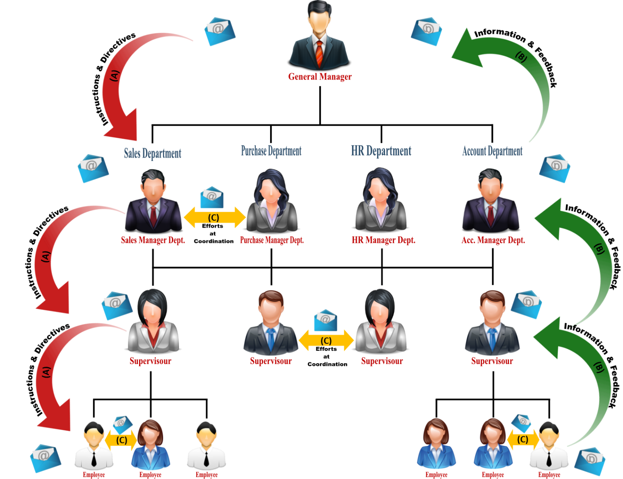
Direction of Formal Communications
Engaging Starters
The First Goal
The Second Goal
The Third Goal
The Fourth Goal
Questions
Next
Communication Skills ادر 213 Chapter 1 Lesson 1.3: Organizational Communication
وزارة التربية والتعليم –الفصل الدراسي الثاني 2020-2021م

Slide 16
Direction of Formal Communications
Arrow (A) shows Downward Communication. This is when messages are sent from managers to subordinates. Downward communication is important because:
subordinates look to their managers for leadership and guidance.
it allows the decisions made by management to be carried out by employees.
it allows managers to command, control and organize.
Engaging Starters
Sales Manager
The First Goal
Plans, policies, rules, producers, orders, instructions, etc.
The Second Goal
The Third Goal
The Fourth Goal
Employee
Questions
Next
Click here to see the diagram
Communication Skills ادر 213 Chapter 1 Lesson 1.3: Organizational Communication
وزارة التربية والتعليم –الفصل الدراسي الثاني 2020-2021م

Slide 17
Direction of Formal Communications
Arrow (B) shows Upward Communication. This is when a message or feedback is passed from subordinates to managers. Upward communication is helpful because it:
Engaging Starters
Sales Manager
The First Goal
helps managers to understand the views and needs of subordinates.
makes staff feel valued and appreciated.
provides managers with information to help them make decisions.
Suggestions, reports, proposals, etc.
The Second Goal
The Third Goal
The Fourth Goal
Employee
Questions
Next
Click here to see the diagram
Communication Skills ادر 213 Chapter 1 Lesson 1.3: Organizational Communication
وزارة التربية والتعليم –الفصل الدراسي الثاني 2020-2021م

Slide 18
Direction of Formal Communications
Arrow (C) shows Horizontal Communication (sometimes referred to as lateral communication). This occurs when people at the same level of an organization communicate with each other. Information and ideas can be exchanged at both formal and informal meetings.
Engaging Starters
The First Goal
The Second Goal
Exchange of information between two departmental heads or two or more managers of equal ranks.
The Third Goal
Production Manager
Marketing Manager
The Fourth Goal
Questions
Next
Click here to see the diagram
Communication Skills ادر 213 Chapter 1 Lesson 1.3: Organizational Communication
وزارة التربية والتعليم –الفصل الدراسي الثاني 2020-2021م

Slide 19
Evaluation Activity
Engaging Starters
Activity
The First Goal
answer Activity (1.3.2) page 31 in the Textbook
The Second Goal
Type of activity
With partner- written
The Third Goal
The Fourth Goal
Time
5 minutes
Questions
Communication Skills ادر 213 Chapter 1 Lesson 1.3: Organizational Communication
وزارة التربية والتعليم –الفصل الدراسي الثاني 2020-2021م

Slide 20
Questions
?
1. Downward communication is the transmitted information from employees to management.
Engaging Starters
The First Goal
The Second Goal
True
False
The Third Goal
The Fourth Goal
Questions
Communication Skills ادر 213 Chapter 1 Lesson 1.3: Organizational Communication
وزارة التربية والتعليم –الفصل الدراسي الثاني 2020-2021م

Slide 21
Questions
?
2. Informal communication is the transition of information through non-official channels within the organization.
Engaging Starters
The First Goal
The Second Goal
True
False
The Third Goal
The Fourth Goal
Questions
Communication Skills ادر 213 Chapter 1 Lesson 1.3: Organizational Communication
وزارة التربية والتعليم –الفصل الدراسي الثاني 2020-2021م

Slide 22
Questions
?
3. Occurs when information passed from top management to employees:
Engaging Starters
The First Goal
a. Downward Communication.
b. External Communication.
The Second Goal
The Third Goal
c. Verbal Communication.
d. Upward Communication.
The Fourth Goal
Questions
Communication Skills ادر 213 Chapter 1 Lesson 1.3: Organizational Communication
وزارة التربية والتعليم –الفصل الدراسي الثاني 2020-2021م

Slide 23
Questions
?
4. If you receive a company memo from your supervisor, what's the best description of this communication?
Engaging Starters
The First Goal
a. Informal Communication.
b. Downward Communication.
The Second Goal
The Third Goal
c. External Communication.
d. Upward Communication.
The Fourth Goal
Questions
Communication Skills ادر 213 Chapter 1 Lesson 1.3: Organizational Communication
وزارة التربية والتعليم –الفصل الدراسي الثاني 2020-2021م

Slide 24
Questions
?
5. You are the manager of the marketing department and you are having a meeting with the managers of the financial department and production department about budgeting for a special project. What type of internal communication is being used in this situation?
Engaging Starters
The First Goal
The Second Goal
The Third Goal
a. Informal Communication.
b. Downward Communication.
The Fourth Goal
c. Horizontal Communication.
d. Upward Communication.
Questions
Communication Skills ادر 213 Chapter 1 Lesson 1.3: Organizational Communication
وزارة التربية والتعليم –الفصل الدراسي الثاني 2020-2021م

Slide 25
Questions
Engaging Starters
The First Goal
The Second Goal
Additional Activity
The Third Goal
To go over workbook pages 17-22
The Fourth Goal
Questions
Communication Skills ادر 213 Chapter 1 Lesson 1.3: Organizational Communication
وزارة التربية والتعليم –الفصل الدراسي الثاني 2020-2021م

Slide 26
End of the Lesson
Thank You!
Communication Skills ادر 213 Chapter 1 Lesson 1.3: Organizational Communication
وزارة التربية والتعليم –الفصل الدراسي الثاني 2020-2021م

Slide 27
Answer: Downward communication is the transmitted information from management to employees .
Next
Communication Skills ادر 213 Chapter 1 Lesson 1.3: Organizational Communication
وزارة التربية والتعليم –الفصل الدراسي الثاني 2020-2021م

Slide 28
Back
Communication Skills ادر 213 Chapter 1 Lesson 1.3: Organizational Communication
وزارة التربية والتعليم –الفصل الدراسي الثاني 2020-2021م

Slide 29
Next
Communication Skills ادر 213 Chapter 1 Lesson 1.3: Organizational Communication
وزارة التربية والتعليم –الفصل الدراسي الثاني 2020-2021م

Slide 30
Back
Communication Skills ادر 213 Chapter 1 Lesson 1.3: Organizational Communication
وزارة التربية والتعليم –الفصل الدراسي الثاني 2020-2021م

Slide 31
Next
Communication Skills ادر 213 Chapter 1 Lesson 1.3: Organizational Communication
وزارة التربية والتعليم –الفصل الدراسي الثاني 2020-2021م

Slide 32
Back
Communication Skills ادر 213 Chapter 1 Lesson 1.3: Organizational Communication
وزارة التربية والتعليم –الفصل الدراسي الثاني 2020-2021م

Slide 33
Next
Communication Skills ادر 213 Chapter 1 Lesson 1.3: Organizational Communication
وزارة التربية والتعليم –الفصل الدراسي الثاني 2020-2021م

Slide 34
Back
Communication Skills ادر 213 Chapter 1 Lesson 1.3: Organizational Communication
وزارة التربية والتعليم –الفصل الدراسي الثاني 2020-2021م

Slide 35
Next
Communication Skills ادر 213 Chapter 1 Lesson 1.3: Organizational Communication
وزارة التربية والتعليم –الفصل الدراسي الثاني 2020-2021م

Slide 36
Back
Communication Skills ادر 213 Chapter 1 Lesson 1.3: Organizational Communication
وزارة التربية والتعليم –الفصل الدراسي الثاني 2020-2021م

