Slide 1
Communication Skills ادر 213
Chapter 1
Communication Channels
SECOND SEMESTER
Pages 19-25
للصف الثاني ثانوي / تجاري

Slide 2
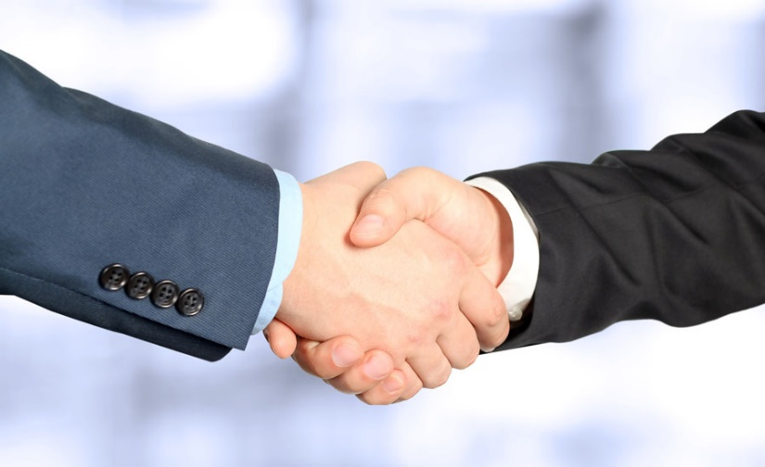
Chapter 1
Communication
in Business
Communication Skills ادر 213 Chapter 1 Lesson 1.2: Communication Channels
وزارة التربية والتعليم –الفصل الدراسي الثاني 2020-2021م

Slide 3
1.2
Communication Channels
Communication Skills ادر 213 Chapter 1 Lesson 1.2: Communication Channels
وزارة التربية والتعليم –الفصل الدراسي الثاني 2020-2021م

Slide 4
Learning Objectives
By the end of this lesson, the student should be able to:
describe the various channels of communication used in the office.
give example of visual channels of communication.
give example of nonverbal channels of communication.
Engaging Starters
The First Goal
The Second Goal
The Third Goal
Questions
Communication Skills ادر 213 Chapter 1 Lesson 1.2: Communication Channels
وزارة التربية والتعليم –الفصل الدراسي الثاني 2020-2021م

Slide 5
Engaging Starters
Businesses use a variety of methods to communicate information. For example, communication might be face-to-face or written. Information can be sent by e-mail or by postal system. Look at the examples below and suggest suitable methods of communication for each of the following cases:
Case 1: A business wants to inform a customer that an order will be delayed because an item is out of stock.
Case 2: An employee has to be informed that they have been promoted to a senior position and will be entitled to a higher pay.
Case 3: A worker needs permission from a supervisor to finish work 15 minutes early to take her daughter for a hospital appointment.
Engaging Starters
The First Goal
The Second Goal
The Third Goal
Questions
Communication Skills ادر 213 Chapter 1 Lesson 1.2: Communication Channels
وزارة التربية والتعليم –الفصل الدراسي الثاني 2020-2021م

Slide 6
Communication Channels
When deciding which of the communication channel would be best for your message, you should take into consideration:
Will it meet the business objectives?
Who is the target receiver?
How much will it cost?
How quickly does a message need to be transmitted?
Does a record need to be kept?
Engaging Starters
The First Goal
The Second Goal
The Third Goal
Questions
Next
Communication Skills ادر 213 Chapter 1 Lesson 1.2: Communication Channels
وزارة التربية والتعليم –الفصل الدراسي الثاني 2020-2021م

Slide 7
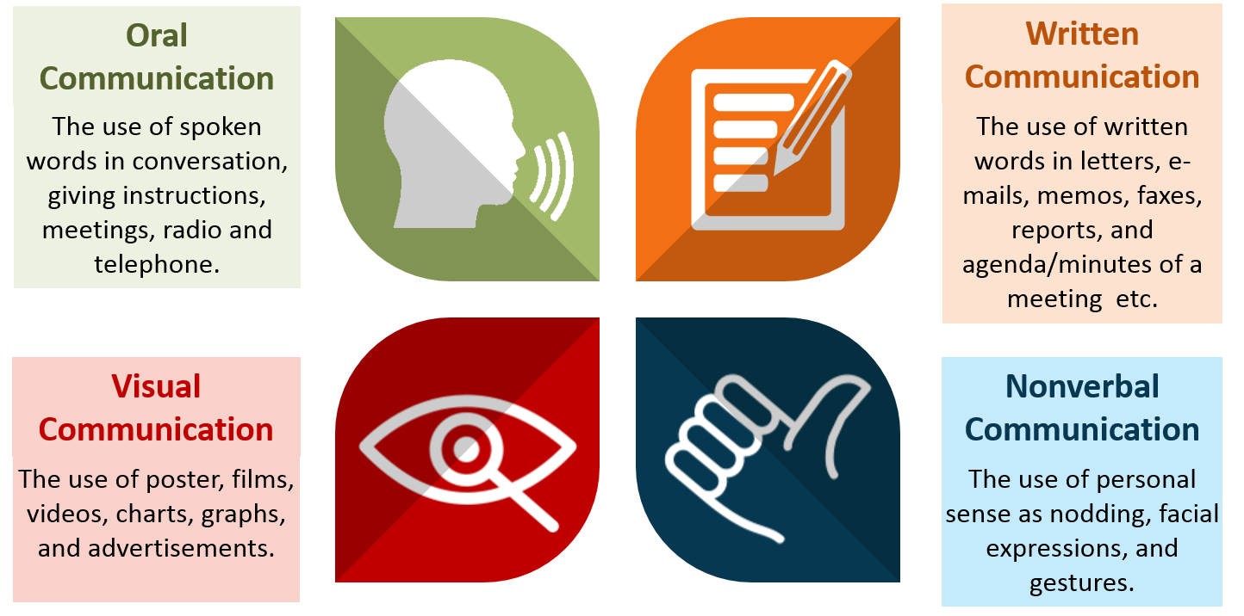
Communication Channels
A message may be sent in one or more of the following ways as shown in the figure:
Engaging Starters
The First Goal
The Second Goal
The Third Goal
Questions
Next
Communication Skills ادر 213 Chapter 1 Lesson 1.2: Communication Channels
وزارة التربية والتعليم –الفصل الدراسي الثاني 2020-2021م

Slide 8
Communication Channels
Social media has become the primary channel for a business to communicate with consumers. Popular internet sites are used by businesses include Twitter, Instagram, Facebook, YouTube, and LinkedIn.
Engaging Starters
The First Goal
This method allows fast, mass communications, can target specific consumers and allows a business to interact with its customers. Not all potential consumers use social media and some people are concerned about the data that may be collected by the businesses who communicate in this way.
The Second Goal
The Third Goal
Questions
Next
Communication Skills ادر 213 Chapter 1 Lesson 1.2: Communication Channels
وزارة التربية والتعليم –الفصل الدراسي الثاني 2020-2021م

Slide 9
Evaluation Activity
Activity
Engaging Starters
List the Communication Channels.
The First Goal
Type of activity
The Second Goal
Individual - written
The Third Goal
Time
Questions
2 minutes
Communication Skills ادر 213 Chapter 1 Lesson 1.2: Communication Channels
وزارة التربية والتعليم –الفصل الدراسي الثاني 2020-2021م

Slide 10
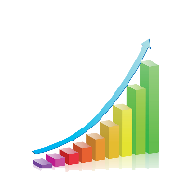
Visual Communication
Visual communication is the conveyance of ideas and information in forms that can be read or looked upon.
Any image that is used to communicate an idea, whether it is a sign, poster, drawing, photograph, chart, diagram, table or television advertisement, can be included in the field of visual communications.
Engaging Starters
The First Goal
The Second Goal
The Third Goal
Questions
Next
Communication Skills ادر 213 Chapter 1 Lesson 1.2: Communication Channels
وزارة التربية والتعليم –الفصل الدراسي الثاني 2020-2021م
Visual communication is the conveyance of ideas and information in forms that can be read or looked upon.

Slide 11
Evaluation Activity
Activity
Engaging Starters
Give examples of visual communication.
The First Goal
Type of activity
The Second Goal
Individual - written
The Third Goal
Time
Questions
2 minutes
Communication Skills ادر 213 Chapter 1 Lesson 1.2: Communication Channels
وزارة التربية والتعليم –الفصل الدراسي الثاني 2020-2021م

Slide 12
Nonverbal Communication
Nonverbal communication is a process of communication through sending and receiving wordless messages.
Gestures touch, and eye contact (or lack of eye contact) are some aspects of nonverbal communication that can vary significantly depending on a person’s cultural background.
Engaging Starters
The First Goal
The Second Goal
The Third Goal
Questions
Next
Communication Skills ادر 213 Chapter 1 Lesson 1.2: Communication Channels
وزارة التربية والتعليم –الفصل الدراسي الثاني 2020-2021م

Slide 13
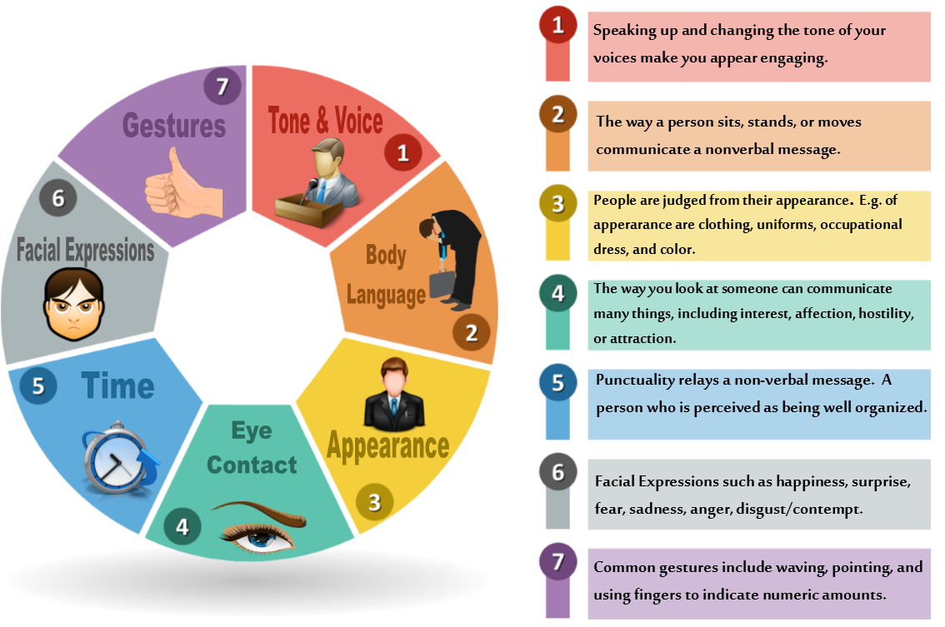
Nonverbal Communication
Engaging Starters
The First Goal
The Second Goal
The Third Goal
Questions
Next
Communication Skills ادر 213 Chapter 1 Lesson 1.2: Communication Channels
وزارة التربية والتعليم –الفصل الدراسي الثاني 2020-2021م

Slide 14
Evaluation Activity
Activity
Engaging Starters
answer Activity (1.2.2) page 24 in the Textbook
The First Goal
Type of activity
The Second Goal
With Partner - written
The Third Goal
Time
Questions
5 minutes
Communication Skills ادر 213 Chapter 1 Lesson 1.2: Communication Channels
وزارة التربية والتعليم –الفصل الدراسي الثاني 2020-2021م

Slide 15
Questions
?
1. Place a ✓ tick in the below box where you think best describes each of the following communication channels:
Engaging Starters
Communication Channel | Written | Oral | Visual | Nonverbal
Sending a letter to place an order
Annual meeting of shareholders
No smoking sign
Job interview
Good employee appearance
The First Goal
The Second Goal
The Third Goal
Questions
Check your answer
Communication Skills ادر 213 Chapter 1 Lesson 1.2: Communication Channels
وزارة التربية والتعليم –الفصل الدراسي الثاني 2020-2021م

Slide 16
Questions
?
2. Write the name of the method of communication for each of the following pictures and classify into (verbal, written, visual, or non-verbal communication).
Engaging Starters
The First Goal
The Second Goal
The Third Goal
Questions
Check your answer
Communication Skills ادر 213 Chapter 1 Lesson 1.2: Communication Channels
وزارة التربية والتعليم –الفصل الدراسي الثاني 2020-2021م

Slide 17
Questions
?
3. Nonverbal communication messages (such as eye contact, nodding, smiling) are related to behavior.
Engaging Starters
The First Goal
True
False
The Second Goal
The Third Goal
Questions
Communication Skills ادر 213 Chapter 1 Lesson 1.2: Communication Channels
وزارة التربية والتعليم –الفصل الدراسي الثاني 2020-2021م

Slide 18
Questions
?
4. Any image that is used to communicate an idea is known as nonverbal communication.
Engaging Starters
The First Goal
True
False
The Second Goal
The Third Goal
Questions
Communication Skills ادر 213 Chapter 1 Lesson 1.2: Communication Channels
وزارة التربية والتعليم –الفصل الدراسي الثاني 2020-2021م

Slide 19
Questions
?
5. Which of the following is the most indirect communication channel?
Engaging Starters
The First Goal
a. Written.
b. Oral.
The Second Goal
c. Visual.
d. Nonverbal.
The Third Goal
Questions
Communication Skills ادر 213 Chapter 1 Lesson 1.2: Communication Channels
وزارة التربية والتعليم –الفصل الدراسي الثاني 2020-2021م

Slide 20
Questions
?
6. Abdulla is making a class presentation. He is very uncomfortable and begins to sweat, rock back and forth, and wring his hands. These actions are examples of:
Engaging Starters
The First Goal
The Second Goal
a. Written.
b. Oral.
The Third Goal
Questions
c. Visual.
d. Nonverbal.
Communication Skills ادر 213 Chapter 1 Lesson 1.2: Communication Channels
وزارة التربية والتعليم –الفصل الدراسي الثاني 2020-2021م

Slide 21
Questions
Engaging Starters
The First Goal
Additional Activity
The Second Goal
To go over workbook pages 12-16
The Third Goal
Questions
Communication Skills ادر 213 Chapter 1 Lesson 1.2: Communication Channels
وزارة التربية والتعليم –الفصل الدراسي الثاني 2020-2021م

Slide 22
End of the Lesson
Thank You!
Communication Skills ادر 213 Chapter 1 Lesson 1.2: Communication Channels
وزارة التربية والتعليم –الفصل الدراسي الثاني 2020-2021م

Slide 23
Answer
Place a ✓ tick in the below box where you think best describes each of the following communication channels:
Communication Channel | Written | Oral | Visual | Nonverbal
Sending a letter to place an order | ✓
Annual meeting of shareholders |  | ✓
No smoking sign |  |  | ✓
Job interview |  | ✓
Good employee appearance |  |  |  | ✓
Next
Communication Skills ادر 213 Chapter 1 Lesson 1.2: Communication Channels
وزارة التربية والتعليم –الفصل الدراسي الثاني 2020-2021م

Slide 24
Answer
2. Write the name of the method of communication for each of the following pictures and classify into (verbal, written, visual, or non-verbal communication).
Method: Telephone
Communication type:
Oral
Method: Graph
Communication type:
Visual
Method: Invoice
Communication type:
Written
Method: Punctuality
Communication type:
Nonverbal
Next
Communication Skills ادر 213 Chapter 1 Lesson 1.2: Communication Channels
وزارة التربية والتعليم –الفصل الدراسي الثاني 2020-2021م

Slide 25
Next
Communication Skills ادر 213 Chapter 1 Lesson 1.2: Communication Channels
وزارة التربية والتعليم –الفصل الدراسي الثاني 2020-2021م

Slide 26
Back
Communication Skills ادر 213 Chapter 1 Lesson 1.2: Communication Channels
وزارة التربية والتعليم –الفصل الدراسي الثاني 2020-2021م

Slide 27
Answer: Any image that is used to communicate an idea is known as visual communication.
Next
Communication Skills ادر 213 Chapter 1 Lesson 1.2: Communication Channels
وزارة التربية والتعليم –الفصل الدراسي الثاني 2020-2021م

Slide 28
Back
Communication Skills ادر 213 Chapter 1 Lesson 1.2: Communication Channels
وزارة التربية والتعليم –الفصل الدراسي الثاني 2020-2021م

Slide 29
Next
Communication Skills ادر 213 Chapter 1 Lesson 1.2: Communication Channels
وزارة التربية والتعليم –الفصل الدراسي الثاني 2020-2021م

Slide 30
Back
Communication Skills ادر 213 Chapter 1 Lesson 1.2: Communication Channels
وزارة التربية والتعليم –الفصل الدراسي الثاني 2020-2021م

Slide 31
Next
Communication Skills ادر 213 Chapter 1 Lesson 1.2: Communication Channels
وزارة التربية والتعليم –الفصل الدراسي الثاني 2020-2021م

Slide 32
Back
Communication Skills ادر 213 Chapter 1 Lesson 1.2: Communication Channels
وزارة التربية والتعليم –الفصل الدراسي الثاني 2020-2021م

