Slide 1
Communication Skills ادر 213
Chapter 1
Communication Process
SECOND SEMESTER
Pages 11-17
للصف الثاني ثانوي / تجاري

Slide 2
Chapter 1
Communication
in Business
Communication Skills ادر 213 Chapter 1 Lesson 1.1: Communication Process
وزارة التربية والتعليم –الفصل الدراسي الثاني 2020-2021م

Slide 3
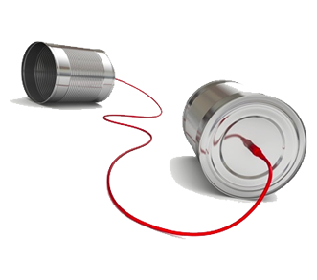
1.1
Communication Process
What is communication?
The process of communication.
One-way and Two-way Communication.
The purpose of communication.
Barriers to communication.
Overcoming barriers.
Communication Skills ادر 213 Chapter 1 Lesson 1.1: Communication Process
وزارة التربية والتعليم –الفصل الدراسي الثاني 2020-2021م

Slide 4
Learning Objectives
By the end of this lesson, the student should be able to:
define effective communication.
draw the communication process.
differentiate between one-way and two-way communication.
memorise the purpose of communication.
understand how communication barriers can arise, and how they can be reduced or removed.
Engaging Starters
The First Goal
The Second Goal
The Third Goal
The Fourth Goal
The Fifth Goal
Questions
Communication Skills ادر 213 Chapter 1 Lesson 1.1: Communication Process
وزارة التربية والتعليم –الفصل الدراسي الثاني 2020-2021م

Slide 5
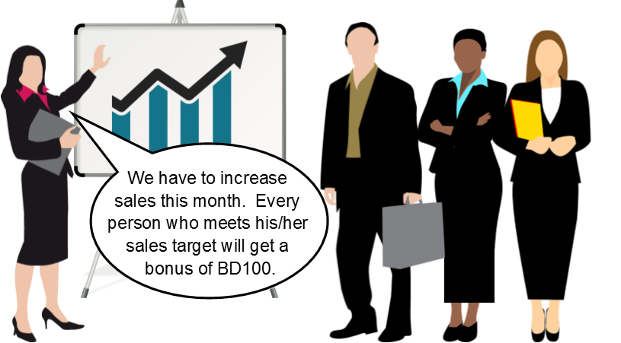
Engaging Starters
Look at the communication example below and answer the questions:
Identify the sender, receiver(s), and the message in the above example of communication.
Engaging Starters
The First Goal
The Second Goal
The Third Goal
The Fourth Goal
The Fifth Goal
Questions
Communication Skills ادر 213 Chapter 1 Lesson 1.1: Communication Process
وزارة التربية والتعليم –الفصل الدراسي الثاني 2020-2021م

Slide 6
What is Communication?
Communication is the transfer of a message from a sender to a receiver, who understands the message.
Engaging Starters
The First Goal
The Second Goal
The Third Goal
The Fourth Goal
The Fifth Goal
Next
Questions
Communication Skills ادر 213 Chapter 1 Lesson 1.1: Communication Process
وزارة التربية والتعليم –الفصل الدراسي الثاني 2020-2021م

Slide 7
Evaluation Activity
Engaging Starters
Activity
The First Goal
Define Communication
The Second Goal
Type of activity
The Third Goal
Individual - written
The Fourth Goal
Time
The Fifth Goal
2 minutes
Questions
Communication Skills ادر 213 Chapter 1 Lesson 1.1: Communication Process
وزارة التربية والتعليم –الفصل الدراسي الثاني 2020-2021م

Slide 8
The Process of Communication
The process of communication as shown in Figure next slide (Figure 1.1.2 - page 14) can be summarized as follows:
The SENDER has information, an idea, or a fact (MESSAGE);
Then the sender ENCODES the idea. This means putting it into written or verbal forms, graphical symbols or using body language;
After the sender selects a suitable MEDIUM or CHANNEL for the transmission of the message;
The RECEIVER gets the message;
The receiver DECODES the message and
Finally, the receiver sends his/her response to the sender as a FEEDBACK.
The process then starts again with another message
Engaging Starters
The First Goal
The Second Goal
The Third Goal
The Fourth Goal
The Fifth Goal
Next
Questions
Communication Skills ادر 213 Chapter 1 Lesson 1.1: Communication Process
وزارة التربية والتعليم –الفصل الدراسي الثاني 2020-2021م

Slide 9
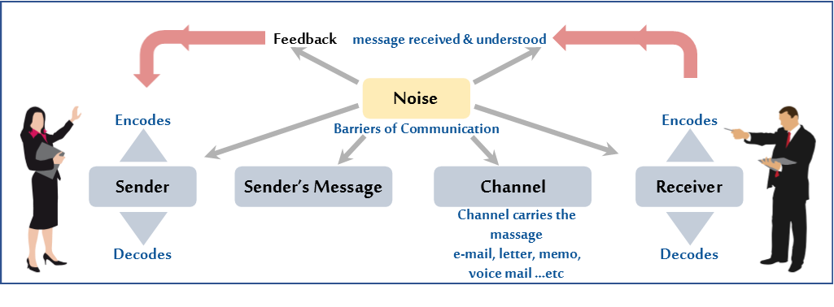
The Process of Communication
Engaging Starters
The First Goal
The Second Goal
The Third Goal
The Fourth Goal
The Fifth Goal
Next
Questions
Communication Skills ادر 213 Chapter 1 Lesson 1.1: Communication Process
وزارة التربية والتعليم –الفصل الدراسي الثاني 2020-2021م

Slide 10
The Process of Communication
Noise is the unplanned distortion or interference during the communication process that results in the receiver getting a different message than the sender sends. In addition, it may occur in any of the steps in the communication process.
Engaging Starters
The First Goal
The Second Goal
The Third Goal
The Fourth Goal
The Fifth Goal
Next
Questions
Communication Skills ادر 213 Chapter 1 Lesson 1.1: Communication Process
وزارة التربية والتعليم –الفصل الدراسي الثاني 2020-2021م

Slide 11
Evaluation Activity
Engaging Starters
Activity
The First Goal
answer Activity (1.1.1) page 14 in the Textbook
The Second Goal
Type of activity
The Third Goal
With Partner - written
The Fourth Goal
Time
The Fifth Goal
2 minutes
Questions
Communication Skills ادر 213 Chapter 1 Lesson 1.1: Communication Process
وزارة التربية والتعليم –الفصل الدراسي الثاني 2020-2021م

Slide 12
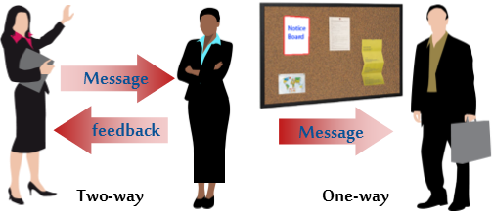
One-way and Two-way Communication
When choosing to communicate effectively, there will be a need to decide whether the purpose will just be sending information (one-way communication) or whether a feedback will be needed (two-way communication). One-way communication is useful for:
Clarifying or reminding.
Giving instructions.
Providing information.
Engaging Starters
The First Goal
The Second Goal
The Third Goal
The Fourth Goal
The Fifth Goal
Next
Questions
Communication Skills ادر 213 Chapter 1 Lesson 1.1: Communication Process
وزارة التربية والتعليم –الفصل الدراسي الثاني 2020-2021م

Slide 13
One-way and Two-way Communication
One-way Communication | Two-way Communication
The person receiving the message cannot reply to it. | The person receiving the message can give a feedback.
Sender Receiver | Sender Receiver
A manager gives instructions but the employees cannot confirm that they have understood the message. | Both the sender and the receiver are involved in the communication.
Mistakes are possible as there is no feedback. | Feedback allows both to check that the message has been received and understood.
Examples: notice boards, posters, web pages, signs. | Examples: meetings, telephone, video conferencing.
Engaging Starters
The First Goal
The Second Goal
The Third Goal
The Fourth Goal
The Fifth Goal
Next
Questions
Communication Skills ادر 213 Chapter 1 Lesson 1.1: Communication Process
وزارة التربية والتعليم –الفصل الدراسي الثاني 2020-2021م

Slide 14
Evaluation Activity
Engaging Starters
Activity
The First Goal
answer Activity (1.1.2) page 15 in the Textbook
The Second Goal
Type of activity
The Third Goal
Individual - written
The Fourth Goal
Time
The Fifth Goal
2 minutes
Questions
Communication Skills ادر 213 Chapter 1 Lesson 1.1: Communication Process
وزارة التربية والتعليم –الفصل الدراسي الثاني 2020-2021م

Slide 15
Purpose of Communication
Engaging Starters
Pass and receive massages
The First Goal
Purposes of communication
Check and receive feedback
The Second Goal
The Third Goal
Give instructions
The Fourth Goal
The Fifth Goal
Methods to discuss issues
Next
Questions
Communication Skills ادر 213 Chapter 1 Lesson 1.1: Communication Process
وزارة التربية والتعليم –الفصل الدراسي الثاني 2020-2021م

Slide 16
Evaluation Activity
Engaging Starters
Activity
The First Goal
answer Activity (1.1.3) page 16 in the Textbook
The Second Goal
Type of activity
The Third Goal
With partner - written
The Fourth Goal
Time
The Fifth Goal
2 minutes
Questions
Communication Skills ادر 213 Chapter 1 Lesson 1.1: Communication Process
وزارة التربية والتعليم –الفصل الدراسي الثاني 2020-2021م

Slide 17
Barriers to Communication
The list below contains some of the techniques that help communicate effectively:
Avoid information overload. The message should be clear and brief.
Develop listening skills.
Use a simple and an understandable language.
Choose a suitable time to pass information. For example, a person who is in a rush to leave work for the day may not listen carefully to what his manager is saying to him/her.
Taking follow up action (ask for feedback).
Select a proper channel (use both oral and written channels when sending a complex message).
Engaging Starters
The First Goal
The Second Goal
The Third Goal
The Fourth Goal
The Fifth Goal
Next
Questions
Communication Skills ادر 213 Chapter 1 Lesson 1.1: Communication Process
وزارة التربية والتعليم –الفصل الدراسي الثاني 2020-2021م

Slide 18
Overcome Barriers
The common barriers to effective communication are listed below:
Information overload.
Poor listening skills.
Difficult language: Use of jargon or terms, which are too technical, should be avoided.
Difference in belief, style, and society (culture).
Physical and environmental barriers (uncomfortable place, unhygienic room, background noise, poor lighting, an environment that is too hot or cold).
Lack of feedback.
Selecting wrong channels.
Engaging Starters
The First Goal
The Second Goal
The Third Goal
The Fourth Goal
The Fifth Goal
Next
Questions
Communication Skills ادر 213 Chapter 1 Lesson 1.1: Communication Process
وزارة التربية والتعليم –الفصل الدراسي الثاني 2020-2021م

Slide 19
Evaluation Activity
Engaging Starters
Activity
The First Goal
answer Activity (1.1.4) page 17 in the Textbook
The Second Goal
Type of activity
The Third Goal
With partner - written
The Fourth Goal
Time
The Fifth Goal
5 minutes
Questions
Communication Skills ادر 213 Chapter 1 Lesson 1.1: Communication Process
وزارة التربية والتعليم –الفصل الدراسي الثاني 2020-2021م
Communication Skills ادر 213 Chapter 1 Lesson 1.1: Communication Process

Slide 20
Questions
?
Answer these questions using the following communication process chart for Al Andalus Company:
Who is the sender? ……………………………………..
Who is the receiver? ……………………………………..
What is the channel used? ……………………………………..
What is the message sent? ……………………………………..
What is the receivers' feedback? ……………………………………..
Engaging Starters
The First Goal
The Second Goal
The Third Goal
Purchase Manager
Purchase of office furniture
Inquiry
letter
Sales
Manager
The Fourth Goal
The Fifth Goal
Quotation
Check your answer
Questions
Communication Skills ادر 213 Chapter 1 Lesson 1.1: Communication Process
وزارة التربية والتعليم –الفصل الدراسي الثاني 2020-2021م

Slide 21
Questions
?
2. Reorder the following procedures for the communication process:
Engaging Starters
1. |  | The receiver gives his/her feedback and expresses his/her reaction.
2. |  | The sender uses a certain channel.
3. |  | The sender has a message.
4. |  | Many kinds of barriers interfere with the communication.
5. |  | The sender is sending his message.
6. |  | The receiver had the message.
The First Goal
The Second Goal
The Third Goal
The Fourth Goal
The Fifth Goal
Check your answer
Questions
Communication Skills ادر 213 Chapter 1 Lesson 1.1: Communication Process
وزارة التربية والتعليم –الفصل الدراسي الثاني 2020-2021م

Slide 22
Questions
?
3. Feedback is the receiver's response to the sender.
Engaging Starters
The First Goal
The Second Goal
The Third Goal
True
False
The Fourth Goal
The Fifth Goal
Questions
Communication Skills ادر 213 Chapter 1 Lesson 1.1: Communication Process
وزارة التربية والتعليم –الفصل الدراسي الثاني 2020-2021م

Slide 23
Questions
?
4. Anything that prevents understanding of messages is known as:
Engaging Starters
The First Goal
The Second Goal
a. Channel.
b. Message.
The Third Goal
c. Feedback.
d. Barrier.
The Fourth Goal
The Fifth Goal
Questions
Communication Skills ادر 213 Chapter 1 Lesson 1.1: Communication Process
وزارة التربية والتعليم –الفصل الدراسي الثاني 2020-2021م

Slide 24
Questions
?
5. The table below, there are some barriers in the problems listed below. Mention the barriers and how you can overcome these barriers.
Engaging Starters
Barrier | Problem | Methods to overcome it
 | Language, which is too difficult, is used. The receiver may not understand 'Jargon' or technical terms.
 | The message is too long and contains too much details which prevent the main points to be understood.
 | The wrong channel is used, so the message is not received on time.
The First Goal
The Second Goal
The Third Goal
The Fourth Goal
The Fifth Goal
Check your answer
Questions
Communication Skills ادر 213 Chapter 1 Lesson 1.1: Communication Process
وزارة التربية والتعليم –الفصل الدراسي الثاني 2020-2021م

Slide 25
Questions
Engaging Starters
The First Goal
The Second Goal
Additional Activity
The Third Goal
To go over workbook pages 6-11
The Fourth Goal
The Fifth Goal
Questions
Communication Skills ادر 213 Chapter 1 Lesson 1.1: Communication Process
وزارة التربية والتعليم –الفصل الدراسي الثاني 2020-2021م

Slide 26
End of the Lesson
Thank You!
Communication Skills ادر 213 Chapter 1 Lesson 1.1: Communication Process
وزارة التربية والتعليم –الفصل الدراسي الثاني 2020-2021م

Slide 27
Answer
Answer these questions using the following communication process chart for Al Andalus Company:
Who is the sender? Purchase Manager
Who is the receiver? Sales Manager
What is the channel used? Letter (inquiry letter)
What is the message sent? Purchase of office furniture
What is the receivers' feedback? Quotation letter
Purchase Manager
Purchase of office furniture
Inquiry
letter
Sales
Manager
Quotation
Next
Communication Skills ادر 213 Chapter 1 Lesson 1.1: Communication Process
وزارة التربية والتعليم –الفصل الدراسي الثاني 2020-2021م

Slide 28
Answer
2. Reorder the following procedures for the communication process:
1. | 5 | The receiver gives his/her feedback and expresses his/her reaction.
2. | 2 | The sender uses a certain channel.
3. | 1 | The sender has a message.
4. | 6 | Many kinds of barriers interfere with the communication.
5. | 3 | The sender is sending his message.
6. | 4 | The receiver had the message.
Next
Communication Skills ادر 213 Chapter 1 Lesson 1.1: Communication Process
وزارة التربية والتعليم –الفصل الدراسي الثاني 2020-2021م

Slide 29
Next
Communication Skills ادر 213 Chapter 1 Lesson 1.1: Communication Process
وزارة التربية والتعليم –الفصل الدراسي الثاني 2020-2021م

Slide 30
Back
Communication Skills ادر 213 Chapter 1 Lesson 1.1: Communication Process
وزارة التربية والتعليم –الفصل الدراسي الثاني 2020-2021م

Slide 31
Next
Communication Skills ادر 213 Chapter 1 Lesson 1.1: Communication Process
وزارة التربية والتعليم –الفصل الدراسي الثاني 2020-2021م

Slide 32
Back
Communication Skills ادر 213 Chapter 1 Lesson 1.1: Communication Process
وزارة التربية والتعليم –الفصل الدراسي الثاني 2020-2021م

Slide 33
Answer
5. The table below, there are some barriers in the problems listed below. Mention the barriers and how you can overcome these barriers.
Barrier | Problem | Methods to overcome it
Difficult language | Language, which is too difficult, is used. The receiver may not understand 'Jargon' or technical terms. | Use a simple and an understandable language.
Information overload | The message is too long and contains too much details which prevent the main points to be understood. | Avoid information overload. The message should be clear and brief.
Selecting wrong channels | The wrong channel is used, so the message is not received on time. | Select a proper channel
Next
Communication Skills ادر 213 Chapter 1 Lesson 1.1: Communication Process
وزارة التربية والتعليم –الفصل الدراسي الثاني 2020-2021م

