Slide 1
Introduction to Office Management ادر 111
FIRST SEMESTER
للصف الثاني ثانوي / تجاري

Slide 2
Chapter 2
Reception

Slide 3
1
The Importance of Reception
Reception Area.
Qualities & Skills of a good receptionist.
Receptionist Duties.
Pages 19-25

Slide 4
Learning Objectives
By the end of this lesson, students should be able to:
Describe the reception area.
Discuss the qualities & business skills of a good receptionist.
Match the picture with the correct receptionist duty.
Engaging Starters
The First Goal
The Second Goal
The Third Goal
Questions
Lesson: The Importance of Reception Introduction to Office Management ادر 111

Slide 5
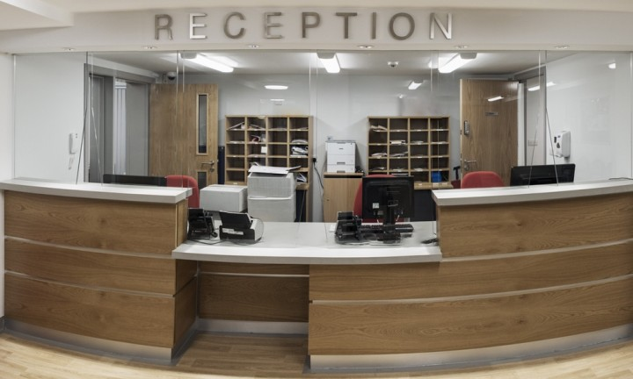
Engaging Starters
What does the above picture represent?
Where did you see this area before?
Why do you think the reception area is important?
Engaging Starters
The First Goal
The Second Goal
The Third Goal
Questions
Lesson: The Importance of Reception Introduction to Office Management ادر 111

Slide 6
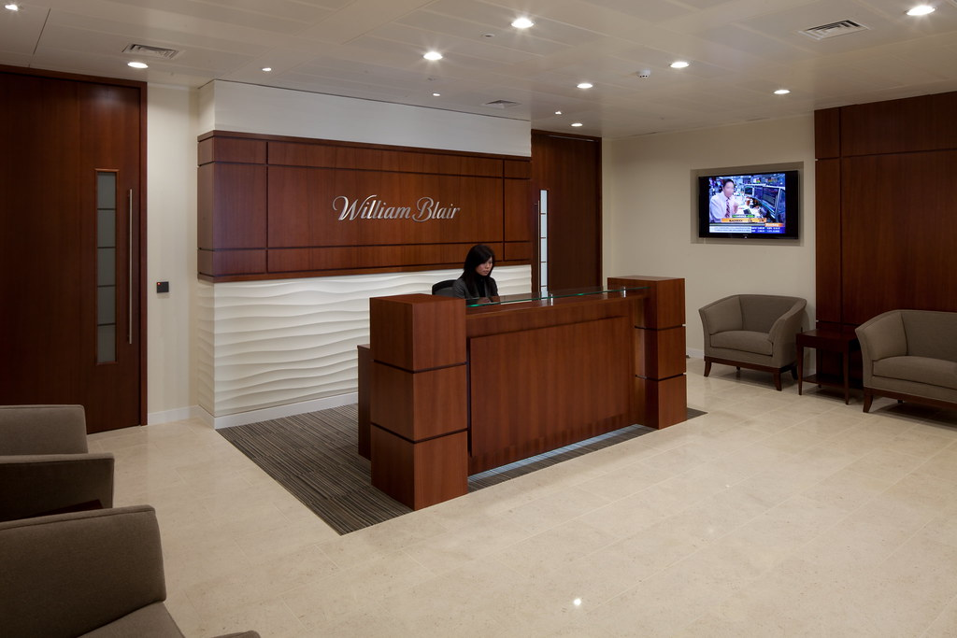
Reception Area
Provides the first impression to outsiders.
Reflects the image of the business.
Visitors may pass through doors in the office for security.
The receptionist is in a separate room, not in the reception & waiting room.
People visit an office :
To attend a meeting.
To apply for a job.
Family visit to an employee.
A customer has a complaint.
Contract agreement with suppliers.
Engaging Starters
The First Goal
The Second Goal
The Third Goal
Questions
Next
Lesson: The Importance of Reception Introduction to Office Management ادر 111

Slide 7
Reception Area
Engaging Starters
Reception Area
The first point of contact with the company.
The First Goal
Receptionist
The person who works in the reception area.
The Second Goal
The Third Goal
Visitors
The people visiting the company.
Questions
Next
Lesson: The Importance of Reception Introduction to Office Management ادر 111

Slide 8
Reception Area
The receptionist's special equipment and materials are likely to include:
An appointments or visitors book.
Reference material and a reference book.
A computer terminal.
A telephone and fax machine.
Relevant security items ,such as visitors badges, car park passes and keys or ID permits for specific access points.
Various stationery.
Equipment & Materials:
Engaging Starters
The First Goal
The Second Goal
The Third Goal
Questions
Next
Lesson: The Importance of Reception Introduction to Office Management ادر 111

Slide 9
Reception Area
Items to impress visitors include:
desk(s).
drink facilities.
seating area for visitors.
filling cabinets
nice, clean decoration.
background music or even a T.V.
Equipment & Materials:
Equipment & Materials:
Engaging Starters
The First Goal
The Second Goal
The Third Goal
Questions
Next
Next
Lesson: The Importance of Reception Introduction to Office Management ادر 111

Slide 10
Evaluation Activity
Engaging Starters
Activity
The First Goal
answer q.4 page 26 in the workbook
Type of activity
The Second Goal
Individual - written
The Third Goal
Time
Questions
2 minutes
Lesson: The Importance of Reception Introduction to Office Management ادر 111

Slide 11
Qualities & Duties of the Receptionist
Engaging Starters
Qualities
The good things about your character that make you an asset to the company, such as being helpful, patient, polite, hardworking, etc...
The First Goal
The Second Goal
Duties
The tasks you carry out as part of your job, such as typing, filing, answering phone calls, etc…
The Third Goal
Questions
Next
Lesson: The Importance of Reception Introduction to Office Management ادر 111

Slide 12
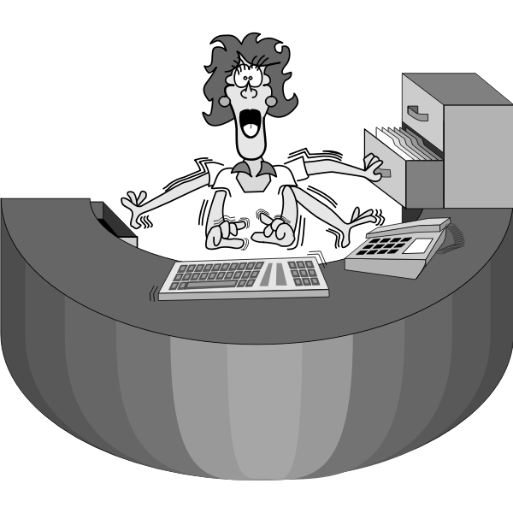
Good Qualities of a Receptionist
A receptionist should treat visitors in a good way and let them feel that they have time for them even if they were busy.
Qualities of a good receptionist:
Engaging Starters
The First Goal
Polite and with good communication skills.
Friendly, helpful, reliable, honest & able to work with
others.
Enthusiastic & having the ability to multitask.
Having enough information about the firm’s products, staff & layout.
Patient & having good telephone etiquette.
Appropriate Appearance / Dress well.
The Second Goal
The Third Goal
Questions
Next
Lesson: The Importance of Reception Introduction to Office Management ادر 111

Slide 13
Positive Image of a Receptionist
Dress appropriately for your organisation and its image.
Engaging Starters
Have time for people.
The First Goal
Be well groomed.
Be polite.
The Second Goal
The Third Goal
Look pleasant, cheerful and welcoming.
Treat everyone in the same way regardless of their appearance.
Questions
Next
Lesson: The Importance of Reception Introduction to Office Management ادر 111

Slide 14
Skills of Receptionist
The receptionist’s voice should be clear & pleasant.
Must know the departments in the organization.
Must know the work they do.
Must have a list of the staff, their job title & telephone extension number.
General information about the business.
Details of their products (flyers, brochures…)
Physical layout of the building.
Where people are located.
Which security areas are not allowed for visitors to enter.
What to do in an emergency.
Understanding the business procedures of how to deal with visitors.
Engaging Starters
The First Goal
The Second Goal
The Third Goal
Questions
Next
Lesson: The Importance of Reception Introduction to Office Management ادر 111

Slide 15
Evaluation Activity
Engaging Starters
Activity
The First Goal
answer q.5 page 26 in the workbook
Type of activity
The Second Goal
Individual - written
The Third Goal
Time
Questions
2 minutes
Lesson: The Importance of Reception Introduction to Office Management ادر 111

Slide 16
Activity
Engaging Starters
Activity
The First Goal
Match the picture with the correct duty in the next slide.
Type of activity
The Second Goal
Individual - written
The Third Goal
Time
Questions
3 minutes
Next
Lesson: The Importance of Reception Introduction to Office Management ادر 111

Slide 17
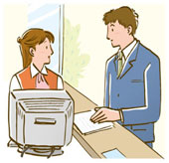
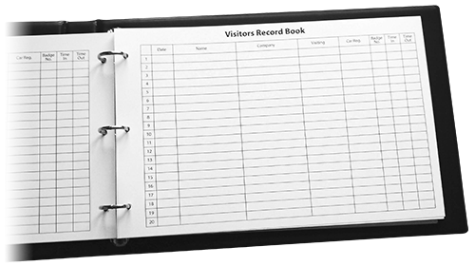
Activity
Purchase dept. go to the right, the second door on your left hand
Thank you
Engaging Starters
Appointments
Dairy
The First Goal
Picture (A)
Picture (B)
Picture (C)
Picture (D)
The Second Goal
Receptionist’s Duties
Dealing with different types of visitors.
Directing visitors to the appropriate sections.
Maintaining a reception register.
Maintaining an appointment diary.
Making business phone calls.
The Third Goal
Questions
Next
Picture (E)
Lesson: The Importance of Reception Introduction to Office Management ادر 111

Slide 18
Activity
Purchase dept. go to the right the second door on your left hand
Appointments
Dairy
Thank you
Engaging Starters
The First Goal
Picture (A)
Picture (B)
Picture (C)
The Second Goal
4) Maintaining an appointment diary.
2) Directing visitors to the appropriate sections.
1) Dealing with different types of visitors.
The Third Goal
5) Making business phone calls.
3) Maintaining a reception register.
Questions
Next
Picture (D)
Picture (E)
Lesson: The Importance of Reception Introduction to Office Management ادر 111

Slide 19
Receptionist’s Duties
There will be time when there are no visitors and other general office work needs to be done. These duties may include the following:
Engaging Starters
Operating a telephone switchboard.
Word processing.
The First Goal
The Second Goal
Dealing with outgoing mail.
Distributing incoming mail to departments & other staff.
The Third Goal
Filing documents.
Giving basic First Aid.
Questions
Next
Lesson: The Importance of Reception Introduction to Office Management ادر 111

Slide 20
Evaluation Activity
Engaging Starters
Activity
The First Goal
Write any 2 duties of the receptionist
Type of activity
The Second Goal
Individual - written
The Third Goal
Time
Questions
2 minutes
Lesson: The Importance of Reception Introduction to Office Management ادر 111

Slide 21
Questions
?
1. The first point of contact that visitors have with a business:
Engaging Starters
The First Goal
a. Mail Room.
b. Reception.
The Second Goal
c. Clerk Office Room.
d. Sales clerk office .
The Third Goal
Questions
Lesson: The Importance of Reception Introduction to Office Management ادر 111

Slide 22
Questions
?
2. You will find all the following equipment in the reception area, except for:
Engaging Starters
The First Goal
a. Drinks Facilities.
b. T.V.
The Second Goal
c. Bed.
d. Chairs.
The Third Goal
Questions
Lesson: The Importance of Reception Introduction to Office Management ادر 111

Slide 23
Questions
?
3. The ability to do many duties (jobs) is called:
Engaging Starters
The First Goal
a. Typing.
b. Multi-tasking.
The Second Goal
c. Filing.
d. Greeting Visitor.
The Third Goal
Questions
Lesson: The Importance of Reception Introduction to Office Management ادر 111

Slide 24
Questions
?
4. Why the receptionist’s job is important? It is important because the receptionist ……….
Engaging Starters
The First Goal
a. Has a good knowledge of the business.
The Second Goal
b. Knows what to do in an emergency.
The Third Goal
c. Is seated near the main entrance of the office.
Questions
d. Provides the first impression to visitors.
Lesson: The Importance of Reception Introduction to Office Management ادر 111

Slide 25
Questions
?
5. A good receptionist should be able to work with others.
Engaging Starters
The First Goal
The Second Goal
True
False
The Third Goal
Questions
Lesson: The Importance of Reception Introduction to Office Management ادر 111

Slide 26
Questions
?
6. There are a number of good and bad qualities in the picture below. Place a tick  for good receptionist qualities:
Engaging Starters
 Polite
Not friendly 
The First Goal
 Not helpful
Impatient 
The Second Goal
Good Communication Skills

 Well Informed
The Third Goal
 Honest
Organized 
Questions
Check your answer
 Unenthusiastic
Smart 
Lesson: The Importance of Reception Introduction to Office Management ادر 111

Slide 27
Questions
Engaging Starters
The First Goal
Additional Activity
The Second Goal
To go over workbook page 25-27
The Third Goal
Questions
Lesson: The Importance of Reception Introduction to Office Management ادر 111

Slide 28
THANK YOU!
Lesson: The Importance of Reception Introduction to Office Management ادر 111

Slide 29
Next
Lesson: The Importance of Reception Introduction to Office Management ادر 111

Slide 30
Back
Lesson: The Importance of Reception Introduction to Office Management ادر 111

Slide 31
Next
Lesson: The Importance of Reception Introduction to Office Management ادر 111

Slide 32
Back
Lesson: The Importance of Reception Introduction to Office Management ادر 111

Slide 33
Next
Lesson: The Importance of Reception Introduction to Office Management ادر 111

Slide 34
Back
Lesson: The Importance of Reception Introduction to Office Management ادر 111

Slide 35
Next
Lesson: The Importance of Reception Introduction to Office Management ادر 111

Slide 36
Back
Lesson: The Importance of Reception Introduction to Office Management ادر 111

Slide 37
Next
Lesson: The Importance of Reception Introduction to Office Management ادر 111

Slide 38
Back
Lesson: The Importance of Reception Introduction to Office Management ادر 111

Slide 39
Answer
6. There are a number of good and bad qualities in the below picture. Place a tick  for good receptionist qualities:
 Polite
Not friendly 
 Not helpful
Impatient 
Good Communication Skills

 Well Informed
 Honest
Organized 
Next
 Unenthusiastic
Smart 
Lesson: The Importance of Reception Introduction to Office Management ادر 111

