Slide 1
Introduction to Office Management ادر 111
FIRST SEMESTER
للصف الثاني ثانوي / تجاري

Slide 2
Chapter 5
Safety and Health

Slide 3
3
Reporting Accidents
& Safety Signs
Accident Report Form.
Safety Signs.
Pages 91-94

Slide 4
Learning Objectives
By the end of this lesson, students should be able to:
Fill in the accident report form.
Memorize safety signs.
Engaging Starters
The First Goal
The Second Goal
Questions
Lesson: Reporting Accidents & Safety Signs Introduction to Office Management ادر 111

Slide 5
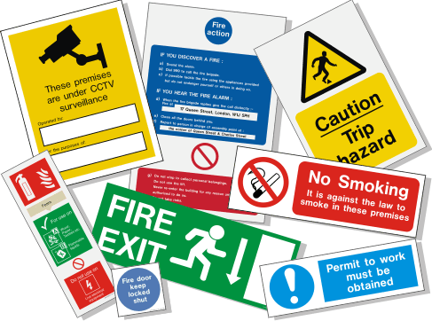
Engaging Starter
Engaging Starters
Where did you see these signs?
For what purpose do you think they are used?
The First Goal
The Second Goal
Questions
Lesson: Reporting Accidents & Safety Signs Introduction to Office Management ادر 111

Slide 6
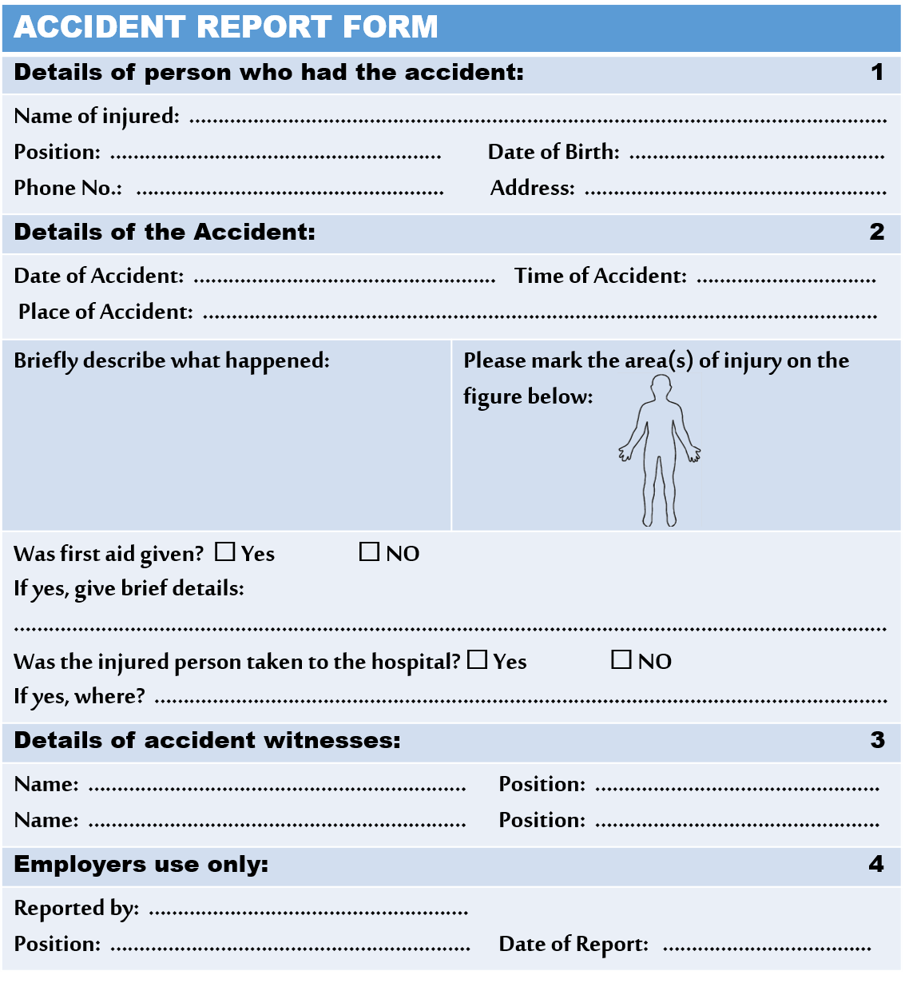
Reporting Accidents
Form Name: Accident Report Form
Purpose: Gives details about the accident which
happened in the office, in other words, proof of
the accident happening during the office hours.
Importance of accident report:
Helps a person in case of insurance.
Proves the accident happened at work.
Copy given to:
Person in-charge of safety and security.
Engaging Starters
The First Goal
The Second Goal
Questions
Next
Lesson: Reporting Accidents & Safety Signs Introduction to Office Management ادر 111

Slide 7
Evaluation Activity
Activity
Engaging Starters
Practice 1 page 84 in the workbook
The First Goal
Type of activity
Individual - written
The Second Goal
Time
Questions
2 minutes
Lesson: Reporting Accidents & Safety Signs Introduction to Office Management ادر 111

Slide 8
Safety Signs
Biological Waste
Wear safety glasses
Fire extinguisher
Fire Exit
Engaging Starters
The First Goal
The Second Goal
Questions
Next
Lesson: Reporting Accidents & Safety Signs Introduction to Office Management ادر 111

Slide 9
Safety Signs
First Aid Kit
Wear Gas Mask
Wear hard hat
Hazardous Area
Engaging Starters
The First Goal
The Second Goal
Questions
Next
Lesson: Reporting Accidents & Safety Signs Introduction to Office Management ادر 111

Slide 10
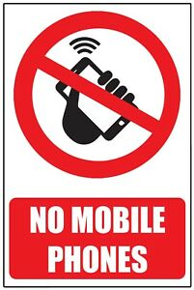
Safety Signs
Access for Wheel Chairs
Heavy Vehicle Traffic
Lift Weight Properly
No Mobile Phones
Engaging Starters
The First Goal
The Second Goal
Questions
Next
Lesson: Reporting Accidents & Safety Signs Introduction to Office Management ادر 111

Slide 11
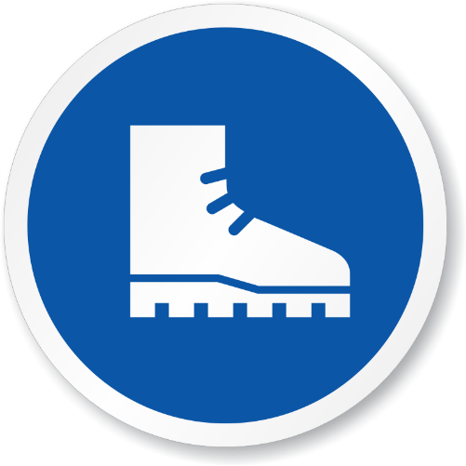
Safety Signs
No Open Flames
No Smoking
Radiation Area
Wear Safety Boots
Engaging Starters
The First Goal
The Second Goal
Questions
Next
Lesson: Reporting Accidents & Safety Signs Introduction to Office Management ادر 111

Slide 12
Safety Signs
Danger high voltage area
Caution wet floor
Engaging Starters
The First Goal
The Second Goal
Questions
Next
Lesson: Reporting Accidents & Safety Signs Introduction to Office Management ادر 111

Slide 13
Evaluation Activity
Activity
Engaging Starters
Practice 3 page 86 in the workbook
The First Goal
Type of activity
Individual - written
The Second Goal
Time
Questions
2 minutes
Lesson: Reporting Accidents & Safety Signs Introduction to Office Management ادر 111

Slide 14
Questions
?
1. Which of the following safety signs you don’t see in Salmaniya Medical Centre:
Engaging Starters
a.
b.
The First Goal
The Second Goal
c.
d.
Questions
Lesson: Reporting Accidents & Safety Signs Introduction to Office Management ادر 111

Slide 15
Questions
?
2. Which of the following safety signs is a warning of heavy vehicle traffic:
Engaging Starters
a.
b.
The First Goal
The Second Goal
c.
d.
Questions
Lesson: Reporting Accidents & Safety Signs Introduction to Office Management ادر 111

Slide 16
Questions
?
3. Which of the following safety signs warns of no smoking:
Engaging Starters
a.
b.
The First Goal
The Second Goal
c.
d.
Questions
Lesson: Reporting Accidents & Safety Signs Introduction to Office Management ادر 111

Slide 17
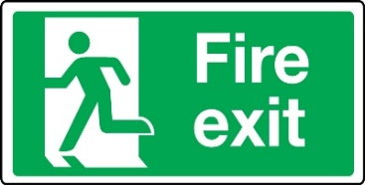
Questions
?
4. Circle the signs that you may find in an office:
Engaging Starters
The First Goal
The Second Goal
Questions
Check your answer
Lesson: Reporting Accidents & Safety Signs Introduction to Office Management ادر 111

Slide 18
Questions
?
5. Use the following information to fill in the Accident Report Form next page:
On Monday (6th Nov 2017), at 9:30 A.M. Mr. Ali Fahad Rashid (Sales Assistant) aged 27, was talking to his colleague Nasser Ahmed (Accountant) in the File Room while he was standing on the swivel chair to place some files on the shelf. Suddenly, he fell down off the chair and broke his left leg. His colleagues Nasser Ahmed and Jassim Moh’d (Receptionist) took him to the First Aid Room and Ms. Noor Abdulla (Nurse) decided to put a sling to ease the pain and take him to Salmaniya Medical Centre for an X-ray and treatment. Then Ali was taken to his house (H. 224, R. 457, Muharraq 788) as recommended by his doctor for a two-week rest.
Note: Ebrahim Jabber is the Safety Officer who wrote the report after two days of the accident.
Engaging Starters
The First Goal
The Second Goal
Questions
Next
Lesson: Reporting Accidents & Safety Signs Introduction to Office Management ادر 111

Slide 19
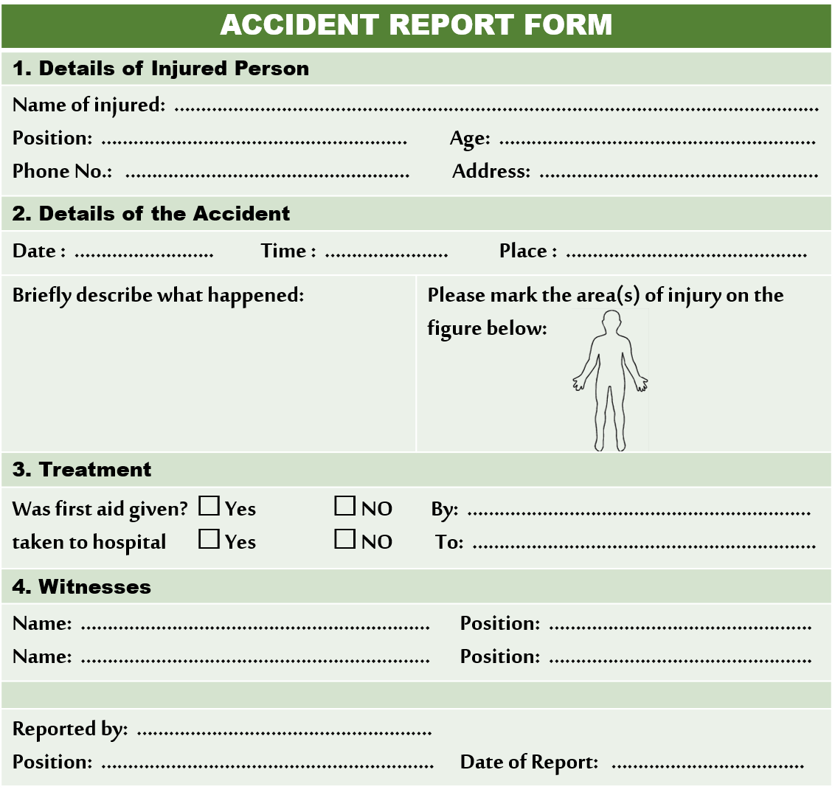
Questions
?
Engaging Starters
17888555
The First Goal
The Second Goal
Questions
Check your answer
Lesson: Reporting Accidents & Safety Signs Introduction to Office Management ادر 111

Slide 20
Questions
Engaging Starters
The First Goal
Additional Activity
The Second Goal
To go over workbook pages 83-86
Questions
Lesson: Reporting Accidents & Safety Signs Introduction to Office Management ادر 111

Slide 21
THANK YOU!
Lesson: Reporting Accidents & Safety Signs Introduction to Office Management ادر 111

Slide 22
Next
Lesson: Reporting Accidents & Safety Signs Introduction to Office Management ادر 111

Slide 23
Back
Lesson: Reporting Accidents & Safety Signs Introduction to Office Management ادر 111

Slide 24
Next
Lesson: Reporting Accidents & Safety Signs Introduction to Office Management ادر 111

Slide 25
Back
Lesson: Reporting Accidents & Safety Signs Introduction to Office Management ادر 111

Slide 26
Next
Lesson: Reporting Accidents & Safety Signs Introduction to Office Management ادر 111

Slide 27
Back
Lesson: Reporting Accidents & Safety Signs Introduction to Office Management ادر 111

Slide 28
Answer
4. Circle the signs that you may find in an office:
Next
Lesson: Reporting Accidents & Safety Signs Introduction to Office Management ادر 111

Slide 29
Answer
Ali Fahad Rashid
Sales Assistant
27 years old
17888555
H. 224, R. 457, Muharraq 788
On Monday (6th Nov 2017), at 9:30 A.M. Mr. Ali Fahad Rashid (Sales Assistant) aged 27, was talking to his colleague Nasser Ahmed (Accountant) in the File Room while he was standing on the swivel chair to place some files on the shelf. Suddenly, he fell down off the chair and broke his left leg. His colleagues Nasser Ahmed and Jassim Moh’d (Receptionist) took him to the First Aid Room and Ms. Noor Abdulla (Nurse) decided to put a sling to ease the pain and take him to Salmaniya Medical Centre for an X-ray and treatment. Then Ali was taken to his house (H. 224, R. 457, Muharraq 788) as recommended by his doctor for a two-week rest.
Note: Ebrahim Jabber is the Safety Officer who wrote the report after two days of the accident.
6-11-2017
9:30 a.m.
File Room
He was standing on the swivel chair to place some files on the shelf. Suddenly, he fell down.
✓
Miss. Noor Hassan (Nurse)
✓
Salmaniya Medical Centre
Nasser Ahmed
Accountant
Jassim Moh’d
Receptionist
Ebrahim Jabber
Next
Safety Officer
8-11-2017
Lesson: Reporting Accidents & Safety Signs Introduction to Office Management ادر 111

