Slide 1
Introduction to Office Management ادر 111
FIRST SEMESTER
للصف الثاني ثانوي / تجاري

Slide 2
Chapter 3
Filing Methods & Systems

Slide 3
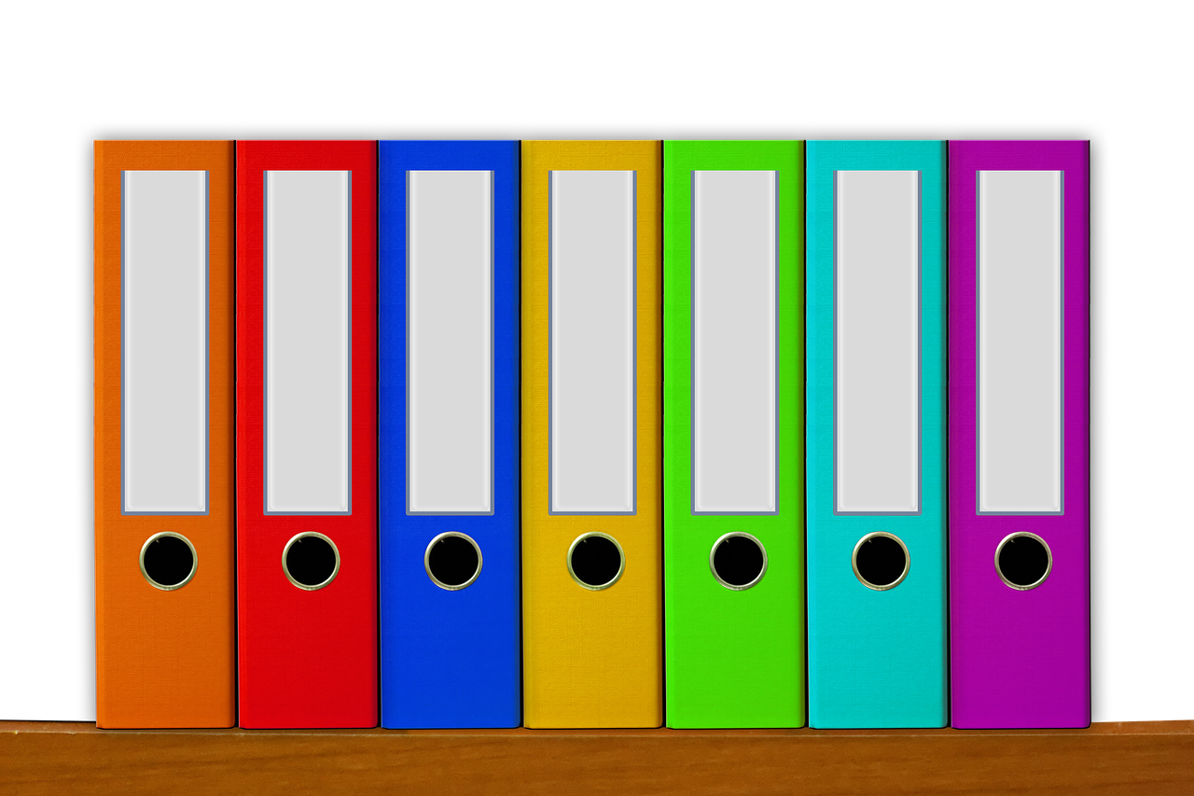
1
Filing
What is filing?
Why we file?
Releasing a document for filing.
Following Movements of the Files.
Dead Files.
Departmental Filing vs. Central Filing.

Slide 4
Learning Objectives
Engaging Starters
By the end of this lesson, the student should be able to:
List the reasons of filing from their knowledge.
Suggest solutions to be used on documents that are ready for filing.
Use the absent card in movements of files.
Classify the departmental & central filing through the given statements.
The First Goal
The Second Goal
The Third Goal
The Fourth Goal
Questions
Lesson: Filing Introduction to Office Management ادر 111

Slide 5
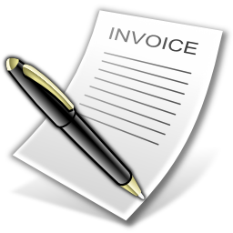
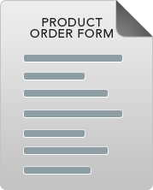
Engaging Starters
What does the above pictures represent?
Where do you keep your documents in the office?
Do you think you should arrange them according to a specific system? Give a reason?
Why do we file?
Engaging Starters
The First Goal
The Second Goal
The Third Goal
The Fourth Goal
Questions
Lesson: Filing Introduction to Office Management ادر 111

Slide 6
What & why is Filing?
Engaging Starters
Arranging documents in groups according to methods of classifications.
Why we file documents?
For future reference.
Find documents quickly & easily.
Keep the documents clean & tidy.
To save them from insects.
The First Goal
The Second Goal
The Third Goal
The Fourth Goal
Next
Questions
Lesson: Filing Introduction to Office Management ادر 111

Slide 7
Evaluation Activity
Engaging Starters
Activity
The First Goal
Write either all the reasons for filing or 3 or 2 reasons
The Second Goal
Type of activity
The Third Goal
Individual - written
The Fourth Goal
Time
2 minutes
Questions
Lesson: Filing Introduction to Office Management ادر 111

Slide 8
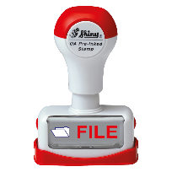
Releasing Document for Filing
Engaging Starters
Rubber stamp reading the word File.
Person’s (Manager’s/
Supervisor’s) initial.
The First Goal
MSJ
The Second Goal
The letter F for filing, in
the margin, top or bottom.
A line drawn across on
face of document.
The Third Goal
The Fourth Goal
F
Next
Questions
Lesson: Filing Introduction to Office Management ادر 111

Slide 9
Evaluation Activity
Engaging Starters
Activity
The First Goal
Question 4 page 40 in the workbook
The Second Goal
Type of activity
The Third Goal
Individual - written
The Fourth Goal
Time
2 minutes
Questions
Lesson: Filing Introduction to Office Management ادر 111

Slide 10
Dead Files
Dead files: files that are not required anymore.
Should be removed from the filing system & stored in boxes.
Engaging Starters
The First Goal
The Second Goal
The Third Goal
The Fourth Goal
Next
Questions
Lesson: Filing Introduction to Office Management ادر 111

Slide 11
Absent Card
Employees borrow files to do their work. The filing clerk makes sure that the file is returned to its place. Absent card is used.
Absent card: used to show details of the file taken out of its folder.
The filing clerk must send a written communication (memo or e-mail) to the borrower to ask him to return the file if he passes the time.
Engaging Starters
The First Goal
The Second Goal
The Third Goal
The Fourth Goal
Next
Questions
Lesson: Filing Introduction to Office Management ادر 111

Slide 12
Absent Card
The Absent Card is used to mark the place where a file has been removed from, so that it can be returned to the correct position easily. This helps to avoid misfiling, which in turn keeps your system accurate. Its includes:
The date file was taken.
File’s name or number.
The person who took/borrowed the file.
Date the person returned the file to the Filing Clerk.
Engaging Starters
The First Goal
The Second Goal
The Third Goal
ABSENT CARD
Date Returned | Taken By | File No. & Name | Date Taken
The Fourth Goal
Next
Questions
Lesson: Filing Introduction to Office Management ادر 111

Slide 13
Evaluation Activity
Engaging Starters
Activity
The First Goal
Practice 1 page 41 in the workbook
The Second Goal
Type of activity
The Third Goal
Individual - written
The Fourth Goal
Time
2 minutes
Questions
Lesson: Filing Introduction to Office Management ادر 111

Slide 14
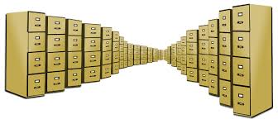
Departmental Filing Vs. Central Filing
Engaging Starters
The First Goal
Personnel Dept.
Sales Dept.
Account Dept.
Account Dept.
The Second Goal
The Third Goal
Sales Dept.
Personnel Dept.
Departmental
Filing
The Fourth Goal
Central
Filing
Next
Questions
Lesson: Filing Introduction to Office Management ادر 111

Slide 15
Departmental Filing Vs. Central Filing
Engaging Starters
Departmental Filing
Central Filing
Kept in the department.
Available at any time.
Better for confidential files.
The filing system isn’t so large, so it is easy to handle.
All files are kept together in one room.
More effective supervision.
Effective follow-up & absent files can be organized.
Use less equipment.
A standard system of filing can be used in the organization.
The First Goal
The Second Goal
The Third Goal
The Fourth Goal
Next
Questions
Lesson: Filing Introduction to Office Management ادر 111

Slide 16
Evaluation Activity
Engaging Starters
Activity
The First Goal
Question 8 page 43 in the workbook
The Second Goal
Type of activity
The Third Goal
Individual - written
The Fourth Goal
Time
2 minutes
Questions
Lesson: Filing Introduction to Office Management ادر 111

Slide 17
Questions
?
Engaging Starters
1. Filing is the arranging of documents in common groups according to some methods of classification.
The First Goal
The Second Goal
True
False
The Third Goal
The Fourth Goal
Questions
Lesson: Filing Introduction to Office Management ادر 111

Slide 18
Questions
?
Engaging Starters
2. Central Filing means each department will keep its own files.
The First Goal
The Second Goal
True
False
The Third Goal
The Fourth Goal
Questions
Lesson: Filing Introduction to Office Management ادر 111

Slide 19
Questions
?
Engaging Starters
3. Dead files are those files that are not required anymore.
The First Goal
The Second Goal
True
False
The Third Goal
The Fourth Goal
Questions
Lesson: Filing Introduction to Office Management ادر 111

Slide 20
Questions
?
Engaging Starters
4. Filing system is used to show details of the file taken out of it’s folder.
The First Goal
The Second Goal
True
False
The Third Goal
The Fourth Goal
Questions
Lesson: Filing Introduction to Office Management ادر 111

Slide 21
Questions
?
Engaging Starters
5. The filing clerk should keep a record of persons who have borrowed files in:
The First Goal
The Second Goal
a. Card Index.
b. Risk Card.
The Third Goal
c. Business Card.
d. Absent Card.
The Fourth Goal
Questions
Lesson: Filing Introduction to Office Management ادر 111

Slide 22
Questions
Engaging Starters
The First Goal
The Second Goal
Additional Activity
The Third Goal
To go over workbook pages 39-43
The Fourth Goal
Questions
Lesson: Filing Introduction to Office Management ادر 111

Slide 23
THANK YOU!
Lesson: Filing Introduction to Office Management ادر 111

Slide 24
Next
Lesson: Filing Introduction to Office Management ادر 111

Slide 25
Back
Lesson: Filing Introduction to Office Management ادر 111

Slide 26
Next
Lesson: Filing Introduction to Office Management ادر 111

Slide 27
Back
Lesson: Filing Introduction to Office Management ادر 111

Slide 28
Next
Lesson: Filing Introduction to Office Management ادر 111

Slide 29
Back
Lesson: Filing Introduction to Office Management ادر 111

Slide 30
Next
Lesson: Filing Introduction to Office Management ادر 111

Slide 31
Back
Lesson: Filing Introduction to Office Management ادر 111

Slide 32
Next
Lesson: Filing Introduction to Office Management ادر 111

Slide 33
Back
Lesson: Filing Introduction to Office Management ادر 111

