Slide 1
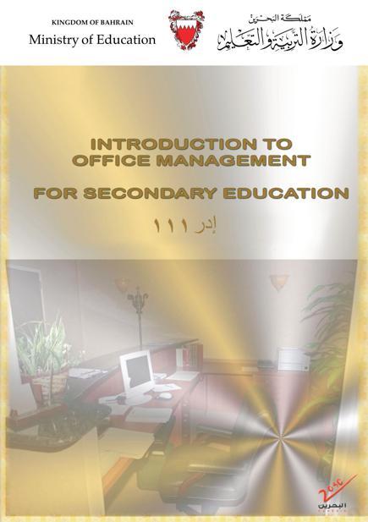
Introduction to
Office Management
ادر 111
FIRST SEMESTER
للصف الثاني ثانوي / تجاري

Slide 2

Chapter 3
Filing Methods & Systems

Slide 3
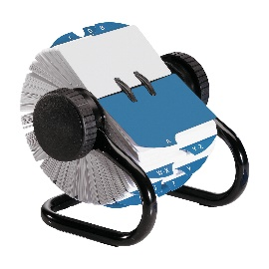



4
Filing Stationery &
Filing Problems
Filing stationery.
Indexing.
Filing Problems & Solutions.
Misfile search tips.
Pages 52-57

Slide 4

Learning Objectives
Engaging Starters
By the end of this lesson, students should be able to:
List the types of files/folders used in filing.
Give examples of indexing files.
Solve problems that occur in the filing section.
State some tips to search a file that is kept incorrectly.
The First Goal
The Second Goal
The Third Goal
The Fourth Goal
Questions
Lesson: Filing Stationary & Filing Problems Introduction to Office Management ادر 111

Slide 5
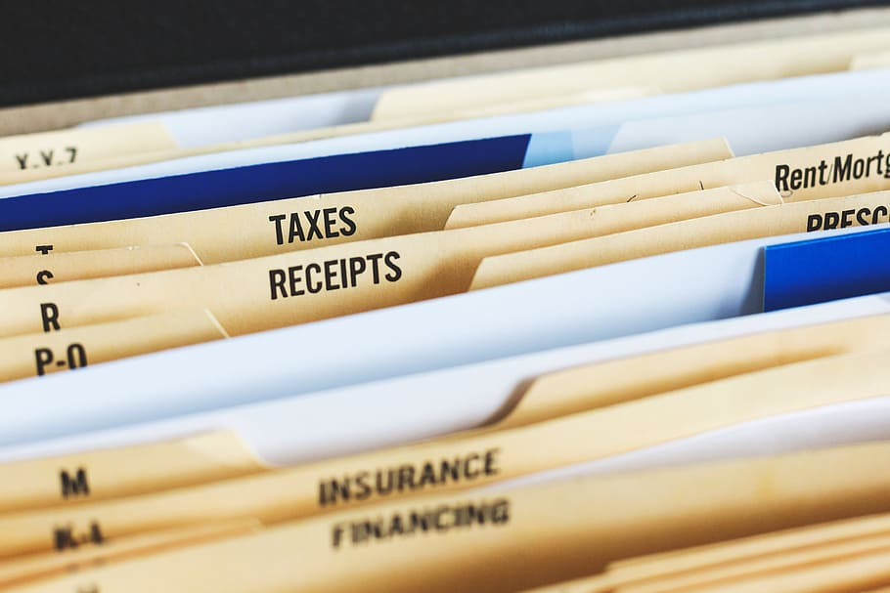
Engaging Starters
What stationery do you think we need in filing documents?
Engaging Starters
The First Goal
The Second Goal
The Third Goal
The Fourth Goal
Questions
Lesson: Filing Stationary & Filing Problems Introduction to Office Management ادر 111

Slide 6

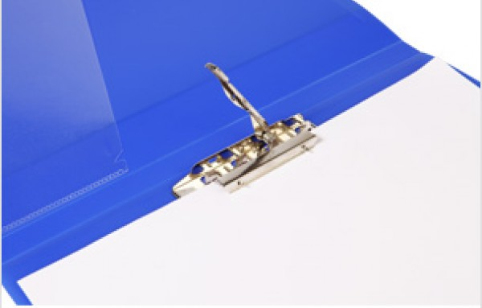
Filing Stationery
Engaging Starters
Box Files
Best for documents that need to be stored for a short time.
Examples of documents: purchase
orders, cheques & store requisitions.
The First Goal
The Second Goal
Clip Files
Hold documents without making a hole in them.
Examples of documents: cheques,
photographs & contracts.
The Third Goal
The Fourth Goal
Next
Questions
Lesson: Filing Stationary & Filing Problems Introduction to Office Management ادر 111

Slide 7
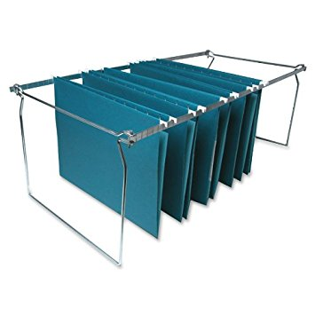
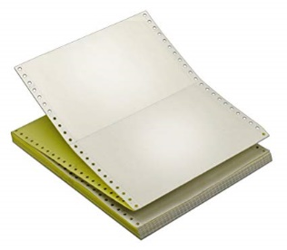
Filing Stationary
Engaging Starters
Hanging Files
Known as file covers.
Used to keep folders in vertical
& horizontal filing systems.
Stay on rails.
The First Goal
The Second Goal
Computer Report Files
Have a binder that can be opened to add or remove computer printouts.
The Third Goal
The Fourth Goal
Next
Questions
Lesson: Filing Stationary & Filing Problems Introduction to Office Management ادر 111

Slide 8
Evaluation Activity
Engaging Starters
Activity
The First Goal
Answer Q 11 page 63 in the workbook
The Second Goal
Type of activity
The Third Goal
Individual - written
The Fourth Goal
Time
2 minutes
Questions
Lesson: Filing Stationary & Filing Problems Introduction to Office Management ادر 111

Slide 9
Indexing
Engaging Starters
Indexing: Method of keeping small amounts of important information about the people who deal with us regularly.
The First Goal
Card Index
Small box, the cards stand upright in the box & are arranged alphabetically according to the customer’s name.
The Second Goal
Page Index
Notebook divided according to the alphabet, like the telephone directory.
The Third Goal
The Fourth Goal
Rotary Index
Similar to the card index. Cards can be removed and kept back after writing the necessary information on the cards.
Questions
Next
Lesson: Filing Stationary & Filing Problems Introduction to Office Management ادر 111

Slide 10
Evaluation Activity
Engaging Starters
Activity
The First Goal
Answer Q 12 page 64 in the workbook
The Second Goal
Type of activity
The Third Goal
Individual - written
The Fourth Goal
Time
2 minutes
Questions
Lesson: Filing Stationary & Filing Problems Introduction to Office Management ادر 111

Slide 11


Filing Problems & Solutions
Engaging Starters
Too many filing places.
Centralize the files with the same information in one place.
The First Goal
The system does not fit the way the materials are called for
Use alphabetic, subject, numeric & geographic filing for certain materials.
The Second Goal
The Third Goal
Missing files are hard to find
Keep track of removed files without guides or make a checkout system.
The Fourth Goal
Questions
Next
Lesson: Filing Stationary & Filing Problems Introduction to Office Management ادر 111

Slide 12
Evaluation Activity
Engaging Starters
Activity
The First Goal
Answer Q 13 page 65 in the workbook
The Second Goal
Type of activity
The Third Goal
Individual - written
The Fourth Goal
Time
3 minutes
Questions
Lesson: Filing Stationary & Filing Problems Introduction to Office Management ادر 111

Slide 13
Misfile Search Tips
When a file is kept incorrectly (in the wrong place), try the following tips to find it:
Look in the folder in front of or behind the correct file.
Look between the folders.
Look under all the folders, especially when using the hanging filing system.
Check for misfiling because of the misreading of letters.
Check alternate spelling.
Look in the year before or after the one in question.
Look in the related subject if using subject filing.
Be aware that the records may be in the storage.
Engaging Starters
The First Goal
The Second Goal
The Third Goal
The Fourth Goal
Questions
Next
Lesson: Filing Stationary & Filing Problems Introduction to Office Management ادر 111

Slide 14
Evaluation Activity
Engaging Starters
Activity
The First Goal
List 4 methods you can attempt to find a misfile.
The Second Goal
Type of activity
The Third Goal
Individual - written
The Fourth Goal
Time
3 minutes
Questions
Lesson: Filing Stationary & Filing Problems Introduction to Office Management ادر 111

Slide 15
Questions
?
1. The notebook which is divided according to the alphabet, like Bahrain Telephone Directory, is called …………………..
Engaging Starters
The First Goal
The Second Goal
a. Card Index.
b. Page Index.
The Third Goal
c. Rotary Index.
d. Follow Up Index.
The Fourth Goal
Questions
Lesson: Filing Stationary & Filing Problems Introduction to Office Management ادر 111

Slide 16
Questions
?
2. It is a small box or cabinet drawer. The cards stand up right in the box and they are usually arranged alphabetically according to the customer’s name. Small plastic tabs show the alphabet.
Engaging Starters
The First Goal
The Second Goal
The Third Goal
a. Card Index.
b. Page Index.
The Fourth Goal
c. Rotary Index.
d. Follow Up Index.
Questions
Lesson: Filing Stationary & Filing Problems Introduction to Office Management ادر 111

Slide 17
Questions
?
3. All of the following are examples of index methods, except for:
Engaging Starters
The First Goal
a. Card Index.
b. Page Index.
The Second Goal
The Third Goal
c. Rotary Index.
d. Box File.
The Fourth Goal
Questions
Lesson: Filing Stationary & Filing Problems Introduction to Office Management ادر 111

Slide 18
Questions
?
4. Files that hold documents without punching a hole in them, and they are good for documents like cheques, contracts, photographs. These files are called…………..
Engaging Starters
The First Goal
The Second Goal
a. Box Files.
b. Hanging Files.
The Third Goal
c. Clip Files.
d. Computer Report Files.
The Fourth Goal
Questions
Lesson: Filing Stationary & Filing Problems Introduction to Office Management ادر 111

Slide 19
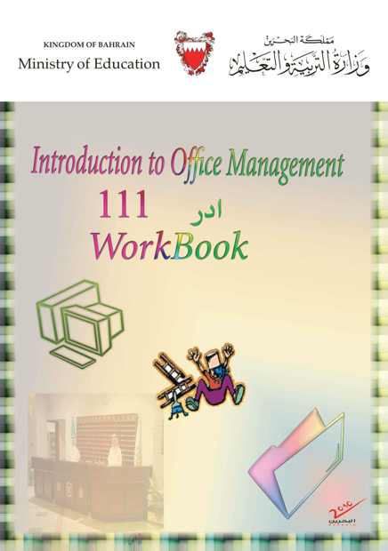
Questions
Engaging Starters
The First Goal
The Second Goal
Additional Activity
The Third Goal
To go over the workbook pages 63-65
The Fourth Goal
Questions
Lesson: Filing Stationary & Filing Problems Introduction to Office Management ادر 111

Slide 20
THANK YOU!
Lesson: Filing Stationary & Filing Problems Introduction to Office Management ادر 111

Slide 21

Next
Lesson: Filing Stationary & Filing Problems Introduction to Office Management ادر 111

Slide 22

Back
Lesson: Filing Stationary & Filing Problems Introduction to Office Management ادر 111

Slide 23
Next
Lesson: Filing Stationary & Filing Problems Introduction to Office Management ادر 111

Slide 24
Back
Lesson: Filing Stationary & Filing Problems Introduction to Office Management ادر 111

Slide 25
Next
Lesson: Filing Stationary & Filing Problems Introduction to Office Management ادر 111

Slide 26
Back
Lesson: Filing Stationary & Filing Problems Introduction to Office Management ادر 111

Slide 27
Next
Lesson: Filing Stationary & Filing Problems Introduction to Office Management ادر 111

Slide 28
Back
Lesson: Filing Stationary & Filing Problems Introduction to Office Management ادر 111

