Slide 1
Introduction to Office Management ادر 111
FIRST SEMESTER
للصف الثاني ثانوي / تجاري

Slide 2
Chapter 2
Reception

Slide 3
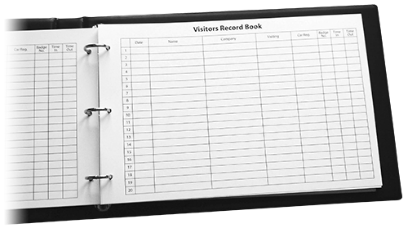
3
Reception Records
Callers’ Register.
Appointment Book.
Pages 30-31

Slide 4
Learning Objectives
By the end of this lesson, students should be able to:
List the reception records.
Record the calls in the caller’s register.
Book an appointment for a visitor.
Engaging Starters
The First Goal
The Second Goal
The Third Goal
Questions
Lesson: Reception Records Introduction to Office Management ادر 111

Slide 5
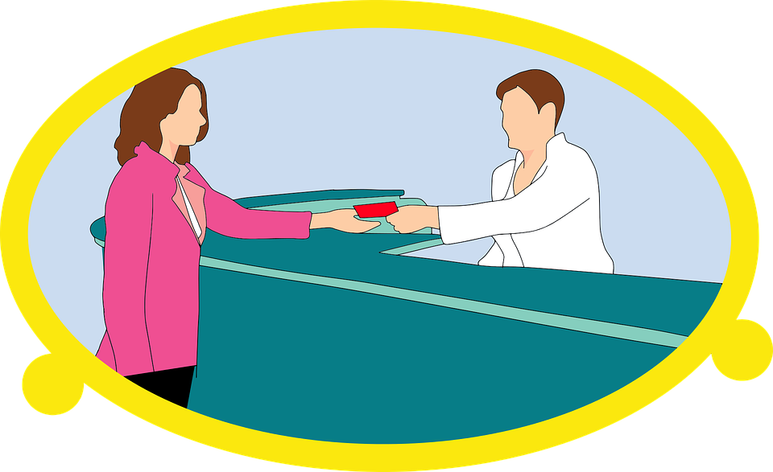
Engaging Starters
Two of the receptionist duties are:
Maintaining a reception register, and maintaining an appointment diary.
From the above duties what are the most important records a receptionist must maintain?
Engaging Starters
The First Goal
The Second Goal
The Third Goal
Questions
Lesson: Reception Records Introduction to Office Management ادر 111

Slide 6
Reception Records
The most important records that a receptionist must maintain are:
A caller’s register (for security & future reference).
An appointment book (to register the appointments).
Engaging Starters
The First Goal
The Second Goal
The Third Goal
Questions
Next
Lesson: Reception Records Introduction to Office Management ادر 111

Slide 7
Evaluation Activity
Engaging Starters
Activity
Write the reception records.
The First Goal
Type of activity
The Second Goal
Individual - written
The Third Goal
Time
Questions
2 minutes
Lesson: Reception Records Introduction to Office Management ادر 111

Slide 8
Caller’s Register
It is used to keep a record of the visitors to the company.
Visitors are often asked to fill in and sign this reception register/callers’ register.
For security or future reference.
A register of callers may look like the following:
Engaging Starters
The First Goal
The Second Goal
Register of Callers
Remarks | Time of Departure | Signature | Seen by | Time of Arrival | Company | Caller’s Name | Date
The Third Goal
Questions
Next
Lesson: Reception Records Introduction to Office Management ادر 111

Slide 9
Caller’s Register
Register of Callers (visitors’ Book) contains details about all visitors.
It includes:
Date of visit.
Name of the visitor.
Name of the visitor’s company.
Time of arrival.
Member of staff they were seen by.
Visitor’s signature.
Time of departure.
Remarks / Action(s) required (e.g. appointment made).
Engaging Starters
Register of Callers
Remarks | Time of Departure | Signature | Seen by | Time of Arrival | Company | Caller’s Name | Date
The First Goal
The Second Goal
The Third Goal
Questions
Next
Lesson: Reception Records Introduction to Office Management ادر 111

Slide 10
Evaluation Activity
Engaging Starters
Activity
The First Goal
Practice 5 page 35 in the workbook
Type of activity
The Second Goal
Individual - written
The Third Goal
Time
Questions
3 minutes
Lesson: Reception Records Introduction to Office Management ادر 111

Slide 11
Appointment Book
This book contains information about the appointments for the day. It includes: date, time, name of the visitor, visitor’s company name, and the name of the person to see.
Engaging Starters
The First Goal
Tuesday 1 September 20--
 | 08:30
 | 09:00
 | 09:30
 | 10:00
 | 10:30
 | 11:00
 | 11:30
 | 12:00
The Second Goal
The Third Goal
Questions
Next
Lesson: Reception Records Introduction to Office Management ادر 111

Slide 12
Evaluation Activity
Engaging Starters
Activity
The First Goal
Practice 6 page 36 in the workbook
Type of activity
The Second Goal
Individual - written
The Third Goal
Time
Questions
3 minutes
Lesson: Reception Records Introduction to Office Management ادر 111

Slide 13
Questions
?
Q1: Using today’s date, complete the “Register of Callers” for ABC Company in the table next page:
Mona Abdulla from AlWatan newspaper came at 10:10 A.M. to meet the HR manager regarding the (Journalist job). She left after 20 minutes.
At 08:30 A.M. Khalid Salah from Y.K. AlMoayyed & Sons came to see the Sales manager to explain the use of the photocopier machine chosen by his office. He left at 09:30.
Noor Hamad from Tamkeen came to see the training officer to give details for some training courses offered by Tamkeen Bahrain. She came at 11:15 A.M. and left at 12:00 P.M.
Engaging Starters
The First Goal
The Second Goal
The Third Goal
Questions
Next
Lesson: Reception Records Introduction to Office Management ادر 111

Slide 14
Questions
?
Q1: Using today’s date, complete the “Register of Callers” for ABC Company in the following table:
Engaging Starters
Register of Callers
Remarks | Time of Departure | Signature | Seen by | Time of Arrival | Company | Caller’s Name | Date
The First Goal
The Second Goal
The Third Goal
Questions
Check your answer
Lesson: Reception Records Introduction to Office Management ادر 111

Slide 15
Questions
?
Q2: Complete the appointment diary for your Human Resources manager on 15 September 2020, from the information given below:
Maram Mahmood from Al Abraj company wants to see the manager before 11:30. Her contact no. is 39777777.
Sara Ahmed from ABC Company wants to see the manager at 8:30. Her mobile no. is 39565656.
Isa Ali from Ithmaar Bank has an appointment at 12:00. His contact no. is 39111111.
Faisal Saoud from Al Zain Group wants to see the manager at any time available. His contact no. is 39888888.
Engaging Starters
The First Goal
The Second Goal
The Third Goal
Questions
Next
Lesson: Reception Records Introduction to Office Management ادر 111

Slide 16
Questions
?
Q2: Complete the appointment diary for your Human Resources manager:
Engaging Starters
Tuesday 15 September 2020
 | 08:30
 | 09:00
 | 09:30
 | 10:00
 | 10:30
 | 11:00
 | 11:30
 | 12:00
The First Goal
The Second Goal
The Third Goal
Questions
Check your answer
Lesson: Reception Records Introduction to Office Management ادر 111

Slide 17
Questions
Engaging Starters
The First Goal
Additional Activity
The Second Goal
To go over the workbook pages 32-36
The Third Goal
Questions
Lesson: Reception Records Introduction to Office Management ادر 111

Slide 18
THANK YOU!
Lesson: Reception Records Introduction to Office Management ادر 111

Slide 19
Answer
Register of Callers
Remarks | Time of Departure | Signature | Seen by | Time of Arrival | Company | Caller’s Name | Date
explain the use of the photocopier machine | 09:30 |  | Sales manager | 08:30 | Y.K. Almoayyed & Sons | Khalid Salah | Today’s date
Journalist job | 10:30 |  | HR manager | 10:10 | AlWatan newspaper | Mona Abdulla
give details for training courses offered by the Tamkeen Bahrain | 12:00 |  | Training Officer | 11:15 | Tamkeen | Noor Hamad
Next
Lesson: Reception Records Introduction to Office Management ادر 111

Slide 20
Answer
Q2: Complete the appointment diary for your Human Resources manager from the information given below:
Tuesday 15 September 2020
Sara Ahmed / ABC Company / 39565656 | 08:30
 | 09:00
 | 09:30
Maram Mahmood / Al Abraj company / 39777777 | 10:00
 | 10:30
Faisal Saoud / Al Zain Group / 39888888 | 11:00
 | 11:30
Isa Ali / Ithmaar Bank / 39111111 | 12:00
Next
Lesson: Reception Records Introduction to Office Management ادر 111

