Slide 1
Introduction to Office Management ادر 111
FIRST SEMESTER
للصف الثاني ثانوي / تجاري

Slide 2
Chapter 2
Reception

Slide 3
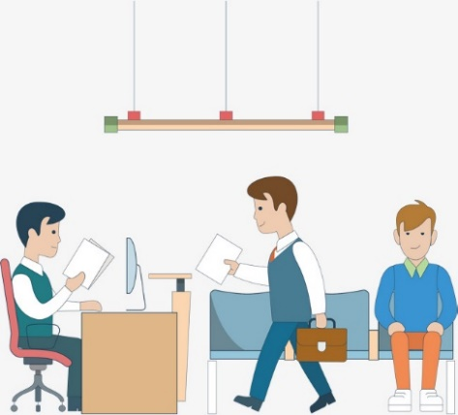
2
Dealing with Visitors
Dealing with visitors.
Problems in reception area.
Pages 25-30

Slide 4
Learning Objectives
By the end of this lesson, students should be able to:
Apply the right ways to deal with visitors through acting.
Explain the problems in the reception area from the previewed videos.
Engaging Starters
The First Goal
The Second Goal
Questions
Lesson: Dealing with Visitors Introduction to Office Management ادر 111

Slide 5
Engaging Starters
Good morning! May I help you?
Engaging Starters
The receptionist duties are not just filing forms and documents, issuing visitors’ badges and giving directions. If you want to become a receptionist, what will your main responsibilities be?
The First Goal
The Second Goal
Questions
Lesson: Dealing with Visitors Introduction to Office Management ادر 111

Slide 6
Dealing with Visitors
Check if the visitor has an appointment & who he wants to see.
If the visitor is expected, contact the wanted staff.
Greet/welcome the visitors.
Engaging Starters
The First Goal
Ask the visitor to record their details in the visitors book.
Tell the visitor about any delay.
Ask if they need help.
The Second Goal
Find out the visitor’s name.
Questions
Issue a visitor’s badge.
Provide refreshment (juice, tea & coffee).
Next
Lesson: Dealing with Visitors Introduction to Office Management ادر 111

Slide 7
Evaluation Activity
Activity
Engaging Starters
Practice 2 on page 27 in the workbook
The First Goal
Type of activity
Individual - written
The Second Goal
Time
Questions
3 minutes
Lesson: Dealing with Visitors Introduction to Office Management ادر 111

Slide 8
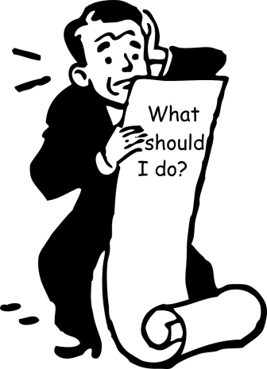
Problems in Reception Area
Dealing with unexpected visitors
Engaging Starters
The First Goal
Dealing with difficult visitors
The Second Goal
Customer
Complaint
Questions
Dealing with complaints
Next
Lesson: Dealing with Visitors Introduction to Office Management ادر 111

Slide 9
Problems in Reception Area
Dealing with unexpected visitors
Engaging Starters
Visitors without an appointment
Visitors with appointment but who arrive earlier or later than expected.
People call to see someone in the organization & they don’t have an appointment.
The First Goal
The Second Goal
Questions
Next
Lesson: Dealing with Visitors Introduction to Office Management ادر 111

Slide 10
Problems in Reception Area
What to do with unexpected visitors
Engaging Starters
Solve the problem.
Deal with the visitor & the problem in a way that still gives a positive image about you & about the company.
The First Goal
The Second Goal
Questions
Next
Lesson: Dealing with Visitors Introduction to Office Management ادر 111

Slide 11
Problems in Reception Area
Dealing with difficult visitors
Engaging Starters
The visitor will NEVER say that he made a mistake.
The receptionist should be diplomatic & try to solve his problem.
Accept the visitor’s problem as a challenge .
The receptionist will make a positive impression on the visitor even if he didn’t solve the problem.
The First Goal
The Second Goal
Questions
Next
Lesson: Dealing with Visitors Introduction to Office Management ادر 111

Slide 12
Problems in Reception Area
Dealing with complaints
Engaging Starters
The receptionist must be ready to listen & note the customer’s complaints.
Give apology or ask to explain the complaint.
Pass the complaint to the concerned person or department.
Refer to the blue box on page 29 in the book.
Customer
Complaint
The First Goal
The Second Goal
Questions
Next
Lesson: Dealing with Visitors Introduction to Office Management ادر 111

Slide 13
Evaluation Activity
Activity
Engaging Starters
Answer question 10 on page 31 in the workbook
The First Goal
Type of activity
Individual - written
The Second Goal
Time
Questions
2 minutes
Lesson: Dealing with Visitors Introduction to Office Management ادر 111

Slide 14
Questions
?
1. As the visitors arrive, the receptionist is generally expected to deal with them. Complete the steps below. They are about how to deal with visitors:
Ask the visitor to record their details in the visitors book.
Engaging Starters
Find out the visitor’s name.
The First Goal
1
2
3
4
5
The Second Goal
Provide refreshment (juice, tea & coffee).
8
6
Questions
9
7
If the visitor is expected contact the wanted staff.
Check your answer
Lesson: Dealing with Visitors Introduction to Office Management ادر 111

Slide 15
Questions
?
2. Different types of visitors are coming to your company, as a receptionist how can you deal with the following visitors:
Engaging Starters
Type of Visitor
A) A visitor who has no appointment.
The First Goal
How to deal with the visitor
The Second Goal
Questions
Check your answer
Lesson: Dealing with Visitors Introduction to Office Management ادر 111

Slide 16
Questions
?
2. Different types of visitors are coming to your company, as a receptionist how can you deal with the following visitors:
Engaging Starters
Type of Visitor
B) A visitor arrives earlier than expected.
The First Goal
How to deal with the visitor
The Second Goal
Questions
Check your answer
Lesson: Dealing with Visitors Introduction to Office Management ادر 111

Slide 17
Questions
?
2. Different types of visitors are coming to your company, as a receptionist how can you deal with the following visitors:
Engaging Starters
Type of Visitor
C) A visitor arrives later than expected.
The First Goal
How to deal with the visitor
The Second Goal
Questions
Check your answer
Lesson: Dealing with Visitors Introduction to Office Management ادر 111

Slide 18
Questions
?
2. Different types of visitors are coming to your company, as a receptionist how can you deal with the following visitors:
Engaging Starters
Type of Visitor
D) A visitor enquired about vacancies for jobs.
The First Goal
How to deal with the visitor
The Second Goal
Questions
Check your answer
Lesson: Dealing with Visitors Introduction to Office Management ادر 111

Slide 19
Questions
?
2. Different types of visitors are coming to your company, as a receptionist how can you deal with the following visitors:
Engaging Starters
Type of Visitor
E) A person who has an appointment with the sales manager, but he is unable to come because of another meeting at the same time.
The First Goal
How to deal with the visitor
The Second Goal
Questions
Check your answer
Lesson: Dealing with Visitors Introduction to Office Management ادر 111

Slide 20
Questions
?
2. Different types of visitors are coming to your company, as a receptionist how can you deal with the following visitors:
Engaging Starters
Type of Visitor
F) A visitor complains about a damaged product.
The First Goal
How to deal with the visitor
The Second Goal
Questions
Check your answer
Lesson: Dealing with Visitors Introduction to Office Management ادر 111

Slide 21
Questions
Engaging Starters
The First Goal
Additional Activity
The Second Goal
To go over the workbook pages 27-32
Questions
Lesson: Dealing with Visitors Introduction to Office Management ادر 111

Slide 22
THANK YOU!
Lesson: Dealing with Visitors Introduction to Office Management ادر 111

Slide 23
Answer
1. As the visitors arrive, the receptionist is generally expected to deal with them. Complete the steps of below of dealing with visitors:
Check if the visitor have appointment & who he wants to see.
Greet/welcome the visitors.
Ask if they need help.
Find out the visitor’s name.
Ask the visitor to record their details in the visitors book.
1
2
3
4
5
Provide refreshment (juice, tea & coffee).
8
6
9
7
Issue a visitors badge.
Tell the visitor about any delay.
If the visitor is expected contact the wanted staff.
Next
Lesson: Dealing with Visitors Introduction to Office Management ادر 111

Slide 24
Answer
2. Different types of visitors are coming to your company, as a receptionist how can you deal with the following visitors:
Type of Visitor
A) A visitor who has no appointment.
How to deal with the visitor
Take another appointment.
Wait for some time & check if the manager not busy, so he can see the visitor.
Transfer him to another employee who an help him if possible.
Next
Lesson: Dealing with Visitors Introduction to Office Management ادر 111

Slide 25
Answer
Different types of visitors are coming to your company, as a receptionist how can you deal with the following visitors:
Type of Visitor
B) A visitor arrives earlier than expected.
How to deal with the visitor
Contact the member of staff to be seen.
If delayed, ask the visitor to take a seat, and offer refreshment for him.
If available, direct visitor to the staff.
Next
Lesson: Dealing with Visitors Introduction to Office Management ادر 111

Slide 26
Answer
2. Different types of visitors are coming to your company, as a receptionist how can you deal with the following visitors:
Type of Visitor
C) A visitor arrives later than expected.
How to deal with the visitor
Take another appointment.
Wait for some time & check if the manager not busy, so he can see the visitor.
Transfer him to another employee who an help him if possible.
Next
Lesson: Dealing with Visitors Introduction to Office Management ادر 111

Slide 27
Answer
2. Different types of visitors are coming to your company, as a receptionist how can you deal with the following visitors:
Type of Visitor
D) A visitor enquired about vacancies for jobs.
How to deal with the visitor
Call the HR Department to ask for appointment if possible.
Next
Lesson: Dealing with Visitors Introduction to Office Management ادر 111

Slide 28
Answer
2. Different types of visitors are coming to your company, as a receptionist how can you deal with the following visitors:
Type of Visitor
E) A person who has an appointment with the sales manager, but he is unable to come because of another meeting at the same time.
How to deal with the visitor
Give him another appointment.
Next
Lesson: Dealing with Visitors Introduction to Office Management ادر 111

Slide 29
Answer
2. Different types of visitors are coming to your company, as a receptionist how can you deal with the following visitors:
Type of Visitor
F) A visitor complains about a damaged product.
How to deal with the visitor
Try to cool him down.
Apologize about what happen.
Try to contact the sales department or any employee who can solve his problem.
Next
Lesson: Dealing with Visitors Introduction to Office Management ادر 111

