Slide 1
Introduction to Office Management ادر 111
FIRST SEMESTER
للصف الثاني ثانوي / تجاري

Slide 2
Chapter 1
Office Design & Function

Slide 3
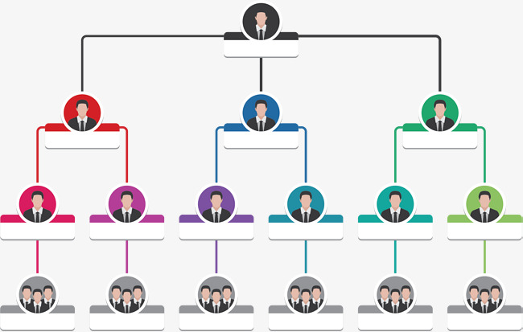
3
Office Organization
Organization Chart.
Duties of Each Department.
Draw an Organization Chart.
Pages 9-11

Slide 4
Learning Objectives
By the end of this lesson, the student should be able to:
Define the term of organizational chart.
Classify the duties with its correct department.
Prepare a diagram illustrating the organization chart of the school.
Engaging Starters
The First Goal
The Second Goal
The Third Goal
Questions
Lesson: Organization Chart Introduction to Office Management ادر 111

Slide 5
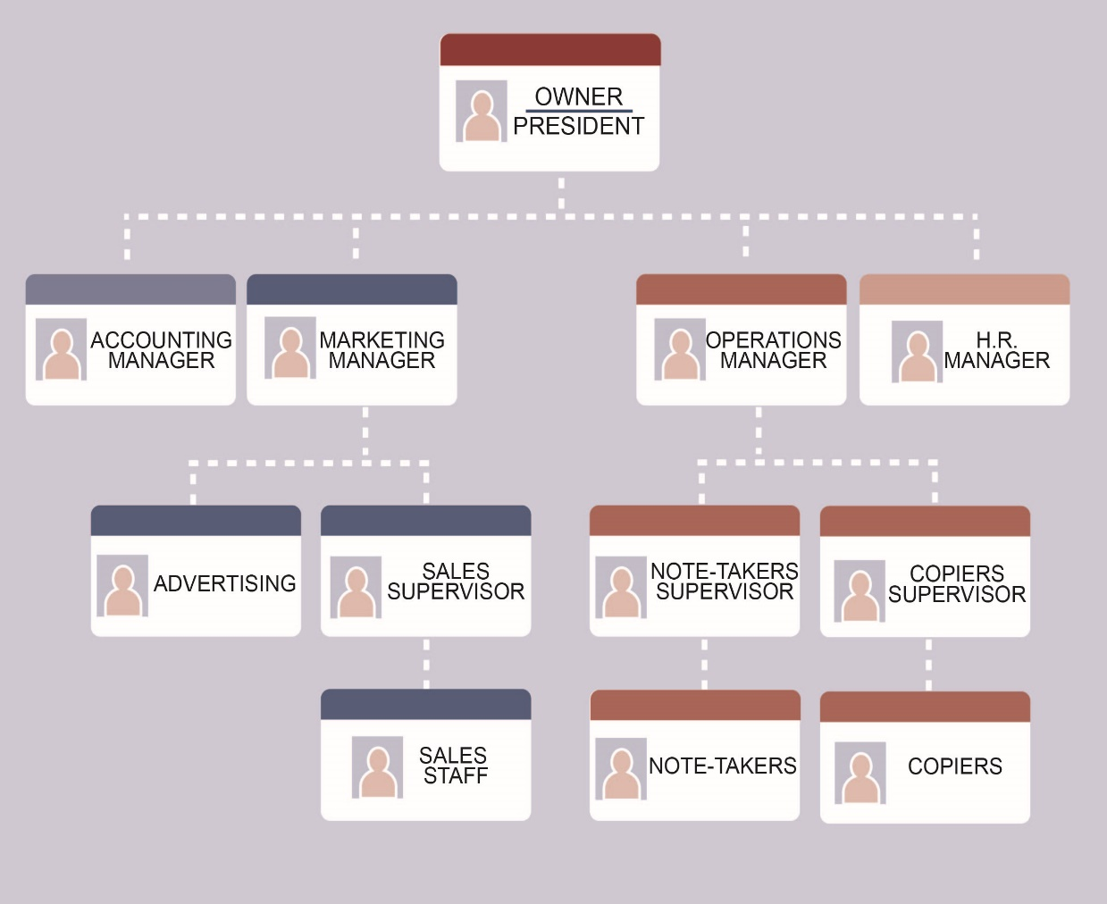
Engaging Starters
Did you saw a similar chart in your school?
What does this chart represent?
Identify the level of administration in the picture?
Why do you think it is important to have this chart?
Engaging Starters
The First Goal
The Second Goal
The Third Goal
Questions
Lesson: Organization Chart Introduction to Office Management ادر 111

Slide 6
Office Organization
Organizations are divided into departments. Each department is managed by a manager or head of department.
Structure:
General Manager (G.M.).
Managers or departmental heads.
Supervisors.
Office Administrators or Office Assistants.
Organizational Chart: a diagram that shows the relationship and relative ranks of its parts & positions.
Engaging Starters
The First Goal
The Second Goal
The Third Goal
Questions
Next
Lesson: Organization Chart Introduction to Office Management ادر 111

Slide 7
Evaluation Activity
Engaging Starters
Activity
The First Goal
Write the definition of Organizational Chart
Type of activity
The Second Goal
Individual - written
The Third Goal
Time
Questions
2 minutes
Lesson: Organization Chart Introduction to Office Management ادر 111

Slide 8
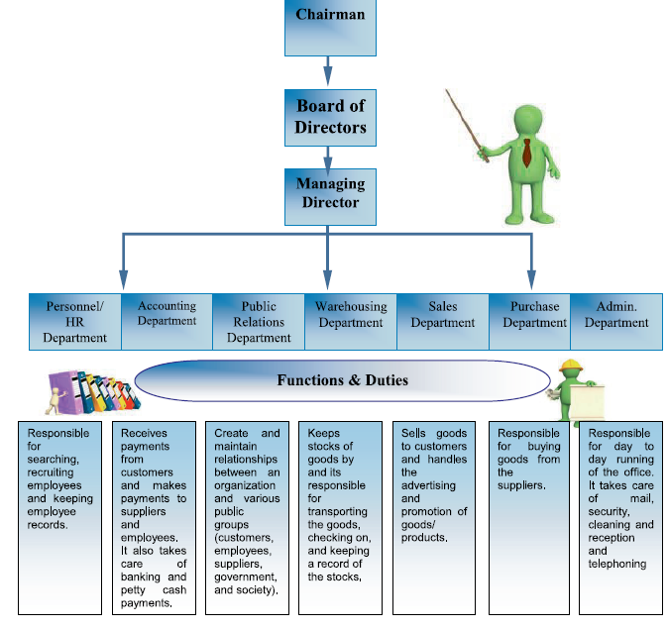
Function & Duties
Engaging Starters
The First Goal
The Second Goal
The Third Goal
Questions
Next
Lesson: Organization Chart Introduction to Office Management ادر 111

Slide 9
Function & Duties
The following are the different departments within a big organization:
Engaging Starters
Function & Duties | Department
Receives payments from customers and makes payments to suppliers and employees. It also takes care of banking and petty cash payments. | Accounting or Finance
Responsible for searching, recruiting employees and keeping employee records. | Human Resources or Personnel
Sells goods to customers and handles the advertising and promotion of goods/products. | Sales
Responsible for buying goods from the suppliers. | Purchasing
Responsible for day to day running of the office. It takes care of mail, security, cleaning and reception and telephoning | Administration
Keeps stocks of goods by and its responsible for transporting the goods, checking on, and keeping a record of the stocks. | Warehousing or Storage
Create and maintain relationships between an organization and various public groups (customers, employees, suppliers, government, and society). | Public Relations
The First Goal
The Second Goal
The Third Goal
Questions
Next
Lesson: Organization Chart Introduction to Office Management ادر 111

Slide 10
Evaluation Activity
Engaging Starters
Activity
The First Goal
Write the correct department next to each function
Type of activity
The Second Goal
Individual - written
The Third Goal
Time
Questions
3 minutes
Next
Lesson: Organization Chart Introduction to Office Management ادر 111

Slide 11
Evaluation Activity
Write the correct department:
Responsible for buying goods from suppliers. ( )
2. Check the goods & keep records of the stocks. ( )
3. Searching for employees. ( )
4. Receive payments from the customer. ( )
Engaging Starters
The First Goal
The Second Goal
The Third Goal
Questions
Next
Lesson: Organization Chart Introduction to Office Management ادر 111

Slide 12
Evaluation Activity
Write the correct department:
Responsible for buying goods from suppliers. (Purchase Dept.)
2. Check the goods & keep records of the stocks. (Warehousing Dept.)
3. Searching for employees. (HR Dept.)
4. Receive payments from the customer. (Account Dept.)
Engaging Starters
The First Goal
The Second Goal
The Third Goal
Questions
Lesson: Organization Chart Introduction to Office Management ادر 111

Slide 13
Evaluation Activity
Engaging Starters
Activity
The First Goal
In groups prepare a diagram illustrating the organization chart of the school in the workbook page 18 practice 6.
Type of activity
The Second Goal
In group - written
The Third Goal
Time
Questions
5 minutes
Lesson: Organization Chart Introduction to Office Management ادر 111

Slide 14
Questions
?
1. Accounting Dept. is responsible for buying goods from the suppliers.
Engaging Starters
The First Goal
The Second Goal
True
False
The Third Goal
Questions
Lesson: Organization Chart Introduction to Office Management ادر 111

Slide 15
Questions
?
2. Purchase Dept. buys goods from the suppliers.
Engaging Starters
The First Goal
The Second Goal
True
False
The Third Goal
Questions
Lesson: Organization Chart Introduction to Office Management ادر 111

Slide 16
Questions
?
3. The department that is responsible for transporting goods and keeping a record of stock is:
Engaging Starters
The First Goal
The Second Goal
A. Sales Department.
B. Warehousing Department.
The Third Goal
C. Human Resource Dept.
Questions
Lesson: Organization Chart Introduction to Office Management ادر 111

Slide 17
Questions
?
4. The department that is responsible for searching, recruiting employees and keeping employee records is:
Engaging Starters
The First Goal
The Second Goal
A. Sales Department.
B. Warehousing Department.
The Third Goal
C. Human Resource Dept.
Questions
Lesson: Organization Chart Introduction to Office Management ادر 111

Slide 18
Questions
Engaging Starters
The First Goal
Additional Activity
The Second Goal
Workbook pages 15-19.
The Third Goal
Questions
Lesson: Organization Chart Introduction to Office Management ادر 111

Slide 19
THANK YOU!
Lesson: Organization Chart Introduction to Office Management ادر 111

Slide 20
Next
Lesson: Organization Chart Introduction to Office Management ادر 111

Slide 21
Back
Lesson: Organization Chart Introduction to Office Management ادر 111

Slide 22
Next
Lesson: Organization Chart Introduction to Office Management ادر 111

Slide 23
Back
Lesson: Organization Chart Introduction to Office Management ادر 111

Slide 24
Next
Lesson: Organization Chart Introduction to Office Management ادر 111

Slide 25
Back
Lesson: Organization Chart Introduction to Office Management ادر 111

Slide 26
Next
Lesson: Organization Chart Introduction to Office Management ادر 111

Slide 27
Back
Lesson: Organization Chart Introduction to Office Management ادر 111

