Slide 1
Introduction to Office Management ادر 111
FIRST SEMESTER
للصف الثاني ثانوي / تجاري

Slide 2
Chapter 1
Office Design & Function

Slide 3
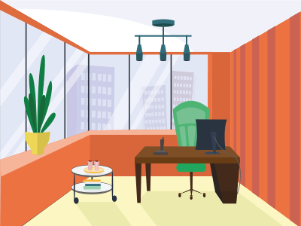
1
Office Design
Term of office.
Types of office.
Advantages & disadvantages of offices.

Slide 4
Learning Objectives
By the end of this lesson, the student should be able to:
Identify the office.
Compare between the types of office.
To classify the advantages & disadvantages of closed & open office.
Engaging Starters
The First Goal
The Second Goal
The Third Goal
Questions
Lesson: Office Design Introduction to Office Management ادر 111

Slide 5
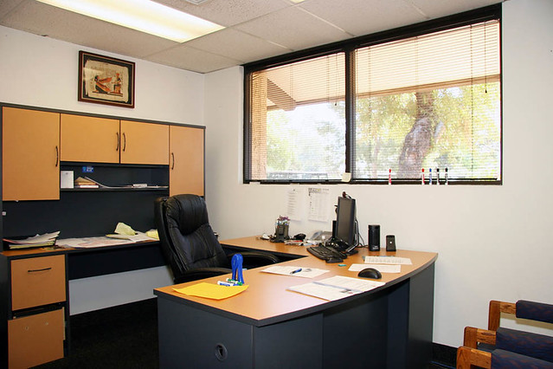
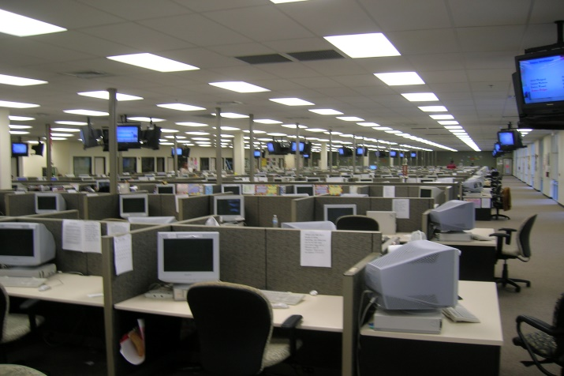
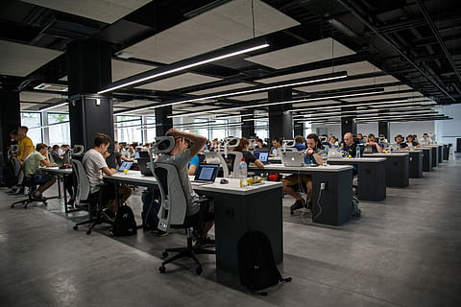
Engaging Starters
What all these pictures represent?
Have you seen these places before? Mention them.
What functions do you think people do in these places?
Engaging Starters
The First Goal
The Second Goal
The Third Goal
Questions
Lesson: Office Design Introduction to Office Management ادر 111

Slide 6
Office
Engaging Starters
A place of business where professional duties are done.
Room or other area where information is received, processed, filed and available when required.
The First Goal
The Second Goal
The Third Goal
Questions
Next
Lesson: Office Design Introduction to Office Management ادر 111

Slide 7
Evaluation Activity
Engaging Starters
Activity
Write the definition of office
The First Goal
Type of activity
The Second Goal
Individual - written
The Third Goal
Time
Questions
2 minutes
Lesson: Office Design Introduction to Office Management ادر 111

Slide 8
Office Design
What are the differences in the above offices design?
In which office from the above pictures you think there is more privacy?
In which office you can work more in a team?
In which office you can have less noise?
Engaging Starters
The First Goal
The Second Goal
Office A
Office B
Office C
The Third Goal
Questions
Next
Lesson: Office Design Introduction to Office Management ادر 111

Slide 9
Office Design
Office can be built in any location, some modern requirements for office make this more difficult. Legal requirement & technical requirement.
Other requirements such as security & flexibility of layout.
Engaging Starters
The First Goal
The Second Goal
The Third Goal
Questions
Next
Lesson: Office Design Introduction to Office Management ادر 111

Slide 10
Office Design
Purpose of an office is to provide a workplace for administrative and managerial workers. Arranging the layout depends on:
How many persons will work in the same room.
How much space available.
Illumination / lightning.
Resources.
Infrastructure.
Office administration responsibilities.
Engaging Starters
The First Goal
The Second Goal
The Third Goal
Questions
Next
Lesson: Office Design Introduction to Office Management ادر 111

Slide 11
Office Design
Engaging Starters
The First Goal
The Second Goal
Closed Office
Cubicle Office
Open Office
Each person sits in a separate room with its own access.
Partially enclosed workspace, separated from each other by partitions, usually 5 to 6 feet.
All employees sits next to each other using their own desk without separation.
The Third Goal
Questions
Next
Lesson: Office Design Introduction to Office Management ادر 111

Slide 12
Evaluation Activity
Engaging Starters
Activity
The First Goal
Compare between the open office and closed office using the table in the book page 6
The Second Goal
Type of activity
Individual - written
The Third Goal
Time
Questions
3 minutes
Lesson: Office Design Introduction to Office Management ادر 111

Slide 13
Advantages & Disadvantages of Closed & Open Office
classify the advantages & disadvantages of Closed & open Office Based on what type you choose.
Time: 3 minutes
Engaging Starters
The First Goal
Closed Office
Open Office
Hard Supervision | Less Communication | High Cost | More Security | Less Teamwork | Hard Movement | More Privacy | Less Noise
The Second Goal
The Third Goal
Easy Supervision | More Communication | Less Cost | Less Security | More Teamwork | Easy Movement | Less Privacy | More Noise
Questions
Next
Lesson: Office Design Introduction to Office Management ادر 111

Slide 14
Advantages & Disadvantages of Closed & Open Office
Engaging Starters
The First Goal
CLOSE OFFICE
DISADVANTAGES | ADVANTAGES
Difficult / hard Supervision | More Privacy
Less Communication | More Security
Less Teamwork | Less Noise
High Cost
Difficult / hard Movement
The Second Goal
The Third Goal
Questions
Next
Lesson: Office Design Introduction to Office Management ادر 111

Slide 15
Advantages & Disadvantages of Closed & Open Office
Engaging Starters
The First Goal
OPEN OFFICE
DISADVANTAGES | ADVANTAGES
More Noise | Easy Supervision
No / Less Security | More Communication
No / Less Privacy | More Teamwork
 | Less Cost
 | Easy Movement
The Second Goal
The Third Goal
Questions
Next
Lesson: Office Design Introduction to Office Management ادر 111

Slide 16
Evaluation Activity
Engaging Starters
Activity
Answer activity 1.2 page 12 in the workbook.
The First Goal
Type of activity
The Second Goal
Individual - written
The Third Goal
Time
Questions
3 minutes
Lesson: Office Design Introduction to Office Management ادر 111

Slide 17
Questions
?
1. There is more privacy in the open office.
Engaging Starters
The First Goal
The Second Goal
True
False
The Third Goal
Questions
Lesson: Office Design Introduction to Office Management ادر 111

Slide 18
Questions
?
2. Office is a room where information is received, processed, filed and available when required.
Engaging Starters
The First Goal
The Second Goal
True
False
The Third Goal
Questions
Lesson: Office Design Introduction to Office Management ادر 111

Slide 19
Questions
?
3. Modern requirements of office design is legal & technical requirements.
Engaging Starters
The First Goal
The Second Goal
True
False
The Third Goal
Questions
Lesson: Office Design Introduction to Office Management ادر 111

Slide 20
Questions
?
4. There is no security in the closed office.
Engaging Starters
The First Goal
The Second Goal
True
False
The Third Goal
Questions
Lesson: Office Design Introduction to Office Management ادر 111

Slide 21
Questions
Engaging Starters
The First Goal
Additional Activity
The Second Goal
Workbook page 10-12
The Third Goal
Questions
Lesson: Office Design Introduction to Office Management ادر 111

Slide 22
THANK YOU!
Lesson: Office Design Introduction to Office Management ادر 111

Slide 23
Next
Lesson: Office Design Introduction to Office Management ادر 111

Slide 24
Back
Lesson: Office Design Introduction to Office Management ادر 111

Slide 25
Next
Lesson: Office Design Introduction to Office Management ادر 111

Slide 26
Back
Lesson: Office Design Introduction to Office Management ادر 111

Slide 27
Next
Lesson: Office Design Introduction to Office Management ادر 111

Slide 28
Back
Lesson: Office Design Introduction to Office Management ادر 111

Slide 29
Next
Lesson: Office Design Introduction to Office Management ادر 111

Slide 30
Back
Lesson: Office Design Introduction to Office Management ادر 111

