Slide 1
Finding the value of annuity Units 15
FINANCIAL MATHEMATICS
Fin 111
First semester Class: second Pages: 77-87

Slide 2
Objectives
At the end of this lesson, Student should be able to:
1- Finding Unknown factors of ordinary annuities.
2- Finding Unknown factors of annuities due.
Annuities FINANCILA MATHEMATICS Fin: 111

Slide 3
Types of annuities
Is a paid at the end of each period.
Payment/Ordinary Annuities
Is a paid at the beginning of each period.
Investment/Due Annuities
Annuities FINANCILA MATHEMATICS Fin: 111

Slide 4
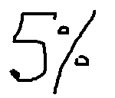
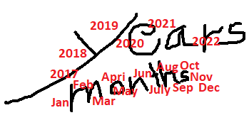
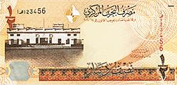
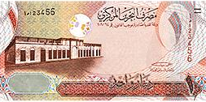
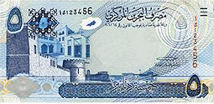
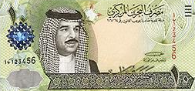
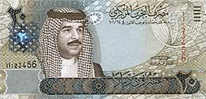
Formula of Compound Amount
Payment/Ordinary Annuities
Compound Amount = Annuity x (((1+ interest rate)^{number of period/Time} - 1) ÷ i
Sn = R x ( (1+ i )^{n} - 1 ) ÷ i
The value of each annuity.
The percentage (%) of interest.
The number of annuities
Annuities FINANCILA MATHEMATICS Fin: 111

Slide 5
Finding value of annuity
Payment/Ordinary Annuities
Example:
Mona pays a loan at the end of each six months for 10 years at 5 % annually compounded semi - annually. If the compound amount of annuities at the end of the period was BD3831.699. what is the value of each ordinary annuity?
R = . Sn .
( (1+ i )^{n} - 1 ) ÷ i
= . 3831.699 . = 3831.699 = BD 150
( ( 1+ 2. 5%)²⁰ - 1 ) ÷ 2. 5% 25.54465
n= 10 x2=20
i= 5%÷2=2.5%
Annuities FINANCILA MATHEMATICS Fin: 111

Slide 6
Finding Annuity of annuity
Payment/Ordinary Annuities
Example:
Awatef paid at the end of each year sum of money at 2%annually so that the amount of annuities after 11 years was BD973.496. What was the value of each annuity?
R = . Sn .
( (1+ i )^{n} - 1 ) ÷ i
= . 973.496 . = 973.496 = BD 80
( ( 1+ 2%)¹¹ - 1 ) ÷ 2% 12.1687
Annuities FINANCILA MATHEMATICS Fin: 111

Slide 7
Finding Annuity of annuity
Investment/Due Annuities
Example:
What quarterly investment will accumulate to BD5812.062 in
five years at 3% quarterly?
R = . Sn .
[ (1+ i )^{n} - 1 ) ÷ i ]×(1+i)
= . 5812.062 . = 5812.062 =BD 210
( ( 1+ 3%)²⁰ - 1 ) ÷ 3% x (1+3%) 27.67648
n= 5 x4=20
Annuities FINANCILA MATHEMATICS Fin: 111

Slide 8
Finding Annuity of annuity
Investment/Due Annuities
Example:
Fahad deposited a sum of money at the beginning of each year at 2.5% annually and the amount of annuity became BD746.428 after 10 years. What was the value of each annuity?
R = . Sn .
[ (1+ i )^{n} - 1 ) ÷ i ]×(1+i)
= . 746.428 . = 746.428 =BD 65
( ( 1+ 2.5%)¹⁰ - 1 ) ÷ 2.5% x (1+2.5%) 11.4835
Annuities FINANCILA MATHEMATICS Fin: 111

Slide 9
1) Calculate the value of Payment annuity of the following:
Sn | Time / Period | Interest Rate | R
BD1086.409 | 8 Years | 10 % annually | BD ???
a- BD90
b- BD95
c- BD100
d- BD105
Annuities FINANCILA MATHEMATICS Fin: 111

Slide 10
2) Isa deposits a sum of money at the beginning of each
year at 4% annually and the amount of annuity became
BD1872.960 after 10 years .What was the value of each
annuity?
a- BD485.208
b- 150.000
c- BD97.899
d- BD421.208
Annuities FINANCILA MATHEMATICS Fin: 111

Slide 11
R = 1086.409 = 1086.409 = 95
((1+ 10%)⁸ - 1)÷ 10% 11.4358
Click on the arrow for the next question

Slide 12
Click the arrow to return to the question

Slide 13
R = 1872.960 = 1872.960 = 150
((1+ 4%)¹⁰ - 1)÷ 4% x(1.04) 12.48635
Click on the arrow for the next question

Slide 14
Click the arrow to return to the question

Slide 15
The lesson ended
We hope
Success
Lesson Objective
Thank you
For more information:
Visit the www.Edunet.com
Questions and activities of the book
Annuities FINANCILA MATHEMATICS Fin: 111

