Slide 1
Amount and interest of
Payment/Ordinary
annuities Units 13-14
FINANCIAL MATHEMATICS
Fin 111
First semester Class: second Pages: 77-83

Slide 2
Objectives
At the end of this course, Student should be able to:
1-ldentify the different between types of annuities.
2- Calculate the compound amount of Payment/Ordinary annuities
3- Calculate the compound interest of Payment/Ordinary annuities
Ordinary annuity FINANCILA MATHEMATICS Fin: 111

Slide 3
Types of annuities
Payment/Ordinary Annuities
Investment/Due Annuities
Is a paid at the end of each period.
Ordinary annuity FINANCILA MATHEMATICS Fin: 111
وزارة التربية والتعليم – 2021م

Slide 4
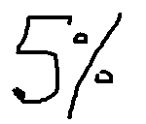
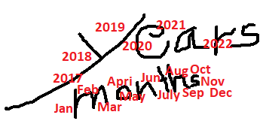
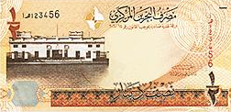
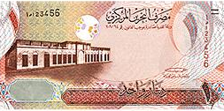
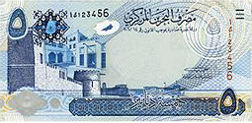
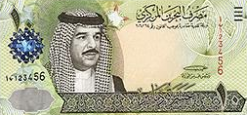
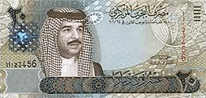
Formula of Compound Amount
Payment/Ordinary Annuities
Compound Amount = Annuity x (((1+ interest rate)^{number of period/Time} - 1) ÷ i
Sn = R x ( (1+ i )^{n} - 1 ) ÷ i
The value of each annuity.
The percentage (%) of interest.
The number of annuities
Ordinary annuity FINANCILA MATHEMATICS Fin: 111
وزارة التربية والتعليم – 2021م

Slide 5
Formula of Compound Interest
Payment/Ordinary Annuities
Compound Interest = Compound Amount - (Annuity x number of period/Time )
CI = Sn - ( R – n)
Ordinary annuity FINANCILA MATHEMATICS Fin: 111
وزارة التربية والتعليم – 2021م

Slide 6
Formula of Compound Amount
Payment/Ordinary Annuities
Example:
A man paid an annuity of BD100 the end of each year for 4 years at an interest rate of 7% annually. Find the compound amount.
Ordinary annuity FINANCILA MATHEMATICS Fin: 111
وزارة التربية والتعليم – 2021م

Slide 7
Formula of Compound Amount
Payment/Ordinary Annuities
Example:
A man paid an annuity of BD100 the end of each year for 4 years at an interest rate of 7% annually. Find the compound amount.
Compound Amount = Annuity x (( (1+ interest rate )^{number of period/Time} - 1 ) ÷ i
Sn = R x ( (1+ i )^{n} - 1 ) ÷ i
= 100 x ( ( 1+ 7%)⁴ - 1 ) ÷ 7%
= BD 443.994
Ordinary annuity FINANCILA MATHEMATICS Fin: 111
وزارة التربية والتعليم – 2021م

Slide 8
Compound Interest
Payment/Ordinary Annuities
Example:
Calculate the compound interest of an ordinary annuity of BD200 paid each quarterly for 6 years if the nominal rate is 9% annually ?
.
n= 6 x4=24
i= 9%÷4=2.25%
Sn = R x ( (1+ i )^{n} - 1 ) ÷ i
= 200 x ( ( 1+ 2.25%)²⁴ - 1 ) ÷ 2.25% = BD 6273.481
Ordinary annuity FINANCILA MATHEMATICS Fin: 111
وزارة التربية والتعليم – 2021م

Slide 9
Compound Interest
Payment/Ordinary Annuities
Example:
Calculate the compound interest of an ordinary annuity of BD200 paid each quarterly for 6 years if the nominal rate is 9% annually ?
.
n= 6 x4=24
i= 9%÷4=2.25%
Sn = R x ( (1+ i )^{n} - 1 ) ÷ i
= 200 x ( ( 1+ 2.25%)²⁴ - 1 ) ÷ 2.25% = BD 6273.481
CI = Sn - ( R x n )
= 6273.481 - ( 200 x 24 ) = BD 1473.481
Ordinary annuity FINANCILA MATHEMATICS Fin: 111
وزارة التربية والتعليم – 2021م

Slide 10
Evaluation
Choose the correct answer for the following:
1) Find the Compound Amount of BD150 paid at the end of
year at 4½% annually for 10 years.
a- BD82.945
b- BD1843.231
c- BD232.945
d- BD1693.231
Ordinary annuity FINANCILA MATHEMATICS Fin: 111
وزارة التربية والتعليم – 2021م

Slide 11
Evaluation
2) Calculate the compound interest of an ordinary annuity
of BD50 paid 4 times a year for 6 years if interest rate is
4% quarterly?
a- BD1954.130
b- BD1904.130
c- BD344.915
d- BD754.130
Ordinary annuity FINANCILA MATHEMATICS Fin: 111
وزارة التربية والتعليم – 2021م

Slide 12
Evaluation
3) Calculate the compound Amount of the following:
SN | Time / Period | Interest Rate | Annuity (ordinary)
BD?? | 4 Years | 1 % monthly | BD 50
a- BD5894.869
b- BD3334.963
c- BD3061.130
d- BD3144.869
Ordinary annuity FINANCILA MATHEMATICS Fin: 111
وزارة التربية والتعليم – 2021م

Slide 13
Evaluation
4) What is the compound interest of $ 400 investment
end of each year for at 7% annually 8 years?
a- $903.92
b- $1191.20
c- $503.92
d- $9639.20
Annuities FINANCILA MATHEMATICS Fin: 111
وزارة التربية والتعليم – 2021م

Slide 14
Evaluation
5) Find the compound interest of KD70 for 6 years
at 5% thirdly. (Ordinary Annuity)
a- KD1804.964
b- KD1969.267
c- KD225.000
d- KD709.267
Ordinary annuity FINANCILA MATHEMATICS Fin: 111
وزارة التربية والتعليم – 2021م

Slide 15
Evaluation
6) Find the compound amount of Ordinary Annuities
of BD70 paid each a year for 6 years if interest rate is
5.75% annually ?
a- BD 485.208
b- BD 513.104
c- BD458.208
d- BD421.208
Ordinary annuity FINANCILA MATHEMATICS Fin: 111
وزارة التربية والتعليم – 2021م

Slide 16
Sn = 150 x((1+ 4½%) ¹⁰ -1) ÷ 4½% = BD1843.231
Click on the arrow for the next question

Slide 17
Click the arrow to return to the question

Slide 18
Sn= 50 x((1+4%)²⁴ -1)÷4%=BD1954.130
CI = 1954.130 – (50x24) BD 754.130
Click on the arrow for the next question

Slide 19
Click the arrow to return to the question

Slide 20
Sn = 50 x((1+ 1%) ⁴⁸ -1) ÷ 1%= BD3061.130
Click on the arrow for the next question

Slide 21
Click the arrow to return to the question

Slide 22
Sn = 400 x((1+7%)⁸ -1)÷ 7% =$4103.92
CI = 4103.92 – (400×8) =$ 903.92
Click on the arrow for the next question

Slide 23
Click the arrow to return to the question

Slide 24
Sn = 70 x((1+ 5%) ¹⁸ -1) ÷5%= KD1969.267
CI = 1969.267 - 1260 = KD 709.267
Click on the arrow for the next question

Slide 25
Click the arrow to return to the question

Slide 26
Sn= 70 x((1+5.75%)⁶ -1)÷5.75% =BD485.208
Click on the arrow for the next slide

Slide 27
Click the arrow to return to the question

Slide 28
The lesson ended
We hope
Success
Lesson Objective
Thank you
For more information:
Visit the www.Edunet.com
Questions and activities of the book
Ordinary annuity FINANCILA MATHEMATICS Fin: 111
وزارة التربية والتعليم – 2021م

