Slide 1
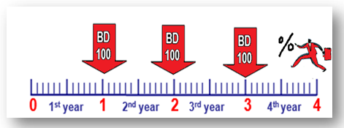
Amount and interest of
Investment/Due
annuities Units 13-14
FINANCIAL MATHEMATICS
Fin 111
First semester Class: second Pages: 77-85

Slide 2
Objectives
At the end of this course, Student should be able to:
1-ldentify the different between types of annuities.
2- Calculate the compound amount of Investment/Due annuities
3- Calculate the compound interest of Investment/Due annuities
Investment/Due Annuities FINANCILA MATHEMATICS Fin: 111
وزارة التربية والتعليم – 2021م

Slide 3
Types of annuities
Payment/Ordinary Annuities
Investment/Due Annuities
Is a paid at the beginning of each period.
Investment/Due Annuities FINANCILA MATHEMATICS Fin: 111
وزارة التربية والتعليم – 2021م

Slide 4
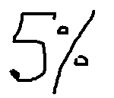
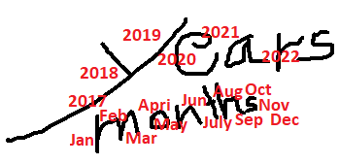
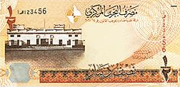
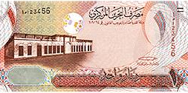
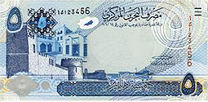
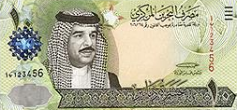
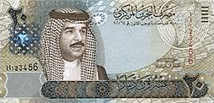
Formula of Compound Amount
Investment/Due Annuities
Compound Amount = Annuity x (((1+ interest rate)^{number of period/Time} - 1) ÷ i x (1+i)
Sn = R x ( (1+ i )^{n} - 1 ) ÷ i x (1+i)
The value of each annuity.
The percentage (%) of interest.
The number of annuities
Investment/Due Annuities FINANCILA MATHEMATICS Fin: 111
وزارة التربية والتعليم – 2021م

Slide 5
Formula of Compound Interest
Investment/Due Annuities
Compound Interest = Compound Amount - (Annuity x number of period/Time )
CI = Sn - ( R – n)
Investment/Due Annuities FINANCILA MATHEMATICS Fin: 111
وزارة التربية والتعليم – 2021م

Slide 6
Compound Amount
Investment/Due Annuities
Example:
A man paid an annuity of BD100 at the beginning of each year for 4 years at an interest rate of 7% annually. Find the compound amount.
Investment/Due Annuities FINANCILA MATHEMATICS Fin: 111
وزارة التربية والتعليم – 2021م

Slide 7
Compound Amount
Investment/Due Annuities
Example:
A man paid an annuity of BD100 at the beginning of each year for 4 years at an interest rate of 7% annually. Find the compound amount.
Compound Amount = Annuity x (( (1+ interest rate )^{number of period/Time} - 1 ) ÷ i x (1+i)
Sn = R x ( (1+ i )^{n} - 1 ) ÷ i x (1+i )
= 100 x ( ( 1+ 7%)⁴ - 1 ) ÷ 7% x (1+7% )
= BD 475.069
Investment/Due Annuities FINANCILA MATHEMATICS Fin: 111
وزارة التربية والتعليم – 2021م

Slide 8
Compound Interest
Investment/Due Annuities
Example:
Calculate the compound interest of an annuity due of BD300 paid each 4 months for 7 years if the nominal rate is 2% thirdly?
n= 7 x3=21
Sn = R x ( (1+ i )^{n} - 1 ) ÷ i x ( 1+i )
= 300 x ( ( 1+ 2 %)²¹ - 1 ) ÷ 2% x ( 1+2% )= BD 7889.695
CI = Sn - ( R x n )
= 7889.695 - ( 300 x 21 ) = BD 1589.695
Investment/Due Annuities FINANCILA MATHEMATICS Fin: 111
وزارة التربية والتعليم – 2021م

Slide 9
Evaluation
Choose the correct answer for the following:
1) Find the Compound Amount of BD150 paid at the beginning
of year at 4½% annually for 10 years.
a- BD82.945
b- BD 1926.176
c- BD 1843.231
d- BD1693.231
Annuities FINANCILA MATHEMATICS Fin: 111
وزارة التربية والتعليم – 2021م

Slide 10
Evaluation
2) Calculate the compound interest of an Investment annuity
of BD50 paid 4 times a year for 6 years if interest rate is
4% quarterly?
a- BD1954.130
b- BD1904.130
c- BD754.130
d- BD 832.295
Annuities FINANCILA MATHEMATICS Fin: 111
وزارة التربية والتعليم – 2021م

Slide 11
Evaluation
3) Calculate the compound Amount of the following:
SN | Time / Period | Interest Rate | Annuity (due)
BD?? | 4 Years | 1 % monthly | BD 50
a- BD3061.130
b- BD3334.963
c- BD 3091.741
d- BD3144.869
Investment/Due Annuities FINANCILA MATHEMATICS Fin: 111
وزارة التربية والتعليم – 2021م

Slide 12
Evaluation
4) What is the compound interest of $ 400 investment
beginning of each year for at 7% annually 8 years?
a- $ 1191.20
b- $1911.20
c- $503.92
d- $903.92
Annuities FINANCILA MATHEMATICS Fin: 111
وزارة التربية والتعليم – 2021م

Slide 13
Evaluation
5) Find the compound interest of KD70 for 6 years at 5% thirdly. (Due Annuities)
a- KD1804.964
b- KD1969.267
c- KD709.267
d- KD 807.730
Investment/Due Annuities FINANCILA MATHEMATICS Fin: 111
وزارة التربية والتعليم – 2021م

Slide 14
Evaluation
7) What is the difference between the compound amount of due and ordinary for payment annuity BD300 at 3% annually paid each year for 6 years.
a- BD58.216
b- BD1940.523
c- BD1998.739
d- BD0.000
Annuities FINANCILA MATHEMATICS Fin: 111
وزارة التربية والتعليم – 2021م

Slide 15
Sn = 150 x((1+ 4½%) ¹⁰ -1) ÷ 4½% x (1+4½)
= BD 1926.176
Click on the arrow for the next question

Slide 16
Click the arrow to return to the question

Slide 17
Sn= 50 x((1+4%)²⁴ -1)÷4% x(1+4%) =BD2032.2952
CI = 2032.2952 – (50x24) BD 832.295
Click on the arrow for the next question

Slide 18
Click the arrow to return to the question

Slide 19
Sn = 50 x((1+ 1%) ⁴⁸ -1) ÷ 1% (1+1%)= BD3091.741
Click on the arrow for the next question

Slide 20
Click the arrow to return to the question

Slide 21
Sn = 400 x((1+7%)⁸ -1)÷ 7% (1+7%)=$4391.19
CI = 4391.19 – (400×8) =$ 1191.20
Click on the arrow for the next question

Slide 22
Click the arrow to return to the question

Slide 23
Sn = 70 x((1+ 5%) ¹⁸ -1) ÷5%x(1.+5%)
= KD2067.730
CI = 2067.730 - 1260 = KD 807.730
Click on the arrow for the next question

Slide 24
Click the arrow to return to the question

Slide 25
Sn=300 x((1+ 3%) ⁶-1)÷ 3%= BD 1940.523
Sn=300 x((1+ 3%) ⁶-1)÷ 3%x(1+3%)=BD1998.739
Diff= 1998.739 -1940.523 = BD 58.216
Click on the arrow for the next slide

Slide 26
Click the arrow to return to the question

Slide 27
The lesson ended
We hope
Success
Lesson Objective
Thank you
For more information:
Visit the www.Edunet.com
Questions and activities of the book
Investment/Due Annuities FINANCILA MATHEMATICS Fin: 111
وزارة التربية والتعليم – 2021م

