Slide 1
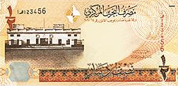
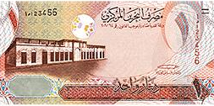
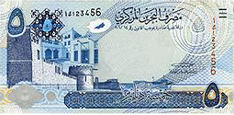
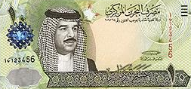
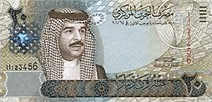
Finding Unknown factors (Principal) 8
Principal
Rate
FINANCIAL MATHEMATICS
Fin 111
First semester Class: second Pages: 44-67

Slide 2
Objectives
At the end of this course, Student should be able to:
1- Finding Principal by knowing amount.
1- Finding Principal by knowing interest.
Finding Unknown factors FINANCILA MATHEMATICS Fin: 111

Slide 3
Finding the Principal
Formula of Finding the Principal
Principal = Compound Amount ÷ ( 1 +Interest rate ) ^{Number of time}
P = CA ÷ ( 1 + i ) ^{n}
The money invested, deposited or borrowed.
The percentage (%) of simple interest.
The number of times compounded interest
Finding Unknown factors FINANCILA MATHEMATICS Fin: 111

Slide 4
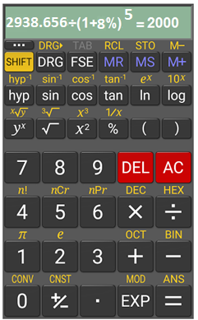
Example:
Find the principal if the compound amount after 5 years is BD2938.656 and the compound interest rate is 8% annually.
Principal = Compound Amount÷(1+ Interest rate ) ^{Number of time}
P = C.A ÷ ( 1+ i ) ^{n}
= 2938.656 ÷ ( 1+ 8 % ) ⁵ = BD 2000
Finding Unknown factors FINANCILA MATHEMATICS Fin: 111

Slide 5
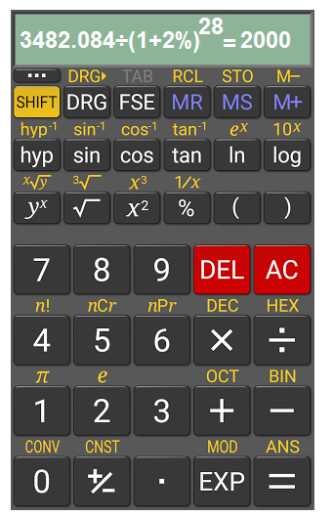
Example:
Hasan deposited an amount of money in a bank at 8% annually commanded quarterly . If the compound amount at the end of 7 years is BD3482.084 - Calculate the principal.
Principal = Compound Amount÷(1+ Interest rate ) ^{Number of time}
i= 8%÷ 4 = 2%
n= 7x 4 = 28
P = C.A ÷ ( 1+ i ) ^{n}
= 3482.084 ÷ ( 1+ 2 % ) ²⁸ = BD 2000
Finding Unknown factors & Discounts FINANCILA MATHEMATICS Fin: 111

Slide 6
Finding the Principal by knowing Interest
Example:
Find the principal that generates an interest of BD700 at 2% annually for 5 years.
Compound Interest = Principal x ((1+ Interest rate ) ^{Number of time} -1 )
C.I = P ÷ ( ( 1+ i ) ^{n} -1 )
P = C.I ÷ ( ( 1+ i ) ^{n} -1 )
= 700 ÷ ( ( 1+ 2% ) ⁵ -1 )
= BD6724.304
Finding Unknown factors & Discounts FINANCILA MATHEMATICS Fin: 111

Slide 7
Evaluation
Choose the correct answer for the following:
1) How much was deposited for an investment of 6%
annually compounded quarterly to have an amount
of BD4040.565 in 5 years?
a- BD3019.345
b- BD3750.696
c- BD1259.867
d- BD3000
Finding Unknown factors FINANCILA MATHEMATICS Fin: 111

Slide 8
2) Find the principal of the following:
CA | Time / Period | Interest Rate | Principal
BD 3107.915 | 3 Years | 3.2 % monthly | BD ???
a- BD3000
b- BD1500
c- BD1000
d- BD900.
Finding Unknown factors FINANCILA MATHEMATICS Fin: 111

Slide 9
Evaluation
Choose the correct answer for the following:
3)Taha calculated the compound interest he will get BD4836.66 if he deposited his money in a bank at 3% annually for 20 years. Find the principal
a- BD8900
b- BD2667.961
c- BD6000
d- BD4563.267
Finding Unknown factors FINANCILA MATHEMATICS Fin: 111

Slide 10
P = 4040.565 ÷ (1+ 1.5%) ²⁰ =
BD 3000
Click on the arrow for the next question

Slide 11
Click the arrow to return to the question

Slide 12
P = 3107.915 ÷(1+ 3.2%) ^{3x12=36}
= BD1000
Click on the arrow for the next question

Slide 13
Click the arrow to return to the question

Slide 14
P = 4836.667 ÷ [(1+ 3%) ²⁰ -1]= BD6000
Click on the arrow for the next
slide

Slide 15
Click the arrow to return to the question

Slide 16
The lesson ended
We hope
Success
Lesson Objective
Thank you
For more information:
Visit the www.Edunet.com
Questions and activities of the book
Finding Unknown factors & Discounts FINANCILA MATHEMATICS Fin: 111

