Slide 1
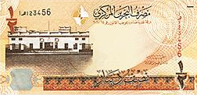
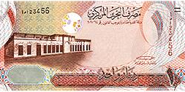
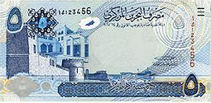
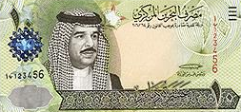
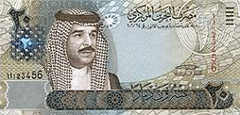
Finding Discount and Present Value Units 11
Principal
Rate
FINANCIAL MATHEMATICS
Fin 111
First semester Class: second Pages: 44-67

Slide 2
Objectives
At the end of this course, Student should be able to:
1- Explaining and apply the concept of discount .
2- Calculating present value by simple and communed interest. .
Finding Discounts FINANCILA MATHEMATICS Fin: 111

Slide 3
Discount and Present value
By Using Simple interest
Example:
A loan with a future value BD 8440 at 9% simple interest is converted to cash. Calculate the present value and discount before 115 days
Discount = Future value x Interest rate x Time
D = Fv x i x T
= 8440 x 9% x 115/360 =BD 242.650
Present value = Future value - discount
Pv = Fv - D
= 8440 - 242.650 = BD 8197.350
Finding Discounts FINANCILA MATHEMATICS Fin: 111

Slide 4
Discount and Present value
By Using Simple interest
Example:
A note has face value BD 1500 at 4% simple interest is converted to cash before 180 days. Find the discount and present value
Discount = Future value x Interest rate x Time
D = Fv x i x T
= 1500 x 4% x 180/360 =BD 30
Present value = Future value - discount
Pv = Fv - D
= 1500 - 30 = BD1470
Finding Discounts FINANCILA MATHEMATICS Fin: 111

Slide 5
Discount and Present value
By Using compound interest
Example:
A loan with a future value BD 8440 at 9% annually compound interest rate is converted to cash. Calculate the present value and discount before 2 years.
Present value = Future value x (1+ Interest rate ) ^{–number of period/Time}
PV = Fv x (1+ i ) ^{– n}
= 8440 x (1+ 9% ) ⁻² =BD 7103.779
Discount = Future value - Present value
D = Fv - PV
= 8440 - 7103.779 = BD 1336.221
Finding Discounts FINANCILA MATHEMATICS Fin: 111

Slide 6
Discount and Present value
By Using compound interest
Example:
A note has face value BD 3000 at compound interest rate 6% annually
is converted to cash before 5 years. Find the discount and present value
Present value = Future value x (1+ Interest rate ) ^{–number of period/Time}
PV = Fv x (1+ i ) ^{– n}
= 3000 x (1+ 6% ) ⁻⁵ =BD 2241.775
Discount = Future value - Present value
D = Fv - PV
= 3000 - 2241.775 = BD 758.225
Finding Discounts FINANCILA MATHEMATICS Fin: 111

Slide 7
1) A note BD1,400 sold two years before their due date at 5%
simple interest , find the present value.
a- BD140
b- BD1400
c- BD1260
d- BD1540
Finding Discounts FINANCILA MATHEMATICS Fin: 111

Slide 8
2) A note BD2500 sold 9 months before their due date at 4.5%
simple interest , find the Discount.
a- BD2584.375
b- BD84.375
c- BD2575
d- BD1012.500
Finding Discounts FINANCILA MATHEMATICS Fin: 111

Slide 9
3) Find present value of the debts BD 3500 for 4 years with a
discount rate 10% annually compounded semi-annually .
a- BD2368.938
b- BD1131.062
c- BD4631.062
d- BD3363.431
Finding Discounts FINANCILA MATHEMATICS Fin: 111

Slide 10
4) Find the discount for a lone BD3,000 for one year and
8 months with a discount rate 7% thirdly ?
a- BD3861.415
b- BD350
c- BD326.339
d- BD861.041
Finding Discounts FINANCILA MATHEMATICS Fin: 111

Slide 11
5) Find the present value for a lone BD4000 for 3 year with a
discount rate 6% annually compounded monthly ?
a- BD690.630
b- BD4786.722
c- BD2819.842
d- BD3342.580
Finding Discounts FINANCILA MATHEMATICS Fin: 111

Slide 12
D = 1400 x 5% x 2 =BD140
PV = 1400 - 140 = BD 1260
Click on the arrow for the next question

Slide 13
Click the arrow to return to the question

Slide 14
D = 2500 x 4.5% x 9/12 =BD84.375
Click on the arrow for the next question

Slide 15
Click the arrow to return to the question

Slide 16
PV = 3500 x (1+5%) ⁻⁸ =BD2368.938
Click on the arrow for the next question

Slide 17
Click the arrow to return to the question

Slide 18
PV = 3000 x (1+7%) ⁻⁵ =BD2138.956
D = 3000 – 2138.956= BD861.041
Click on the arrow for the next question

Slide 19
Click the arrow to return to the question

Slide 20
PV = 4000 x (1+0.005) ⁻³⁶ =BD3342.580
Click on the arrow for the next question

Slide 21
Click the arrow to return to the question

Slide 22
The lesson ended
We hope
Success
Lesson Objective
Thank you
For more information:
Visit the www.Edunet.com
Questions and activities of the book
Finding Unknown factors & Discounts FINANCILA MATHEMATICS Fin: 111

