Slide 1
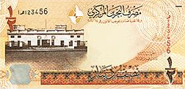
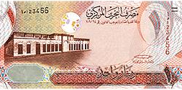
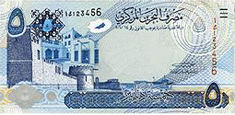
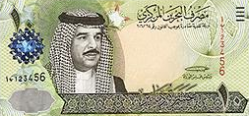
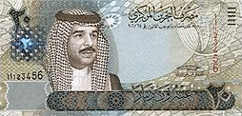
Finding Unknown factors
(Time /Period)
Principal
Rate
FINANCIAL MATHEMATICS
Fin 111
First semester Class: second Pages: (46-47),(50-55)

Slide 2
Objectives
At the end of this course, Student should be able to:
1- Writing formula of finding Unknown factor of time.
2- Finding Unknown factor of time by Know compound amount .
3- Finding Unknown factor of time by Know compound Interest .
Finding Unknown factors FINANCILA MATHEMATICS Fin: 111

Slide 3
Finding the Time/period
Formula of Finding time/period
( 1 +Interest rate ) ^{Number of time} = Compound Amount ÷ Principal
( 1 + i ) ^{n} = CA ÷ P
The percentage (%) of simple interest.
The number of times compounded interest
The money invested, deposited or borrowed.
Finding Unknown factors – Time FINANCILA MATHEMATICS Fin: 111
وزارة التربية والتعليم – 2021م

Slide 4
Finding the time
Example:
A principal of BD3000 invested at 6% annually, How long would it take to make the compound amount to BD5372.542?
(1+ Interest rate ) ^{Number of time} = Compound Amount÷ Principal
( 1+ i ) ^{n} = C.A ÷ P
( 1+ 6% ) ^{n} = 5372.542 ÷ 3000 = 1.790813
Finding Unknown – Time FINANCILA MATHEMATICS Fin: 111
وزارة التربية والتعليم – 2021م

Slide 5
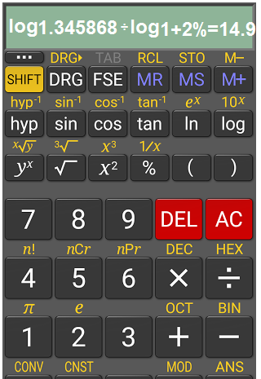
Finding the time
Example:
A principal of BD3000 invested at 6% annually, How long would it take to make the compound amount to BD5372.542?
(1+ Interest rate ) ^{Number of time} = Compound Amount÷ Principal
( 1+ i ) ^{n} = C.A ÷ P
( 1+ 6% ) ^{n} = 5372.542 ÷ 3000 = 1.790847
n = Log 1.790847 ÷ log 1+6% =14.999 ≈ 15 = 10 years
Finding Unknown – Time FINANCILA MATHEMATICS Fin: 111
وزارة التربية والتعليم – 2021م

Slide 6
Finding the time
Example:
A principal of BD6000 invested at 2% thirdly, How long would it take to make the compound amount to BD8075.210?
(1+ Interest rate ) ^{Number of time} = Compound Amount÷ Principal
( 1+ i ) ^{n} = C.A ÷ P
( 1+ 2% ) ^{n} = 8075.210 ÷ 6000 = 1.345868
Finding Unknown factors – Time FINANCILA MATHEMATICS Fin: 111
وزارة التربية والتعليم – 2021م

Slide 7
Finding the time
Example:
A principal of BD6000 invested at 2% thirdly, How long would it take to make the compound amount to BD8075.210?
(1+ Interest rate ) ^{Number of time} = Compound Amount÷ Principal
( 1+ i ) ^{n} = C.A ÷ P
( 1+ 2% ) ^{n} = 8075.210 ÷ 6000 = 1.345868
n = Log 1.345868 ÷ log 1+2% =14.999 ≈ 15 ÷ 3 = 5 years
Finding Unknown factors FINANCILA MATHEMATICS Fin: 111
وزارة التربية والتعليم – 2021م

Slide 8
Finding the time
Example:
A principal of BD1500 invested at 9% annually, How long would it take to make the Compound Interest to BD1488.844?
Compound Amount = Principal + compound Amount
= 1500 + 1488.844 = BD 2988.844
(1+ Interest rate ) ^{Number of time} = Compound Amount÷ Principal
( 1+ i ) ^{n} = C.A ÷ P
( 1+ 9% ) ^{n} = 2988.844 ÷ 1500 = 1.992562
n = Log 1.1.992562 ÷ log 1+9% = 8 years
Finding Unknown factors – Time FINANCILA MATHEMATICS Fin: 111
وزارة التربية والتعليم – 2021م

Slide 9
Finding the time
Example:
How long will it take to make the money to double itself at 4% annually?
(1+ Interest rate ) ^{Number of time} = Compound Amount÷ Principal
( 1+ i ) ^{n} = C.A ÷ P
( 1+ 4% ) ^{n} = 2 ÷ 1 = 2
n = Log 2 ÷ log 1+4% =17.673 ≈ 18 years
Finding Unknown factors – Time FINANCILA MATHEMATICS Fin: 111
وزارة التربية والتعليم – 2021م

Slide 10
Evaluation
Choose the correct answer for the following:
1) A principal of BD 900 invested at 11% annually, How long
would it take to make the amount to BD 2074.084?
a- 5 years
b- 6 years
c- 8 years
d- 11 years
Finding Unknown factors – Time FINANCILA MATHEMATICS Fin: 111
وزارة التربية والتعليم – 2021م

Slide 11
Evaluation
2) If BD 6,600 amounts to BD8433.392 at 4% - Find the Time?
a- 6 years.
b- 6 years & 3 months
c- 6 years & 4 months
d- 6 years & 6 months
Finding Unknown factors – Time FINANCILA MATHEMATICS Fin: 111
وزارة التربية والتعليم – 2021م

Slide 12
Evaluation
3) A principal of BD1200 invested at 3.75% quarterly , How long would it take to make the compound Interest to BD666.545?
a- 12 years.
b- 6 years .
c- 4 years
d- 3 years
Finding Unknown factors – Time FINANCILA MATHEMATICS Fin: 111
وزارة التربية والتعليم – 2021م

Slide 13
Evaluation
4) How long will it take the money to triple it self at 6% annually?
a- 16 years.
b- 17 years .
c- 18 years
d- 19 years
Finding Unknown factors – Time FINANCILA MATHEMATICS Fin: 111
وزارة التربية والتعليم – 2021م

Slide 14
(1+11%)^{n} = 2074.084 ÷ 900 = 2.304537
n = Log 2.304537 ÷ log1+11%
=7.99 ≈ 8 years
Click on the arrow for the next question

Slide 15
Click the arrow to return to the question

Slide 16
(1+4%)^{n} = 8433.392 ÷ 6600 =1.277786
n = Log 1.2777786 ÷ log1+4% =6.25 years Or 6 years & 3 months (0.25*12=3)
Click on the arrow for the next side

Slide 17
Click the arrow to return to the question

Slide 18
CA = 1200 + 666.545 = BD 1866.545
(1+3.75%)^{n} = 1866.545 ÷ 1200 =1.5554543
n = Log 1.5554543 ÷ log1+3.75%
=12 ÷ 4 = 3 years
Click on the arrow for the next side

Slide 19
Click the arrow to return to the question

Slide 20
( 1+ 6% ) n = 3 ÷ 1 = 3
n = Log 3 ÷ log1+6% =18.854 ≈ 19years
Click on the arrow for the next side

Slide 21
Click the arrow to return to the question

Slide 22
The lesson ended
We hope
Success
Lesson Objective
Thank you
For more information:
Visit the www.Edunet.com
Questions and activities of the book
Finding Unknown factors – Time FINANCILA MATHEMATICS Fin: 111
وزارة التربية والتعليم – 2021م

