Slide 1
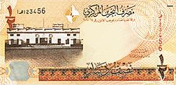
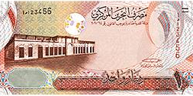
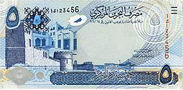
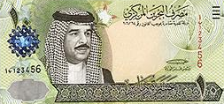
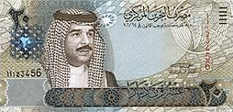
Finding Unknown factors
(Interest Rate)
Principal
Rate
FINANCIAL MATHEMATICS
Fin 111
First semester Class: second Pages: 48-55

Slide 2
Objectives
At the end of this course, Student should be able to:
1- Writing formula of finding Unknown factor of Interest Rate.
2- Finding Unknown factor of Interest Rate by Know compound amount .
3- Finding Unknown factor of Interest Rate by Know compound Interest .
Finding Unknown factors- Rate FINANCILA MATHEMATICS Fin: 111

Slide 3
Finding the Interest Rate
Formula of Finding Interest Rate
( 1 +Interest rate ) ^{Number of time} = Compound Amount ÷ Principal
( 1 + i ) ^{n} = CA ÷ P
The percentage (%) of simple interest.
The number of times compounded interest
The money invested, deposited or borrowed.
Finding Unknown factors- Rate FINANCILA MATHEMATICS Fin: 111
وزارة التربية والتعليم – 2021م

Slide 4
Finding the interest rate
Example:
A principal of BD3000 invested for 10 years, If the compound amount is BD5372.542. Find the interest rate.
(1+ Interest rate ) ^{Number of time} = Compound Amount÷ Principal
( 1+ i ) ^{n} = C.A ÷ P
( 1+ i ) ¹⁰ = 5372.542 ÷ 3000 = 1.7908473
Finding Unknown factors - Rate FINANCILA MATHEMATICS Fin: 111
وزارة التربية والتعليم – 2021م

Slide 5
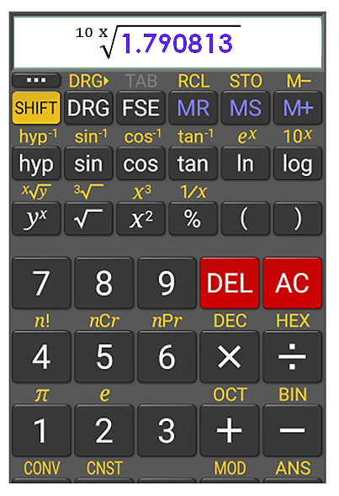
Finding the interest Rate
Example:
A principal of BD3000 invested for 10 years, If the compound amount is BD5372.542. Find the interest rate.
(1+ Interest rate ) ^{Number of time} = Compound Amount÷ Principal
( 1+ i ) ^{n} = C.A ÷ P
( 1+ i ) ¹⁰ = 5372.542 ÷ 3000 = 1.7908473
=1.059 - 1 = 0.06x 100 = 6% annually
$$\sqrt[10 x]{\text{1}\text{.}\text{7908473} }$$
Finding Unknown factors - Rate FINANCILA MATHEMATICS Fin: 111
وزارة التربية والتعليم – 2021م

Slide 6
Finding the interest rate
Example:
A principal of BD6000 borrowed for 5 years. Find the interest rate if the compound amount to BD8075.210 and the interest compounded thirdly.
(1+ Interest rate ) ^{Number of time} = Compound Amount÷ Principal
( 1+ i ) ^{n} = C.A ÷ P
( 1+ i ) ^{5 x 3=15} = 8075.210 ÷ 6000 = 1.345868
Finding Unknown factors - Rate FINANCILA MATHEMATICS Fin: 111
وزارة التربية والتعليم – 2021م

Slide 7
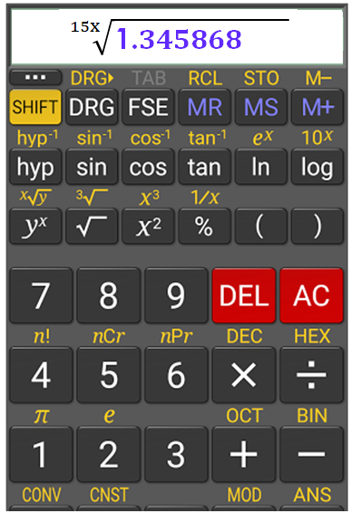
Finding the interest rate
Example:
A principal of BD6000 borrowed for 5 years. Find the interest rate if the compound amount to BD8075.210 and the interest compounded thirdly.
(1+ Interest rate ) ^{Number of time} = Compound Amount÷ Principal
( 1+ i ) ^{n} = C.A ÷ P
( 1+ i ) ^{5 x 3=15} = 8075.210 ÷ 6000 = 1.345868
=1.0199 - 1 = 0.0199x 100 = 2% thirdly
$$\sqrt[15x]{\text{1}\text{.}345868 }$$
Finding Unknown factors - Rate FINANCILA MATHEMATICS Fin: 111
وزارة التربية والتعليم – 2021م

Slide 8
Finding the interest rate
Example:
A man deposited BD1500 in the bank, if the Compound Interest was BD1488.844 at the end of 8 years ?
Compound Amount = Principal + compound Amount
= 1500 + 1488.844 = BD 2988.844
(1+ Interest rate ) ^{Number of time} = Compound Amount÷ Principal
( 1+ i ) ^{n} = C.A ÷ P
( 1+ i) ⁸ = 2988.844 ÷ 1500 = 1.992562
=1.0899 - 1 = 0.09x 100 = 9% annually
$$\sqrt[8 x]{\text{1}\text{.} 992562 }$$
Finding Unknown factors - Rate FINANCILA MATHEMATICS Fin: 111
وزارة التربية والتعليم – 2021م

Slide 9
Finding the interest rate
Example:
What is the interest rate it take the money to double itself after 18 years.
(1+ Interest rate ) ^{Number of time} = Compound Amount÷ Principal
( 1+ i ) ^{n} = C.A ÷ P
( 1+ i ) ¹⁸ = 2 ÷ 1 = 2
=1.039- 1 = 0.04x 100 = 4% annually
$$\sqrt[18 x]{2 }$$
Finding Unknown factors - Rate FINANCILA MATHEMATICS Fin: 111
وزارة التربية والتعليم – 2021م

Slide 10
Evaluation
Choose the correct answer for the following:
1) A principal of BD 900 invested in bank, Find the interest rate
if the amount to BD 2074.084 at end of the 8 years.
a- 9%
b- 10%
c- 11%
d- 12%
Finding Unknown factors - Rate FINANCILA MATHEMATICS Fin: 111
وزارة التربية والتعليم – 2021م

Slide 11
Evaluation
2) If BD 6,600 amounts to BD8433.392 at end of 6 years and 3
months - Find the interest rate?
a- 4% monthly
b- 4% annually
c- 4% quarterly
d- 4% thirdly
Finding Unknown factors - Rate FINANCILA MATHEMATICS Fin: 111
وزارة التربية والتعليم – 2021م

Slide 12
Evaluation
Find the missing factor of the following:
Compound interest | Time / Period | Interest Rate | Principal
BD 721.239 | 3 years | ?? % quarterly | BD 1,200
a- 16%
b- 8%.
c- 6%
d- 4%
Finding Unknown factors - Rate FINANCILA MATHEMATICS Fin: 111
وزارة التربية والتعليم – 2021م

Slide 13
Evaluation
4)What is the interest rate it take the money to triple after 19 years.
a- 3%
b- 4%
c- 5%
d- 6%
Finding Unknown factors - Rate FINANCILA MATHEMATICS Fin: 111
وزارة التربية والتعليم – 2021م

Slide 14
(1+i)⁸ = 2074.084 ÷ 900 = 2.304537
=1.1099 - 1 = 0.109x 100 = 11% annually
$$\sqrt[8 x]{2.304537}$$
Click on the arrow for the next question

Slide 15
Click the arrow to return to the question

Slide 16
(1+i)^{6.25} = 8433.392 ÷ 6600 =1.277786
$$\sqrt[6.25 x]{1.277786}$$
=1.0399 - 1 = 0.039x 100 = 4% annually
Click on the arrow for the next side

Slide 17
Click the arrow to return to the question

Slide 18
CA = 1200 + 721.239 = BD 1921.239
(1+i%)^{3*4=12} = 1921.239 ÷ 1200 =1.5554543
=1.04 - 1 = 0.04x 100 = 4% quarterly.
$$\sqrt[12 x]{1.6010325}$$
Click on the arrow for the next side

Slide 19
Click the arrow to return to the question

Slide 20
( 1+ 6% ) n = 3 ÷ 1 = 3
=1.0595 - 1 = 0.059x 100 = 6% annually
$$\sqrt[19 x]{3 }$$
Click on the arrow for the next side

Slide 21
Click the arrow to return to the question

Slide 22
The lesson ended
We hope
Success
Lesson Objective
Thank you
For more information:
Visit the www.Edunet.com
Questions and activities of the book
Finding Unknown factors - Rate FINANCILA MATHEMATICS Fin: 111
وزارة التربية والتعليم – 2021م

