Slide 1
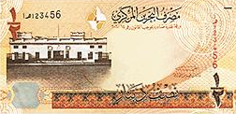
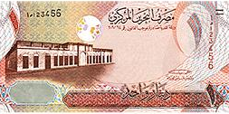
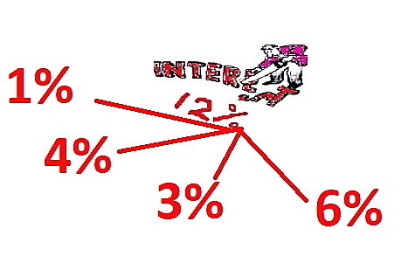
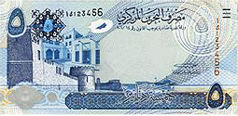
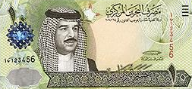
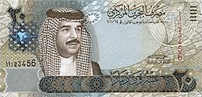
Compound Amount and Interest- Partial Rate Units 6
FINANCIAL MATHEMATICS
Fin 111
First semester Class: second Pages: 36-40

Slide 2
Objectives
At the end of this course, Student should be able to:
1-Differentiating between nominal and partial interest rates.
2- Identifying the method of calculating monthly
,semi-annually, thirdly and quarterly.
Compound Amount FINANCILA MATHEMATICS Fin: 111

Slide 3
Annual Interest rate
Example:
If Interest rate 12% annually for 5 years Find the compound amount and interest of BD1000. If the interest compounded as follow :
12 times
3 times
a-Monthly
c-Thirdly
The Time multiplied by the number of compounded
X
The interest rate divided by the number of compounded
÷
4 times
2 times
b-Semi-annually
d-Quarterly
Compound Amount FINANCILA MATHEMATICS Fin: 111

Slide 4
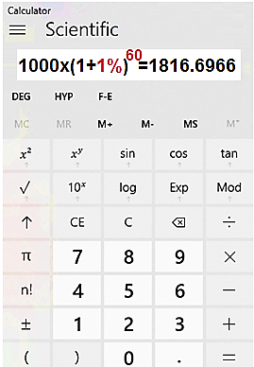
Annual Interest rate
a-Monthly
CA = P x ( 1+ i ) ^{n}
= 1000 x (1+ 1% )⁶⁰ = BD1816.697
i=12%÷12=1%
n=5x12=60
CI = CA – P
= 1816.697 – 1000 = BD816.697
Compound Amount FINANCILA MATHEMATICS Fin: 111

Slide 5
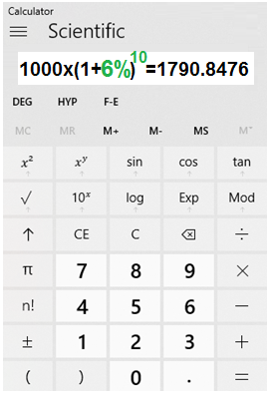
Annual Interest rate
b-Semi-annually
CA = P x ( 1+ i ) ^{n}
= 1000 x (1+ 6% )¹⁰ = BD1790.848
I = 12% ÷2=6%
n=5x2=10
CI = CA – P
= 1790.848 – 1000 = BD790.848
Compound Amount FINANCILA MATHEMATICS Fin: 111

Slide 6
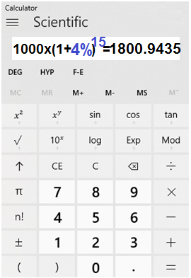
Annual Interest rate
c-Thirdly
CA = P x ( 1+ i ) ^{n}
= 1000 x (1+ 4% )¹⁵ = BD1800.944
I =12%÷ 3 = 4%
n=5 x 3 =15
CI = CA – P
= 1800.944 – 1000 = BD800.944
Compound Amount FINANCILA MATHEMATICS Fin: 111

Slide 7
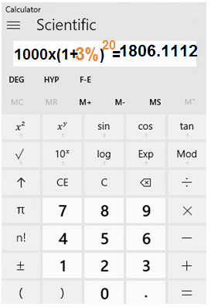
Annual Interest rate
d-Quarterly
CA = P x ( 1+ i ) ^{n}
= 1000 x (1+ 3% )²⁰ = BD1806.111
I =12% ÷4 = 3%
n=5x4=20
CI = CA – P
= 1806.111 – 1000 = BD806.111
Compound Amount FINANCILA MATHEMATICS Fin: 111

Slide 8
Partial interest rate
Example:
Find the compound amount and Interest of BD800 for 3 years.
If the Interest rate is the following:
12 times
3 times
a-5%Monthly
c-5%Thirdly
The Time multiplied by the number of compounded
X
2 times
4 times
b-5% Semi-annually
d-5%Quarterly
Compound Amount FINANCILA MATHEMATICS Fin: 111

Slide 9
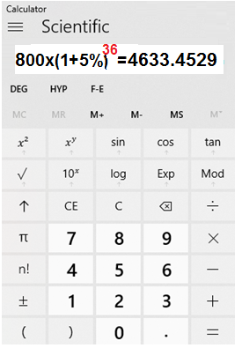
Partial interest rate
12 times
a-5%Monthly
CA = P x ( 1+ i ) ^{n}
= 800 x (1+ 5% )³⁶ = BD4633.453
n=3x12=36
CI = CA – P
= 4633.453 – 800 = BD3833.453
Compound Amount FINANCILA MATHEMATICS Fin: 111

Slide 10
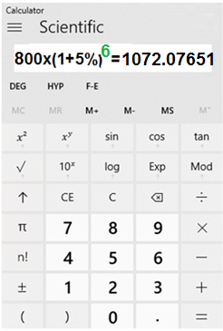
Partial interest rate
2 times
b-5% Semi-annually
n= 3x 2 = 6
CA = P x ( 1+ i ) ^{n}
= 800 x (1+ 5% ) ⁶ = BD1072.077
CI = CA – P
= 1072.077 – 800 = BD272.077
Compound Amount FINANCILA MATHEMATICS Fin: 111

Slide 11
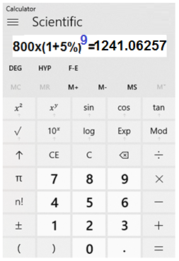
Partial interest rate
3 times
c-5%Thirdly
n=3x 3= 9
CA = P x ( 1+ i ) ^{n}
= 800 x (1+ 5% ) ⁹ = BD1241.063
CI = CA – P
= 1241.063 – 800 = BD441.063
Compound Amount FINANCILA MATHEMATICS Fin: 111

Slide 12
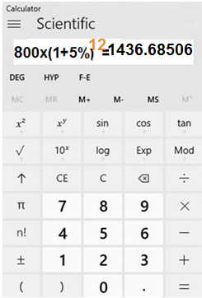
Partial interest rate
4 times
d-5%Quarterly
n= 3x 4 =12
CA = P x ( 1+ i ) ^{n}
= 800 x (1+ 5% ) ¹² = BD1436.685
CI = CA – P
= 1436.685 – 800 = BD636.685
Compound Amount FINANCILA MATHEMATICS Fin: 111

Slide 13
1) What is the compound interest on $ 8,400 invested for
4 years at 7% annually compounded semi-annually?
a- $2661.196
b- $11061.196
c- $11010.686
d- $9639.193
Compound Amount FINANCILA MATHEMATICS Fin: 111

Slide 14
2) Find the compound interest of KD750 for 6 years
at days at 5% thirdly.
a- KD1804.964
b- KD2554.964
c- KD225000.
d- KD1054.964
Compound Amount FINANCILA MATHEMATICS Fin: 111

Slide 15
3) If ¥200 is invested making 6 % annually compounded
monthly, what is the compound interest after 2 years.
a- ¥225.43
b- ¥645.02
c- ¥455.02
d- ¥25.43
Compound Amount FINANCILA MATHEMATICS Fin: 111

Slide 16
CA = 8400 x(1+ 3½%)⁸ =BD11061.196
CI = 11061.196 - 8400 = BD 2661.196
أضغط على السهم للانتقال إلى السؤال التالي

Slide 17
أضغط على السهم للرجوع إلى السؤال

Slide 18
CA = 750 x(1+ 5%) ¹⁸ = KD1804.964
CI = 1804.96 - 750 = KD 1054.964
أضغط على السهم للانتقال إلى السؤال التالي

Slide 19
أضغط على السهم للرجوع إلى السؤال

Slide 20
CA = 200 x(1+ 0.5%) ²⁴ = ¥ 225.43
CI = 225.432 - 200 = ¥ 25.43
أضغط على السهم للانتقال إلى الشريحة التالية

Slide 21
أضغط على السهم للرجوع إلى السؤال

Slide 22
The lesson ended
We hope
Success
Lesson Objective
Thank you
For more information:
Visit the www.Edunet.com
Questions and activities of the book
Compound Amount FINANCILA MATHEMATICS Fin: 111

