Slide 1
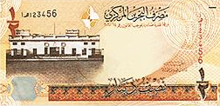
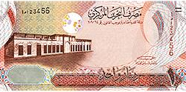
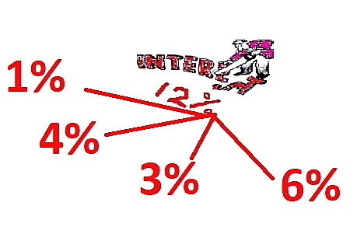
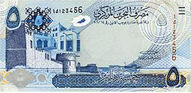
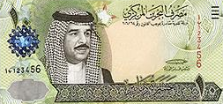
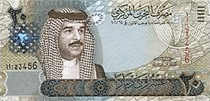
Compound Amount and Interest Units 4-5
FINANCIAL MATHEMATICS
Fin 111
First semester Class: second Pages: 29-37

Slide 2
Objectives
At the end of this course, Student should be able to:
1- Recognizing the concept of Compound Interest.
2- Calculating Compound Amount & Interest.
Compound Amount FINANCILA MATHEMATICS Fin: 111

Slide 3
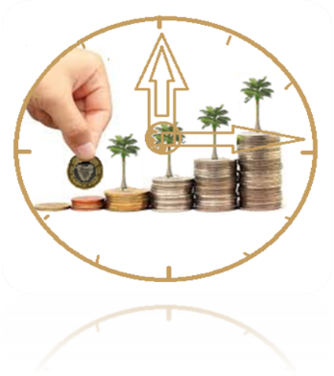
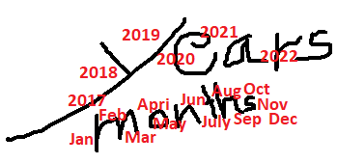
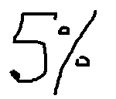
Compound Amount
Formula of Compound Amount
Compound Amount= Principal x ( 1 +Interest rate ) ^{Number of time}
CA = P x ( 1 + i ) ^{n}
The money invested, deposited or borrowed.
The percentage (%) of simple interest.
The number of times compounded interest
Compound Amount FINANCILA MATHEMATICS Fin: 111

Slide 4
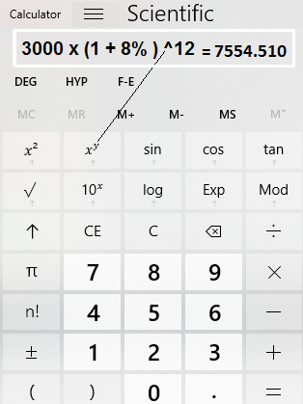
Compound Amount
Example:
A trader borrowed BD3000 from a bank at 8% annually for 12 years . Find the compound amount at the end of the period .
Compound Amount = Principal x (1+ Interest rate ) ^{Number of time}
C.A = P x ( 1+ i ) ^{n}
= 3000 x ( 1+ 8% ) ¹²
= BD 7554.510
Compound Amount FINANCILA MATHEMATICS Fin: 111

Slide 5
Compound Amount and Interest
Example:
Ahmed borrowed BD2500 from a bank at 5% annually for 10 years . Find the compound amount and interest at the end of the period? .
Compound Amount = Principal x (1+ Interest rate ) ^{Number of time}
C.A = P x ( 1+ i ) ^{n}
= 2500 x ( 1+ 5% ) ¹⁰
= BD 4072.237
C.I = CA - P
= 4072.237 – 2500 =
= BD 1572.237
Compound Amount FINANCILA MATHEMATICS Fin: 111

Slide 6
Compound Amount and Interest
Example:
Find the compound amount and interest of BD6200 borrowed from a bank at 4% annually for 7 years and 6 months.
Compound Amount = Principal x (1+ Interest rate ) ^{Number of time}
C.A = P x ( 1+ i ) ^{n}
= 6200 x ( 1+ 4% ) ^{7.5}
= BD 8320.353
C.I = CA - P
= 8320.353 – 6200 =
= BD 2120.353
Compound Amount FINANCILA MATHEMATICS Fin: 111

Slide 7
Compound Amount
Example:
A trader invested BD1900 in a bank at 3.75% annually for 9 years and 3 months . Find the compound amount at the end of the period?
Compound Amount = Principal x (1+ Interest rate ) ^{Number of time}
C.A = P x ( 1+ i ) ^{n}
= 1900 x ( 1+ 3.75% ) ^{9.25}
= BD 2670.814
Compound Amount FINANCILA MATHEMATICS Fin: 111

Slide 8
Evaluation
Choose the correct answer for the following:
1) Find the Compound Amount on BD10,500 at 4½%
annually for 5 years.
a- BD2584.910
b- BD13084.910
c- BD2362.500
d- BD12862.500
Compound Amount FINANCILA MATHEMATICS Fin: 111

Slide 9
2)Saeed opens a saving account in a bank with an
compound interest rate of 2.5% annually . If he deposits BD580 to the account, How much interest will he earn after 4 years?
a- BD60.211
b- BD638
c- BD522
d- BD580
Compound Amount FINANCILA MATHEMATICS Fin: 111

Slide 10
3) Calculate the compound Amount of the following:
CA | Time / Period | Interest Rate | Principal
BD?? | 8 Years and 4 months | 10 % annually | BD 2,750
a- BD5894.869
b- BD3334.963
c- BD6084.963
d- BD3144.869
Compound Amount FINANCILA MATHEMATICS Fin: 111

Slide 11
7) The difference between the simple interest and compound interest for BD3,000 at 3.5% annually for one years.
a- BD0.000
b- BD3105
c- BD105
d- BD359
Compound Amount FINANCILA MATHEMATICS Fin: 111

Slide 12
CA = 10500 x(1+ 4½%) ⁵ = BD13084.910
أضغط على السهم للانتقال إلى السؤال التالي

Slide 13
أضغط على السهم للرجوع إلى السؤال

Slide 14
CA = 580 x(1+ 2½%) ⁴ = BD640.211
CI = 640.211 - 580 = BD 60.211
أضغط على السهم للانتقال إلى السؤال التالي

Slide 15
أضغط على السهم للرجوع إلى السؤال

Slide 16
CA = 2750 x(1+ 10%) ^{8.333} = BD6084.963
أضغط على السهم للانتقال إلى السؤال التالي

Slide 17
أضغط على السهم للرجوع إلى السؤال

Slide 18
CA = 3000 x(1+ 3.5%) ¹ = BD 3105
CI = 3105 - 3000 = BD 105
SI = 3000 x 3.5% x1 = BD 105
diff= 105 - 105 = BD 0.000
أضغط على السهم للانتقال إلى الشريحة التالية

Slide 19
أضغط على السهم للرجوع إلى السؤال

Slide 20
The lesson ended
We hope
Success
Lesson Objective
Thank you
For more information:
Visit the www.Edunet.com
Questions and activities of the book
Compound Amount FINANCILA MATHEMATICS Fin: 111

