Slide 1
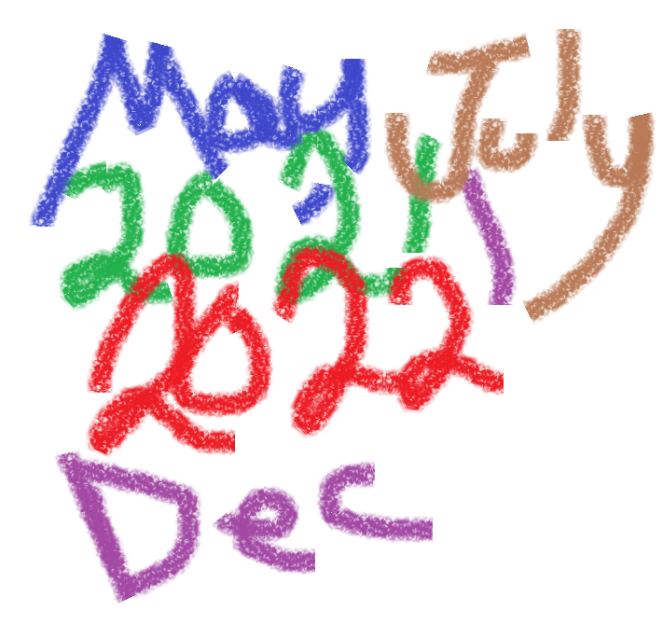
Unit 1-2 Simple Interest
FINANCIAL MATHEMATICS
Fin 111
First semester Class: second Pages: 12- 18

Slide 2
Objectives
At the end of this course, Student should be able to:
1- Recognizing the concept of Interest.
2- Explaining types of the Simple interest.
3- Identifying the method of calculating Simple interest.
4- Identifying the method of calculating monthly and years.

Slide 3
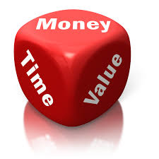
Simple Interest
Formula of simple interest
Simple interest = Principal x interest rate x Time
SI = P x i x T
The money invested, deposited or borrowed.
The percentage (%) of simple interest.
The time period of the loan (years, months).
Lesson: Simple interest - years & months Financial Mathematics Fin:111
وزارة التربية والتعليم – 2021م

Slide 4
Simple Interest
Formula of simple Amount
Amount = Simple interest + Principal
A = SI + P
Simple interest= SI = P x i x T
The money invested, deposited or borrowed.
Lesson: Simple interest - years & months Financial Mathematics Fin:111
وزارة التربية والتعليم – 2021م

Slide 5
Simple Interest- years
Example:
Hoda invested BD5,000 in N.B.B with interest rate of 4%.
How much interest and amount would she earn after 3 years?
Simple Interest = Principal x Interest rate x Time
S.I = P x i x T
= 5,000 x %4 x 3
= BD 600
Lesson: Simple interest - years & months Financial Mathematics Fin:111
وزارة التربية والتعليم – 2021م

Slide 6
Amount- years
Example:
Hoda invested BD5,000 in N.B.B with interest rate of 4%.
How much interest and amount would she earn after 3 years?
= 5,000 x %4 x 3
= BD 600
Amount = Principal + Simple Interest
A = P + S.I
= 5000 + 600 = BD 5600
Lesson: Simple interest - years & months Financial Mathematics Fin:111
وزارة التربية والتعليم – 2021م

Slide 7
Simple Interest- years
Example:
If some one borrowed BD6,000 from BBK for 3.5 years at 5%
simple annual interest - how much amount will he earn?
Simple Interest = Principal x Interest rate x Time
S.I = P x i x T
= 6,000 x 5% x 3.5
= BD 1050
Lesson: Simple interest - years & months Financial Mathematics Fin:111
وزارة التربية والتعليم – 2021م

Slide 8
Divide the number of months by 12
Simple Interest- Months
Jan | Feb | Mar | Apr | May | Jun | July | Aug | Sep | Oct | Nov | Des
Example:
Jassim put BD1,000 into a saving account at Bank. The interest on this account is 3.5% for 9 months. How much will Jassim have at the end of that period ?
Simple Interest = Principal x Interest rate x Time /12
S.I = P x i x T/12
= 1,000 x 3.5% x 9/12
= BD 26.250
Lesson: Simple interest - years & months Financial Mathematics Fin:111
وزارة التربية والتعليم – 2021م

Slide 9
Amount- Months
= 1,000 x 3.5% x 9/12
= BD 26.250
Example:
Jassim put BD1,000 into a saving account at Bank. The interest on this account is 3.5% for 9 months. How much will Jassim have at the end of that period ?
Amount = Principal + Simple Interest
A = P + S.I
= 1000 + 26.250
= BD 1026.250
Lesson: Simple interest - years & months Financial Mathematics Fin:111
وزارة التربية والتعليم – 2021م

Slide 10
Evaluation
Choose the correct answer for the following:
1-Find the simple interest on BD10,500 at 4½% for 5 years.
a- BD 2598.750
b- BD 2.598
c- BD 2362.500
d- BD 13098.500
Lesson: Simple interest - years & months Financial Mathematics Fin:111
وزارة التربية والتعليم – 2021م

Slide 11
2-Find the Amount of BD5,000 at 4 % for 3.75 years.
a- BD 0.750
b- BD 5750
c- BD 750
d- BD 4250
Lesson: Simple interest - years & months Financial Mathematics Fin:111
وزارة التربية والتعليم – 2021م

Slide 12
3-Saeed opens a saving account in a bank with an annual interest rate of 2.5%. If he deposits BD580 to the account, how much interest will he earn after 4 years?
a- BD 58
b- BD 638
c- BD 522
d- BD 580
Lesson: Simple interest - years & months Financial Mathematics Fin:111
وزارة التربية والتعليم – 2021م

Slide 13
4-Calculate the Amount of the following:
Amount | Time / Period | Interest Rate | Principal
BD ??? | 8 Years | 10 % | BD 2,750
a- BD 2200
b- BD 4950
c- BD 2570
d- BD 200
Lesson: Simple interest - years & months Financial Mathematics Fin:111
وزارة التربية والتعليم – 2021م

Slide 14
5- What is the interest on $ 8,400 invested for 6 months at 7% Simple interest?
a- $ 3528
b- $ 8694
c- $ 11928
d- $ 294
Lesson: Simple interest - years & months Financial Mathematics Fin:111
وزارة التربية والتعليم – 2021م

Slide 15
6- Calculate the amount of BD2100 invested for 3 years and 3 months at 11%.
a- BD 2850.750
b- BD 2762.3
c- BD 2793
d- BD 2693
Lesson: Simple interest - years & months Financial Mathematics Fin:111
وزارة التربية والتعليم – 2021م

Slide 16
Si= 10500x4.5%x5
BD 2362.500
أضغط علي السهم للانتقال للسؤال التالي

Slide 17
أضغط علي السهم
للمحاولة مرة أخرى

Slide 18
SI= 5000x4%x3.75= BD750
A= 5000 + 750 = BD5750
أضغط علي السهم للانتقال للسؤال التالي

Slide 19
أضغط علي السهم
للمحاولة مرة أخرى

Slide 20
Si= 580x2.5%x4=
BD 58
أضغط علي السهم للانتقال للسؤال التالي

Slide 21
أضغط علي السهم
للمحاولة مرة أخرى

Slide 22
Si= 2750x10%x8+2750=
BD 4950
أضغط علي السهم للانتقال للسؤال التالي

Slide 23
أضغط علي السهم
للمحاولة مرة أخرى

Slide 24
Si= 8400x7%x6÷12=
BD 294
أضغط علي السهم للانتقال للسؤال التالي

Slide 25
أضغط علي السهم
للمحاولة مرة أخرى

Slide 26
Si= 2100x11%x3.25=BD 750.750
A= 2100 + 750.75 =BD 2850.750
أضغط علي السهم للانتقال للسؤال التالي

Slide 27
أضغط علي السهم
للمحاولة مرة أخرى

Slide 28
The lesson ended
We hope
Success
Lesson Objective
Thank you
For more information:
Visit the www.Edunet.com
Questions and activities of the book
Lesson: Simple interest - years & months Financial Mathematics Fin:111
وزارة التربية والتعليم – 2021م

