Slide 1
Commercial Subjects Group Level 3
Subject | Accounting (2) – محا 212
Chapter | Chapter 1 General Journal For Merchandise Business Perpetual Inventory System
Title | Purchases Merchandise
الفصل الدراسي الأول 2020-2021

Slide 2
Accounting 1 Journal Entries for Merchandise Business – Perpetual Inventory System Acc. 111
Learning Objectives
By the end of this lesson, the student should be able to:
1- identify the difference between services and merchandise companies.
2- describe the steps in determining inventory quantities.
3- identify the items making up merchandise inventory.
4- identify the costs of merchandise inventory.
5- explain the recording of purchases under a perpetual inventory without cash discount.
6- explain the recording of purchases under a perpetual inventory with cash discount.

Slide 3
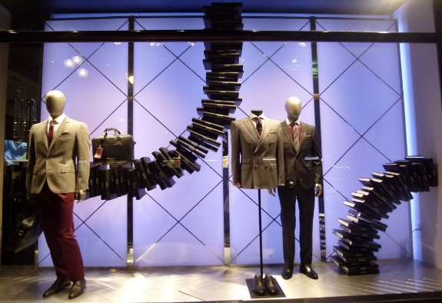
Accounting 1 Journal Entries for Merchandise Business – Perpetual Inventory System Acc. 111
Identify the difference between services and merchandise companies
A service business provides services to its customers. Accountants, law firms and cleaning services are examples of service businesses.
A merchandising business sells goods, also known as merchandise. Good examples of merchandising businesses include retail clothing, grocery stores and bookstores. A merchandiser earns net income by buying and selling merchandise. Merchandisers are often identified as either wholesaler or retailer. A wholesaler is an intermediary that buys products from manufactures or other wholesaler and sells them to retailers or other wholesalers.
A retailer is an intermediary that buys products from manufacturers or wholesalers and sells them to consumers. Many retailers sell both products and services.
وزارة التربية والتعليم – 2020م

Slide 4
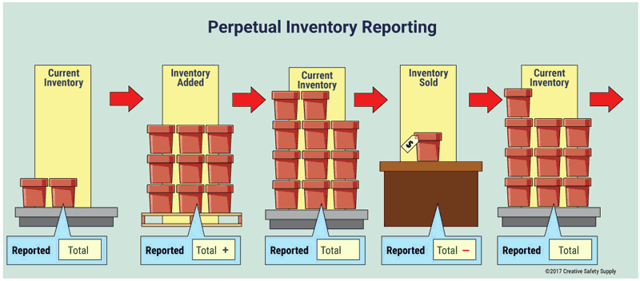
Accounting 1 Journal Entries for Merchandise Business – Perpetual Inventory System Acc. 111
Definition of Perpetual Inventory System
Companies keep detailed records of the cost of each inventory purchase and sale. These records continuously – perpetually – show the inventory that should be on hand for every item. Companies that sell products with fixed prices use perpetual inventory systems.
وزارة التربية والتعليم – 2020م

Slide 5
Accounting 1 Journal Entries for Merchandise Business – Perpetual Inventory System Acc. 111
Perpetual Inventory System
The following diagram shows debits and credits to the merchandise inventory account using the perpetual system.
Perpetual Inventory System
DEBIT
CREDIT
Double Entry System
Debit
Credit
1- Purchased Goods (Inventory)
Sales Goods
2- Purchases Return Of Goods (Inventory)
2- Sales Returned Of Goods
3- Sales Discount Of Goods
3- Purchases Discount Goods (Inventory)
وزارة التربية والتعليم – 2020م

Slide 6
Accounting 1 Journal Entries for Merchandise Business – Perpetual Inventory System Acc. 111
Recording investment in the General Journal
Debit
+ Assets
Invested=Deposited=Contributed
DEBIT
CREDIT
Credit
+ Capital
Illustration 1:
On Jan 1 2020, Salman’s Company invested cash BD60,000 in the business. It recorded in the general journal:
GENERAL JOURNAL
Date | Account Title and Explanation | PR | Debit | Credit
Jan. 1 | Cash |  | 60,000
 | Capital |  |  | 60,000
 | Owner’s investment of cash in business
وزارة التربية والتعليم – 2020م

Slide 7
Accounting 1 Journal Entries for Merchandise Business – Perpetual Inventory System Acc. 111
Recording Purchases Goods in the General Journal
B-1) Purchases goods for cash:
Debit
Merchandise Inventory
Purchased goods (merchandise)
Illustration 2:
On Jan 2 2020, Salman’s Company purchased merchandise from Raja Est, BD8,000 for cash. It recorded in the general journal:
Credit
Cash
Date | Account Title and Explanation | PR | Debit | Credit
Jan. 2 | Merchandise Inventory |  | 8,000
 | Cash |  |  | 8,000
 | Purchased merchandise for cash
B-2) Purchases Returns and allowance of goods for cash:
Debit
Cash
Purchases Returns (merchandise) for cash
Illustration 3:
On Jan 5 2020, Salman’s Company received refund from Raja Est, BD350 for returned goods on cash purchase of Jan 2. It recorded in the general journal:
Credit
Merchandise Inventor
Date | Account Title and Explanation | PR | Debit | Credit
Jan. 5 | Cash |  | 350
 | Merchandise Inventory |  |  | 350
 | Returns purchase goods for cash
وزارة التربية والتعليم – 2020م

Slide 8
Accounting 1 Journal Entries for Merchandise Business – Perpetual Inventory System Acc. 111
Recording Purchases Goods in the General Journal
Debit
Merchandise Inventory
B-3) Purchases goods on account without discount:
Purchased goods (merchandise) on account
Credit
Illustration 4:
On Jan 7 2020, Salman’s Company purchased merchandise from Sultan Est, BD12,500 on account. It recorded in the general journal:
Account payable
Date | Account Title and Explanation | PR | Debit | Credit
Jan. 7 | Merchandise Inventory |  | 12,500
 | Account Payable (Sultan Est, ) |  |  | 12,500
 | Purchased merchandise on credit
B-4) Purchases Returns and allowance of goods on account without discount:
Debit
Account payable
Purchases Returns (merchandise) on account
Illustration 5:
On Jan 9 2020, Salman’s Company received refund from Sultan Est, BD500 for returned goods on account purchase of Jan 7. It recorded in the general journal:
Credit
Merchandise Inventory
Date | Account Title and Explanation | PR | Debit | Credit
Jan. 9 | Account Payable (Sultan Est, ) |  | 500
 | Merchandise Inventory |  |  | 500
 | Returns purchase goods on credit
وزارة التربية والتعليم – 2020م

Slide 9
Accounting 1 Journal Entries for Merchandise Business – Perpetual Inventory System Acc. 111
Recording Purchases Goods in the General Journal
Debit
Account payable
B-5) Payment of net purchases to creditor without discount
Paid net purchases to creditor
Credit
Cash
Illustration 6:
On Jan 5 2020, Salman’s Company paid full due to Sultan Est, It recorded in the general journal:
Date | Account Title and Explanation | PR | Debit | Credit
Jan. 15 | Account Payable (Sultan Est, ) |  | 12,000
 | Cash |  |  | 12,000
 | Payment to creditor Sultan Est,
B-6) Purchases goods on account with discount:
2 /10, n/30
Illustration 7:
On Jan 16 2020, Salman’s Company purchased merchandise from Eman Est, BD20,600, terms 2/10, n/30. It recorded in the general journal:
Paid full due. If payment after 10 days, due in 30 days from the invoice date.
2 % Cash Discount
If payment within
10 days of the invoice date.
Date | Account Title and Explanation | PR | Debit | Credit
Jan. 16 | Merchandise Inventory |  | 20,600
 | Account Payable (Eman Est,) |  |  | 20,600
 | Purchased merchandise on credit with discount.
وزارة التربية والتعليم – 2020م

Slide 10
Accounting 1 Journal Entries for Merchandise Business – Perpetual Inventory System Acc. 111
Recording Purchases Goods in the General Journal
B-7) Purchases Returns and allowance of goods on account with discount:
Debit
Account payable
Purchases Returns (merchandise) on account
Illustration 8:
On Jan 17 2020, Salman’s Company received refund from Eman Est, BD600 for returned goods on account purchase of Jan 16. It recorded in the general journal:
Credit
Merchandise Inventory
Date | Account Title and Explanation | PR | Debit | Credit
Jan. 17 | Account Payable (Eman Est,) |  | 600
 | Merchandise Inventory |  |  | 600
 | Returns purchase goods on credit
B-8) Payment of net purchases to creditor with discount:
Illustration 9:
On Jan 23 2020, Salman’s Company paid full due to Eman Est, It recorded in the general journal:
Date | Account Title and Explanation | PR | Debit | Credit
Jan. 23 | Account Payable (Eman Est,) (20,600 -600) |  | 20,000
 | Merchandise Inventory (20,000 ×2%) |  |  | 400
 | Cash |  |  | 19,600
وزارة التربية والتعليم – 2020م

Slide 11
Accounting 1 Journal Entries for Merchandise Business – Perpetual Inventory System Acc. 111
Recording Payment after discount period in the General Journal
Illustration 10:
On Jan 28 2020, Salman’s Company paid full due to Eman Est, It recorded in
the general journal:
GENERAL JOURNAL
Date | Account Title and Explanation | PR | Debit | Credit
Jan. 28 | Account Payable (Eman Est,) (20,600 -600) |  | 20,000
 | Cash |  |  | 20,000
 | Payment to creditor after discount period
وزارة التربية والتعليم – 2020م

Slide 12
Accounting 1 Journal Entries for Merchandise Business – Perpetual Inventory System Acc. 111
Activity (1):
Bader’s Company uses the perpetual inventory system and had the following transactions during October 2020:
Oct 2: Purchased merchandise for BD5000. The seller credit terms are 4/10, n/30.
Oct 6: Returned merchandise for BD300 worth of defective units on credit.
Oct 8: Paid the amount due, less the returned items.
Required: Prepare journal entries to record each of the preceding transactions.
GENERAL JOURNAL
Date | Account Title and Explanation | PR | Debit | Credit
Oct, 2 | Merchandise Inventory |  | 5,000
 | Account Payable |  |  | 5,000
Oct, 6 | Account Payable |  | 300
 | Merchandise Inventory |  |  | 300
Oct, 8 | Account Payable (5,000 – 300) |  | 4,700
 | Merchandise Inventory (4,700 × 4%) Cash |  |  | 188 4,512
وزارة التربية والتعليم – 2020م

Slide 13
Accounting 1 Journal Entries for Merchandise Business – Perpetual Inventory System Acc. 111
Activity (2):
Ahmed purchased goods for BD8,000 from Abdulla, terms 2/10 n, 30. If Ahmed paid within a discount period, the payment cash is BD7,840:
وزارة التربية والتعليم – 2020م

Slide 14
Accounting 1 Journal Entries for Merchandise Business – Perpetual Inventory System Acc. 111
Activity (2): Solution
Ahmed purchased goods for BD8,000 from Abdulla, terms 2/10 n, 30. If Ahmed paid within a discount period, the payment cash is BD7,840:
Cash = 8000 × (100% - 2%)
=8000 × 98%
= BD7,840
وزارة التربية والتعليم – 2020م

Slide 15
Accounting 1 Journal Entries for Merchandise Business – Perpetual Inventory System Acc. 111
Activity (3):
Fawaz purchased goods for BD8,000 from Rehab, terms 5/15 n, 30. The journal entry must be recorded,
Dr. Merchandise Inventory
Cr. Cash
وزارة التربية والتعليم – 2020م

Slide 16
Accounting 1 Journal Entries for Merchandise Business – Perpetual Inventory System Acc. 111
Activity (3): Solution
Fawaz purchased goods for BD8,000 from Rehab, terms 5/15 n, 30. The journal entry must be recorded,
Dr. Merchandise Inventory
Cr. Account Payable
وزارة التربية والتعليم – 2020م

Slide 17
Accounting 1 Journal Entries for Merchandise Business – Perpetual Inventory System Acc. 111
End of Lesson
1- Identify the difference between services and merchandise companies.
2- Describe the steps in determining inventory quantities.
3- Identify the items making up merchandise inventory.
4- Identify the costs of merchandise inventory.
5- Explain the recording of purchases under a perpetual inventory without cash discount.
6- Explain the recording of purchases under a perpetual inventory with cash discount.
لمزيد من المعلومات:
www.Edunet.com1- زيارة البوابة التعليمية
2- حل أسئلة وأنشطة الكتاب المدرسي.
وزارة التربية والتعليم – 2020م

