Slide 1
Commercial Subjects Group Level 3
Subject | Accounting (2) – محا 212
Chapter | Chapter 4
Title | Deprecation of plant Assets Second ( Double Declining Method)
وزارة التربية والتعليم –الفصل الدراسي الثاني 2020-2021م

Slide 2
Accounting 2 Declining Balance Method Acc. 212
Learning Objectives
By the end of this lesson, the student should be able to:
1.
Compere between the Straight line method and double declining method
2.
Apply the declining balance method equation to find the Net book value.
3.
Prepare the adjusting entry.
وزارة التربية والتعليم –الفصل الدراسي الثاني 2020-2021م

Slide 3
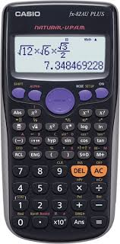
Accounting 2 Declining Balance Method Acc. 212
Requirements
وزارة التربية والتعليم –الفصل الدراسي الثاني 2020-2021م

Slide 4
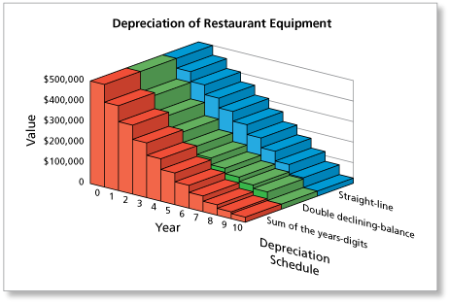
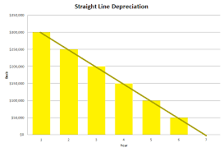
Accounting 2 Declining Balance Method Acc. 212
Calculate the depreciation expense using the declining balance method
Look at the graphs carefully!!
What is the common thing between the graphs??
وزارة التربية والتعليم –الفصل الدراسي الثاني 2020-2021م

Slide 5
Compare between straight line & double decline methods
Accounting 2 Declining Balance Method Acc. 212
Title | Straight line | Double decline
Calculation of first year (using) | Depreciable Cost | Acquisition cost
Depreciation Rate | $$\frac{\text{100}}{\text{Useful} \text{life} }$$ | $\frac{\text{100}}{\text{Useful} \text{life} }$× 2
Annual depreciation Expense | Fixed amount | Declining (Decreasing) amount
Calculation of final year | Same calculation for any year | Net book value(previous year) –Salvage Value
وزارة التربية والتعليم –الفصل الدراسي الثاني 2020-2021م

Slide 6
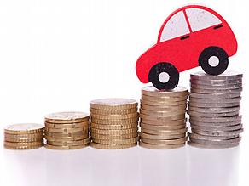
Accounting 2 Declining Balance Method Acc. 212
Calculate the depreciation expense using the declining balance method:
The value of an asset decreases over the time period, its high in the earlier years and lesser in the later years.
Any asset is being used over the period it becomes old and at the same time its value decreases.
 | 2010 | 2011 | 2012 | 2013
No. of year | 1 | 2 | 3 | 4
Amount (BD) | 12000 | 9500 | 7452 | 6487
وزارة التربية والتعليم –الفصل الدراسي الثاني 2020-2021م

Slide 7
Accounting 2 Declining Balance Method Acc. 212
1. Declining Balance Method equation = Acquisition cost x (depreciation rate x 2) or double the rate directly.
2. Calculation:
Year 1 -> Acquisition cost x double declining rate
Year 2 -> Book value for year 1 x double declining rate
Year 3 -> Book value for year 2 x double declining rate
Year 4 -> Book value for year 3 x double declining rate
Final year -> Book value for previous year – salvage Value
3. Depreciation expense decreases every year, it is not fixed as straight line method.
وزارة التربية والتعليم –الفصل الدراسي الثاني 2020-2021م

Slide 8
Accounting 2 Declining Balance Method Acc. 212
Illustrate (1): Double Declining Method of depreciation.
On Jan 1 2016, A business purchased machines at cost BD 15,000. It estimated salvage value for BD800 at the end of useful life 5 years.
Required :
complete the depreciation schedule by using Double declining balance method.
Depreciation Rate = $\frac{\text{100}}{\text{Useful} \text{life} }$ × 2 $\frac{\text{100}}{\text{5}}$ × 2 =40%
Annual Period | Depreciation For the Period |  |  | End Of the Period
 | Beginning Book Value | x $\text{Deprecation} \text{Rate}$ | Depreciation Expense | Accumulated Depreciation | Net Book Value
1/1/2016 | - | - | - | - | 15,000
Dec 31 2016 | $$\text{15}\text{,}\text{000}$$ | $$\text{x} \text{40}\text{\%}$$ | 6,000 | 6,000 | 15,000 - 6,000 =BD9,000
Dec 31 2017 | $$\text{9}\text{,}\text{000}$$ | $$\text{x} \text{40}\text{\%}$$ | 3,600 | 9,600 | 15,000 – 9,600 =BD5,400
Dec 31 2018 | $$\text{5}\text{,}\text{400}$$ | $$\text{x} \text{40}\text{\%}$$ | 2,160 | 11,760 | 15,000 – 11,760=BD3,240
Dec 31 2019 | $$\text{3}\text{,}\text{240}$$ | $$\text{x} \text{40}\text{\%}$$ | 1,296 | 13,056 | 15,000 – 13,056 BD1,944
Dec 31 2020 | $$\text{1}\text{,}\text{944}\text{− }\text{800}$$ | -------- | 1,144 | 14,200 =Depreciation Base | 15,000 – 14,200=BD800 =Salvage Value
Salvage Value
وزارة التربية والتعليم –الفصل الدراسي الثاني 2020-2021م

Slide 9
Accounting 2 Declining Balance Method Acc. 212
Activity 1
On Jan 1 2017, A motor vehicle costs BD 10,000. It will be kept for 4 years useful life, and then sold for a scrap value for BD 500.
Required :
1- complete the depreciation schedule by using Double declining balance method.
2- Prepare adjusted entry for 2017.
Annual Period | Depreciation For the Period |  |  | End Of the Period
 | Beginning Book Value | x $\text{Deprecation} \text{Rate}$ | Depreciation Expense | Accumulated Depreciation | Net Book Value
1/1/2017
Dec 31 2017
Dec 31 2018
Dec 31 2019
Dec 31 2020
Date | Explanation | Debit | Credit
وزارة التربية والتعليم –الفصل الدراسي الثاني 2020-2021م

Slide 10
Accounting 2 Declining Balance Method Acc. 212
Activity 1 Solution
On Jan 1 2017, A motor vehicle costs BD 10,000. It will be kept for 4 years useful life, and then sold for a scrap value for BD 500.
Required :
1- complete the depreciation schedule by using Double declining balance method.
2- Prepare adjusted entry for 2017.
Depreciation Rate = $\frac{\text{100}}{\text{Useful} \text{life} }$ × 2 $\frac{\text{100}}{\text{4}}$ × 2 = 50%
Annual Period | Depreciation For the Period |  |  | End Of the Period
 | Beginning Book Value | x $\text{Deprecation} \text{Rate}$ | Depreciation Expense | Accumulated Depreciation | Net Book Value
1/1/2017 | - | - | - | - | 10,000
Dec 31 2017 | 10,000 | x 50% | 5,000 | 5,000 | 10,000 – 5,000 BD5,000
Dec 31 2018 | 5,000 | x 50% | 2,500 | 7,500 | 10,000 – 7,500 =BD2,500
Dec 31 2019 | 2,500 | x 50% | 1,250 | 8,750 | 10,000 – 8,750 =BD1,250
Dec 31 2020 | 1,250- 500 | * | 750 | 9,500 | 10,000 -9,500 =BD500
Salvage Value
وزارة التربية والتعليم –الفصل الدراسي الثاني 2020-2021م

Slide 11
Accounting 2 Declining Balance Method Acc. 212
Activity 1 Solution
2- Prepare adjusted entry for 2017.
Date | Explanation | Debit | Credit
Dec 31, 2017 | Depreciation Expense | 5,000
 | Accumulated Depreciation – Motor vehicle |  | 5,000
Annual Period | Depreciation For the Period |  |  | End Of the Period
 | Beginning Book Value | x $\text{Deprecation} \text{Rate}$ | Depreciation Expense | Accumulated Depreciation | Net Book Value
1/1/2017 | - | - | - | - | 10,000
Dec 31 2017 | 10,000 | x 50% | 5,000 | 5,000 | 10,000 – 5,000 BD5,000
Dec 31 2018 | 5,000 | x 50% | 2,500 | 7,500 | 10,000 – 7,500 =BD2,500
Dec 31 2019 | 2,500 | x 50% | 1,250 | 8,750 | 10,000 – 8,750 =BD1,250
Dec 31 2020 | 1,250- 500 | * | 750 | 9,500 | 10,000 -9,500 =BD500
Salvage Value
وزارة التربية والتعليم –الفصل الدراسي الثاني 2020-2021م

Slide 12
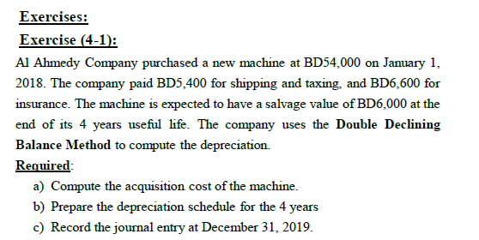
Accounting 2 Declining Balance Method Acc. 212
Exercise (4-1) work Book p 68
Annual Period | Depreciation For the Period |  |  | End Of the Period
 | Beginning Book Value | $×$Depreciation Rate | Depreciation Expense | Accumulated Depreciation | Net Book Value
وزارة التربية والتعليم – 2020م

Slide 13
Accounting 2 Declining Balance Method Acc. 212
Solution (4-1) work Book p 68
a-Acquisition cost =BD54,000 + BD 5,400 + BD 6,600 = BD 66,000,
B- Depreciation Rate = $\frac{100}{Useful life}$ X 2 = $\frac{100}{4}$ X 2 = =50%
Annual Period | Depreciation For the Period |  |  | End Of the Period
 | Beginning Book Value | $×$Depreciation Rate | Depreciation Expense | Accumulated Depreciation | Net Book Value
1-1-2018 | - | - | - |  | 66,000
31-12-2019 | $$66,000$$ | 50% | 33,000 | 33,000 | 66,000-33,00 =33,000
31-12-2020 | 33,000 | 50% | 16,500 | 49,500 | 66,000-49,500 =16,500
31-12-2021 | 16,500 | 50% | 8,250 | 57,750 | 66, 000-57,750 =8,250
31-12-2022 | 8,250 – 6,000 | * | 2,250 | 60,000 | 66,000-60,000 =6,000
Salvage Value
وزارة التربية والتعليم –الفصل الدراسي الثاني 2020-2021م

Slide 14
Accounting 2 Declining Balance Method Acc. 212
C- Prepare adjusted entry for 2019.
Date | Explanation | PR | Debit | Credit
Dec 31 ,2019 | Depreciation Expenses – Machine |  | 33,000
 | Accumulated Depreciation |  |  | 33,000
Annual Period | Depreciation For the Period |  |  | End Of the Period
 | Beginning Book Value | $×$Depreciation Rate | Depreciation Expense | Accumulated Depreciation | Net Book Value
1-1-2018 | - | - | - |  | 66,000
31-12-2019 | $$66,000$$ | 50% | 33,000 | 33,000 | 66,000-33,00 =33,000
31-12-2020 | 33,000 | 50% | 16,500 | 49,500 | 66,000-49,500 =16,500
31-12-2021 | 16,500 | 50% | 8,250 | 57,750 | 66, 000-57,750 =8,250
31-12-2022 | 8,250 – 6,000 | - | 2,250 | 60,000 | 66,000-60,000 =6,000
Salvage Value
وزارة التربية والتعليم –الفصل الدراسي الثاني 2020-2021م

Slide 15
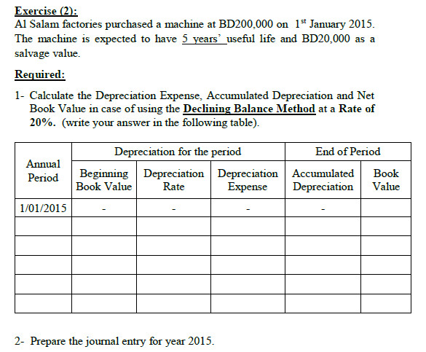
Accounting 2 Declining Balance Method Acc. 212
Exercise (2) work Book p 79
Annual Period | Depreciation For the Period |  |  | End Of the Period
 | Beginning Book Value | $×$Depreciation Rate | Depreciation Expense | Accumulated Depreciation | Net Book Value
Date | Explanation | PR | Debit | Credit
وزارة التربية والتعليم –الفصل الدراسي الثاني 2020-2021م

Slide 16
Accounting 2 Declining Balance Method Acc. 212
Solution Ex (2) work Book p 79
Annual Period | Depreciation For the Period |  |  | End Of the Period
 | Beginning Book Value | $×$Depreciation Rate | Depreciation Expense | Accumulated Depreciation | Net Book Value
1-1-2015 | - | - | - |  | 200,000
31-12-2015 | 200,000 | 20% | 40,000 | 40,000 | 160,000
31-12-2016 | 160,000 | 20% | 32,000 | 72,000 | 128,000
31-12-2017 | 128,000 | 20% | 25,600 | 97,000 | 103,000
31-12-2018 | 103,000 | 20% | 20,600 | 117,600 | 82,400
31-12-2019 | 82,400-20,000 | * | 62,400 | 180,000 | 20,000
Salvage Value
Date | Explanation | PR | Debit | Credit
Dec 31 ,2015 | Depreciation Expenses – Machine |  | 40,000
 | Accumulated Depreciation |  |  | 40,000
وزارة التربية والتعليم –الفصل الدراسي الثاني 2020-2021م

Slide 17
Accounting 2 Declining Balance Method Acc. 212
Declining Balance Method- Fractional Period
1. Calculation for Fractional Period:
Year 1 -> (Acquisition cost or Original cost x double declining rate) x No. of months/12
Year 2 -> Book value for year 1 x double declining rate
Year 3 -> Book value for year 2 x double declining rate
Year 4 -> Book value for year 3 x double declining rate
Final year -> Book value for previous year – salvage cost
وزارة التربية والتعليم –الفصل الدراسي الثاني 2020-2021م

Slide 18
Accounting 2 Declining Balance Method Acc. 212
End of Lesson
The student achieved the objectives:
Compere between the Straight line method and double declining method
Apply the declining balance method equation to find the Net book value.
Prepare the adjusting entry.
لمزيد من المعلومات:
www.Edunet.com1- زيارة البوابة التعليمية
2- حل أسئلة وأنشطة الكتاب المدرسي.
وزارة التربية والتعليم –الفصل الدراسي الثاني 2020-2021م

