Slide 1
Commercial Subjects Group Level 3
Subject | Accounting (3) – محا213 -806
Chapter | Chapter 5
Title | INVENTORIES AND COST OF SALES FIFO Method – Perpetual system
وزارة التربية والتعليم –الفصل الدراسي الثاني 2020-2021م

Slide 2
Accounting 3 INVENTORIES AND COST OF SALES Acc. 213
Learning Objectives
By the end of this lesson, the student should be able to:
definition of Perpetual Inventory System
The calculation of cost of goods sold and closing inventory by using the FIFO method – Perpetual System.
وزارة التربية والتعليم –الفصل الدراسي الثاني 2020-2021م

Slide 3
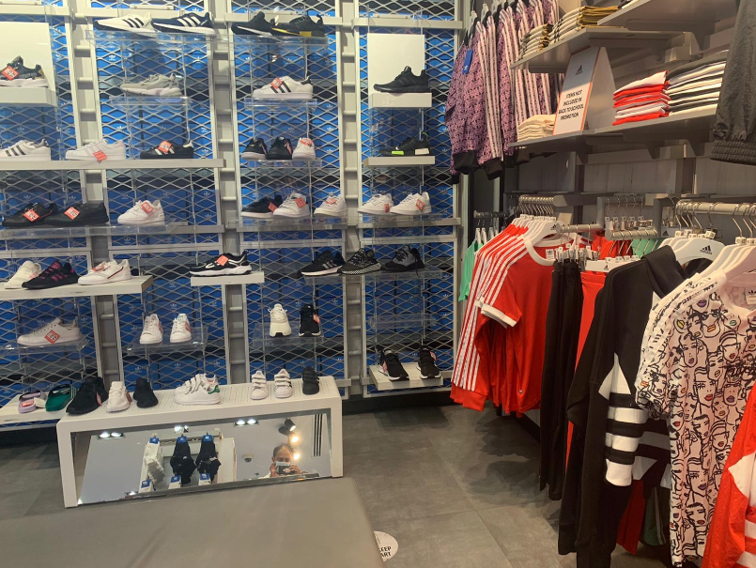
Accounting 3 INVENTORIES AND COST OF SALES Acc. 213
INTRODUCTION
INVENTORY is an asset that is intended for sale, or to be used in producing goods.
Inventory represents a large (if not the largest) portion of assets.
Inventory represents such an important part of the Balance Sheet.
وزارة التربية والتعليم –الفصل الدراسي الثاني 2020-2021م

Slide 4
Accounting 3 INVENTORIES AND COST OF SALES Acc. 213
The Need for Inventory Valuation
The types of inventories owned by business organizations differ depending on the type of activities or operations they perform. For example:
1. Merchandising Companies, i.e. businesses which purchase and sell goods, but do not process them. Inventories consists of goods purchased, in their completed state, and remaining unsold at the end of the accounting period.
2. Manufacturing Companies, i.e. businesses which produce or process inventory the term (inventory) include raw materials, work-in-progress and finished goods awaiting sale.
3. Service Companies, i.e. businesses which provide services to the public like, accountants and bankers. These hold very little, if any, inventories the conventional sense of the term, though accountants will have a significant balance of work-in-progress representing services provided but not yet billed while banks possess large investments which present their own valuation problems.
وزارة التربية والتعليم –الفصل الدراسي الثاني 2020-2021م

Slide 5
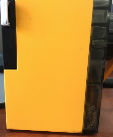
Accounting 3 INVENTORIES AND COST OF SALES Acc. 213
Definition of Perpetual Inventory System
Companies keep detailed records of the cost of each inventory purchase and sale. These records continuously – perpetually – show the inventory that should be on hand for every item. Companies that sell products with fixed prices use perpetual inventory systems.
Perpetual Inventory System
Current Inventory
Inventory
Added
Current Inventory
Inventory
Sold
Current Inventory
Reported
Total
Reported
+ Total
Reported
Total
Reported
Total
Reported
Total
وزارة التربية والتعليم –الفصل الدراسي الثاني 2020-2021م

Slide 6
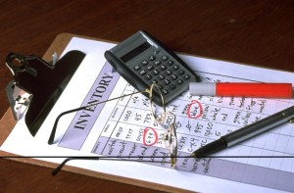
Accounting 3 INVENTORIES AND COST OF SALES Acc. 213
Methods of Stock Valuation
FIFO (First In First Out) – Perpetual Inventory System
Example 1:
Abdulhadi’s Company uses a perpetual inventory system. It entered into the following information for the month of May 2020.
Unit Sold (BD) | Unit Cost (BD) | Units | Explanation | Date
 | 25 | 200 | Beginning Inventory | May. 01
 | 30 | 300 | Purchases | May.08
60 |  | 400 | Sales | May. 12
 | 35 | 400 | Purchases | May. 19
 | 42 | 100 | Purchases | May. 24
70 |  | 250 | Sales | May. 28
Required:
1. Compute cost of goods sold and cost of ending Inventory using FIFO Method 2. Compute the gross profit.
وزارة التربية والتعليم –الفصل الدراسي الثاني 2020-2021م

Slide 7
Accounting 3 INVENTORIES AND COST OF SALES Acc. 213
Methods of Stock Valuation
FIFO (First In First Out) – Perpetual Inventory System
Example 1:Solution
Date | Goods Purchased | Cost of Goods Sold | Inventory Balance
May. 01 |  |  | 200×25=BD5,000
May.08 | 300×30=BD9,000 |  | 300×30=BD9,000
May. 12 |  | 200×25=BD5,000
 |  | 200×30=BD6,000
 |  |  | 100×30=BD3000
May. 19 | 400×35=BD14,000 |  | 400×35=BD14,000
May. 24 | 100×42=BD4,200 |  | 100×42=BD4,200
May. 28 |  | 100×30=BD3000
 |  | 150×35=BD5,250
 |  |  | 250×35=BD8,750
 |  |  | 100×42=BD4,200
Totals |  | 650 BD19,250 | 350 BD12,950
Abdulhadi’s Company uses a perpetual inventory system. It entered into the following information for the month of May 2020.
1
2
1
Unit Sold (BD) | Unit Cost (BD) | Units | Explanation | Date
 | 25 | 200 | Beginning Inventory | May. 01
 | 30 | 300 | Purchases | May.08
60 |  | 400 | Sales | May. 12
 | 35 | 400 | Purchases | May. 19
 | 42 | 100 | Purchases | May. 24
70 |  | 250 | Sales | May. 28
2
2
3
4
2
3
Required:
1. Compute cost of goods sold and cost of ending Inventory using FIFO Method
3
4
وزارة التربية والتعليم –الفصل الدراسي الثاني 2020-2021م

Slide 8
Accounting 3 INVENTORIES AND COST OF SALES Acc. 213
Activity (1): Exercise (4): page 58
Salman Company uses a perpetual inventory system. It entered into the following information for the month of June 2020.
Unit Sold (BD) | Unit Cost (BD) | Units | Explanation | Date
 | 10 | 800 | Beginning Inventory | June 01
 | 12 | 1000 | Purchases | June 09
20 |  | 1200 | Sales | June 14
 | 15 | 700 | Purchases | June 18
 | 18 | 500 | Purchases | June 23
20 |  | 250 | Sales | June 27
Required:
Compute cost of goods available for sales.
Compute the number of units in ending inventory.
Compute cost of goods sold and cost of ending Inventory using FIFO Method
4. Compute the gross profit.
وزارة التربية والتعليم –الفصل الدراسي الثاني 2020-2021م

Slide 9
Accounting 3 INVENTORIES AND COST OF SALES Acc. 213
Activity (1): Exercise (4): Solution
Salman Company uses a perpetual inventory system. It entered into the following information for the month of June 2020.
Compute cost of goods available for sales.
Unit Sold (BD) | Unit Cost (BD) | Units | Explanation | Date
 | 10 | 800 | Beginning Inventory | June 01
 | 12 | 1000 | Purchases | June 09
20 |  | 1200 | Sales | June 14
 | 15 | 700 | Purchases | June 18
 | 18 | 500 | Purchases | June 23
20 |  | 250 | Sales | June 27
Date | Units | Unit Cost (BD) | Total Value (BD)
June 01 | 800 × | 10 | = 8,000
June 09 | 1000 × | 12 | = 12,000
June 18 | 700 × | 15 | =10,500
June 23 | 500 × | 18 | = 9,000
Total | 3,000 |  | 39,500
2. Compute the number of units in ending inventory.
Ending Inventory in units = 3,000 – (1,200 +250)
= 1,550 units
وزارة التربية والتعليم –الفصل الدراسي الثاني 2020-2021م

Slide 10
Accounting 3 INVENTORIES AND COST OF SALES Acc. 213
Activity (1): Exercise (4): Solution
3. Compute cost of goods sold and cost of ending Inventory (FIFO)
Salman Company uses a perpetual inventory system. It entered into the following information for the month of June 2020.
Date | Goods Purchased | Cost of Goods Sold | Inventory Balance
June 01 |  |  | 800×10=BD8,000
June 09 | 1,000×12=BD12,000 |  | 1,000×12=BD12,000
June 14 |  | 800×100=BD8,000
 |  | 400×12=BD4,800
 |  |  | 600×12=BD7,200
June 18 | 700×15=BD10,500 |  | 700×15=BD10,500
June 23 | 500×18=BD9,000 |  | 500×18=BD9,000
June 27 |  | 250×12=BD3000
 |  |  | 350×12=BD4,200
 |  |  | 700×15=BD10,500
 |  |  | 500×18=BD9,000
Totals |  | 1450 BD15,800 | 1550 BD23,700
1
Unit Sold (BD) | Unit Cost (BD) | Units | Explanation | Date
 | 10 | 800 | Beginning Inventory | June 01
 | 12 | 1000 | Purchases | June 09
20 |  | 1200 | Sales | June 14
 | 15 | 700 | Purchases | June 18
 | 18 | 500 | Purchases | June 23
20 |  | 250 | Sales | June 27
2
1
2
2
3
4
2
2
3
4
وزارة التربية والتعليم –الفصل الدراسي الثاني 2020-2021م

Slide 11
Accounting 3 INVENTORIES AND COST OF SALES Acc. 213
Activity (1): Exercise (4): Solution
Unit Sold (BD) | Unit Cost (BD) | Units | Explanation | Date
 | 10 | 800 | Beginning Inventory | June 01
 | 12 | 1000 | Purchases | June 09
20 |  | 1200 | Sales | June 14
 | 15 | 700 | Purchases | June 18
 | 18 | 500 | Purchases | June 23
20 |  | 250 | Sales | June 27
Date | Goods Purchased | Cost of Goods Sold | Inventory Balance
June 01 |  |  | 800×10=BD8,000
June 09 | 1,000×12=BD12,000 |  | 1,000×12=BD12,000
June 14 |  | 800×100=BD8,000
 |  | 400×12=BD4,800
 |  |  | 600×12=BD7,200
June 18 | 700×15=BD10,500 |  | 700×15=BD10,500
June 23 | 500×18=BD9,000 |  | 500×18=BD9,000
June 27 |  | 250×12=BD3000
 |  |  | 350×12=BD4,200
 |  |  | 700×15=BD10,500
 |  |  | 500×18=BD9,000
Totals |  | 1450 BD15,800 | 1550 BD23,700
4. Compute the gross profit.
Sales = (1,200×20) + (250×20)
= (24,000 + 5,000)
=BD29,000
Gross profit = Sales – COGS
= 29,000 – 15,800 = BD13,200
وزارة التربية والتعليم –الفصل الدراسي الثاني 2020-2021م

Slide 12
Accounting 3 INVENTORIES AND COST OF SALES Acc. 213
End of Lesson
definition of Perpetual Inventory System
The calculation of cost of goods sold and closing inventory by using the FIFO method – Perpetual System.
لمزيد من المعلومات:
www.Edunet.com1- زيارة البوابة التعليمية
2- حل أسئلة وأنشطة الكتاب المدرسي.
وزارة التربية والتعليم –الفصل الدراسي الثاني 2020-2021م

