Slide 1
Commercial Subjects Group Level 3
Subject | Accounting (2) – محا 212 - 804
Chapter | Chapter 3
Title | Accounting For Receivable
وزارة التربية والتعليم –الفصل الدراسي الثاني 2020-2021م

Slide 2
Accounting 2 Accounting for Receivable Acc. 212
Requirements
وزارة التربية والتعليم –الفصل الدراسي الثاني 2020-2021م

Slide 3
Accounting 2 Accounting for Receivable Acc. 212
Learning Objectives
By the end of this lesson, the student should be able to:
1.
Explain how companies prepare journal entry for Allowance for Doubtful Debts.
2.
Explain how companies calculate the estimated Allowance for Doubtful Debts as a Percentage of Account Receivable.
3.
Applying exercise in preparing the journal entries by using Allowance for Doubtful Debts as a Percentage of Account Receivable
وزارة التربية والتعليم –الفصل الدراسي الثاني 2020-2021م

Slide 4
Accounting 2 Accounting for Receivable Acc. 212
Difference between the methods companies use to value Account Receivable
Two method to find the estimated uncollectible amount
1- Percentage of Credit Sales
2- Percentage of Account Receivable
1- Direct write - off method
when a company determines a particular account to be uncollectible directly write off the account
No estimation at the beginning
First, The companies estimate uncollectible of account receivable
Then, The companies write off a specific account
2- Allowance method.
وزارة التربية والتعليم –الفصل الدراسي الثاني 2020-2021م

Slide 5
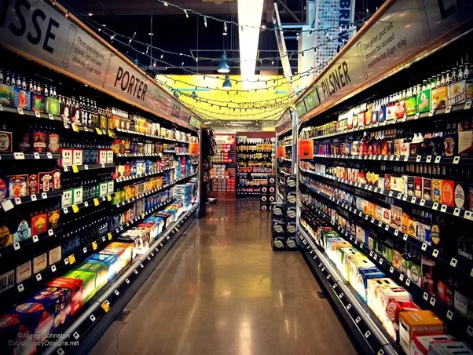
Accounting 2 Accounting for Receivable Acc. 212
Income Statement Approach
Allowance for Doubtful Debts
Normal Balance is:
(Credit Balance)
Balance Sheet Approach
%
Sales
%
Account Receivable
Aging Schedule
% Account Receivable
% Sales: Ignored Credit Balance of Allowance for doubtful A/C
% A/C Receivable:
Estimated % - Credit Balance of Allowance
Or Estimated % + Debit Balance of Allowance
وزارة التربية والتعليم –الفصل الدراسي الثاني 2020-2021م

Slide 6
Accounting 2 Accounting for Receivable Acc. 212
Allowance for Doubtful Account AS
% of Account Receivable
وزارة التربية والتعليم –الفصل الدراسي الثاني 2020-2021م

Slide 7
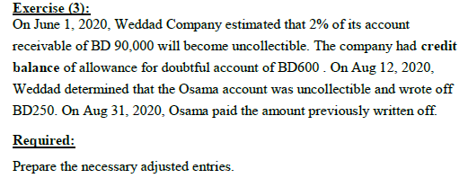
Accounting 2 Accounting for Receivable Acc. 212
2- ALLOWNCE METHOD FOR UNCOLLECTIBLE ACCOUNTS
% A/C Receivable:
Estimated % - Credit Balance of Allowance
Or Estimated % + Debit Balance of Allowance
Illustration 1
Date | Explanation | Debit | Credit
Jun 1
Aug 12
Aug 31
Aug 31
وزارة التربية والتعليم –الفصل الدراسي الثاني 2020-2021م

Slide 8
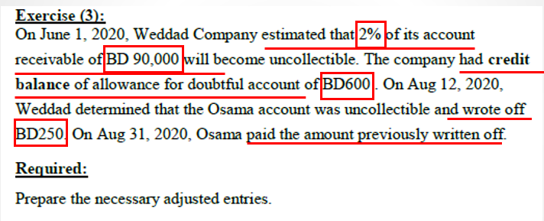
Accounting 2 Accounting for Receivable Acc. 212
2- ALLOWNCE METHOD FOR UNCOLLECTIBLE ACCOUNTS
Exercise (3): Solution
Date | Explanation | Debit | Credit
Jun 1
Aug 12
Aug 31
Aug 31
Bad Debts Expense (90,000 X 2%) - 600
1,200
Illustration 1
Allowance for Doubtful Accounts
1,200
Allowance for Doubtful Accounts
250
Account Receivable (Osama)
250
Account Receivable (Osama)
250
Allowance for Doubtful Accounts
250
Cash
250
Account Receivable (Osama)
250
وزارة التربية والتعليم –الفصل الدراسي الثاني 2020-2021م

Slide 9
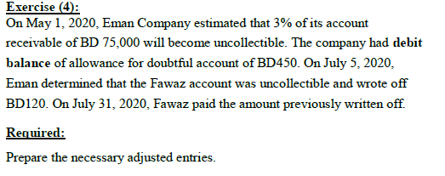
Accounting 2 Accounting for Receivable Acc. 212
Exercise (4): work book P:61
5 mins
% A/C Receivable:
Estimated % - Credit Balance of Allowance
Or Estimated % + Debit Balance of Allowance
Activity 1
Date | Explanation | Debit | Credit
May 1
July 5
July 31
July 31
وزارة التربية والتعليم –الفصل الدراسي الثاني 2020-2021م

Slide 10
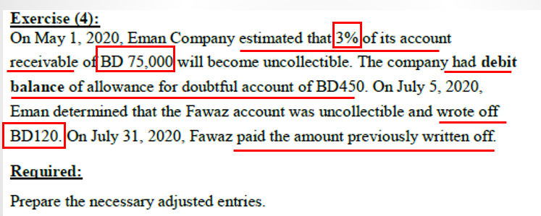
Accounting 2 Accounting for Receivable Acc. 212
Exercise (4): Solution
Activity 1: Solution
Date | Explanation | Debit | Credit
May 1
July 5
July 31
July 31
Bad Debts Expense (75,000 X 3%) + 450
2,700
Allowance for Doubtful Accounts
2,700
Allowance for Doubtful Accounts
120
Account Receivable- Fawaz
120
Account Receivable - Fawaz
120
Allowance for Doubtful Accounts
120
Cash
120
Account Receivable - Fawaz
120
وزارة التربية والتعليم –الفصل الدراسي الثاني 2020-2021م

Slide 11
Accounting 2 Accounting for Receivable Acc. 212
Aging Schedule
وزارة التربية والتعليم –الفصل الدراسي الثاني 2020-2021م

Slide 12
Accounting 2 Accounting for Receivable Acc. 212
2- ALLOWNCE METHOD FOR UNCOLLECTIBLE ACCOUNTS
B- ESTIMATING THE ALLOWANCE AS A PERCENTAGE-OF-RECEIVABLE:
Illustration 2:
The following an aging schedule for Essa’s Company. Note that as the estimated percentage uncollectible from 1-30 days to over 90 days, increases from 5% to 20% as the number of days past due increases.
Customer | Total | Number of Days Past Due
 |  | 1-30 | 31-60 | 61-90 | Over 90
Ahmed | 10,000 | 4,000 |  | 3,000 | 3,000
Osama | 12,000 | 6,000 | 4,000 |  | 2,000
Abdulla | 18,000 | 7,000 | 5,000 | 4,000 | 2,000
Salma | 20,000 | 10,000 | 6,000 | 4,000
Mohammed | 25,000 | 3,000 | 6,000 | 9,000 | 7,000
Total | 85,000 | 30,000 | 21,000 | 20,000 | 14,000
Estimated Percentage Uncollectible |  | 5% | 10% | 15% | 20%
Total Estimated Bad Debts | -------- | -------- | -------- | -------- | --------
If the trail balance shows allowance for doubtful accounts with a credit balance of BD2,400,
Required:
1- Prepare the necessary journal entries for estimating bad debts expense.
SOLUTION
General Journal
Date | Explanation | Debit | Credit
Dec 31
وزارة التربية والتعليم –الفصل الدراسي الثاني 2020-2021م

Slide 13
Accounting 2 Accounting for Receivable Acc. 212
2- ALLOWNCE METHOD FOR UNCOLLECTIBLE ACCOUNTS
B- ESTIMATING THE ALLOWANCE AS A PERCENTAGE-OF-RECEIVABLE:
Illustration 2:
The following an aging schedule for Essa’s Company. Note that as the estimated percentage uncollectible from 1-30 days to over 90 days, increases from 5% to 20% as the number of days past due increases.
Customer | Total | Number of Days Past Due
 |  | 1-30 | 31-60 | 61-90 | Over 90
Ahmed | 10,000 | 4,000 |  | 3,000 | 3,000
Osama | 12,000 | 6,000 | 4,000 |  | 2,000
Abdulla | 18,000 | 7,000 | 5,000 | 4,000 | 2,000
Salma | 20,000 | 10,000 | 6,000 | 4,000
Mohammed | 25,000 | 3,000 | 6,000 | 9,000 | 7,000
Total | 85,000 | 30,000 | 21,000 | 20,000 | 14,000
Estimated Percentage Uncollectible |  | 5% | 10% | 15% | 20%
Total Estimated Bad Debts
If the trail balance shows allowance for doubtful accounts with a credit balance of BD2,400,
Required:
1- Prepare the necessary journal entries for estimating bad debts expense.
9,400
1,500
2,100
3,000
2,800
SOLUTION
General Journal
% A/C Receivable:
Estimated % - Credit Balance of Allowance
Or Estimated % + Debit Balance of Allowance
Date | Explanation | Debit | Credit
Dec 31 | Bad Debts Expense (9,400 – 2,400) | 7,000
 | Allowance for Doubtful Accounts |  | 7,000
وزارة التربية والتعليم –الفصل الدراسي الثاني 2020-2021م

Slide 14
Accounting 2 Accounting for Receivable Acc. 212
2- ALLOWNCE METHOD FOR UNCOLLECTIBLE ACCOUNTS
B- ESTIMATING THE ALLOWANCE AS A PERCENTAGE-OF-RECEIVABLE:
Illustration 3:
The following an aging schedule for Essa’s Company. Note that as the estimated percentage uncollectible from 1-30 days to over 90 days, increases from 5% to 20% as the number of days past due increases.
Customer | Total | Number of Days Past Due
 |  | 1-30 | 31-60 | 61-90 | Over 90
Ahmed | 10,000 | 4,000 |  | 3,000 | 3,000
Osama | 12,000 | 6,000 | 4,000 |  | 2,000
Abdulla | 18,000 | 7,000 | 5,000 | 4,000 | 2,000
Salma | 20,000 | 10,000 | 6,000 | 4,000
Mohammed | 25,000 | 3,000 | 6,000 | 9,000 | 7,000
Total | 85,000 | 30,000 | 21,000 | 20,000 | 14,000
Estimated Percentage Uncollectible |  | 5% | 10% | 15% | 20%
Total Estimated Bad Debts | 9,400 | 1,500 | 2,100 | 3,000 | 2,800
If the trail balance shows allowance for doubtful accounts with a debit balance of BD600,
Required:
1- Prepare the necessary journal entries for estimating bad debts expense.
SOLUTION
General Journal
Date | Explanation | Debit | Credit
Dec 31
وزارة التربية والتعليم –الفصل الدراسي الثاني 2020-2021م

Slide 15
Accounting 2 Accounting for Receivable Acc. 212
2- ALLOWNCE METHOD FOR UNCOLLECTIBLE ACCOUNTS
B- ESTIMATING THE ALLOWANCE AS A PERCENTAGE-OF-RECEIVABLE:
Illustration 3:
The following an aging schedule for Essa’s Company. Note that as the estimated percentage uncollectible from 1-30 days to over 90 days, increases from 5% to 20% as the number of days past due increases.
Customer | Total | Number of Days Past Due
 |  | 1-30 | 31-60 | 61-90 | Over 90
Ahmed | 10,000 | 4,000 |  | 3,000 | 3,000
Osama | 12,000 | 6,000 | 4,000 |  | 2,000
Abdulla | 18,000 | 7,000 | 5,000 | 4,000 | 2,000
Salma | 20,000 | 10,000 | 6,000 | 4,000
Mohammed | 25,000 | 3,000 | 6,000 | 9,000 | 7,000
Total | 85,000 | 30,000 | 21,000 | 20,000 | 14,000
Estimated Percentage Uncollectible |  | 5% | 10% | 15% | 20%
Total Estimated Bad Debts | 9,400 | 1,500 | 2,100 | 3,000 | 2,800
If the trail balance shows allowance for doubtful accounts with a debit balance of BD600,
Required:
Prepare the necessary journal entries for estimating bad debts expense.
SOLUTION
General Journal
Date | Explanation | Debit | Credit
Dec 31 | Bad Debts Expense (9,400 + 600) | 10,000
 | Allowance for Doubtful Accounts |  | 10,000
وزارة التربية والتعليم –الفصل الدراسي الثاني 2020-2021م

Slide 16
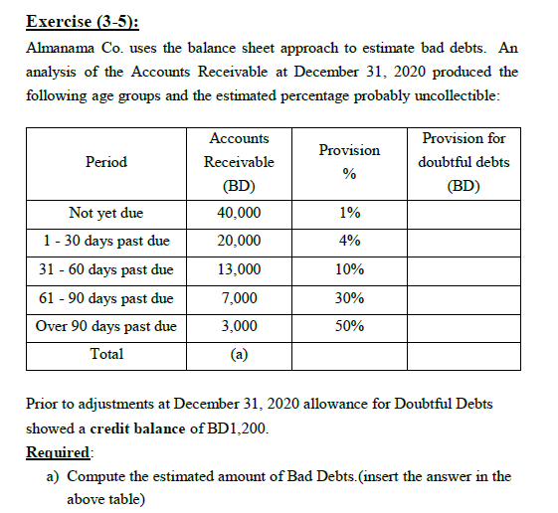
Accounting 2 Accounting for Receivable Acc. 212
Exercise (3-5): work book P:49
5 mins
Activity 2
Date | Explanation | Debit | Credit
B Dec 31
C May 17
وزارة التربية والتعليم –الفصل الدراسي الثاني 2020-2021م

Slide 17
Accounting 2 Accounting for Receivable Acc. 212
Exercise (3-5): Solution
Activity 2
a
X
= 400
X
= 800
X
= 1,300
X
= 2,100
= 1,500
= 6,100
وزارة التربية والتعليم –الفصل الدراسي الثاني 2020-2021م

Slide 18
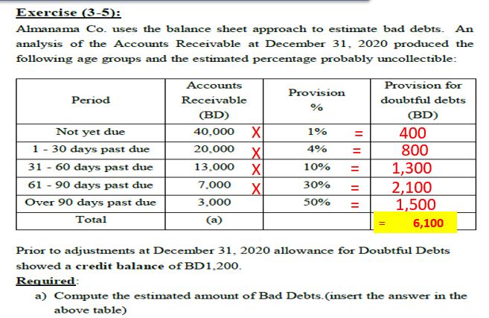
Accounting 2 Accounting for Receivable Acc. 212
Exercise (3-5): Solution
Activity 2
General Journal
Date | Explanation | Debit | Credit
B Dec 31
C May 17
Bad Debts Expense (6,100 – 1,200)
4,900
Allowance for Doubtful Accounts
4,900
Allowance for Doubtful Accounts
400
Account Receivable - Kholood
400
Credit balance for allowance for doubtful Debt
وزارة التربية والتعليم –الفصل الدراسي الثاني 2020-2021م

Slide 19
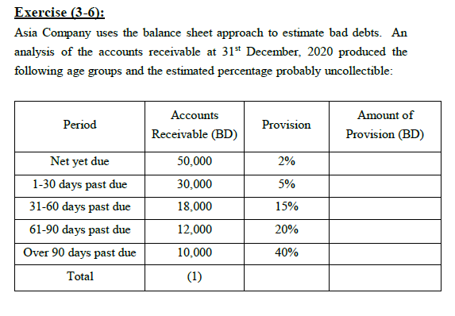
Accounting 2 Accounting for Receivable Acc. 212
Exercise (3-6): work book P:49
5 mins
Activity 3
Date | Explanation | Debit | Credit
2 Dec 31
3 Dec 31
4 Dec 31
4 Dec 31
وزارة التربية والتعليم –الفصل الدراسي الثاني 2020-2021م

Slide 20
Accounting 2 Accounting for Receivable Acc. 212
Exercise (3-6): Solution
General Journal
Activity 3
Date | Explanation | Debit | Credit
2 Dec 31
3 Dec 31
4 Dec 31
4 Dec 31
Bad Debts Expense (11,600 + 2,500)
14,100
Allowance for Doubtful Accounts
14,100
Allowance for Doubtful Accounts
800
1
Account Receivable
800
X
= 1,000
Account Receivable
X
= 1,500
600
X
= 2,700
Allowance for Doubtful Accounts
600
X
= 2,400
Cash
X
= 4,000
600
= 11,600
Account Receivable
600
وزارة التربية والتعليم – 2020م

Slide 21
Accounting 2 Accounting for Receivable Acc. 212
Summary
5 Mins
With % of Account receivable
1. When the company estimated uncollectible Receivable
% A/C Receivable:
Estimated % - Credit Balance of Allowance
Or Estimated % + Debit Balance of Allowance
DR. Bad Debts Expense (Account Receivable X % )
CR. Allowance for Doubtful Accounts
2. When the company decided to write off the customer account to be uncollectible.
DR. Allowance for doubtful accounts
CR. Account Receivable (customer Name )
3. When the company recovered the customer account which wrote off.
DR. Account Receivable (customer Name )
CR. Allowance for doubtful accounts
Both of entries records in
the same Date
&
the same Amount
DR. Cash
CR. Account Receivable
وزارة التربية والتعليم –الفصل الدراسي الثاني 2020-2021م

Slide 22
Accounting 2 Accounting for Receivable Acc. 212
End Of Lesson
The student should be achieved the objectives:
Explain how companies prepare journal entry for Allowance for Doubtful Debts
. Explain how companies calculate the estimated Allowance for Doubtful Debts as a Percentage of Account Receivable.
Applying exercise in preparing the journal entries by using Allowance for Doubtful Debts as a Percentage of Account Receivable
لمزيد من المعلومات:
www.Edunet.com1- زيارة البوابة التعليمية
2- حل أسئلة وأنشطة الكتاب المدرسي.
وزارة التربية والتعليم –الفصل الدراسي الثاني 2020-2021م

