Slide 1
Commercial Subjects Group Level 3
Subject | Accounting (2) – محا 212 - 804
Chapter | Chapter 3
Title | Accounting For Receivable Allowance Method
وزارة التربية والتعليم –الفصل الدراسي الثاني 2020-2021م

Slide 2
Accounting 2 Accounting for Receivable Acc. 212
Learning Objectives
By the end of this lesson, the student should be able to:
1.
Explain how companies prepare journal entry by using Allowance Method
2.
Explain how companies calculate the estimated uncollectible receivables
3.
Applying exercise in preparing the journal entries by using Allowance Method
وزارة التربية والتعليم –الفصل الدراسي الثاني 2020-2021م

Slide 3
Accounting 2 Accounting for Receivable Acc. 212
Type of recording uncollectible accounts
Two methods are used in accounting for uncollectible accounts:
1- Direct write - off method
when a company determines a particular account to be uncollectible directly write off the account
it’s charges the loss to Bad Debts Expense
✓
2- Allowance method.
It’s involves estimating uncollectible accounts at the end of each period
وزارة التربية والتعليم –الفصل الدراسي الثاني 2020-2021م

Slide 4
Accounting 2 Accounting for Receivable Acc. 212
2- ALLOWNCE METHOD FOR UNCOLLECTIBLE ACCOUNTS
The allowance method of accounting for bad debts involves estimating uncollectible accounts at the end of each period. This provides better matching on the income statement. It also ensures that companies state receivables on the balance sheet at their cash (net) realizable value. Cash (net) realizable value is the net amount the company expects to receive in cash, when collecting the receiving. It excludes amounts that the company estimates it will not collect. This method reduces receivable in the balance sheet by the amount estimated uncollectible receivables
Emphasis on Income Statement Emphasis on Balance Sheet
Relationships Relationships
Cash Realizable Value
Sales Bad Debts
Receivable Expenses
Cash Realizable Value
Accounts Allowance for
Receivable Doubtful Accounts
Percentage of Sales
Percentage of Receivable
وزارة التربية والتعليم –الفصل الدراسي الثاني 2020-2021م

Slide 5
Accounting 2 Accounting for Receivable Acc. 212
Allowance Method
Steps to prepare the journal entries by using the Allowance Method
Companies estimate uncollectible of account receivable
Companies write off a specific account
If the customer pay : company recover the customer account that wrote off before (record the amount Received )
1
2
3
وزارة التربية والتعليم –الفصل الدراسي الثاني 2020-2021م

Slide 6
Accounting 2 Accounting for Receivable Acc. 212
2- ALLOWNCE METHOD FOR UNCOLLECTIBLE ACCOUNTS
Illustration 1:
Khalid Company had the following transitions involving bad debts in 2018 & 2019:
December 31,2018: Estimated bade debts expenses of BD 9,000
February 12, 2019: Wrote off balance of customer Nasser of BD 3,500 as uncollectible.
September 18,2019: Nasser won money and paid the amount due.
Required:
Prepare the necessary journal entries.
Date | Explanation | Debit | Credit
Dec 31 2018
Jan 15 2019
Jan 31 2019
Jan 31 2019
وزارة التربية والتعليم –الفصل الدراسي الثاني 2020-2021م

Slide 7
Accounting 2 Accounting for Receivable Acc. 212
SOLUTION
2- ALLOWNCE METHOD FOR UNCOLLECTIBLE ACCOUNTS
Illustration 1:
Khalid Company had the following transitions involving bad debts in 2018 & 2019:
December 31,2018: Estimated bade debts expenses of BD 9,000
February 12, 2019: Wrote off balance of customer Nasser of BD 3,500 as uncollectible.
September 18,2019: Nasser won money and paid the amount due.
Required:
Prepare the necessary journal entries.
Same Date
Same Amount
Date | Explanation | Debit | Credit
December 31 2018
February 12 2019
September 18 2019
September 18 2019
estimate uncollectible account receivable
Bad Debts Expense
9,000
Allowance for Doubtful Accounts
9,000
Write off the uncollectible account
Allowance for doubtful accounts
3,500
Account Receivable
3,500
Reopen the uncollectible account to recover it
Account Receivable
3,500
Allowance for doubtful accounts
3,500
Cash
3,500
Record receiving amount due
Account Receivable
3,500
وزارة التربية والتعليم –الفصل الدراسي الثاني 2020-2021م

Slide 8
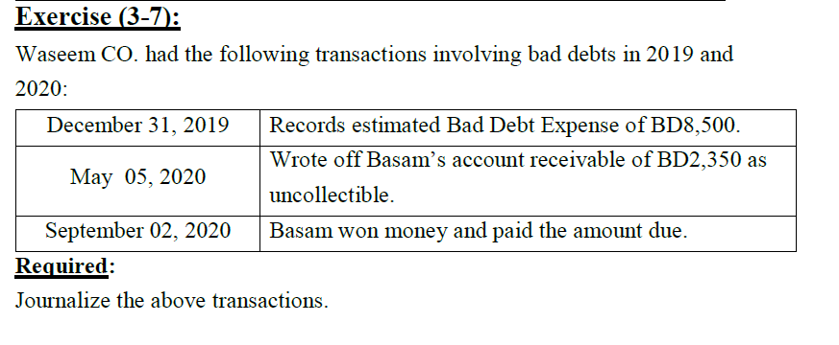
Accounting 2 Accounting for Receivable Acc. 212
2- ALLOWNCE METHOD FOR UNCOLLECTIBLE ACCOUNTS
Date | Explanation | Debit | Credit
December 31 2019
May o5 2020
September 02 2020
September 02 2020
وزارة التربية والتعليم –الفصل الدراسي الثاني 2020-2021م

Slide 9
Accounting 2 Accounting for Receivable Acc. 212
2- ALLOWNCE METHOD FOR UNCOLLECTIBLE ACCOUNTS
How can we calculate the estimated uncollectible receivable amount ???
Date | Explanation | Debit | Credit
December 31 2019
May o5 2020
September 02 2020
September 02 2020
Bad Debts Expense
8,500
Allowance for Doubtful Accounts
8,500
Allowance for doubtful accounts
2,350
Account Receivable – Bassam
2,350
Account Receivable - Bassam
2,350
Allowance for doubtful accounts
2,350
Cash
2,350
Account Receivable
2,350
وزارة التربية والتعليم –الفصل الدراسي الثاني 2020-2021م

Slide 10
Accounting 2 Accounting for Receivable Acc. 212
Two method to calculate the estimated uncollected receivable amount
Allowance for Doubtful Debts
Normal Balance is:
(Credit Balance)
%
Sales
%
Account Receivable
% Sales: Ignored Credit or debit Balance of Allowance for doubtful A/C
% A/C Receivable:
Estimated % - Credit Balance of Allowance
Or Estimated % + Debit Balance of Allowance
وزارة التربية والتعليم –الفصل الدراسي الثاني 2020-2021م

Slide 11
Accounting 2 Accounting for Receivable Acc. 212
2- ALLOWNCE METHOD FOR UNCOLLECTIBLE ACCOUNTS
ESTIMATING THE ALLOWANCE AS A PERCENTAGE-OF-SALE:
When estimated a percentage of sales always take
credit sales not cash Sales
Illustration 2:
Abdulla Company has credit sales of BD500,000 in 2018. Of this amount , BD100,000 remains uncollectible and credit balance of allowance for doubtful accounts BD20,000 at Dec 31 2018. The manger estimated that 10% of credit sales will be uncollectible. On Jan 15 2019, Customer Ahmed has bankrupt and the company write off his balance BD2,700 is to be uncollectible. On Jan 31 2019, Ahmed has increasing sales in his business and paid his balance due.
Required:
1- Prepare the necessary journal entries.
Date | Explanation | Debit | Credit
Dec 31 2018
Jan 15 2019
Jan 31 2019
Jan 31 2019
وزارة التربية والتعليم –الفصل الدراسي الثاني 2020-2021م

Slide 12
Accounting 2 Accounting for Receivable Acc. 212
2- ALLOWNCE METHOD FOR UNCOLLECTIBLE ACCOUNTS
SOLUTION
ESTIMATING THE ALLOWANCE AS A PERCENTAGE-OF-SALE:
Illustration 2:
Abdulla Company has credit sales of BD500,000 in 2018. Of this amount , BD100,000 remains uncollectible and credit balance of allowance for doubtful accounts BD20,000 at Dec 31 2018. The manger estimated that 10% of credit sales will be uncollectible. On Jan 15 2019, Customer Ahmed has bankrupt and the company write off his balance BD2700 is to be uncollectible. On Jan 31 2019, Ahmed has increasing sales in his business and paid his balance due.
Required:
1- Prepare the necessary journal entries.
2- Show the effect on balance sheet.
Date | Explanation | Debit | Credit
Dec 31 2018
Jan 15 2019
Jan 31 2019
Jan 31 2019
Bad Debts Expense (500 000 X 10%)
50,000
Allowance for Doubtful Accounts
50,000
Allowance for doubtful accounts
2,700
Account Receivable – Ahmed
2,700
Account Receivable - Ahmed
2,700
Allowance for doubtful accounts
2,700
Cash
2,700
% Sales: Ignored Credit or debit Balance of Allowance for doubtful A/C
Account Receivable
2,700
وزارة التربية والتعليم –الفصل الدراسي الثاني 2020-2021م

Slide 13
Accounting 2 Accounting for Receivable Acc. 212
Summary
5 Mins
1. When the company estimated uncollectible Receivable
DR. Bad Debts Expense (credit sales X %)
CR. Allowance for Doubtful Accounts
Be sure to
use only >>> credit sales
Don’t use >>> cash sales
2. When the company decided to write off the customer account to be uncollectible.
DR. Allowance for doubtful accounts
CR. Account Receivable (customer Name )
3. When the company recovered the customer account which wrote off.
DR. Account Receivable (customer Name )
CR. Allowance for doubtful accounts
Both of entries records in
the same Date
&
the same Amount
DR. Cash
CR. Account Receivable
وزارة التربية والتعليم –الفصل الدراسي الثاني 2020-2021م

Slide 14
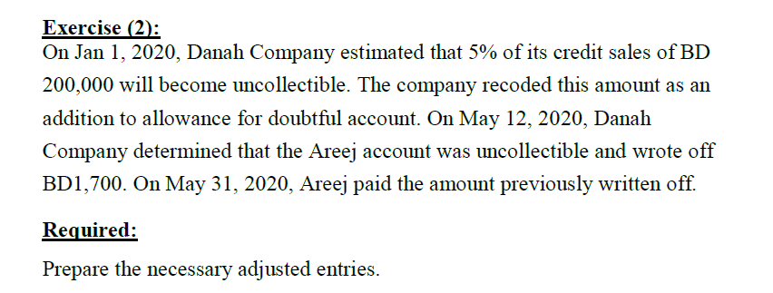
Accounting 2 Accounting for Receivable Acc. 212
2- ALLOWNCE METHOD FOR UNCOLLECTIBLE ACCOUNTS
Date | Explanation | Debit | Credit
Jan 1 2020
May 12 2020
May 31 2020
May 31 2020
وزارة التربية والتعليم –الفصل الدراسي الثاني 2020-2021م

Slide 15
Accounting 2 Accounting for Receivable Acc. 212
2- ALLOWNCE METHOD FOR UNCOLLECTIBLE ACCOUNTS
Date | Explanation | Debit | Credit
Jan 1 2020
May 12 2020
May 31 2020
May 31 2020
Bad Debts Expense (200 000 X 5%)
10,000
Allowance for Doubtful Accounts
10,000
Allowance for doubtful accounts
1,700
Account Receivable – Areej
1,700
Account Receivable - Areej
1,700
Allowance for doubtful accounts
1,700
Cash
1,700
Account Receivable
1,700
وزارة التربية والتعليم –الفصل الدراسي الثاني 2020-2021م

Slide 16
Accounting 2 Accounting for Receivable Acc. 212
End Of Lesson
The student should be achieved the objectives:
Explain how companies prepare journal entry by using Allowance Method
Explain how companies Allowances calculate the estimated uncollectible receivables
Applying exercise in preparing the journal entries by using Allowance Method
لمزيد من المعلومات:
www.Edunet.com1- زيارة البوابة التعليمية
2- حل أسئلة وأنشطة الكتاب المدرسي.
وزارة التربية والتعليم –الفصل الدراسي الثاني 2020-2021م

