Slide 1
Commercial Subjects Group Level 3
Subject | Accounting (3) –محا 213
Chapter | Chapter 5
Title | INVENTORIES AND COST OF SALES FIFO Method – Periodic system
وزارة التربية والتعليم –الفصل الدراسي الثاني 2020-2021م

Slide 2
Accounting 3 INVENTORIES AND COST OF SALES Acc. 213
Learning Objectives
By the end of this lesson, the student should be able to:
The need for stock valuation.
The different methods of stock valuation.
The calculation of cost of goods sold and closing inventory by using the FIFO method.
وزارة التربية والتعليم –الفصل الدراسي الثاني 2020-2021م

Slide 3
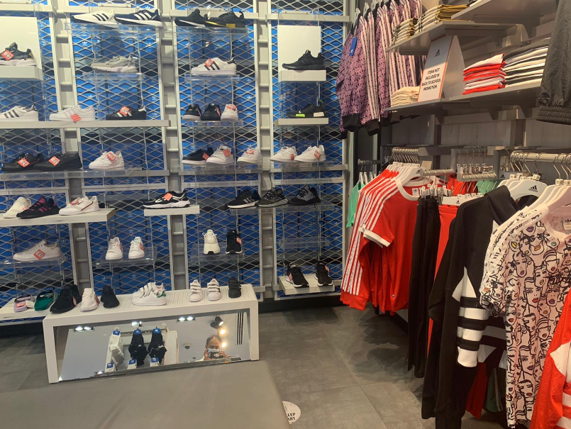
Accounting 3 INVENTORIES AND COST OF SALES Acc. 213
INTRODUCTION
INVENTORY is an asset that is intended for sale, or to be used in producing goods.
Inventory represents a large (if not the largest) portion of assets.
Inventory represents such an important part of the Balance Sheet.
وزارة التربية والتعليم –الفصل الدراسي الثاني 2020-2021م

Slide 4
Accounting 3 INVENTORIES AND COST OF SALES Acc. 213
The Need for Inventory Valuation
The types of inventories owned by business organizations differ depending on the type of activities or operations they perform. For example:
1. Merchandising Companies, i.e. businesses which purchase and sell goods, but do not process them. Inventories consists of goods purchased, in their completed state, and remaining unsold at the end of the accounting period.
2. Manufacturing Companies, i.e. businesses which produce or process inventory the term (inventory) include raw materials, work-in-progress and finished goods awaiting sale.
3. Service Companies, i.e. businesses which provide services to the public like, accountants and bankers. These hold very little, if any, inventories the conventional sense of the term, though accountants will have a significant balance of work-in-progress representing services provided but not yet billed while banks possess large investments which present their own valuation problems.
وزارة التربية والتعليم –الفصل الدراسي الثاني 2020-2021م

Slide 5
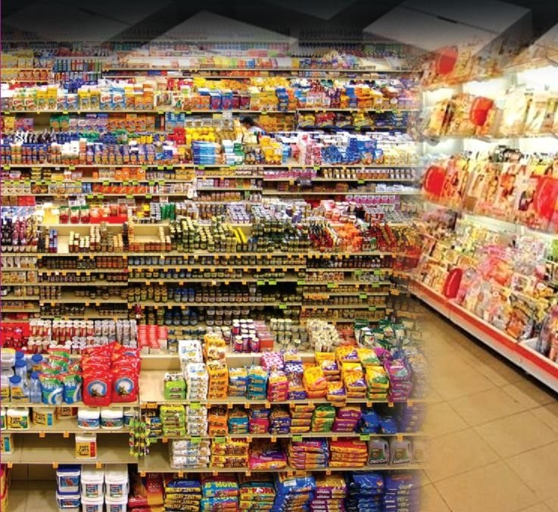
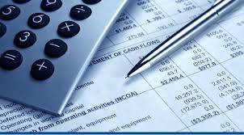
Accounting 3 INVENTORIES AND COST OF SALES Acc. 213
Definition of Periodic Inventory System
Periodic Inventory system:
In a periodic inventory system, companies do not keep detailed inventory records of the goods on hand throughout the period. Instead, they determine the cost of their inventory on hand at the end of the accounting period a physical inventory count.
Unlike the perpetual system, cost of goods sold under the periodic inventory system is not known at any point in time. Rather cost of goods sold will be known only at the end of the period after taking the physical count to the inventory on hand. Cost of goods sold is found according to this formula.
وزارة التربية والتعليم –الفصل الدراسي الثاني 2020-2021م

Slide 6
Accounting 3 INVENTORIES AND COST OF SALES Acc. 213
Methods of Stock Valuation
FIFO (First In First Out) – Periodic Inventory System
Example:
Abdulla Company uses a periodic inventory system. Its records show the following information for the year ended Dec 31, 2016, in which 450 units were sold by selling price BD25 each.
Required:
1. Compute cost of goods available for sales.
2. Compute the number of units in ending
inventory.
3. Compute cost of goods sold and cost of
ending Inventory using FIFO method.
4. Compute the gross profit under each
method.
Unit Cost (BD) | Units | Explanation | Date
10 | 100 | Beginning Inventory | Jan. 01
11 | 200 | Purchases | April 15
12 | 300 | Purchases | Aug. 24
13 | 400 | Purchases | Nov. 27
 | 1,000 | Total
وزارة التربية والتعليم –الفصل الدراسي الثاني 2020-2021م

Slide 7
Accounting 3 INVENTORIES AND COST OF SALES Acc. 213
Solution:
1. Cost of Goods Available for Sales = Beginning Inventory + Cost of Purchases
Abdulla Company uses a periodic inventory system. Its records show the following information for the year ended Dec 31, 2016, in which 450 units were sold by selling price BD25 each.
Total Cost (BD) | Unit Cost (BD) | Units | Explanation | Date
1,000 | 10 | 100 | Beginning Inventory | Jan. 01
2,200 | 11 | 200 | Purchases | April 15
3,600 | 12 | 300 | Purchases | Aug. 24
5,200 | 13 | 400 | Purchases | Nov. 27
12,000 |  | 1,000 | Total cost of goods available for sales
1
2
Unit Cost (BD) | Units | Explanation | Date
10 | 100 | Beginning Inventory | Jan. 01
11 | 200 | Purchases | April 15
12 | 300 | Purchases | Aug. 24
13 | 400 | Purchases | Nov. 27
 | 1,000 | Total
3
4
2. No of Ending Inventory units = Units available for sales – Units sold
= 1,000 – 450 = 550 Units
وزارة التربية والتعليم –الفصل الدراسي الثاني 2020-2021م

Slide 8
Accounting 3 INVENTORIES AND COST OF SALES Acc. 213
3.Cos t of goods sold and cost of ending Inventory
First In First Out (FIFO):-
3- The value of COGS:
Unit Cost (BD) | Units | Explanation | Date
10 | 100 | Beginning Inventory | Jan. 01
11 | 200 | Purchases | April 15
12 | 300 | Purchases | Aug. 24
13 | 400 | Purchases | Nov. 27
 | 1,000 | Total
Date | Units | Unit Cost (BD) | Total Cost (BD)
Jan. 01 | 100 | 10 | 1,000
April 15 | 200 | 11 | 2,200
Aug. 24 | 150 | 12 | 1,800
Total | 450 |  | 5,000
1
1
2
2
3
3
4
The value of Ending Inventory is:
Date | Units | Unit Cost (BD) | Total Cost (BD)
Aug. 24 | 150 | 12 | 1,800
Nov. 27 | 400 | 13 | 5,200
Total | 550 |  | 7,000
4. Gross Profit = Sales – COGS
= (450 × 25) – 5,000
= 11,250 – 5,000 = BD6,250
3
4
وزارة التربية والتعليم –الفصل الدراسي الثاني 2020-2021م

Slide 9
Accounting 3 INVENTORIES AND COST OF SALES Acc. 213
Activity (1):
The accounting records of Mariam Electronics show the following data:
Jan. 1: Beginning Inventory | 4,000 units @ BD30
Jan. 18: Purchases | 6,000 units @ BD40
Jan.25: Sales | 3,000 units @ BD60
Required:
1. Compute cost of goods available for sales.
2. Compute the number of units in ending inventory.
3. Compute the Cost of Ending Inventory and Cost of goods sold during the period under a periodic inventory system using FIFO Method.
4. Compute the gross profit under each method.
وزارة التربية والتعليم –الفصل الدراسي الثاني 2020-2021م

Slide 10
Accounting 3 INVENTORIES AND COST OF SALES Acc. 213
Activity(1): (Solution)
The accounting records of Mariam Electronics show the following data:
Jan. 1: Beginning Inventory | 4,000 units @ BD30
Jan. 18: Purchases | 6,000 units @ BD40
Jan.25: Sales | 3,000 units @ BD60
Required:
Compute cost of goods available for sales = Beginning Inventory + Cost of Purchases
= (4,000×30) + (6,000×40) = BD360,000
2. No of Ending Inventory units = Units available for sales – Units sold
= 10,000 – 3,000 = 7,000 Units
وزارة التربية والتعليم –الفصل الدراسي الثاني 2020-2021م

Slide 11
Accounting 3 INVENTORIES AND COST OF SALES Acc. 213
Activity: (Solution)
3.Cos t of goods sold and cost of ending Inventory
First In First Out (FIFO):-
3 - The value of COGS:
Date | Units | Unit Cost (BD) | Total Cost (BD)
Jan. 01 | 3,000 | 30 | 90,000
Total | 3,000 |  | 90,000
Jan.1: Beginning Inventory | 4,000 units @ BD30
Jan.18: Purchases | 6,000 units @ BD40
Jan.25: Sales | 3,000 units @ BD60
1
2
1
The value of Ending Inventory is:
Date | Units | Unit Cost (BD) | Total Cost (BD)
Jan.01 | 1,000 | 30 | 30,000
Jan.18 | 6,000 | 40 | 240,000
Total | 550 |  | 270,000
4. Gross Profit = Sales – COGS
= (3,000 × 60) – 90,000
= 11,250 – 5,000 = BD6,250
1
2
وزارة التربية والتعليم –الفصل الدراسي الثاني 2020-2021م

Slide 12
Accounting 3 INVENTORIES AND COST OF SALES Acc. 213
Activity 2
The following information were extracted from the book of Khulood Company. Beginning inventory 400 Units @ BD20 each, and purchases 700 Units @ BD25 each during the year 2018. if the company sold 900 unit, the cost of good sold under FIFO method is BD22,500.
وزارة التربية والتعليم –الفصل الدراسي الثاني 2020-2021م

Slide 13
Accounting 3 INVENTORIES AND COST OF SALES Acc. 213
Answer:
Activity(1): (Solution)
400 x 20= 8000
500 x 25= 12,500
900 20,500
وزارة التربية والتعليم –الفصل الدراسي الثاني 2020-2021م

Slide 14
Accounting 3 INVENTORIES AND COST OF SALES Acc. 213
Answer:
Activity(1): (Solution)
400 x 20= 8000
500 x 25= 12,500
900 20,500
وزارة التربية والتعليم –الفصل الدراسي الثاني 2020-2021م

Slide 15
Accounting 3 INVENTORIES AND COST OF SALES Acc. 213
Activity 3
The following information during May, 2018.
Cost per unit | Unit | Title | Date
BD30 | 50 | Beginning inventory | Mar, 01
BD35 | 80 | Purchases | Mar, 10
BD40 | 70 | Purchases | Mar, 12
 | 60 | Ending inventory | Mar, 31
The cost of good sold and cost of ending inventory under FIFO method are BD4,700 and BD3,500.
وزارة التربية والتعليم –الفصل الدراسي الثاني 2020-2021م

Slide 16
Accounting 3 INVENTORIES AND COST OF SALES Acc. 213
Answer
COGS:
50 x 30 = 1,500
80 x 35 = 2,800
10 x 40 = 400
4,700
Ending :
60 x 40 = 2,400
وزارة التربية والتعليم –الفصل الدراسي الثاني 2020-2021م

Slide 17
Accounting 3 INVENTORIES AND COST OF SALES Acc. 213
Answer
COGS:
50 x 30 = 1,500
80 x 35 = 2,800
10 x 40 = 400
4,700
Ending :
60 x 40 = 2,400
وزارة التربية والتعليم –الفصل الدراسي الثاني 2020-2021م

Slide 18
Accounting 3 INVENTORIES AND COST OF SALES Acc. 213
End of Lesson
The student should be achieved the objectives:
The need for stock valuation.
The different methods of stock valuation.
The calculation of cost of goods sold and closing inventory by using the FIFO method.
لمزيد من المعلومات:
www.Edunet.com1- زيارة البوابة التعليمية
2- حل أسئلة وأنشطة الكتاب المدرسي.
وزارة التربية والتعليم –الفصل الدراسي الثاني 2020-2021م

