Slide 1
Commercial Subjects Group Level 3
Subject | Accounting (2) – محا 212 - 804
Chapter | Chapter 3
Title | Accounting For Receivable Direct write - off method
وزارة التربية والتعليم –الفصل الدراسي الثاني 2020-2021م

Slide 2
Accounting 2 Accounting for Receivable Acc. 212
Learning Objectives
By the end of this lesson, the student should be able to:
1.
Distinguish between the methods and bases companies use to value account receivable.
2.
Explain how companies prepare journal entry to recovering bad debts under Direct Write off Method
3.
Applying exercise on recovering bad debts under Direct Write off Method
وزارة التربية والتعليم –الفصل الدراسي الثاني 2020-2021م

Slide 3
Accounting 2 Accounting for Receivable Acc. 212
Introduction
How Should the companies reports receivables in the financial statements
Asset
Report account receivable on the balance sheet as an
But the difficulty is in
Determining the amount to report is sometimes difficult because some receivables will become uncollectible
In case of
uncollectible amount
Companies record these uncollectible amount as:
Bad Debts Expense (or uncollectible account receivable).
وزارة التربية والتعليم –الفصل الدراسي الثاني 2020-2021م

Slide 4
Accounting 2 Accounting for Receivable Acc. 212
Type of recording uncollectible accounts
Two methods are used in accounting for uncollectible accounts:
1- Direct write - off method
when a company determines a particular account to be uncollectible directly write off the account
it’s charges the loss to Bad Debts Expense
2- Allowance method.
It’s involves estimating uncollectible accounts at the end of each period
وزارة التربية والتعليم –الفصل الدراسي الثاني 2020-2021م

Slide 5
Accounting 2 Accounting for Receivable Acc. 212
Type of recording uncollectible accounts
1- Direct Write - Off Method

Slide 6
Accounting 2 Accounting for Receivable Acc. 212
1- DIRECT WRITE-OFF METHOD FOR UNCOLLECTIBLE ACCOUTS.
Under the direct write-off method, when a company determines a particular account to be uncollectible, it charges the loss to Bad Debts Expense.
Illustration 1:
On Jan 1 2020 , Ahmed Company has BD 5,200 balance of account receivable and decided to write off as uncollectible Salma’s BD500 balance. On Jan 15 2020, Salma won money and paid BD300 from her balance which wrote off on Jan 1 2020.
Required:
1- Prepare the necessary journal entries.
وزارة التربية والتعليم –الفصل الدراسي الثاني 2020-2021م

Slide 7
Accounting 2 Accounting for Receivable Acc. 212
1- DIRECT WRITE-OFF METHOD FOR UNCOLLECTIBLE ACCOUTS.
Illustration 1:
On Jan 1 2020 , Ahmed Company has BD 5,200 balance of account receivable and decided to write off as uncollectible Salma’s BD500 balance. On Jan 15 2020, Salma won money and paid BD300 from her balance which wrote off on Jan 1 2020.
Required:
1- Prepare the necessary journal entries.
SAME
Amount
SAME DATE
Date | Explanation | Debit | Credit
Jan 1 2020 | Bad Debts Expense | 500
 | Account Receivable |  | 500
Jan 15 2020 | Account Receivable | 300
 | Bad Debts Expense (Recovery) |  | 300
Jan 15 2020 | Cash | 300
 | Account Receivable |  | 300
وزارة التربية والتعليم –الفصل الدراسي الثاني 2020-2021م

Slide 8
Accounting 2 Accounting for Receivable Acc. 212
Summary
Keywords:
Wrote off/Uncollected/Uncollectable/
Cannot Pay/Could not pay/Bankrupt
1. When the company decided to write off the customer account to be uncollectible.
DR. Bad Debt Expenses
CR. Account Receivable (customer Name)
2. When the company recovered the customer account which wrote off.
DR. Account Receivable (customer Name)
CR. Bad Debt Expenses
Both entries in
the same Date
&
same Amount
DR. Cash
CR. Account Receivable
وزارة التربية والتعليم –الفصل الدراسي الثاني 2020-2021م

Slide 9
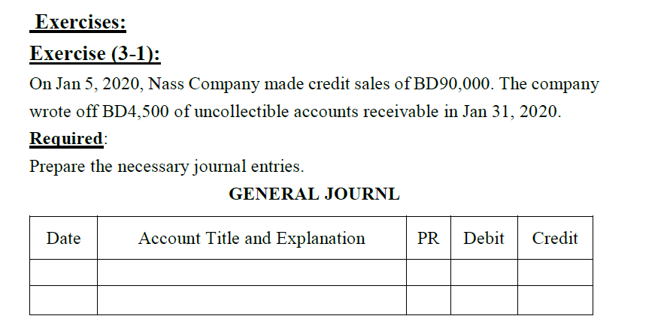
Accounting 2 Accounting for Receivable Acc. 212
1- DIRECT WRITE-OFF METHOD FOR UNCOLLECTIBLE ACCOUTS.
Exercise (3-1): work book P:47
3 Mins
For bad debts
GENERAL JOURNAL
Date | Account Title and Explanation | PR | Debit | Credit
Jan 31
وزارة التربية والتعليم –الفصل الدراسي الثاني 2020-2021م

Slide 10
Accounting 2 Accounting for Receivable Acc. 212
Exercise (3-1): Solution
GENERAL JOURNAL
Will NOT Collect
Date | Account Title and Explanation | PR | Debit | Credit
Jan 31
Bad Dets Expenses
4,500
Account Receivable- (XXX)
4,500
وزارة التربية والتعليم –الفصل الدراسي الثاني 2020-2021م

Slide 11
Accounting 2 Accounting for Receivable Acc. 212
Exercise (3-2): work book P:47
5 Mins
GENERAL JOURNAL
Date | Account Title and Explanation | PR | Debit | Credit
Oct 15
Nov 23
Nov 23
وزارة التربية والتعليم – 2020م

Slide 12
Accounting 2 Accounting for Receivable Acc. 212
Exercise (3-2): Solution
Total Account Receivable
GENERAL JOURNAL
Date | Account Title and Explanation | PR | Debit | Credit
Oct 15
Nov 23
Nov 23
Bad Dets Expenses
1,600
Account Receivable- (Noor)
1,600
Will NOT Collect
Account Receivable- (Noor)
1,600
Bad Dets Expenses
1,600
Cash
1,600
Account Receivable
1,600
وزارة التربية والتعليم –الفصل الدراسي الثاني 2020-2021م

Slide 13
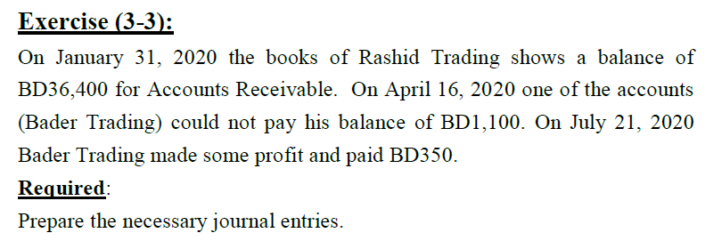
Accounting 2 Accounting for Receivable Acc. 212
Exercise (3-3): work book P:48
5 Mins
GENERAL JOURNAL
Date | Account Title and Explanation | PR | Debit | Credit
Apr 16
Jul 21
Jul 21
وزارة التربية والتعليم –الفصل الدراسي الثاني 2020-2021م

Slide 14
Accounting 2 Accounting for Receivable Acc. 212
Exercise (3-3): Solution
Total Account Receivable will not be used in preparing the General Journal under Direct Write off
GENERAL JOURNAL
Date | Account Title and Explanation | PR | Debit | Credit
Apr 16
Jul 21
Jul 21
Bad Dets Expenses
1,100
Account Receivable- (Bader)
1,100
Account Receivable- (Bader)
350
Bad Dets Expenses
350
Cash
350
Account Receivable- (Bader)
350
وزارة التربية والتعليم –الفصل الدراسي الثاني 2020-2021م

Slide 15
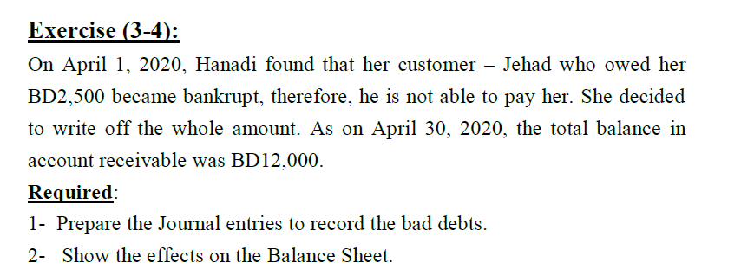
Accounting 2 Accounting for Receivable Acc. 212
Exercise (3-5): work book P:48
3 Mins
GENERAL JOURNAL
Date | Account Title and Explanation | PR | Debit | Credit
April 1
وزارة التربية والتعليم –الفصل الدراسي الثاني 2020-2021م

Slide 16
Accounting 2 Accounting for Receivable Acc. 212
Exercise (3-4): Solution
Total Account Receivable will not be used in preparing the General Journal under Direct Write off
GENERAL JOURNAL
Date | Account Title and Explanation | PR | Debit | Credit
April 1
Bad Dets Expenses
2,500
Account Receivable- (Jehad)
2,500
وزارة التربية والتعليم –الفصل الدراسي الثاني 2020-2021م

Slide 17
Accounting 2 Accounting for Receivable Acc. 212
End of Lesson
1- Distinguish between the methods and bases companies use to value account receivable.
2- Explain how companies prepare journal entry to recovering bad debts under Direct Write off Method.
3- Applying exercise on recovering bad debts under Direct Write off Method
لمزيد من المعلومات:
www.Edunet.com1- زيارة البوابة التعليمية
2- حل أسئلة وأنشطة الكتاب المدرسي.
وزارة التربية والتعليم –الفصل الدراسي الثاني 2020-2021م

