Slide 1
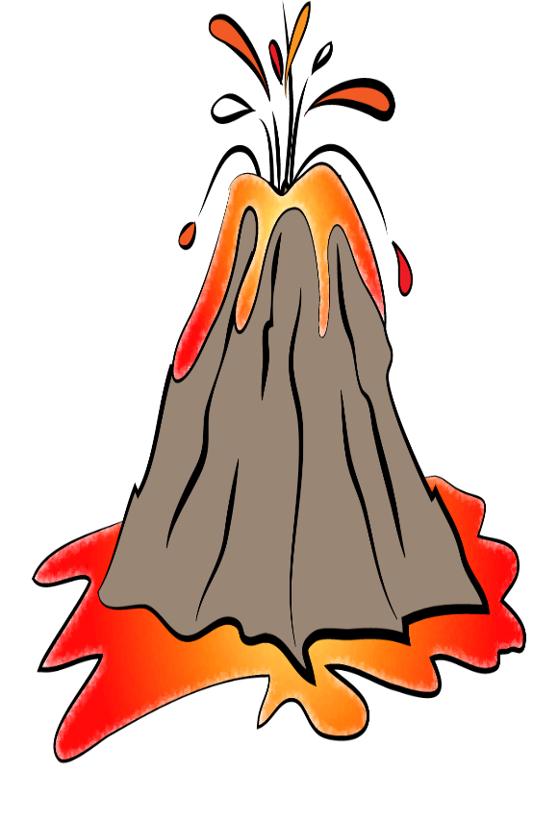
Eng101
New Language Leader Level 1
First Secondary
First semester
Unit 5 Lesson 4
Study and Writing Skills

Slide 2
Eng101 New Language Leader Level 1
OBJECTIVE(S):
By the end of the lesson, students will have:
learnt strategies for correcting their writing.
revised aspect of word order and punctuation.
developed a better understanding of topic sentences and reference words.
Written a paragraph about a volcano.

Slide 3
Think!
What is self correction?
A self correction is the ability to recognize your mistakes and correct them before you present final draft.
How is it useful in writing ?
self-correction increases awareness of the language. Students can notice and correct problem areas in their writing better.
Eng101 New Language Leader Level 1 5.4 Study & Writing Skills

Slide 4
Correcting your writing.
Which of these sentences are true for you when you have writing task ?
1. I always check draft writing carefully after I write final writing.
2. I read my teacher’s comments and corrections carefully.
3. I often rewrite my work after my teacher gives it back to make it better.
4. I look at my mistakes but never remember them.
5. The only thing I look at is my mark.
Eng101 New Language Leader Level 1 5.4 Study & Writing Skills

Slide 5
Match these common types of mistake with the sentences below.
grammar – vocabulary – spelling – punctuation – word order – leaving words out
largest
1.The pacific ocean is the larger ocean in the world.
Grammar
That’s
2.Thats a clever idea .
Punctuation.
not as
3. Great Britain is as not cold as Greenland .
Word order
of
4. These factories have caused a lot ^ damage.
Leaving words out
suggestion
useful
5. Their sugestion was usefull.
spelling
hopeless
5. The situation is bad, but it isn’t useless.
vocabulary
Eng101 New Language Leader Level 1 5.4 Study & Writing Skills

Slide 6
Think!
1. What is the word order rules in English?
Subject- verb- object
2. Is forming a sentence different than forming a question?
Yes, it is.
A sentence: Subject- verb- object
A question: Verb- subject -object
Eng101 New Language Leader Level 1 5.4 Study & Writing Skills

Slide 7
Word order
Change the position of one word in each sentence to make it correct.
1. An ocean bigger than a sea is.
An ocean is bigger than a sea.
2. Are many in danger species there in your country?.
Are there many in danger species in your country?.
3. The red deer destroyed the forests natural.
The red deer destroyed the natural forests.
4. What you do learn from this article?
What do you learn from this article?
Eng101 New Language Leader Level 1 5.4 Study & Writing Skills

Slide 8
Leaving words out
Add one word to each sentence to make it correct.
1. It’s highest mountain in the world.
It’s the highest mountain in the world.
2. The natural changes difficult to control.
The natural changes are difficult to control.
3. A city is crowded than a village.
A city is more crowded than a village.
4. This picture shows team of people.
This picture shows a team of people.
Eng101 New Language Leader Level 1 5.4 Study & Writing Skills

Slide 9
Corrections in white
Think!
1. What is punctuation?
Punctuation means the use of full stops, capital letters and commas.
Eng101 New Language Leader Level 1 5.4 Study & Writing Skills

Slide 10
Punctuation
Correct the punctuation in this piece of writing. Use full stops and capital letters, and take out unnecessary commas.
the environment is very important to us as and we must be careful, not to destroy or damage it, today, because of pollution many places are in danger, from greenland to madagascar .
The environment is very important to us as and we must be careful not destroy or damage it. Today, because of pollution many places are in danger, from Greenland to Madagascar.
………………………………………………………………………………………………………………………………………………………………………………………………………………………………………........
Eng101 New Language Leader Level 1 5.4 Study & Writing Skills

Slide 11
Correct the mistakes in the student’s writing below. Use the correction code to help you.
Gr = grammar WW = wrong word (vocabulary) Sp = spelling
WO = Worde order ^ = missing word P= punctuation
islands
it’s
Sp
P
to
Many islnds are impressive and magical, but its important ^ remember that they can also have dangerous. If we visiting them, we should make sure, for example that we have the equipment correct.
WW
be
Gr
visit
P
,
WO
correct equipment
Eng101 New Language Leader Level 1 5.4 Study & Writing Skills

Slide 12
Read the rest of the student's work. Look for mistakes and write the correct symbol above the mistake. Use the “correction code” on the previous to help you.
Sp
Gr
The wether can change very quick and it’s easy lose your way. If you don’t have much experiment, its better go with someone who can you guide. If you have any difficulties.
^
P
WW
P
^
WO
P
The weather can change very quickly and it’s easy to lose your way if you don’t have much experience. It’s better to go with someone who can guide you if you have any difficulties.
Eng101 New Language Leader Level 1 5.4 Study & Writing Skills

Slide 13
Think!
1. What is a paragraph?
A paragraph is a piece of writing about one topic. It starts on a new line. It is often part of a longer piece of writing.
2. How long are paragraphs?
There is no fixed rule, but a good length for paragraphs is about three or four sentences.
3. Why do we use paragraphs when we write?
Paragraphs make the writer’s ideas easier to understand.
Eng101 New Language Leader Level 1 5.4 Study & Writing Skills

Slide 14
How many of these words related to volcanoes do you know?
active
dormant
erupt
cone
peak
eruption
Note: Use your dictionary to help you look up the meanings of unknown words.
Eng101 New Language Leader Level 1 5.4 Study & Writing Skills

Slide 15
Paragraph organisation
Read the following paragraph about a volcano. Then put the point below in the order they appear in the paragraph below. Number one is done for you as an example.
Mount Etna is the highest and most active volcano in Europe just outside the city of Caucuses and the highest peak in Italy. It’s 3,330 m high. This means it’s not the only active volcano in Italy. Also, It has experienced more than 200 eruptions, a variety of eruption styles, including violent explosions and voluminous lava flows since 1500 BC. Mount Etna is known of its ongoing eruptions, which can cover large areas and destroy crops and buildings. The last eruption of Mount Etna was in 2018, forced the closure of airspace around the area.
6
 | how dangerous it is | a
 | effects of recent eruption | b
 | height | c
 | date of recent eruption | d
 | location | e
1 | name | f
 | size comparison | g
 | active or dormant | h
8
4
7
3
5
2
Eng101 New Language Leader Level 1 2.4 Study & Writing Skills

Slide 16
Put these points in the correctt order according to the previous paragraph about “ Mount Etna”.
 | the eruption | a
 | general information about the volcano | b
 | comparison with other volcanoes | c
3
1
2
Why is this a good order?
First, we learn about the main subject, then compare it with another volcano for context. Finally, we learn about a specific eruption.
…………………………………………………………………………………………………………………………………………………………………………………………………………
Eng101 New Language Leader Level 1 5.4 Study & Writing Skills

Slide 17
Think!
1. What is a topic sentence?
A topic sentence tells us the topic of the paragraph. It is usually the first sentence of the paragraph.
Eng101 New Language Leader Level 1 5.4 Study & Writing Skills

Slide 18
Topic sentences
Look at these topic sentences. What information do you think we can find in the rest of the paragraph?
1. Asia is the world’s largest continent.
Size of Asia, size compared with next biggest continent and variety of landscapes in the continent.
……………………………………………………………………………………………………………………………………………………………………………………………………………………..
2. My favourite program shows how to lose weight in 14 days.
Name of the program, what is the program and who is the right person to apply the program.
……………………………………………………………………………………………………………………………………………………………………………………………………………………..
Eng101 New Language Leader Level 1 5.4 Study & Writing Skills

Slide 19
Reference words
1.What are the reference words in Mount Etna paragraph?
It, its and it’s
……………………………………………………………………
2. How can reference words improve a paragraph?
They help in avoiding repetition and increasing the cohesion.
………………………………………………………………………………………
Eng101 New Language Leader Level 1 5.4 Study & Writing Skills

Slide 20
Reference words
Read the following paragraph about the volcanic island “Krakatoa”. Then improve this paragraph by using it, its and it’s.
Krakatoa is a small volcanic island in Indonesia located 100 miles west of Jakarta. Krakatoa used to stand 338 meters high, now just 110 meters tall. Krakatoa’s shape is almost perfect - a tall, conical volcano. Krakatoa is an active volcano which has last erupted in April 2020. The eruption is not thought to be major, although it’s the longest eruption since 2018.
Krakatoa is a small volcanic island in Indonesia located 100 miles west of Jakarta. It used to stand 338 meters high, now just 110 meters tall. Its shape is almost perfect - a tall, conical volcano. It’s an active volcano which has last erupted in April 2020. The eruption is not thought to be major, although it’s the longest eruption since 2018.
Eng101 New Language Leader Level 1 5.4 Study & Writing Skills

Slide 21
Use the notes below to write a paragraph about the volcano Villarrica. Remember: the good order of ideas, then join them up and use reference words.
Location: Chile, Latin America
Height: 3,000 meters above sea level
Name: Villarrica
Last eruption: 2019
Active or dormant: active
Shape: cone shape
Size: the eighth largest volcano in world
Eng101 New Language Leader Level 1 5.4 Study & Writing Skills

Slide 22
Possible answer
Villaricca is the eighth active volcano in the world. It is in Chile In Latin America. It is 3,000 meters high above the sea level. Its shape is classically cone- shaped volcano. It last erupted in May 2019.
Eng101 New Language Leader Level 1 5.4 Study & Writing Skills

Slide 23
Thank You!
Eng101 New Language Leader Level 1 5.4 Study & Writing Skills

