Slide 1
Eng101
New Language Leader Level 1
First Semester / 1st Secondary
Unit 3 Lesson 2
World News

Slide 2
Eng101 New Language Leader Level 1
OBJECTIVE(S):
By the end of the lesson, students will have:
read for gist and for specific information.
practiced related nouns for people and their jobs.
practised using relative pronouns in defining relative clauses.

Slide 3
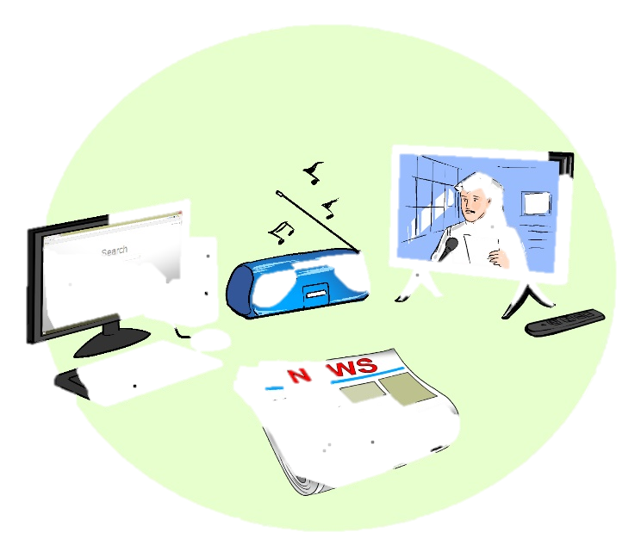
Think!
News
Do you watch news?
Where?
What is the latest news stories at the moment?
Eng101 New Language Leader Level 1 3.2 World News

Slide 4
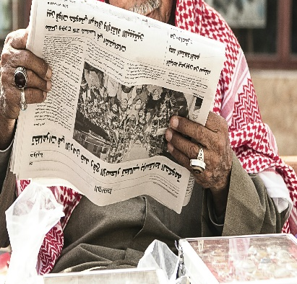
Read the article from a magazine and find out more about how to avoid fake news.
Every time you're online, you are blasted by pictures, articles, links and videos trying to tell their story. Unfortunately, not all of those are true. Sometimes they want you to click on another story or advertisement at their own site, other times they want to upset people for political reasons. These days it's so easy to share information. These stories spread quickly, and the result is … fake news AKA rumours.
There is a range of fake news: from crazy stories which people easily recognise to more subtle types of misinformation. And sometimes the journalists differs between real news and fake news, for examples anyone who has a twitter account can make news nowadays! Social media can turn us into citizen journalists which means that we can write news and not get paid, which is different that professional journalists or journalism.
Experts in media studies and online psychology have been examining the fake news phenomenon. Read these tips, and don't get tricked!
1. Check the source
Look at the website where the story comes from. Does it look real? Is the text well written? Are there a variety of other stories or is it just one story? Fake news websites often use addresses that sound like real newspapers, but don't have many real stories about other topics. If you aren't sure, click on the 'About' page and look for a clear description of the organisation, if there isn’t one then the site is not trusted.
Eng101 New Language Leader Level 1 3.2 World News

Slide 5
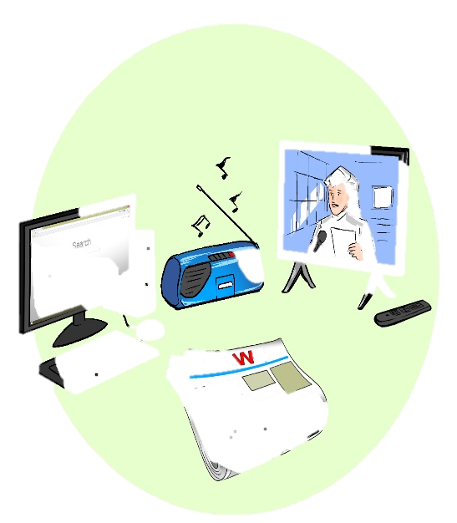
2. Watch out for fake photos
Many fake news stories use images that are Photoshopped or taken from an unrelated site. Sometimes, if you just look closely at an image, you can see if it has been changed. Or use a tool like Google Reverse Image search. It will show you if the same image has been used in other contexts.
3. Check the story is in other places
Look to see if the story you are reading is on other news sites that you know and trust. If you do find it on many other sites, then it probably isn't fake (although there are some exceptions), as many big news companies try to check their sources before they publish a story.
4. Look for other signs
There are other techniques that fake news uses. These include using ALL CAPS and lots of ads that pop up when you click on a link. Also, think about how the story makes you feel. If the news story makes you angry, it's probably designed to make you angry.
If you know these things about online news, and can apply them in your everyday life, then you have the control over what to read, what to believe and most importantly what to share. If you find a news story that you know is fake, the most important advice is: don't share it!
Eng101 New Language Leader Level 1 3.2 World News

Slide 6
After reading!
Choose the best title (1-5) for the text.
Experts share dangers of fake news
Experts share top tips for resisting fake news
How to create fake news: a guide
Tips on how to read the news online
Experts share dangers of fake news
Experts share top tips for resisting fake news
How to create fake news: a guide
Tips on how to read the news online
Eng101 New Language Leader Level 1 3.2 World News

Slide 7
Read again and answer the questions.
What are the reasons for an online fake news story?
They want you to click on another story or advertisement at their own site, or sometimes they want to upset people for political reasons.
How do you know if a news site should not be trusted?
The site's 'About' page does not clearly describe the organisation.
How can you tell if the image with the news is fake?
They might be real images, but come from a different website or that have been changed.
What should you do with fake news?
Not to share it with other people.
Eng101 New Language Leader Level 1 3.2 World News

Slide 8
Personal reflection
Think about these questions!
1 Do you ever watch any of the international news channels or get your news from the internet?
2 Which news channels or sites do you trust?
3 have you ever shared a piece of news and discovered that it was fake?
4 Do you believe everything you read in the internet or the social media?
Eng101 New Language Leader Level 1 3.2 World News

Slide 9
Choose the correct word to complete each of these definitions.
1 A Photographer /Photography is someone who takes pictures for newspapers, news websites, art galleries, magazines, or advertisements.
1 A Photographer /Photography is someone who takes pictures for newspapers, news websites, art galleries, magazines, or advertisements.
2 Photographer /Photography is the job of taking pictures for newspapers, news websites, art galleries, magazines, or advertisements.
2 Photographer /Photography is the job of taking pictures for newspapers, news websites, art galleries, magazines, or advertisements.
Vocabulary
Noun suﬃxes which are used for:
people
–ist e.g. Journalist, specialist.
– er e.g. Photographer, teacher.
-ian e.g. Musician, technician.
jobs
–ism e.g. Journalism, specialism.
-y e.g. Photography, psychology.
–ing. E.g. Teaching, writing.
Eng101 New Language Leader Level 1 3.2 World News

Slide 10
Put the words between brackets into the following table according to the categories.
art artist blogger blogging journalism
journalist photographer photography politician teaching
politics psychologist psychology reporter writer
reporting scientist science musician architecture
Person | Job / subject
artist, blogger, journalist, photographer, politician, psychologist, reporter, writer, scientist, musician
art, blogging, journalism, photography, teaching, politics, psychology, reporting, science, architecture
Eng101 New Language Leader Level 1 3.2 World News

Slide 11
Relative Pronouns
A sentence can have two pieces of information and we use relative pronouns to connect the information together.
Look at the example:
The novelist is an experienced writer who provides us with amazing novels.
The sentence tells us that:
The novelist is an experienced writer
And
The novelist provides us with amazing novels
Eng101 New Language Leader Level 1 3.2 World News

Slide 12
Find the two pieces of information in each sentence.
With subscribers of over 1.5 billion people, the YouTube channels make money from advertisements.
There are several internet sites that have stories about the pandemic of Covid 19.
The writers of these fake news are often local people who write the stories for the advertisements.
The internet sites that spread fake news usually have one story to tell.
Social medias, which are often free, can easily spread rumours.
YouTube channels subscribers of over 1.5 billion people.
The YouTube channels make money from advertisements.
There are several internet sites.
Those sites have stories about the pandemic of Covid 19.
The writers are often local people.
They write the stories for the advertisements.
The internet sites spread fake news.
They usually have one story to tell.
Social medias are often free
They can easily spread rumours.
Eng101 New Language Leader Level 1 3.2 World News

Slide 13
Rule
Use which and that to refer to things or ideas.
Use that when the information given defines/is essential to the subject.
It’s the movie that stars George Clooney.
Use which to add extra information, when the sentence would make sense without it.
The movie, which aired in September, stars George Clooney.
Use who and that to refer to people.
He’s the actor who/ that stars in ER.
Use where to refer to places.
YouTube is a website where you can upload video Clips.
Eng101 New Language Leader Level 1 3.2 World News

Slide 14
Rule
Use relative pronouns to link pieces of information about a person or thing.
Christopher Columbus was an Italian Explorer. He discovered the Americas.
Christopher Columbus was an Italian Explorer who discovered the Americas.
The information after the relative pronoun often defines the subject.
Google Map is a programme that provides locations of places.
A reporter is a person who reports the news on the TV.
Do not repeat the subject after a relative pronoun. The pronoun is the subject.
Mark Zuckerberg is the man who started Facebook ✓
Mark Zuckerberg is the man who he started Facebook x
Eng101 New Language Leader Level 1 3.2 World News

Slide 15
Practice!
Join the sentences together using a relative pronoun
1. Doctors are very important people.
Doctors save lives of sick and injured people.
2. The UNESCO is a universal organization.
The UNESCO spreads peace through education, the sciences and culture.
3. I visited the Louvre.
The Mona Lisa painting has been in the Louvre since 1797.
1. Doctors are very important people who save lives of sick and injured people.
2. The UNESCO is a universal organization that spreads peace through education, the sciences and culture.
3. I visited the Louvre where the Mona Lisa painting has been in there since 1797.
Eng101 New Language Leader Level 1 3.2 World News

Slide 16
Practice!
Join 1-3 with a-c using who or that to form definitions
A news reporter is someone ...
It’s a company ...
“Universal” is an adjective ..
means “international” or “global”.
filters news, the real from the fake one.
reports news either written or in a video/audio segment.
1/c A news reporter is someone who reports news either written or in a video/audio segment.
2/b It’s a company that filters news, the real from the fake one.
3/a “Universal” is an adjective that means “international” or “global”.
Eng101 New Language Leader Level 1 3.2 World News

Slide 17
Thank You
Eng101 New Language Leader Level 1 3.2 World News

