Slide 1
Eng101
New Language Leader Level 1
First Semester / 1st Secondary
Unit 1 Lesson 1
One World

Slide 2
Eng101 New Language Leader Level 1
OBJECTIVE(S):
By The End of this lesson, students will have:
answered gist & detailed reading questions.
developed language to talk about nationalities.
revised the present simple and present continuous.
written about their favourite place.

Slide 3
Starter:
Why do we learn English?
When do we use it in our lives?
Eng101 New Language Leader Level 1 1.1 One World

Slide 4
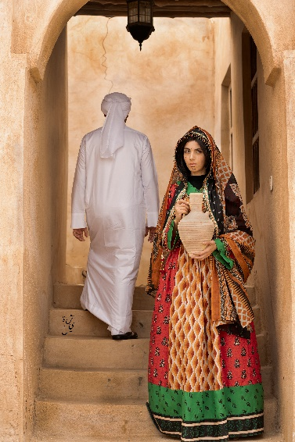
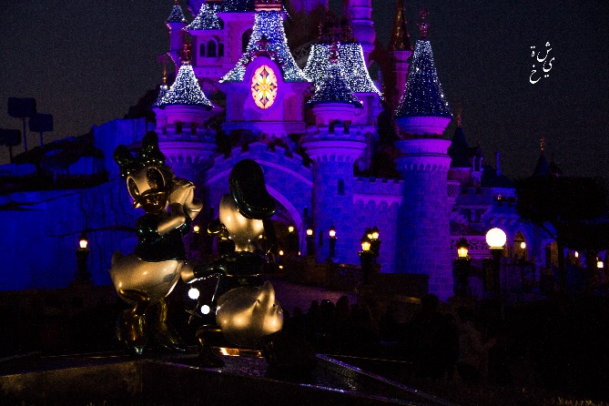
Read the following text
Reading
http://
What a Wonderful World!
This is a travellers website that gives you a portrait of the world.
What a wonderful world is a venue for travellers - or regular people who travelled - to share the world & countries they travelled to & the exotic places they have been to. People these days take pictures of anything and everything, and those people can share their pictures & experiences in videos or audios on this website.
This unique approach is to bring the world to you & bring people together. Would you like to share? Here’s what to do.
Take a photograph of your favourite travel destination.
Make a voice recording to go with your photograph: in English state your name, where you are & tell us about your favourite destination.
Post your photograph & Mp3 recording on the website.
To submit a photograph and recording, click here.
To view the online exhibition, click here.
Eng101 New Language Leader Level 1 1.1 One World

Slide 5
After reading..
Think outloud! What’s the website for?
Think of the following questions:
What does the website offer?
Why does the website refer to the participants as travellers and in other times people?
What language does the website owner want the voice recordings to be in? why?
Do you think that the website meets its goal?
Eng101 New Language Leader Level 1 1.1 One World

Slide 6
What do the following terms mean?
Country:
an area of land that has its own government, army, etc.
Continent:
a large geographical land mass that consists of many countries.
Region:
a sub-division of a particular country or an area which does not have fixed boundaries.
Eng101 New Language Leader Level 1 1.1 One World

Slide 7
Match the countries with the continents and regions
Japan Canada Kuwait Argentina
Malaysia Sweden Ghana New Zealand
Europe North America West Africa Australia
South Africa East Asia The Arab World South-East Asia
Answers
Japan / East Asia Canada / North America,
Kuwait /The Arab World Argentina / South America
Malaysia / South-East Asia Sweden / Europe,
Ghana / West Africa New Zealand / Australia
Eng101 New Language Leader Level 1 1.1 One World

Slide 8
How do you turn a noun into an adjective?
By adding a suffix!
For example: –ian, -ish, -er, -ese
For example
Italy
Italian
Eng101 New Language Leader Level 1 1.1 One World

Slide 9
What are the adjectives from the country and region nouns?
Japan Canada Kuwait Argentina
Malaysia Sweden Ghana New Zealand
Japanese Canadian Kuwaiti Argentinian
Malaysian Swedish Ghanaian New Zealand
Europe North America West Africa Australia
South Africa East Asia South-East Asia
European North American West African Australian
South African East Asian South-East Asian
Eng101 New Language Leader Level 1 1.1 One World

Slide 10
Grammar:
Which of the following sentences are in the present simple (PS)? Which ones are in the present continuous (PC)?
Right now, people are sleeping.
I’m working in a bank.
Currently, sandals are selling fast.
She visits her parents every weekend.
It’s easy to follow the directions.
PC
PC
PC
PS
PS
Now match the sentences above with the grammar notes below.
This is a trend (changing situation).
This is an action happening now, or around now.
This is a fact or general truth.
This is a regular action or a habit.
3- Currently, sandals are selling fast.
1- Right now, people are sleeping.
2- I’m working in a bank.
5- It’s easy to follow the directions.
4- She visits her parents every weekend.
Eng101 New Language Leader Level 1 1.1 One World

Slide 11
Present Simple and Present Continuous:
Present Simple : Used for facts and true things/information
It rains a lot in India.
It snows in Canada every winter.
Present Continuous : Used for describing actions
The weather is getting hotter.
I’m trying to finish my assignment.
Eng101 New Language Leader Level 1 1.1 One World

Slide 12
Complete the following sentences. Use the present simple or present continuous form of the verbs in the box
I __________________ the classroom. What about you?
She usually ______________________ a book at night.
Currently, they __________________________ the bus to college, until they get their license.
The moon _________________ up at sunset, and it ___________________ down at dawn.
‘m entering
enter
reads
read
‘re taking
take
comes
Come, go
goes
Eng101 New Language Leader Level 1 1.1 One World

Slide 13
Present Simple and Present Continuous:
Underline the main verb in the following sentences. Are they state or action verbs?
I’m a lawyer.
The news is always changing.
I’m playing charades with my cousins.
I love the biscuit part of the cheesecake.
She runs in the tracks every morning.
People are taking photographs.
’m (state).
is changing (action).
’m playing (action).
love (state).
runs (action).
are taking (action).
Eng101 New Language Leader Level 1 1.1 One World

Slide 14
Present Simple and Present continuous:
Describe an action
We use both the present simple and present continuous with action verbs (i.e rain / work / play).
The children play with their friends on Sunday.
The children are playing right now.
Describe a state
State verbs for feelings & situations don’t usually have a continuous form (i.e want, believe, be, know, understand)
I want a sandwich.
2. I’m wanting a sandwich.
Some verbs can be state or action verbs (i.e think)
I think the dress is beautiful. (my opinion)
I’m thinking about what to eat. (deciding)
Eng101 New Language Leader Level 1 1.1 One World

Slide 15
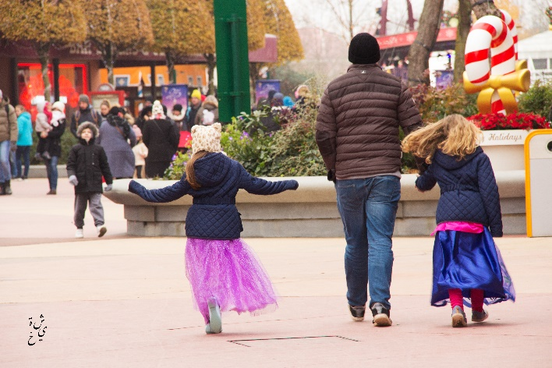
Complete the extract from the website “What a Wonderful World”. Use the present simple or present continuous form of the verbs.
Hi, I’m Shaikha. I’m Bahraini & I _______________ (live) in Muharraq. I travelled to Paris last year. In the picture, I’m in Disney Land Paris, my favourite travel destination. I ___________ (love) coming here because it’s very fun & entertaining and it _________ (have) a family atmosphere. Right now, a young girl dressed as a princess ____________ (walk) around and __________ (have) a happy chat with her sister and father. Everyone always _______________ (feel) happy and excited here. I _______________ (study) photography at the moment, so I often ____________ (travel) with my camera and __________ (take) a lot of pictures.
live
love
has
is walking
having
feels
‘m studying
travel
take
Also, the Louvre Museum ____________ (be) here, so I usually __________ (have) breakfast near and then ________________ (visit) an exhibition at the museum.
is
have
visit
Eng101 New Language Leader Level 1 1.1 One World

Slide 16
Writing:
Think!
Think of one of your favourite places. Draw a picture to write about it. Plan what to say about it.
Write!
Use your notes to write a paragraph about your favourite place.
I used the present simple and present continuous
My writing has:
Introduction
Body
Conclusion
Hint: Use the text about Bahrain as a model
Eng101 New Language Leader Level 1 1.1 One World

Slide 17
Thank you!

