Slide 1
Eng.201 New Language Leader Grade 11 First Semester Unit2 Travel L.2.5 Study and writing skills (pages 24-25)

Slide 2
ENG201 – unit 2. L.2.5 Study & writing skills
Objectives
By the end of the lesson you will be able to
extract specific information from a biography.
write a short biographical profile.

Slide 3
What is a biography?
It is a text written about someone else’s life (usually someone famous).
ENG201 – unit 2. L.2.5 Study & writing skills

Slide 4
3 min
Read the biography of Taha Hussein then match each paragraph with one of the below topics.
1- Taha Hussein was an Egyptian novelist, educator and a symbol of strong well and resilience. Born in November 1889, Taha Hussein was one of 11 siblings in a family that underestimated his abilities. He lost his eye sight at a very young age due to an eye illness and an attempt to treat it with traditional medicine.
2- Like all the children in his village he started his education in al Kuttab or the Quranic school where he faced some challenges that never impeded his pursue of education and knowledge. In 1902 he was sent to Cairo where he attended Al-azhar to continue his education and which he left in 1908 to join the newly opened University of Cairo to study in the field of Arabic and Islamic studies. In 1914 he obtained the first doctorate awarded by the university for his thesis on Abu-l-Ala al-Maarri who was also a blind philosopher and poet. A year later, Taha Hussein won a scholarship to study in France, first to Montpellier and then to the Sorbonne in Paris. During his studies he became familiar with the culture of the West and became deeply interested in French Literature. Taha Hussein's assertive character supported him in defining his life goals to pursue his education despite his poverty and blindness and that made all the difference.
3-In 1919 Taha Hussain returned to Egypt and became a lecturer in ancient history at Egyptian University. Taha Hussain’s achievements continued through his life. He became the minister of education and was nominated for Nobel Prize in literature more than a dozen times, the first nomination was in 1949.
4- He married a young Frenchwoman and student, Suzanne Bresseau, whom he hired as his reader when he first went to France. He had two children Amina and Moenis.
5-In 1952 he retired to continue his writings, which he did until his death in 1973 leaving behind a legacy of literary work including books, essays and translations on poetry, social history and more. The jewel of his work is his moving autobiography, Al-Ayyam (3 vols., 1929-1955; The Days), where he retells in simple yet painful details his own story, from village life and childhood blindness through educational trials and maturity. It was translated in several languages including Chinese, English, and Russian.
a. career
b. Education and
ambitions
c. Legacy and work
D. Beginning
d. Challenges
e. family
3
2
2
1
3
4
ENG201 – unit 2. L.2.5 Study & writing skills

Slide 5
A biography lay out
challenges
ambitions
early life
achievements
ENG201 – unit 2. L.2.5 Study & writing skills

Slide 6
4min
Write a biography of an adventurer you know. Follow the right lay out.
1. early life (Name, age, job)
2. the achievements.
3. the challenges.
4. ambitions.
ENG201 – unit 2. L.2.5 Study & writing skills

Slide 7
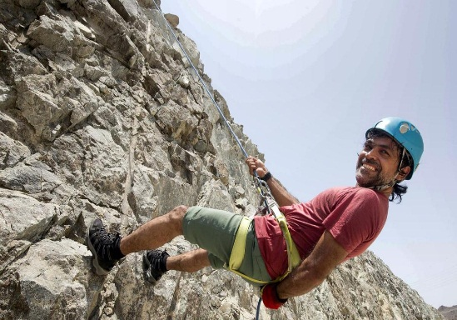
Suggested answer
Saeed Al Memari is a 43- year Emirati adventurer. He was born in Fujairah between the mountains and the sea, so he was always looking for a challenge that can stop him and say: ‘This is your limit’, but he says
“I have not found that yet”. He is the director-general of Fujairah Centre for Adventures.
Al Memari said “It is my dream to leave something behind for the next generation so they can also have big dreams”. He started by climbing the highest and one of the deadliest summits, Mount Everest and K2 - He has created his legacy after becoming the first Emirati to climb the summit of Mount Everest back in 2011. In 2014, he raised the Dubai Expo 2020 logo on North America's highest peak.
Al Memari said “climbing mountains is unique as every mountain has its own challenge – it can be the terrain, snow or the weather. Sometimes on a small mountain, you hit extreme weather, but as soon as you reach the summit you forget all the challenges.
Al Memari has learned from his experiences that there is no limit for your dreams and if you want to achieve your goals you have to be a risk taker and ambitious.
ENG201 – unit 2. L.2.5 Study & writing skills

Slide 8
End of the lesson
Thank you for your perseverance
and hard work
ENG201 – unit 2. L.2.5 Study & writing skills

