Slide 1
Eng.201 New Language Leader Grade 11 First Semester Unit1 – Travel Lesson 2.1- Tourism and Travelling (pages 16-17)
Notes:
Dear Students,
Welcome to this presentation.
The purpose of my presentation is to cover lesson 1.1 Unit 1 of NEW LANGUAGE LEADER 2

Slide 2
Objectives
By the end of the lesson you will be able to
identify vocabulary related to travel.
extract specific information from a reading text.

Slide 3
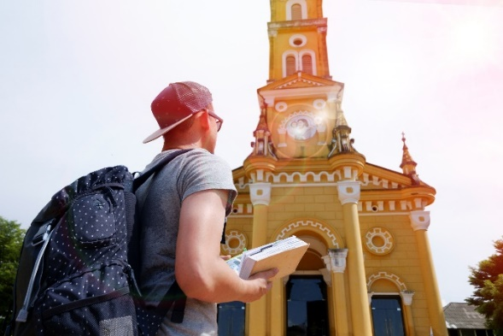
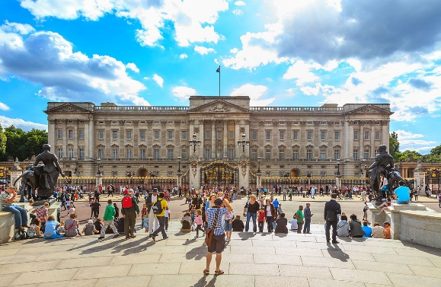
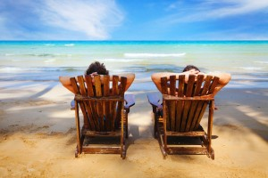
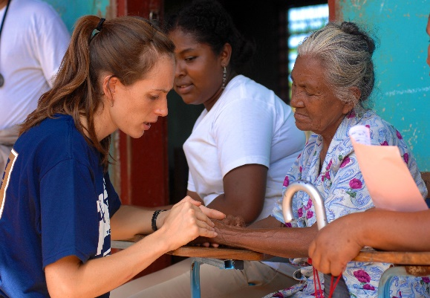
Introduction
Everyone of us enjoys travelling and would like to travel when ever it is possible. Traveling brings lots of fun and benefits because it can change us physically and psychologically. But what's all this fuss about how important it is to travel? Why do people travel and love travelling this much?
Give some reasons

Slide 4
Some possible answers
People travel to……
1. Work and earn money.
2. Study for qualifications abroad, learn languages and new skills.
3. Relax and get away from life.
4. Explore new places and see new sights.
5. Explore different culture and meet new people.
6. Do voluntary work.

Slide 5
04:00
Put the words in the correct order to make questions about travelling?
1 | have/ the/destination / you / what’s / travelled/ furthest/to?
2 | ever / you / have /been /abroad/?
3 | you /ever/ have/on /trip /been /a /business /?
4 | you/ like/ package / do/ holidays /where/ is / everything/ for / arranged /you?
5 | you/ did /go/ where/to?
6 | What/ the/ journey/ is /you/ longest/ have / to / been/?
7 | are /the/ what / for / popular/ most / destinations / Bahrainis?
8 | think/ you / do/ the / travel / that / broadens / mind?

Slide 6
Key answer
1 | What’s the furthest destination you have travelled to?
2 | Have you ever been abroad?
3 | Have you ever been on a business trip?
4 | Do you like holiday packages where everything is arranged for you?
5 | Where did you go to?
6 | What is the longest journey you have been to?
7 | What are the most popular destinations for Bahrainis?
8 | Do you think that travel broadens the mind?

Slide 7
Many people often use " tourism " and " travel" as one term when talks about visiting other locations, but experts in the travel community differentiate between these two terms as each has a specific meaning that describes travelling as an activity with its own purpose.
To “travel “means to make a long journey. It simply refers to an individual’s movement from a point to another point. People usually travel to different places for different purposes. For example, some people travel to another countries or cities for work related purposes, while other people travel to visit their friends and relatives. In addition, the facilities in some specific locations like education, healthcare may prompt people to travel.
“Tourism” is the activity of traveling to a place for pleasure. Sometimes people travel to places for no reason rather than relaxing and taking a break from everyday life. They just want to spend days in leisure and enjoy new places. These people are called tourists. They may stay at a place for several days and enjoy visiting the attractions of that place such as beaches, national parks, museums, famous historical sites or spend few days in leisure.

Slide 8
However, we can say that all tourists are travelers, but not all travelers are tourists as there are some distinct differences between travellers and tourists. For example, tourists seek for convenient or luxury accommodations to stay in and relax. They may pack many electronic devices such as cameras or iPads for entertainment. They tend to stay in their comfort zone, carry a guidebook and hardly communicate with locals while roaming. They only visit the popular areas and attractions that other tourists visit based on the tourist group’s planned schedule. In contrast, travellers seek affordable accommodations; they don’t mind staying in a hostel, tent or a vehicle. They only packed the important and essential things such as clothes, food and toiletries. They immerse in the local culture, communicate with the locals and spend time with them to learn about their culture. They also prefer to make plans to destinations as they go and try to explore the less-travelled areas and locations where tourism doesn't drive the economy. Travellers may consider a trip a journey rather than a vacation; looking for places that are not commonly visited or seen instead of escaping from everyday life.
All in all, " Tourism " and " Travel" aren’t one term, they are two different terms with some distinct differences. Based on the discussed above, next time you think of travelling , you should consider being a traveller or a tourist.

Slide 9
02:00
Complete the sentences with a suitable word from the box.
accommodation abroad trip attraction hostel
1. Bahrain National Museum is the most popular tourist ………………. in Bahrain.
2. …………………is the place where you live or stay on holiday or while studying in another country.
3. I am away on a business ……… in London, but Mariam is here on a shopping ……… because her wedding is next month.
5. If Ahmad finished school , he would like to study…………. in UK.
6. A place where student can stay cheaply for while they are studying abroad with shared rooms and sometimes some private rooms is called student ……….. .

Slide 10
Key Answer
1. Bahrain National Museum is the most popular tourist attraction in Bahrain.
2. Accommodations is the place where you live or stay on holiday or while studying in another country.
3. I am away on a business trip in London, but Mariam is here on a shopping trip because her wedding is next month.
5. If Ahmad finished school , he would like to study abroad in UK.
6. A place where student can stay cheaply for while they are studying abroad with shared rooms and sometimes some private rooms is called student hostel.

Slide 11
3:00
According to the text:
Are these statements true (T), false(F) or not given (NG)?
1 | " Tourism " and " Travel" are one term with the same meaning.
2 | Tourists are people who travel for leisure and pleasure.
3 | Tourists don’t mind staying in a hostel, tent or a vehicle.
4 | Travellers follow a scheduled plan to destinations.
5 | Travellers spend time with locals to learn about their culture.
6 | Travellers and tourists use two different visas when travelling.

Slide 12
Key Answer
1 | " Tourism " and " Travel" are one term with the same meaning. | F
2 | Tourists are people who travel for leisure and pleasure. | T
3 | Tourists don’t mind staying in a hostel, tent or a vehicle. | F
4 | Travellers follow a scheduled plan to destinations. | F
5 | Travellers spend time with locals to learn about their culture. | T
6 | Travellers and tourists use two different visas when travelling. | NG

Slide 13
3:00
Answer the following questions
1 | Why do people travel? Give three reasons.
2 | How are travellers different from tourists? Give two example.

Slide 14
Key Answer
1 | Why do people travel? Give three reasons
1.People travel for work related. 2.People travel to visit their friends 3. People travel for facilities in some specific locations like education, healthcare.
2 | How are travellers different from tourists? Give two example
1.Travellers seek affordable accommodations such as hostels, tents or vehicles. 2.Travellers only packed the important and essentials things such as clothes, food and toiletries. Or 1.Travellers immerse in the local culture, communicate with the locals and spend time with them to learn about their culture. 2. Travellers explore the less-travelled areas and locations.

Slide 15
End of the lesson
Thank you for your perseverance
and hard work

