Slide 1
Eng.201 New Language Leader Grade 11 First Semester Unit 4 Advertising Lesson 5: Study and Writing Skills
Notes:
Dear Students,
Welcome to this presentation.
The purpose of my presentation is to cover lesson 1.1 Unit 1 of NEW LANGUAGE LEADER 2

Slide 2
Objectives
By the end of the lesson, you will be able to …
identify a set of vocabulary to describe fractions, percentages, changes in numbers and trends;
practice interpreting charts based on models provided;
write a short report to interpret information in a bar chart.

Slide 3
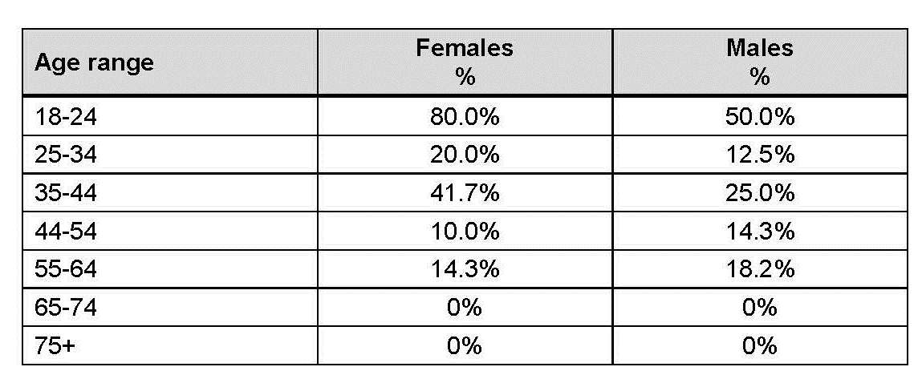
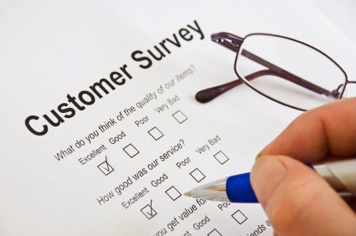
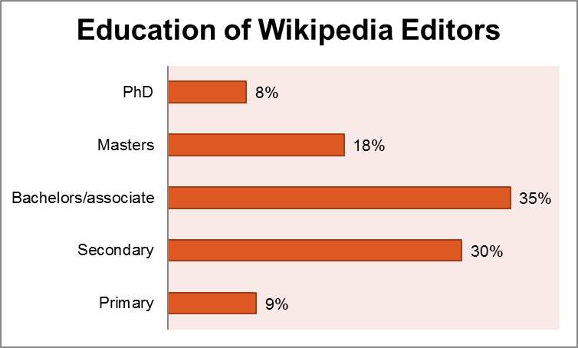
Introduction
What is a survey?
A survey is a method of gathering information from a group of people and investigating their opinions, experiences or behaviour in a specific area. It is done by asking them questions, with the intention of generalizing the results to a larger population. Surveys provide a critical source of data and insight for nearly everyone engaged in the process.

Slide 4
Convert the following percentages into fractions and write them in words.
23%
80%
52%
74.5%
48%
32%
67%
75%

Slide 5
Now here are some possible answers.
23%
80%
52%
74.5%
just under a quarter
more than three quarters
just over half
approximately three quarters
48%
32%
67%
75%
almost half
slightly less than a third
just over two thirds
(exactly) three quarters

Slide 6
Use the fractions in words from the previous slide to replace the following percentages.
1 | Seventy five percent (75%) of the clients were very satisfied with the internet services at MA Mobile Company.
2 | Fifty two percent (52%) of the college fees should be paid before the second semester.
3 | Eighty percent (80%) of students were satisfied with online teaching this year.
4 | Twenty three (23%) of the city’s kids were affected by air pollution.
5 | Forty eight percent (48%) of the patients were not satisfied with the services provided by our clinic.
6 | Seventy four and a half percent (74.5%) of your mobile storage is used.
7 | Sixty seven percent (67%) of Arab tourists and travelers prefer Asian countries.
8 | Thirty two percent (32%) of the bookshops’ books are educational.

Slide 7
Check your answers.
1 | Exactly three quarters of the clients were very satisfied with the internet services at MA Mobile Company.
2 | Just over half of the college fees should be paid before the second semester.
3 | More than three quarters of students were satisfied with online teaching this year.
4 | Just under a quarter of the city’s kids were affected by air pollution.
5 | Almost half of the patients were not satisfied with the services provided by our clinic.
6 | Approximately three quarters of your mobile storage is used.
7 | Just over two thirds of Arab tourists and travelers prefer Asian countries.
8 | Slightly less than a third of the bookshops’ books are educational.

Slide 8
The table below shows the results of questionnaires from 100 clients of two mobile phone companies conducted this year and the last. The survey was about the client’s satisfaction in regards to the provided services. Look at the questionnaire results and decide whether the statements below are True or False.
1- A small minority of the clients had no opinion about the services provided by both companies.(….)
2- The majority of the clients were very satisfied or satisfied with the provided services by both companies.(....)
3- Twelve percent of the clients weren't satisfied with the services provided by Company 1.(….)
4- Just under a quarter of the clients were very satisfied with the services provided by Company 2.(….)
5- Just over half of the clients were satisfied with the services provided by Company 2.(….)
6- Six percent of the clients were quite satisfied with the services provided by Company 1.(….)
 | Company 1 |  | Company 2
 | Last year | This year | Last year | This year
very satisfied | 51 | 65 | 32 | 10
satisfied | 24 | 24 | 38 | 52
quite satisfied | 10 | 6 | 20 | 25
not satisfied | 12 | 2 | 8 | 12
no opinion | 3 | 3 | 2 | 1

Slide 9
Check your answers
1- A small minority of the clients had no opinion about the services provided by both companies. ( T )
2- The majority of the clients were very satisfied or satisfied with the provided services by both companies. ( T )
3- Twelve percent of the clients weren't satisfied with the services provided by Company 1. ( F )
4- Just under a quarter of the clients were very satisfied with the services provided by Company 2. ( F )
5- Just over half of the clients were satisfied with the services provided by Company 2. ( T )
6- Six percent of the clients were quite satisfied with the services provided by Company 1. ( T )

Slide 10
Look at the chart below and choose the best summary
1:00
Now, click the Enter Key to check your answer.
1- This chart shows the usage of mobile phones in Bahrain 15 years ago.
2-This chart compares the number of mobile phone brands used in Bahrain 15 years ago and now.
3- This chart shows some changes in the brands of mobile phones used in Bahrain 15 years ago and now.

Slide 11
Complete the report below with words from the box on your left.
The bar chart shows of mobile phone brands used in Bahrain 15 years ago compared to today. These brands are Nokia, Samsung, iPhone, LG, Blackberry and Sony. , the chart demonstrates that the usage of two mobile phone brands has increased while the usage of two other brands has decreased.
Fifteen years ago, Samsung mobile phones were used by 5% of the Bahraini population. This has increased to the present percentage of almost 38%.
In contrast, the percentage of Nokia mobile phone usage has from 50% to 5%. Similarly, there was a decrease in the percentage of Sony mobile phone usage from 15% to 7%. Blackberry used to be used by 20% of Bahrainis fifteen years ago. However, it is no longer in use today.
There was no percentage given for iPhone phone usage fifteen years ago. ____________, at present about 40% percent of the population uses iPhone mobile phones.
overall
decreased
significantly decreased
however
the approximate percentage

Slide 12
Check your answers.
The bar chart shows _____________________________ of mobile phone brands used in Bahrain 15 years ago compared to today. These brands are Nokia, Samsung, iPhone, LG, Blackberry and Sony. _________, the chart demonstrates that the usage of two mobile phone brands has increased while the usage of two other brands has decreased.
Fifteen years ago, Samsung mobile phones were used by 5% of the Bahraini population. This has increased to the present percentage of almost 38%.
In contrast, the percentage of Nokia mobile phone usage has __________________________ from 50% to 5%. Similarly, there was a decrease in the percentage of Sony mobile phone usage from 15% to 7%. Blackberry used to be used by 20% of Bahrainis fifteen years ago. However, it is no longer in use today.
There was no percentage given for iPhone mobile phone usage fifteen years ago. __________, at present about 40% percent of the population uses iPhone mobile phones.
the approximate percentage
Overall
significantly decreased
However

Slide 13
The layout of the essay
Introduction
Para1
The bar chart shows the approximate percentage of mobile phone brands used in Bahrain 15 years ago and today. These brands are Nokia, Samsung, iPhone, LG, Blackberry and Sony. Overall, the chart demonstrates that the usage of two mobile phone brands has increased while the usage of two other brands has decreased.
Fifteen years ago, Samsung mobile phones were used by 5% of the Bahraini population. This has increased to the present percentage of almost 38%.
In contrast, the percentage of Nokia mobile phone usage has significantly decreased from 50% to 5%. Similarly, there was a decrease in the percentage of Sony mobile phone usage from 15% to 7%. Blackberry was used by 20% of Bahrainis fifteen years ago. However, it is no longer in use today.
There was no percentage given for iPhone mobile phones usage fifteen years ago. However, at present about 40% percent of the population uses iPhone mobile phones.
Information about the chart
Para 2
Para 3
Further information about the chart
Para 3

Slide 14
Write a report about the information in the chart. You can use the report on the previous slide as a model.

Slide 15
 | I followed the given layout
 | I wrote (3-4) paragraphs.
 | I used appropriate linkers in each paragraph.
 | I used the present tense .
 | I wrote between 200-250 words
 | I used the appropriate punctuation marks & the right capitalization I revised my essay.
---------------------------------------------------------------------------------------------------------------------------------------------------------------------------------------------------------------------------------------------------------------------------------------------------------------------------------------------------------------------------------------------------------------------------------------------------------------------------------------------------------------------------------------------------------------------------------------------------------------------------------------------------------------------------------------------------------------------------------------------------------------------------------------------------------------------------------------------------------------------------------------------------------------------------
---------------------------------------------------------------------------------

Slide 16
This is a model answer.
The bar chart shows the approximate percentage of the average time spent by a teenager thirty years ago and today on different activities which are watching TV, going out, studying, chatting with friends, social activities and playing.
Overall, the chart demonstrates that the time spent on two activities has increased but on the other hand, the time spent on two others has decreased. Thirty years ago, teenagers spent 15% of their time chatting with friends. This has increased to the present percentage of almost 40%. Teenagers also spent 5% of their time on going out, but this percentage has only increased to 20%.
In contrast, the time spent on studying has significantly decreased from 35% to 15%. Similarly, there was a significant decrease in time spent on social activities from 25% to 5%.
However, the time spent watching TV and playing has remained unchanged.

Slide 17
This is the end of the lesson.
Thank you for your perseverance and hard work

