Slide 1
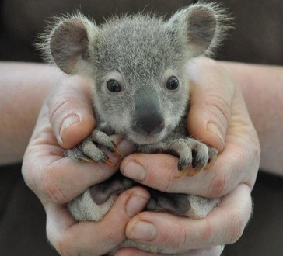
Animal welfare
3d/ Page 36/ 1St Semester
3rd Intermediate

Slide 2
Objectives:
At the end of this lesson the student will be able to:
- extract information from a reading passage to label statements using ‘Ture/ False’.
- write a short description of a picture.

Slide 3
1:00
Getting started
Why would you adopt an animal? Number the reasons below in order of importance (1-5).
Suggested answers.
I would adopt an animal …
4
A
to learn more about that animal.
1
B
to help pay for its food and daily care.
5
C
to get free gifts.
2
D
to help pay for any medical attention it needs.
3
E
to make it feel good.

Slide 4
Reading activity

Slide 5
Task 1

Slide 6
10:00
Read the interview about an animal adoption scheme and put T or F for the statements below.
Check your answers.
Our next guest is Ameer Yousef from the local wildlife reservation, and he’s come to tell us about their new animal adoption scheme. Welcome to the show, Ameer.
Ameer: Thank you. You know I always love coming on your show, Basem.
Basem: Well, we’ve surely learnt a lot from you about the animal kingdom. Today, I’d like to ask you what this ‘Animal Adoption’ scheme is all about.
Ameer: This is a scheme that we came up with to help pay for the upkeep of the wildlife reservation and the cost of taking care of the animals. As you know, Basem, the reservation has been experiencing financial difficulties for some time and this is one way we can make sure that the animals don’t have to pay the price.
Basem: I understand that you’ve had a very good response even though the programme is new.
Ameer: Oh yes. I’m glad to say that, so far, it has been a great success. We got over 50 applicants in the first 3 weeks.
Basem: Well, I think most of us would agree that it is an important cause. Now, according to your leaflet, it costs BD15 a year to adopt an animal. Is that correct?
Ameer: Yes, that’s right.
Basem: Can you tell us exactly how this money is used to help the animals?
Ameer: Of course. BD10 helps pay for the food and medical attention for the animal you have selected. The remaining BD5 pays for the administration cost of running the adoption scheme.
Basem: I see. Well, that doesn’t seem expensive at all. Do people get updates about the animals they adopt?
Ameer: Oh yes. Everyone of them gets a monthly newsletter with pictures and information about their adopted animal. They also get an official adoption certificate.
Basem: That sounds like a good deal to me. So, Ameer, if any one is interested in your animal adoption scheme, what should he/ she do?
Ameer: Well, he/ she can come down to the wildlife reservation and fill in an application form, or he/ she can call us and we’ll be happy to send him/ her one.
Basem: Great, thanks a lot for being with us today Ameer.
T
The wildlife reservation doesn’t have enough money.
The animal adoption scheme hasn’t been successful.
The annual adoption fee is BD10 only.
You don’t get an adoption certificate if you adopt an animal.
If you want to adopt an animal must fill in a form.
F
F
F
T

Slide 7
Describing pictures

Slide 8
Task 2

Slide 9
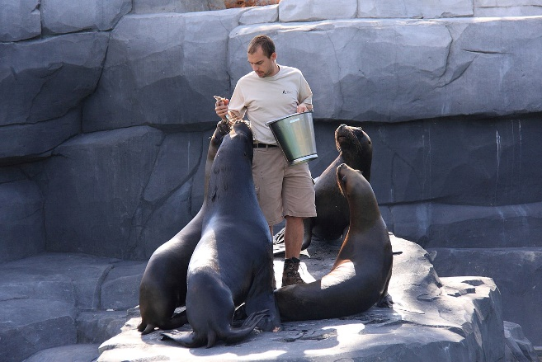
6:00
Describing pictures
Read the description of the picture given below then answer the questions.
Now check your answers.
1- Who is this person?
He could be a zookeeper.
2- Where is he?
In this photograph there is a man and four seals. The photograph was probably taken at a zoo. The man and the seals are standing on a rock. The man is holding a bucket of fish. He is trying to feed the seals. He could be a zookeeper. I think he likes working with animals.
He is probably in a zoo.
3- What is he doing?
He is holding a bucket of fish and feeding the (four) seals .
4- How do you think he feels?
I think he likes working with animals.

Slide 10
Task 3

Slide 11
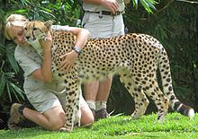
3:00
Describing pictures
Read the description of the picture given below then find out the following:
Now check your answers.
person(s)
place
In this photograph there is a man and a woman. The photograph was probably taken at a zoo. The woman is hugging a cheetah. The cheetah might be sick. The woman could be a zookeeper. I think she likes taking care of animals.
activity
person’s feelings

Slide 12
Task 4

Slide 13
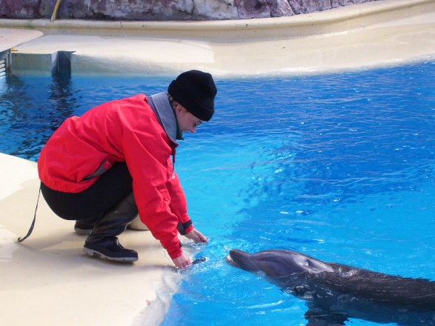
7:00
Assessment
Write a short description for the picture given below. Write about:
- person
- place
- activity
- person’s feelings
----------------------------------------------------------------------------------------------------------------------------------------------------------------------------------------------------------------------------------------------------------------------------------------------------------------------------------------------------------------------------------------------------------------------------------------------------------------------------------------------------------------------------------------------------------------------------------------------------------------------------------------------------------------------------------------------------------------------------------------------------------
*Put a (✓) if you followed the criteria.
Criteria | Self-assessment
I write about all the points.
I use the correct tense.
I spell correctly.
I punctuate well. (full-stops, commas, ----)
I use capitals.

Slide 14
A suggested answer
In this photograph there is a woman near the edge of a pool. The photograph was probably taken at a zoo or marine park. The woman is looking at a dolphin. The dolphin is facing her and she is feeding it. The woman could be a zookeeper or a dolphin trainer. I think the woman is having a good time because she is smiling.

Slide 15
Thank you

