Slide 1
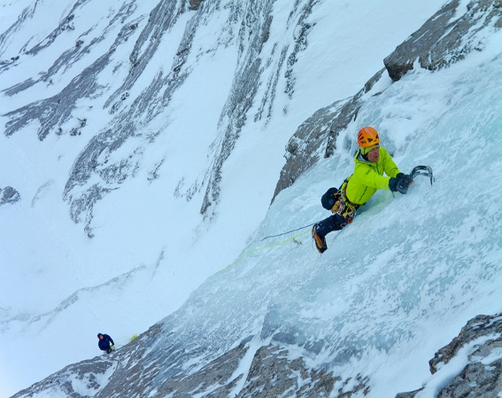
Upstream 3
3rd Intermediate
Semester 2
Unit 8
8d. Express yourself

Slide 2
Objectives
By the end of this lesson, student will be able to:
give an opinion about a topic.
listen for specific information.
read for specific information.
write a short dialogue about health problems.

Slide 3
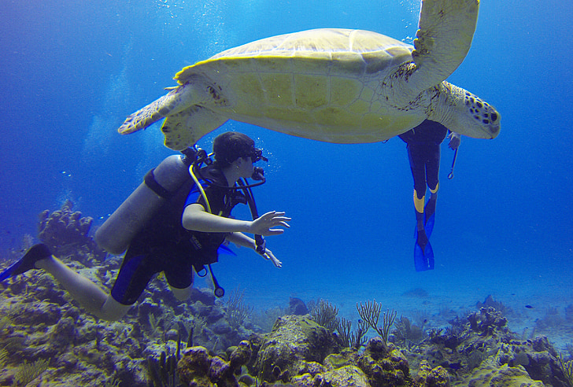
Getting started!
Look at the pictures, imagine you’re diving and describe the scene.
Click for a suggested answer
Under the sea looks very nice and wonderful. The bottom of the sea looks dark and mysterious. There are a lot of beautiful and colourful sea creatures swimming around, there are different kinds of fish, there is a giant turtle and lots of things to explore.

Slide 4
Getting started!
Which of the statements about diving do you agree with? Give reasons.
There’s nothing more interesting than being under the sea.
2
Click for a suggested answer
1
It’s quite risky because there are dangerous sea creatures around, or when diving in deep areas.
I agree with statement 1. I believe that under the sea is a great and mysterious world where one can discover lots of wonderful sea creatures while diving. We only need to be trained on how to dive safely and be guided by an expert.

Slide 5
Task 1

Slide 6
Listen to the dialogue between Ahmed and Mariam about diving and decide which statement (1-5) is True ( T ) and which is False ( F )
1. Ahmed and Mariam went diving in Hawar Islands the other day. ( )
2. Ahmed took two courses before diving. ( )
3. The introductory course was done in a swimming pool. ( )
4. Ahmed went 13 meters under the sea. ( )
5. Ahmed finds diving interesting and fun. ( )

Slide 7
Listen to the dialogue between Ahmed and Mariam about diving and decide which statement (1-5) is True ( T ) and which is False ( F )
Click for answers
1. Ahmed and Mariam went diving in Hawar Islands the other day. ( )
2. Ahmed took two courses before diving. ( )
3. The introductory course was done in a swimming pool. ( )
4. Ahmed went 13 meters under the sea. ( )
5. Ahmed finds diving interesting and fun. ( )
F
F
T
T
T

Slide 8
Task 2

Slide 9
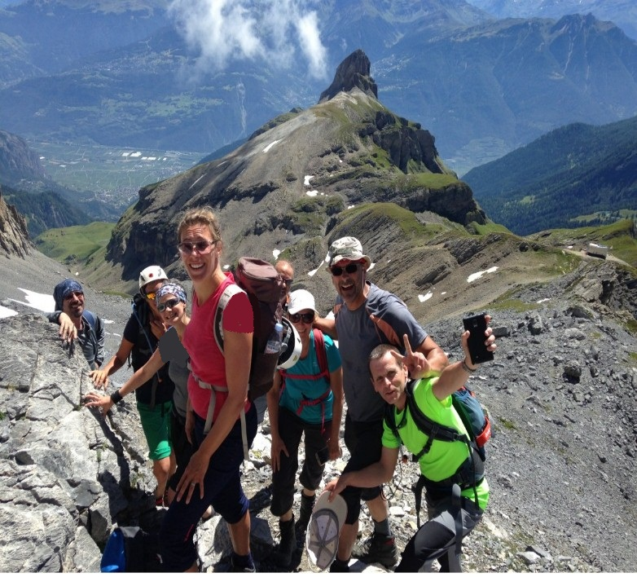
Describe the below picture.
Think about
Where they are.
What they are wearing.
What they are doing.
How they are feeling.

Slide 10
A suggested answer
The picture shows eight people hiking in the mountains. They might be on vacation somewhere aboard. The weather is sunny and cool as they are wearing light clothes and look comfortable. They are smiling, so I think they are happy and enjoying their time.

Slide 11
Let’s look closer!
When you are answering a question, you have to support your opinion with examples and/ or reasons.
When you are answering a question, you have to use linkers such as because, as, since, etc.

Slide 12
Task 3

Slide 13
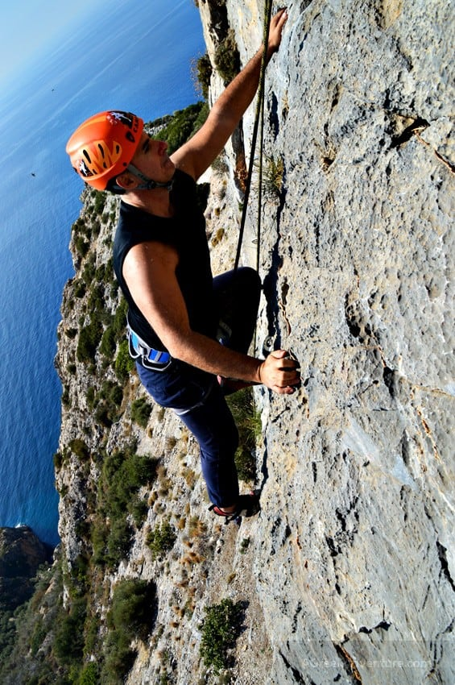
Look at the pictures. Use the phrases in the box to answer the below questions.
Expressing your opinion
in my opinion/ point of view … I feel … I think … | I don’t think that … I (strongly) believe … I’d say/ wouldn’t say …
How dangerous is climbing mountains? If not (Why)?
Why do you think some people choose to do dangerous sports?
Would you try any kind of dangerous sport?

Slide 14
A suggested answer
I think it is too dangerous especially when the mountain is too high and full of slopes and rocks. People should be fully equipped and ready to act fast to ensure their safety.
I strongly believe that people do dangerous sports for two reasons. First, it may be a part of their adventurous personality where they feel excited and enjoy feelings the dangerous situations. Second, some people fight their fears and get over specific insecurities by facing dangerous situations brought up by these kinds of sports.
I think I would try climbing a mountain one day because it looks an interesting and fun experience.

Slide 15
Task 4

Slide 16
Match responses (A-D) to the spaces (1-4) to complete the dialogue.
Doctor: Hello Mr. Ahmed. What’s the matter?
Ahmed: (1)……………………………………………………
Doctor: How long has it been bothering you?
Ahmed: (2)…………………………………………………..
Doctor: Do you have any history of such pain?
Ahmed: (3)………………………………………………….
Doctor: I see. Have you been taking any medication for it?
Ahmed: (4)……………………………………………………
Doctor: Ok. Let’s do some blood tests and ex-rays, then we will see.
No! Just painkillers from time to time.
Yes, I had it a couple of times the last two months.
Good evening. I have a terrible headache.
Well….. about a week.

Slide 17
Suggested Answer Key
Doctor: Hello Mr. Ahmed. What’s the matter?
Ahmed: Good evening. I have a terrible headache.
Doctor: How long has it been bothering you?
Ahmed: Well….. about a week.
Doctor: Do you have any history of such pain?
Ahmed : Yes, I had it a couple of times the last two months.
Doctor: I see. Have you been taking any medication for it?
Ahmed: No! just painkillers from time to time
Doctor: Ok. Let’s do some blood tests and ex-rays then we will see.
Answer
1 | C
2 | D
3 | B
4 | A

Slide 18
Task 5

Slide 19
Expressing sympathy/ Giving advise
Read the short dialogue and classify the sentences in the table below.
What’s the matter?
I’ve got a toothache.
Oh dear! Perhaps you should see a dentist.
Click for answers
Giving advice | Describing health problems | Expressing sympathy | Asking about health
Giving advice | Describing health problems | Expressing sympathy | Asking about health
Perhaps you should see a dentist. | I’ve got a toothache. | Oh dear! | What’s the matter?

Slide 20
Let’s look closer!
Asking about health
What’s the matter? What seems to be the matter? Are you alright? You don’t look well. What’s wrong? Is something wrong?
Describing health problems
I’ve got …………… My …… (really) hurt/ aches. My …… is /are a bit sore.
Expressing sympathy
Oh no, that’s awful. Oh dear. That’s terrible. I’m sorry to hear that.
Giving advice
Why don’t you …….. ? You should ………………… If I were in your place, I’d …………….

Slide 21
Task6

Slide 22
Use the prompts below and the previous slide to write a short dialogue.
headache/ earache/ leg pain/ sore throat
rest/ painkiller/ hot bath/ doctor
Self Assessment | Mark | My Score
I write sentences asking about health | 1.5
I write sentences describing health problems | 1.5
I write sentences expressing sympathy | 1.5
I write sentences giving advice | 1.5
I use correct spelling and grammar | 2
I use correct punctuation marks | 2

Slide 23
A suggested answer
You don’t look well. What’s wrong?
My back really hurts.
That’s terrible.
You should
rest.
A: Are you alright?
B: I’ve got a sore throat.
A: Oh, that’s awful. If I were in your place, I’d see a doctor.

Slide 24
End of the lesson
Thank You

