Slide 1
Upstream 3
3rd Intermediate
Unit 6
6c. Planning ahead

Slide 2
Objectives
At the end of this lesson the student will be able to:
recognise the future tense forms.
identify the three forms of future tense rules.
practice using the three forms of future tense.
write a short informal invitation email.

Slide 3
Use the time expressions from the box below to write sentences about things you are planning to do.
tonight / tomorrow / next weekend
No | Sentence
1
2
3
4
5
6

Slide 4
Suggested answer Key
No | Sentence
1 | I will help mom cleaning the house tomorrow.
2 | I’m leaving for London tonight.
3 | I’m going to the cinema with Ahmed tomorrow.
4 | I’m having a math exam next week; I will study hard.
5 | I’m going to play football with my friends next week.
6 | I’m working on the science project tonight.

Slide 5
Task 1

Slide 6
2:00
Read the dialogue below and underline all the future tenses.
No, I can’t! because I’m travelling to Dubai tonight.
Oh great! But you have to tell Ali that you can’t make it.
Hi Salman, Are you going to Ali’s party tonight?
Yes Hamad, you are right.
I will call him later.
Are you going to play with the team in the school match?
I still don’t know. I’m going to think about it.
Ok Salman, enjoy your trip, see you soon.
Thank you, Hamad, send my regards to all tonight.
I will, Bye.
Bye.

Slide 7
Now, let’s look closer at the sentences:
1. Are you going to Ali’s party tonight?
1. future
present continuous
2. I’m travelling to Dubai tonight.
3. I will call him later.
2. future will
4. Are you going to play with the team?
3. future going to
5. I’m going to think about it.

Slide 8
Future present continuous rule
A definite arrangement in the future
subject + verb (to be) + verb (ing)
Examples:
1. I am meeting my friend for dinner at six pm.
2. She is flying to Dubai tomorrow. (she’s got a ticket)
3. They are having exams Thursday morning.

Slide 9
Future Going to rule
A future intention, plan, ambition or prediction
subject + verb (to be) + going to + verb
Examples:
1. I am going to play chess with my friend.
2. She is going to visit her grandmother next week.
3. They are going to study after school.
4. It’s cloudy. It is going to rain today.

Slide 10
Future will rule
On spot decision (at the moment of speaking)
subject + will + infinitive verb
Examples:
1. My room is messy, I will clean it today.
2. I forgot to submit my homework, I will do it tonight.
3. They are too late, they will leave now.

Slide 11
Task 2

Slide 12
Read the dialogues below and change the verbs to the right form of future tense.
1. A: ___________________ tonight? (travel)
B: Yes, my flight is at 8 o’clock.
2. A: When _______________________ our exam papers? (correct)
B: I don’t know, we have to ask her today.
3. A: Oh my God, it’s 11 o’clock! You are still awake!
B: Ok, I __________ now. (sleep)
4. A: Salman __________ to a new house next month. (move)
B: Really! I __________ him to congratulate him. (call)
5. A: Mona __________ me tomorrow, why don’t you come? (visit)
B: I ________ my mom. (ask)
Are you travelling
is she going to correct
will sleep
is moving
will call
is visiting
will ask

Slide 13
Task 3

Slide 14
Future continuous rule
being in the middle of doing something at a specific time in the future.
subject + will + be + verb(ing)
Examples:
1. Don’t call me between 8 and 9. I will be working.
2. At 8 o'clock tomorrow. Mariam and Ahmed will be flying to London.

Slide 15
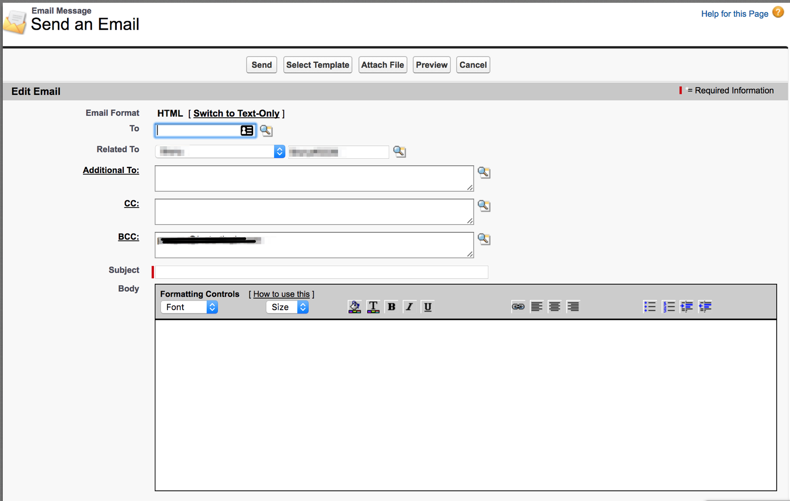
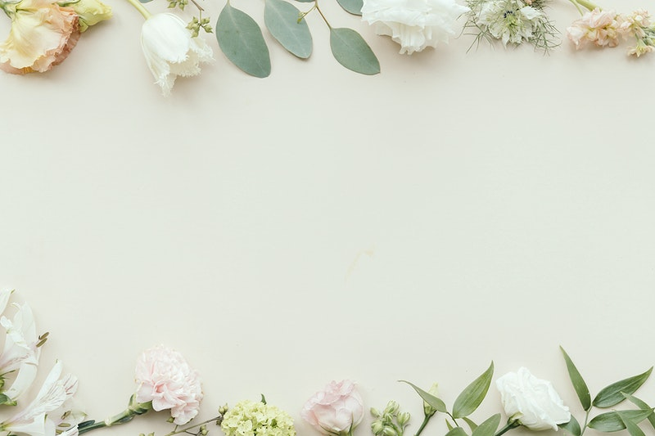
Name the types of Mariam’s messages (A – D)
8:30 am plane leave for London
3:30pm- 6:30pm meeting with Mr. Ali
7:00pm - 8:30pm business dinner with
Mr. Ali
February Monday 22nd
Dear Mariam,
I’m having a fancy-dress party!
Place: 31, Milestone Street
Time: 9:00,
Sunday, 28th February
Hope you can come
yours,
Amani
Mariam
an informal invitation
an email
a diary page
a diary page
C
C
Dinner party
A
Dear Mariam,
I’m having a dinner party on Saturday 20th February.
Please come.
Best wishes,
Mona
Hi Mariam,
Amal called. She booked tickets for Thu. 25th 9:30 – Seef Cinema. Call her for details.
Mona
a note
B
Click for answer
D

Slide 16
Imagine today is Sunday 21st February. What will Mariam be doing:
tomorrow morning at 8.30?
tomorrow afternoon at 3:45?
tomorrow evening?
next Sunday evening at 9?
at 9.30 pm on Thursday?

Slide 17
Suggested answer key
tomorrow morning at 8.30? | She will be flying to London.
tomorrow afternoon at 3:45? | She will be having a meeting with Mr. Ali.
tomorrow evening? | She will be having a business dinner with Mr. Ali.
next Sunday evening at 9? | She will be attending a fancy-dress party.
at 9.30 pm on Thursday? | She will be watching a film with Amal.

Slide 18
Task 4

Slide 19
Write a short email to a friend inviting her/him to a birthday party. In your writing include the following points:
the event
place
date
time
Self Assessment | Mark | My Score
I write about the event | 1
I write about place, date, time | 3
I use a correct email layout | 2
I write between (40-60) words | 1
I use correct spelling and grammar | 2
I use correct punctuation marks | 1

Slide 20
Suggested answer key
Dear Sahar,
I’m having my birthday party at my house on Saturday, 27th February at 7:30 pm and I would like you and Fatima to join us! Do come please.
Yours,
Fatima

Slide 21
End of the lesson
Thank You

