Slide 1
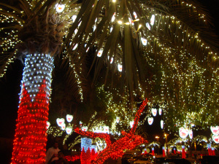
Upstream 3
3rd Intermediate
Semester 2
Unit 6
6b. Let’s celebrate

Slide 2
Objectives
At the end of this lesson the student will be able to:
read for specific information.
use adjectives to describe celebrations.
use adjectives to discuss likes and dislikes related to celebrations.
write a short paragraph describing an event celebrated in Bahrain.

Slide 3
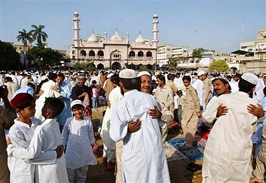
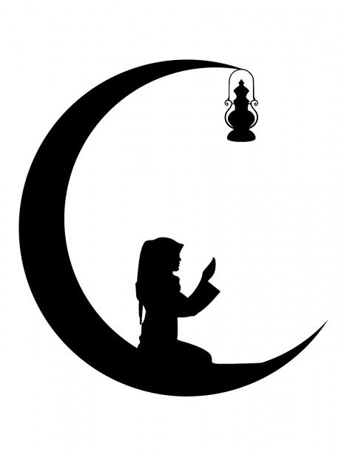
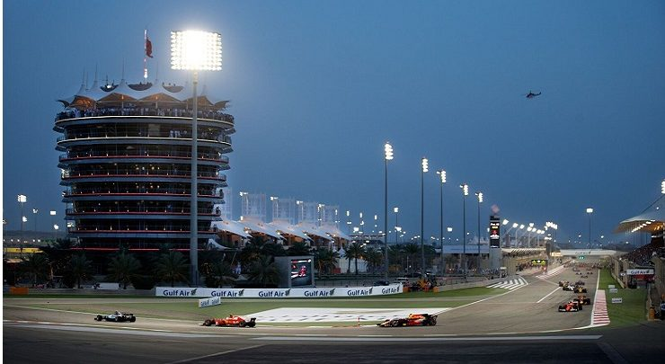
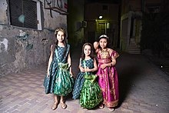
Introduction
Name the celebrations in the pictures below
1
2
3
4
5

Slide 4
Suggested answer key
1
2
3
Eid Al-Fitr
National Day
Ramadan
4
5
Formula 1
“Gergaoon”

Slide 5
Task 1

Slide 6
Match the festivals with the correct customs
1
2
3
4
Eid Al-Fitr
National Day
Ramadan
“Gergaoon”
Wear traditional clothes, visit houses in the neighbourhood and sing traditional songs.
Children receive sweets and nuts as gifts.
Fast every day from sunrise to sunset, do good deeds such as helping poor people. Pray and read the Quran.
Cook traditional food and have a big meal after sunset.
Wear new clothes,
visit relatives and friends.
Exchange greetings and eat special food.
Children receive lots of money on this day.
Wear traditional clothes, decorate streets and buildings with lights and flags.
Sing notional songs and watch fireworks.

Slide 7
Suggested answer key
1
2
3
4
Eid Al-Fitr
National Day
Ramadan
“Gergaoon”
Wear traditional clothes, visit houses in the neighbourhood and sing traditional songs.
Children receive sweets and nuts as gifts.
Fast every day from sunrise to sunset, do good deeds such as helping poor people. Pray and read the Quran.
Cook traditional food and have a big meal after sunset.
Wear new clothes,
visit relatives and friends.
Exchange greetings and eat special food.
Children receive lots of money on this day.
Wear traditional clothes, decorate streets and buildings with lights and flags.
Sing notional songs and watch fireworks.
4
3
1
2

Slide 8
Task 2

Slide 9
Describe one of the celebrations using their customs
1
2
3
4
Eid Al-Fitr
National Day
Ramadan
“Gergaoon”
Wear new clothes,
visit relatives and friends.
Exchange greetings and eat special food.
Children receive lots of money on this day.
Wear traditional clothes, decorate streets and buildings with lights and flags.
Sing notional songs and watch fireworks.
Fast every day from sunrise to sunset, do good deeds such as helping poor people. Pray and read the Quran.
Cook traditional food and have a big meal after sunset.
Wear traditional clothes, visit houses in the neighbourhood and sing traditional songs.
Children receive sweets and nuts as gifts.

Slide 10
Suggested answer key
National Day
The National day of Bahrain is celebrated on the 16th of December every year. All citizens participate in this celebration. Children wear traditional clothes, sing national and traditional songs. The buildings and streets are decorated with red and white lights and Bahrain flags. People watch fireworks and attend concerts of famous Bahraini singers.

Slide 11
Suggested answer key
Ramadan
Ramadan is a holy month. Muslims from all over the world, fast every day from sunrise to sunset. They break their fast by having a big family meal after sunset; they usually cook specific traditional food in this month. They spend the month praying and reading the Holy Quran, doing good deeds as helping people in need in different ways.

Slide 12
Task 3

Slide 13
Read the below exchange carefully and use the table on the following slide to write a similar one for different occasions
A: The school basketball team won the game!
B: That’s awesome! Well done!
A: We are really pleased.
A
B

Slide 14
Now, choose and write
Occasion | Feeling | Congratulating | Thanking
have a new baby sister | thrilled | well done! | thanks.
graduated from secondary school | satisfied | that’s great! | thanks a lot.
pass my driving test | relieved | that’s wonderful! | you’re too kind.
buy a new house (or car) | excited | congratulations! | thank you.
get a new mobile phone | pleased | that’s awesome! | thank you very much

Slide 15
Suggested answer key
A: I have a new baby sister.
B: That’s wonderful! Congratulations.
A: Thanks. I'm so happy.
1
A: I have just graduated from secondary school.
B: Congratulations, good job dear.
A: Thanks a lot.
2
A: I passed my driving test!
B: Awesome, congratulations!
A: Thanks. I'm relieved.
3
A
B

Slide 16
Task 4
_________________________________________________________________________________________________________________________________________________
Ministry of Education- second Semester -2020-2021 English- 3rd Inter- 6b. Let’s celebrate

Slide 17
Look at the example, then discuss your feelings about an occasion or event you’ve attended using the information in the table
Occasion / Event | Positive feeling | Negative feeling
your sister’s engagement party | interesting | boring
a movie or play | entertaining | crowded
your friend’s graduation party | fun | dull
a concert | amusing | terrible
A: Mona’s graduation party was interesting! I enjoyed it a lot.
B: Well, I found it dull and boring.
A
B

Slide 18
Suggested answer key
A: The concert of my favourite band, last week,
was amazing, I really had fun.
B: Well, I found the hall rather crowded. There were
many people.
1
A
B
A: The movie last night was really entertaining. I enjoyed every
scene.
B: You are right. It was enjoyable.
2

Slide 19
Task 5

Slide 20
Match the greeting cards to the correct occasions / events in the table on the next slide
Congratulations
On the birth of your daughter
Congratulations
All the best for the future
Best Wishes
For your future together
Happy
17th
1
2
3
4
5
Well done!
Best Wishes for the new year
Best Wishes
For a speed recovery
Many Happy
Returns of the Day
6
7
8
9
10

Slide 21
Suggested Answer Key
Occasion / Event | Answer
Graduation | 3, 7
New Year | 8
Accident | 4, 9
Birthday | 1, 10
Wedding | 5
Newborn Baby | 2
Anniversary | 6

Slide 22
Task 6

Slide 23
Write a short paragraph about an event in Bahrain. In your writing include the following points:
Self assessment | Mark | My Score
I write the name of the event | 1
I write when the event is celebrated | 1
I write the reason behind the celebration | 1
I write about the activities done | 1
I write between (40-60) words | 2
I use correct spelling and grammar | 2
I use correct punctuation marks | 2
name of the event
when it is celebrated
reason behind the celebration
activities done

Slide 24
Suggested answer key
Eid Al-Fitr
The feast of breaking the Fast or Eid Al – Fitr is a very important day in the Islamic calendar. It is celebrated on the 1st of Shawwal, Muslims celebrate the completion of Ramadan. On this day Muslims around the world wear new clothes and go to perform the Eid Prayer in the mosques, early in the morning. After the prayer, people visit their relatives and friends and exchange greetings. They also eat special traditional food that is cooked especially for this occasion. It is a joy to see children wearing new and beautiful clothes. It is also a delight seeing how happy they are receiving lots of money and candy from their parents and relatives. It is called “Eidiyah”

Slide 25
End of the lesson
Thank You

