Slide 1
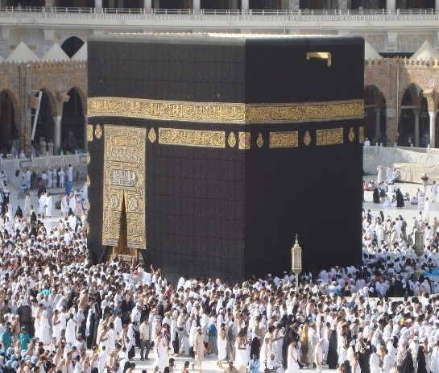
Upstream 3
3rd Intermediate
Semester 2
Unit 6
6a. An amazing journey

Slide 2
Objectives
At the end of this lesson the student will be able to:
practice reading for specific information.
practice forming collocations.
write a short paragraph about someone's experience at Mecca.

Slide 3
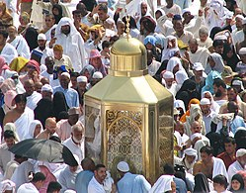
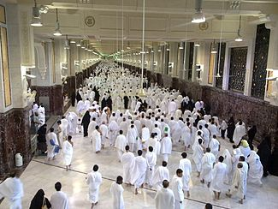
Describe the pictures using the given words
The Great Mosque / Pilgrims / Mecca / Pray / The Ka’bah

Slide 4
Suggested Answer Key
People travelling to Mecca every year are called pilgrims. They walk counter-clockwise seven times around the Kaaba, and they pray in the Great Mosque.

Slide 5
Task 1

Slide 6
How much do you know about the Hajj? Choose the correct answer
1- Every Muslim should take part in the Hajj …
a. every year
b. twice in lifetime
c. at least once
2- During the Hajj men wear …
a. traditional items of clothing
b. special items of clothing
c. formal items of clothing
3- Ihram shows that …
a. all Muslims have been to Macca
b. all Muslims are equal
c. Muslims are different

Slide 7
Suggested Answer Key
1- Every Muslim should take part in the Hajj …
c. at least once
2- During the Hajj men wear …
b. special items of clothing
3- Ihram shows that …
b. all Muslims are equal

Slide 8
Task 2

Slide 9
Read the “The Hajj” text carefully and complete
the activities on the following slides

Slide 10
The Hajj
The pilgrimage to Mecca or the Hajj as Muslims call it, is the biggest annual pilgrimage in the world where millions of Muslims head toward the holy city of Mecca in Saudi Arabia seeking to deepen their faith and practicing the fifth pillar of Islam. As Islam states, all able-bodied Muslims are required to perform it once in their lifetime. The Hajj is a life changing journey; it’s seen as a chance to wipe past sins clean and start fresh.
Once Hajj starts and pilgrims reach Mecca, men wear traditional items of clothing called an ‘ihram’. It is a two-piece of white cloth that they wrap around the body. Women wear clothes that cover the whole body but not their faces. Pilgrims wear so as apart of entering a state of spiritual purity known as “ihram” aimed at shedding symbols of materialism, giving up worldly pleasures and focusing on the inner self over the outward appearance and to show how all people are equal before Allah.

Slide 11
The Hajj takes place during the month of Dhu Al-Hijjah, which is the final month of the lunar calendar. During the Hajj period, Muslims take part in different religious ceremonies. On 7th day of this sacred month the great Hajj starts (Al-Hajj Al-Akbar). This day pilgrims leave Mecca and travel to the town of Mena and spend a night there. On the 9th day, they head towards Mount Arafat and stay there till sunset. After that they leave to Muzdalifah where they gather some pebbles for the stoning of the Jamaraat. Eid Al-Adha comes on the 10th day of the month when pilgrims return to Mena and throw seven pebbles at the largest Jamraah (Jamrat Al-Aqaba).

Slide 12
Task 3

Slide 13
Match words / phrases in bold from the text with their correct meaning
No | Meaning | Answer
1 | yearly
2 | Holy / godly
3 | small stones
4 | traditional
5 | alike
6 | a religious journey
7 | something so intense that it changes the way you think, feel and behave
8 | throwing stones at something
9 | physically strong and healthy

Slide 14
Suggested Answer Key
No | Meaning | Answer
1 | yearly | annual
2 | Holy / godly | sacred
3 | small stones | pebbles
4 | traditional | customary
5 | alike | equal
6 | a religious journey | pilgrimage
7 | something so intense that it changes the way you think, feel and behave | life-changing
8 | throwing stones at something | stoning
9 | physically strong and healthy | abled-body

Slide 15
Task 4

Slide 16
Read the text again and mark the statements below T (True), F (False) or DS (Doesn’t Say).
No | Statement | Answer
1 | The Hajj is preformed twice every year.
2 | Women have to cover their face in the Hajj.
3 | Pilgrims are not allowed to wear regular clothes.
4 | Old people can also perform the Hajj.
5 | Pilgrims throw seven pebbles on the 10 day of the Islamic month.

Slide 17
Suggested Answer Key
No | Statement | Answer
1 | The Hajj is preformed twice every year. | F
2 | Women have to cover their face in the Hajj. | F
3 | Pilgrims are not allowed to wear regular clothes. | DS
4 | Old people can also perform the Hajj. | DS
5 | Pilgrims throw seven pebbles on the 10 day of the Islamic month. | T

Slide 18
Task 5

Slide 19
What is a collocation?
Two or more words that appear together to form fixed relationships.
Examples
Holly Quran, free time, cash flow, make money…etc.

Slide 20
Match the words in list A to the right word in list B to form the correct collocation.
 | list A |  | list B | answer
1 | traditional | a | month
2 | religious | b | pilgrimage
3 | annual | c | journey
4 | sacred | d | clothing
5 | Life-changing | e | ceremony

Slide 21
Suggested Answer Key
 | list A |  | list B | answer
1 | traditional | a | month | traditional clothing
2 | religious | b | pilgrimage | religious ceremony
3 | annual | c | journey | annual pilgrimage
4 | sacred | d | clothing | sacred month
5 | life-changing | e | ceremony | life-changing journey

Slide 22
Task 6

Slide 23
Write a short paragraph about the experience of someone you know at Mecca. In your writing include the following points:
when they went Hajj
what happened
how they felt
Self Assessment | Mark | My Score
I write about when they went | 1
I write about what happened | 2
I write about their personal feelings | 1
I write between (40-60) words | 2
I use correct spelling and grammar | 2
I use correct punctuation marks | 2

Slide 24
A suggested answer key
My brother went to Hajj in 2019. He took a flight from Bahrain to Saudi Arabia on December 2nd . On the plane he changed his clothes and wore his ihram.
He arrived in Jeddah, where he took the bus to Mecca. He spent two days there before going to Mena. On the 9th of Dhu Al-Hijjah he went to mount Arafat with the pilgrims. He said the view of all the pilgrims there praising Allah was really majestic. “Hajj is a very spiritual experience where you feel the greatness of Allah the almighty” added my brother. He promised to take me to Hajj after two years.

Slide 25
End of the lesson
Thank You

